Slide 1
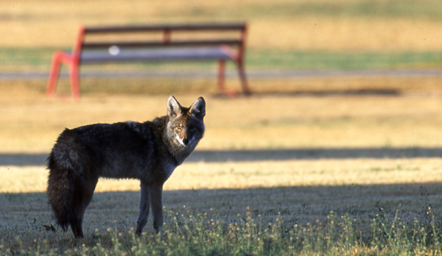
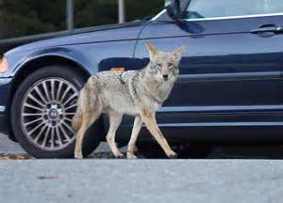
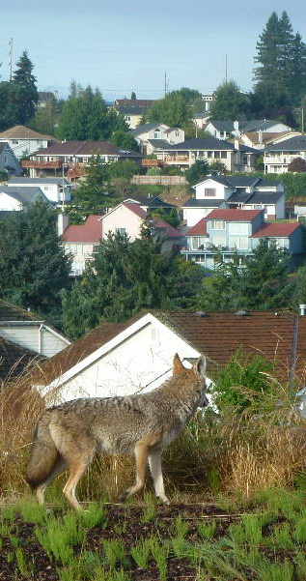
Urban Coyote Phenomenon
Matt Stevens
Assistant District Supervisor - Wildlife Biologist
USDA-Wildlife Services
Bremerton District, WA/AK program
(425) 954-6766
matthew.r.stevens@usda.gov

Slide 2
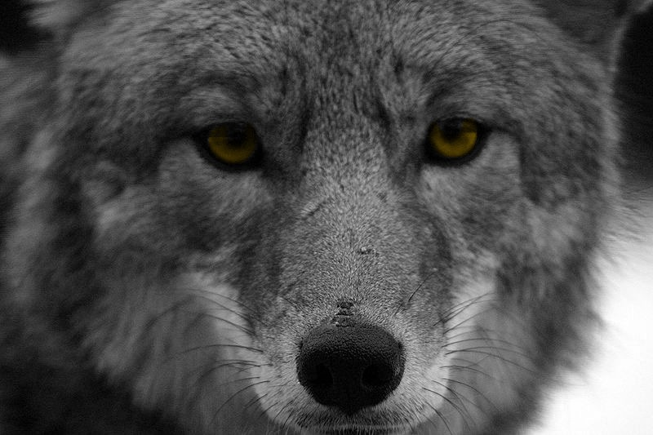
When are we ever going to use this?
Wildlife conflict issues (coyote):
Misinformation & Fear
Evokes emotional responses
Can be Controversial

Slide 3
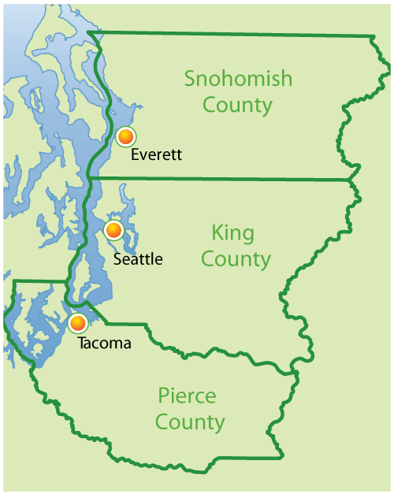
Pierce, King, and Snohomish Counties
USDA-Wildlife Services – Bremerton District
2011 to 2019
Work Tasks for coyotes:
6,260
Coyotes Taken
597

Slide 4
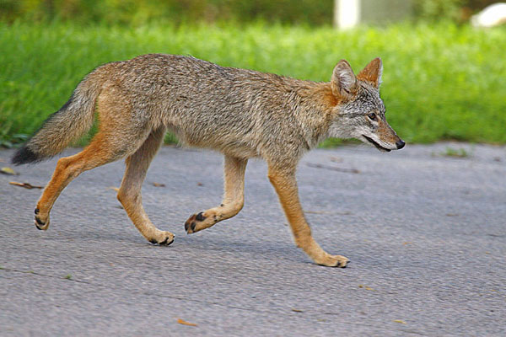
Who is Canis latrans?
Member of dog family
Pointy ears, slender nose
Gray, silver, brown, black
Both Predator and Scavenger
Average adult = 20-35 lbs. in Western Washington
Lifespan: 6-8 years in the wild, up to 20 years in captivity

Slide 5
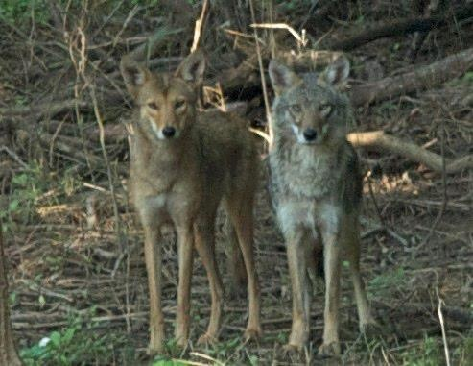
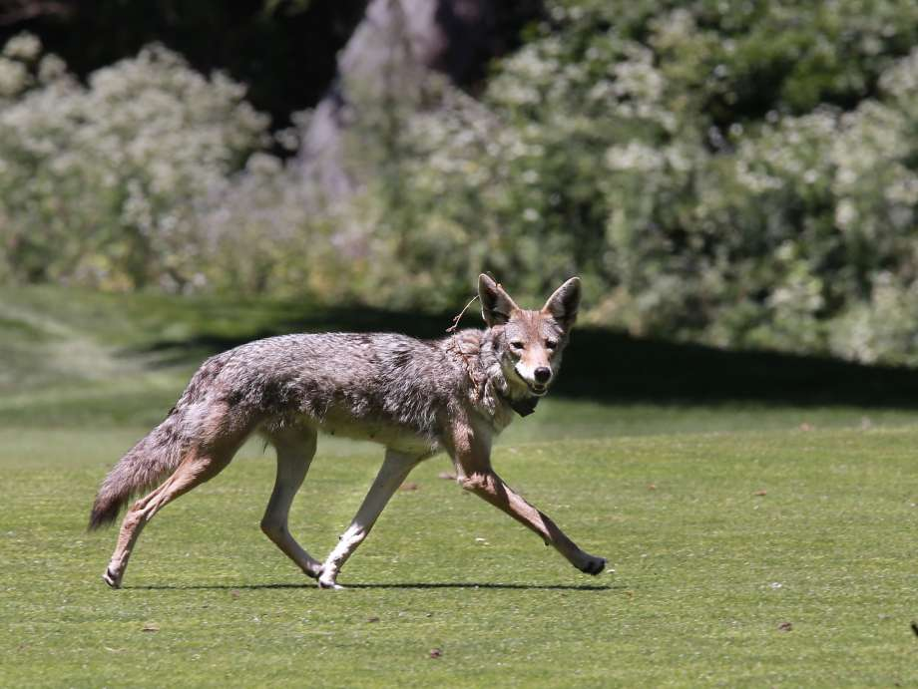
Seasonal Variation in Appearance
Summer: “It looks really sick” season

Slide 6
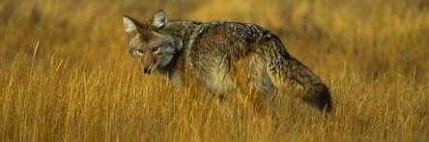
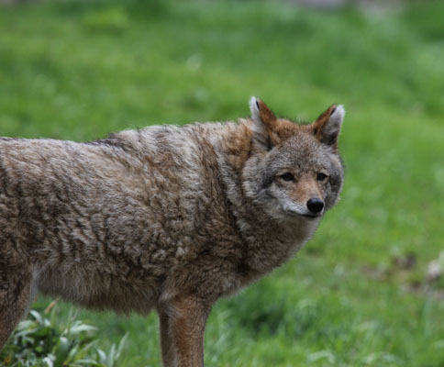
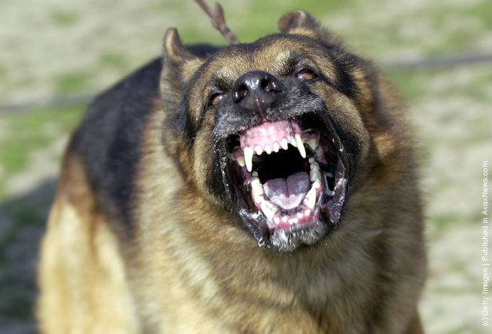
Seasonal Variation in Appearance
Winter: “German Shepherd” season

Slide 7
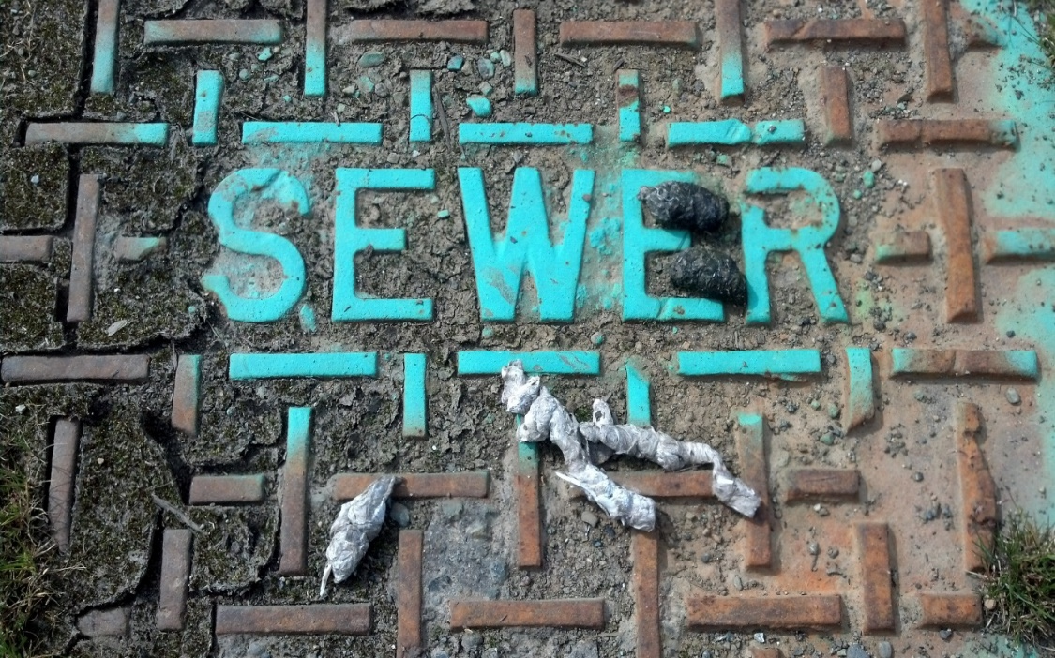
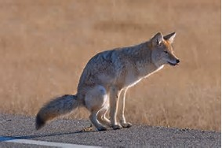
TERRITORY:
Size varies, usually in W-WA between 1.5 to 3 square miles
Size depends on available resources
Boundaries marked by scent posts (Urine, Droppings, Glandular Secretions)
Defended against other coyotes

Slide 8
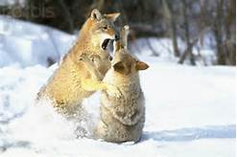
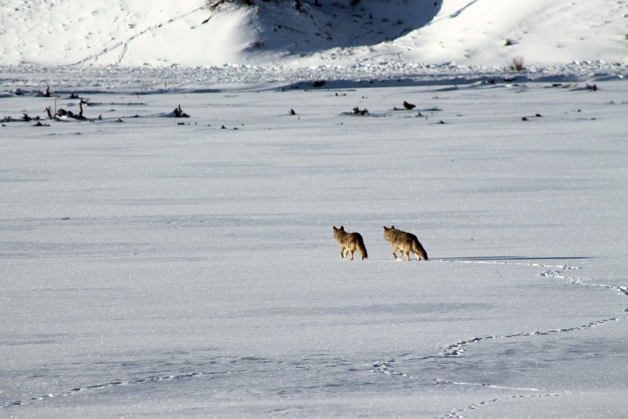
HUMAN CONFLICT LEVEL -
LOW
= Coyotes pair focused on each other
Life Cycle - Family Group Structure
Dominant Pair Occupies Territory:
Timing Varies
Causes few conflicts

Slide 9
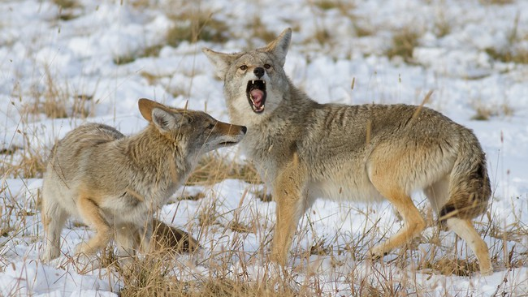
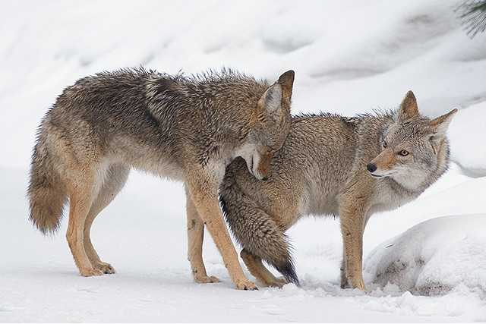
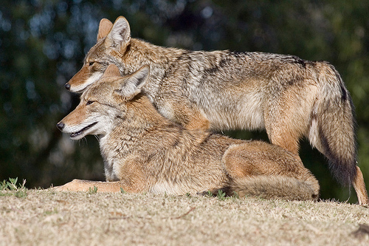
HUMAN CONFLICT LEVEL -
MODERATE
= Slight increase in territorial behavior
Life Cycle/Family Group Structure
Breeding
Usually happens in February

Slide 10
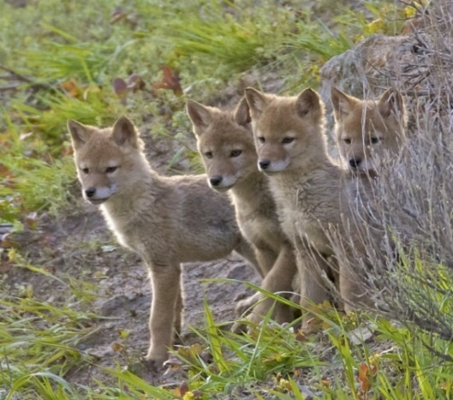
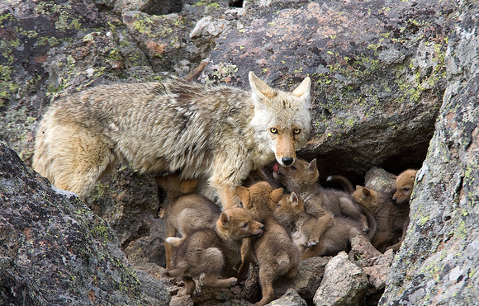
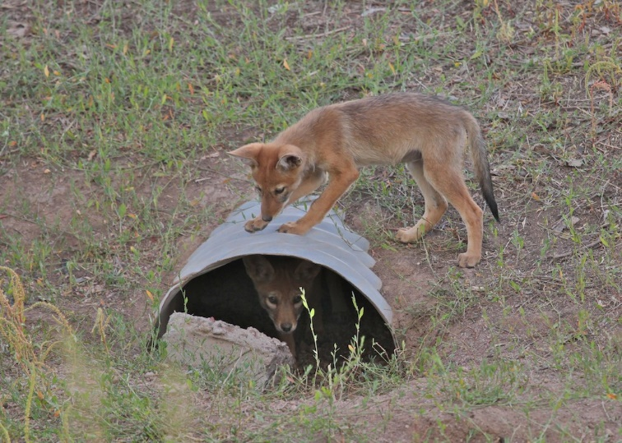
HUMAN CONFLICT LEVEL -
HIGH
= Protect pups at all costs
Life Cycle/Family Group Structure
Pup Rearing:
April thru June
Increases conflicts:
Nutritional demand/lactating/more mouths to feed
Hypersensitive to other canine threats

Slide 11
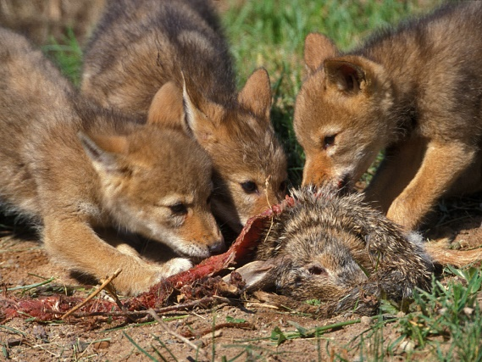
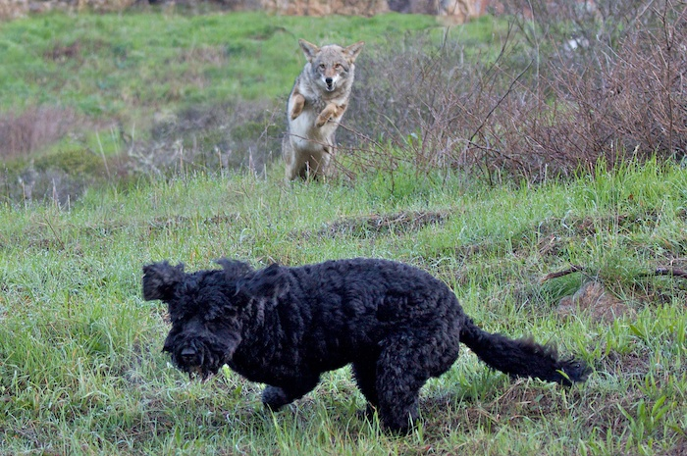
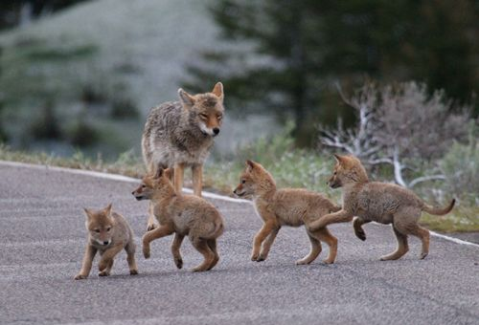
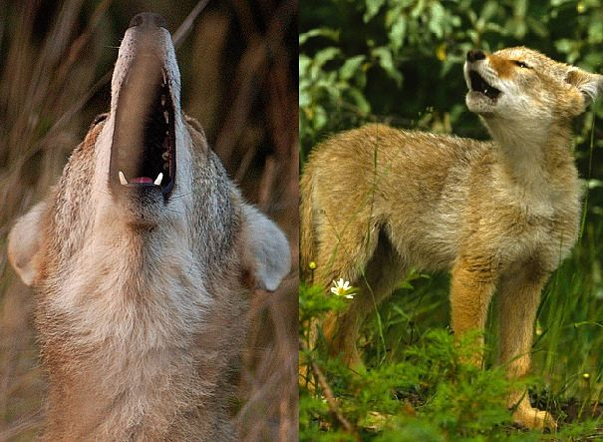
HUMAN CONFLICT LEVEL -
HIGH
= Big dogs = THREAT, small dogs = FOOD
Life Cycle/Family Group Structure
Juvenile Education Period:
June thru October
Highest number of observations for the year
Young coyotes don’t know the rules of the road
Juveniles learning to howl and often get lost = more vocalizations
Nice weather, longer daylight hours – both human & coyote activity increases

Slide 12
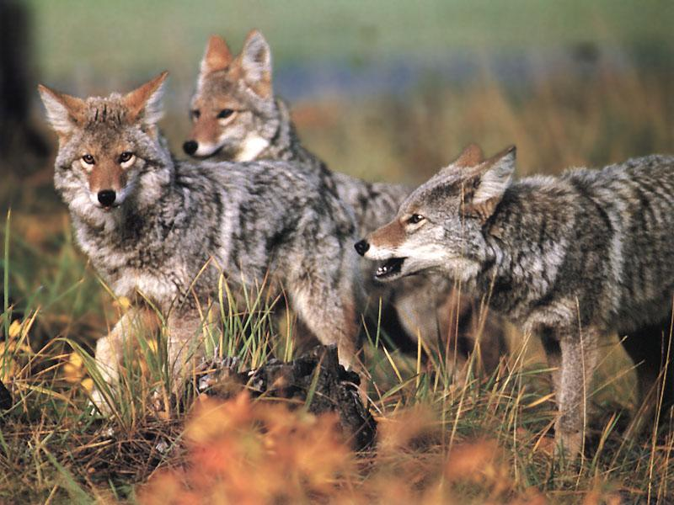
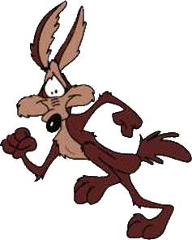

HUMAN CONFLICT LEVEL -
MOD/LOW
= Juveniles are wary; LET’S KEEP IT THAT WAY!
Life Cycle/Family Group Structure
Dispersal:
October through February
Dominant Pair “Holds Over” 1-2 female juveniles
Rest of litter forced to make their way in the world

Slide 13
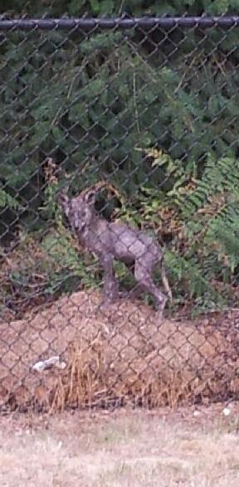
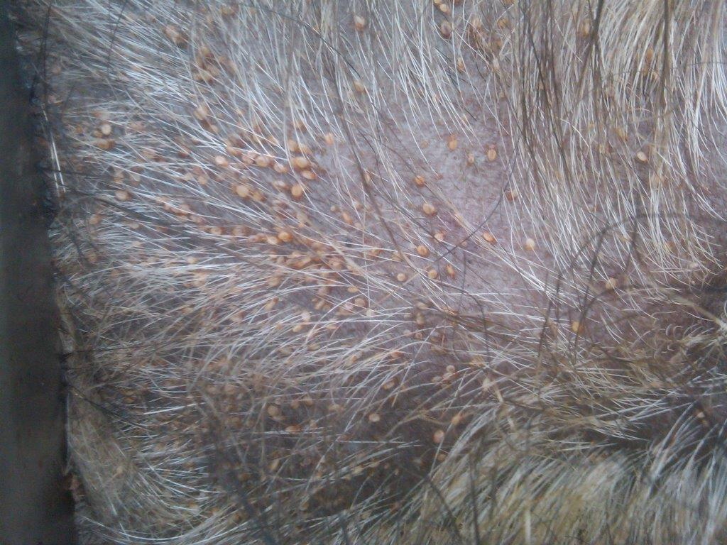
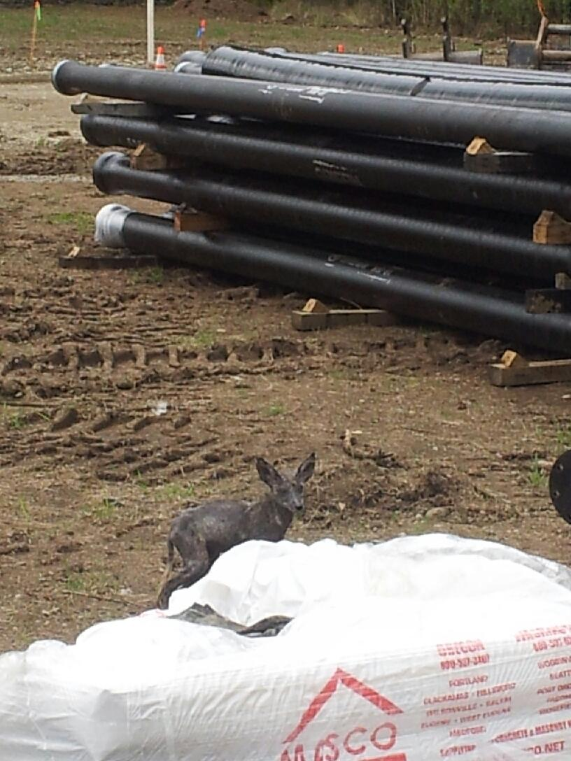
Disease and Coyotes
*Not a common rabies carrier*
Sarcoptic Mange is most likely culprit when dealing with reports of “Sick Coyotes”
Caused by a skin mite
Most visible sign is hair loss caused by animal scratching and biting in response to itching
Not transferable to pets without sustained, close contact

Slide 14
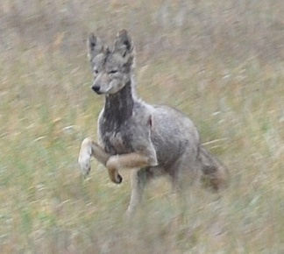
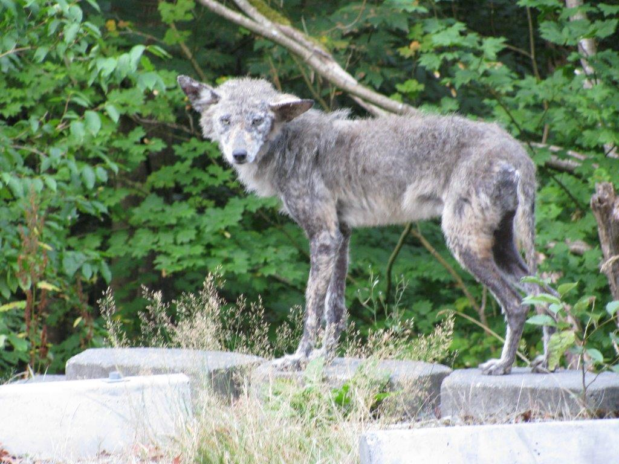
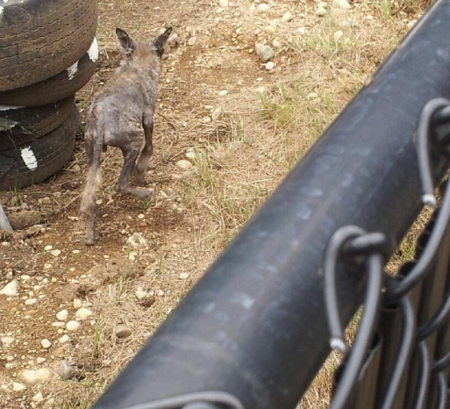

Slide 15
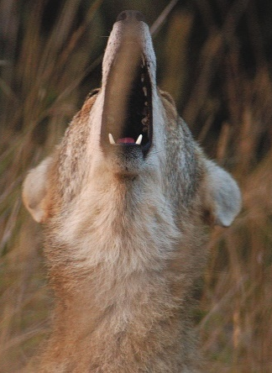
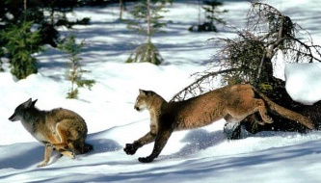
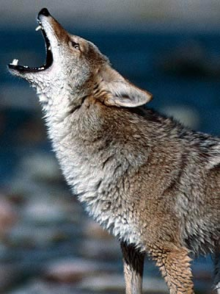
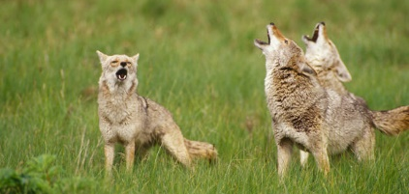
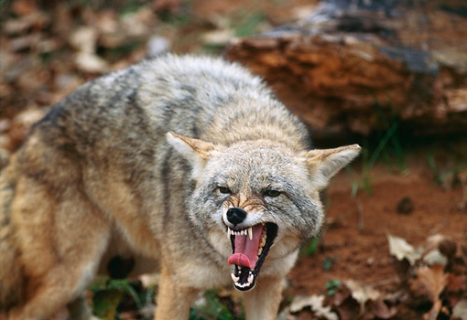

Coyote Vocalizations:
What they don’t mean
Dinner’s ready!
I’m on the prowl……..
There’s 100 of us out here!
What they mean
Is there anybody out there?
Who wants to fight?
Hey big boy……
I’m smarter than you!
Get off my lawn!
Ouch, that hurt!

Slide 16
RECAP:
Common Public Misconceptions:
German Shepherd Phenomenon
Rabies
If something isn’t done they’ll keep breeding and we’ll be over run!
Coyotes hunt in packs
I’m HEARING them KILL things!

Slide 17
No….not really!
“They were here before us!”
“We’re taking all their habitat away!”
“They’ve lost their home.”
“We need to stop developing the land.”
“What do you expect?”
“They have nowhere to go!”

Slide 18
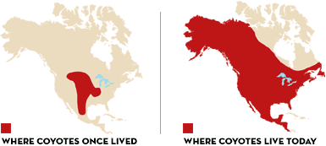
Prior to European Settlers arrival in N. America Coyotes were found only in American plains and SW.
Settlers reduction of wolf population allowed coyotes to expand their range.
As an extremely adaptable animal, coyotes now found from Alaska to Panama.

Slide 19
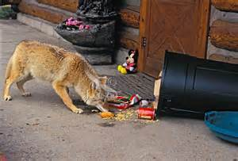
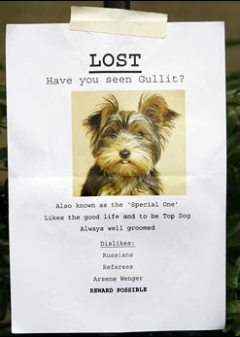
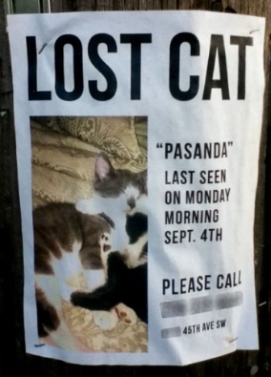
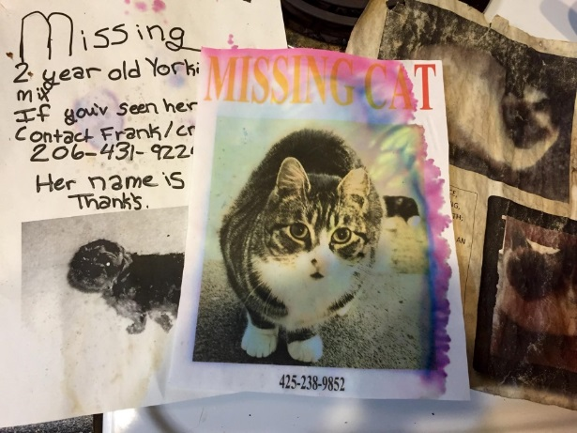
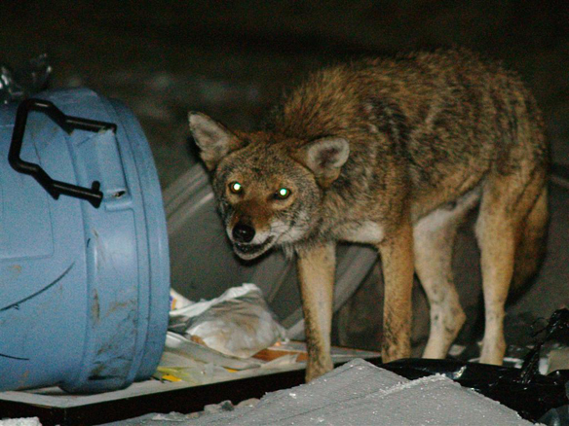
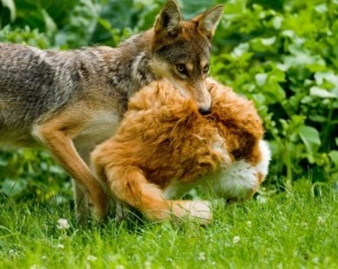
WHY SUBURBIA?
More Food
Less Effort
More Coyotes

Slide 20
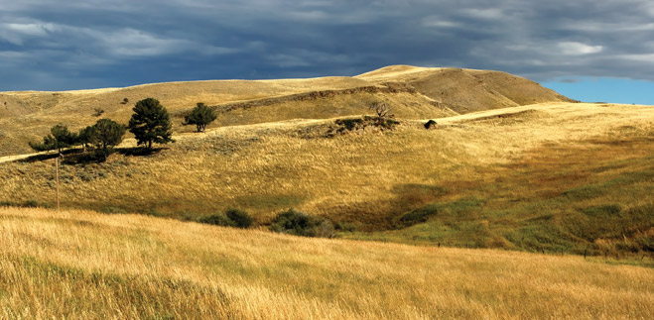

WHY SUBURBIA?
2
2
10 miles
10 miles
Rodents
Rabbits
Reptiles
Insects
Carrion
Large game
Rodents
Garbage
Fruit
Pet food
Pets
Handouts

Slide 21
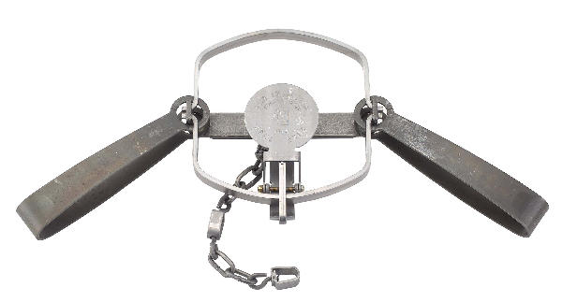
WHY SUBURBIA?
Initiative 713 effects:
Initiative 713 (Passed in 2000) and the resulting lack of coyote population control in rural areas lead to population growth and increased dispersal into developed areas.
USDA conflict calls rose exponentially from 2008 to 2012, and then leveled off as urban coyote populations reached “saturation”.

Slide 22
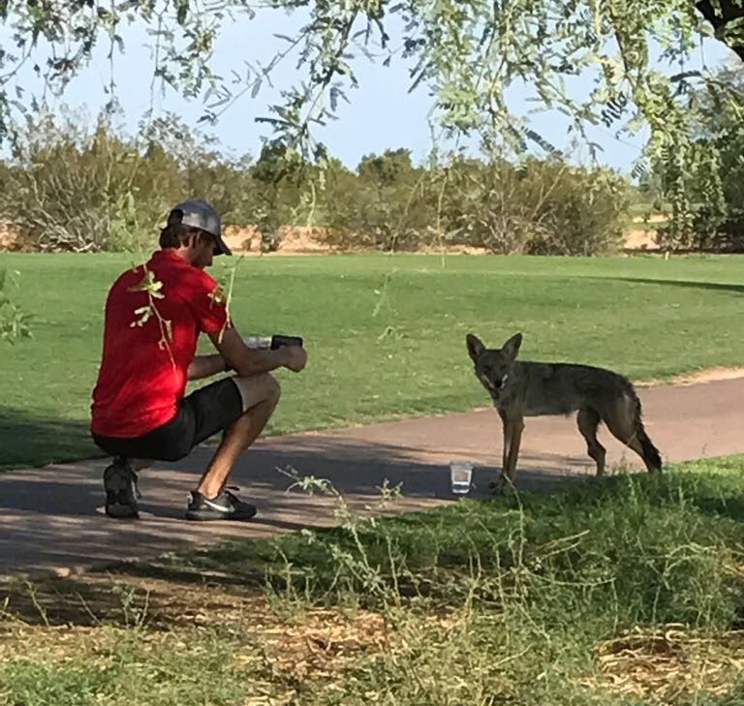
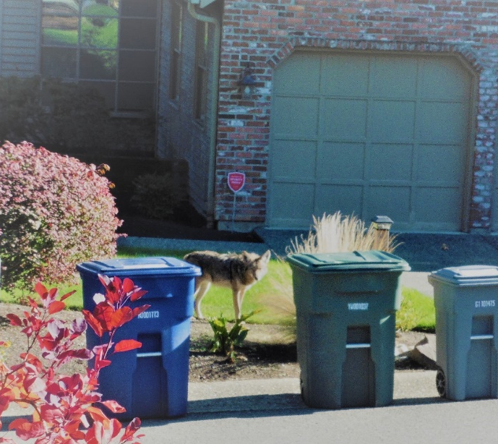
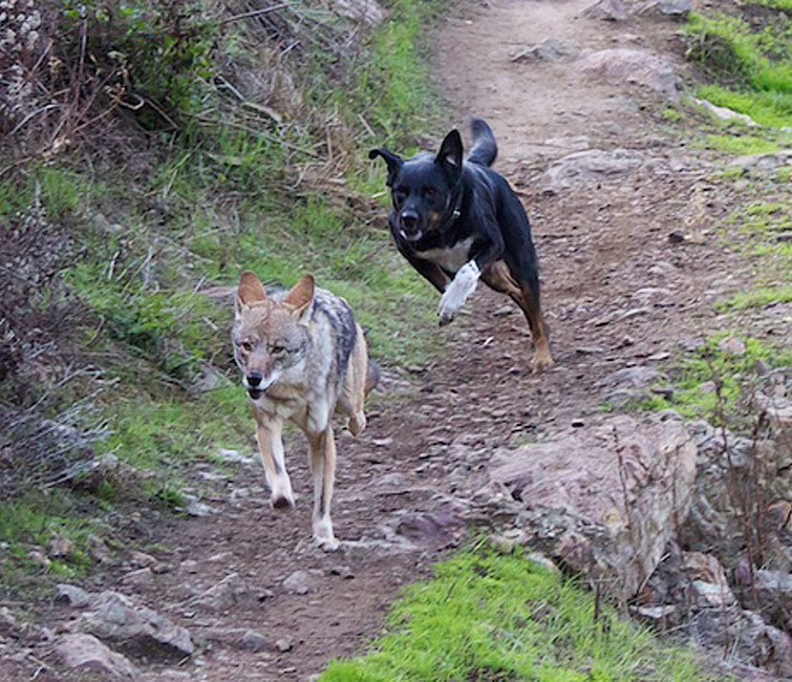
Why do coyotes lose fear of humans?
Habituation and reward
Positive Experiences
Neutral Experiences (Most common by far)
Negative Experiences

Slide 23




Attended Pets versus Unattended Pets
Presence of coyotes means pet ownership practices must change PERMANENTLY.

Slide 24
7 Point Scale for coyote behavior
Coyotes rarely seen, but are heard at night.
Increase in taking of unattended pets.
Increase in observance of coyotes on streets and yards at night.
Daytime observance of coyotes on streets, in parks, and yards.
Coyotes chasing or taking attended pets, especially during the day.
Taking pets on leash and chasing joggers, bikers, etc.
Coyotes seen in and around children’s play areas and parks in midday.
You Crossed the Line !!!

Slide 25

What happens when they cross the line?
Why we do not relocate:
Prohibited by Law - WAC 232-12-064
Stressful on Animal – Must find new/unknown food sources, another animals territory, loss of area memory, immediate urge to return
Relocate the Problem – Animals know what they know – many behaviors learned
Disease Transmission – Many Zoonotic Diseases as well as wildlife Diseases
Maybe a temporary fix to a problem of overpopulation or High densities
Studies and USDA-WS’ experience have shown that the only way to modify coyote behavior in these situations is the lethal removal of some of the family group members, which will change the behavior of the remaining coyotes.

Slide 26



HUMAN HEALTH AND SAFETY
NATIONWIDE AVERAGE FROM THE LAST 15 YEARS
Bites to human by:
Dogs -
12,000 every day
Coyotes -
1 every 5 days
60,000 times more likely bitten by dog
Human fatalities from:
11,000
750
2 (1981, 2009)

Slide 27





Who’s job is this anyway?
Kinda….

Slide 28
Requirements for WS to begin lethal removal:
Always at request of cooperator
Non-lethal methods have either failed or are not practical for the situation
Cooperative Funding source in place
Signed property access agreements are in place
Work is aimed at behavior modification, NOT eradication.

Slide 29


Methods of Coyote Removal
All WS methods approved as humane by the American Veterinary Medical Association
Incidental Shooting/Shooting over bait
(Livestock Situations)
Calling and Shooting
Trapping

Slide 30
Forward Looking Infra-Red (FLIR)
Using the FLIR enables WS to work during the hours of darkness, which brings several advantages:
Fewer people=increased safety and decreased risk of interruption (intentional and unintentional)
Less wary and more active coyotes
Combined with Night Vision equipped, suppressed rifles and IR Spotlights = GREATLY DECREASED chance of detection by bystanders.

Slide 31


Slide 32


Slide 33


Slide 34



Trapping
Only appropriate in some situations
Requires more experience than most think to do safely and effectively
Requires permit from WDFW, as coyotes are almost impossible to capture in unregulated cage type traps
Mandatory padded jaws and 24 hour trap checks in WA state

Slide 35








Coyote Conflicts and the Media

Slide 36



Coyote Conflicts and the Media
Best medium for mass education
Message should be consistent from all agencies
Important to be up front about reasons for control work, but not about control work specifics
Time
Location
Personnel involved
Expect Controversy

Slide 37
Identifying Coyote Damage
Most common sign in urban areas that a coyote was responsible is an absence of any evidence
Domestic Dogs play with their food, and aren’t very good killers
Abundant missing pet signs are often the first indicators of a problem
* If in doubt, call WS sooner rather than later, don’t disturb the scene

Slide 38



Coyote Sign - Tracks

Slide 39



Coyote Sign - Scat
Look for hair and bone chips in scat
Domestic dog scat will look like the processed food they eat
Coyote scat will usually be more segmented and tapered at one end

Slide 40
*Wildlife Services and Law Enforcement*
WS will contact local 911 dispatch when appropriate to provide contact information, location, and activity.
Approaching WS during a calling or shooting stand can be detrimental to control efforts, call ahead and make arrangements if contact is required.
Usual citizen call in is for suspicious vehicle, not man with a gun. USDA vehicles all have Government License Plates, roof mounted “whooptie” lights, and may or may not be marked with magnetic placards.

Slide 41

Contact Information
Scott Gilbert
Urban Coyote Program Coordinator
(253) 285-6165
Scott.m.gilbert@usda.gov
Matt Stevens
Assistant District Supervisor
Matthew.r.stevens@usda.gov
Brook Zscheile
District Supervisor
Brook.zscheile@usda.gov
Satellite Office:
3601 109th St. SW
Everett, WA 98204
(425) 954-6766
District Office:
100 NW Tupelo Way
Poulsbo, WA 98370
(360) 337-2778
USDA – APHIS – Wildlife Services State Office 720 O’Leary St NW, Olympia, WA 98502

