Slide 1
Effective Communication With Individuals in Behavioural Crisis
Kevin St Jacques, PsyD, LMHC, CCIS-III, CAMS-III
St Jacques Consulting Group, LLC
©2020 SJCG

Slide 2
Today’s Goals
Understand anger and aggression
Understand the Person in Crisis
Understand how to effectively self-manage in a crisis
Gain proficiency in I.N.S.E.R.T via lecture and practical scenarios
Gain proficiency in I.R.P.D. via lecture and practical scenarios
Understand how to effectively engage with difficult personalities

Slide 3

Anger and Aggression

Slide 4

Anger
“Nothing is either good nor bad, but thinking makes it so”
William Shakespeare
*Strong feeling of irritation, displeasure, or hostility
All anger is a result of an unmet need
*Merriam Webster, 2017

Slide 5
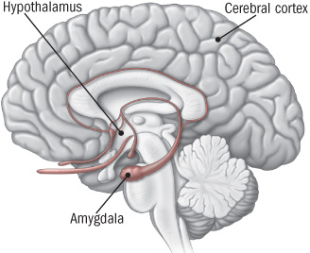
Fight/Flight Response
Adrenalin and Cortisol are released
Increased heart rate
Increased breathing rate
Increase blood pressure
Tunnel vision
Auditory exclusion
Sweating
Digestion stops
Primitive brain takes over
https://www.health.harvard.edu/staying-healthy/understanding-the-stress-response

Slide 6
Continuum
Enraged
Very Very Angry
As we move up the continuum
Really Angry
Our ability to process decreases
Quite Angry
Angry
Getting Angry
Annoyed
Irritated
Frustrated
OK
Pfeiffer, R (2012). Anger Management Workbook and Curriculum.

Slide 7

Aggression
*Aggression is hostile or violent behaviour or attitudes toward another person
The external manifestation of anger
Often Minimized
*Merriam-Webster, 2017

Slide 8
The Person in Crisis

Slide 9
The Crisis
*A time when a difficult or important decision must be made
https://www.merriam-webster.com/dictionary/crisis
Can result on positive change
Opportunity for learning an growing
*https://www.merriam-webster.com/dictionary/crisis

Slide 10
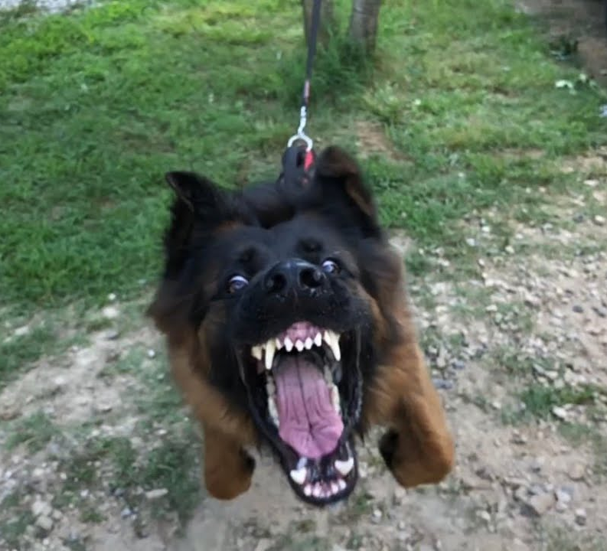
Crisis?
What crisis might your customer be experiencing?

Slide 11
Understanding the Person in Crisis (PIC)
Attachment Disturbance
Attachment: Innate ability for humans to form bond
Causes:
Emotionally unavailable parent
Inconsistent parenting
Frightening, threatening, and disoriented parenting
Impact:
Result in adults who cannot self-regulate
These adults are prone to violence, aggression, and crisis
Prisco, Moss, & Pfeiffer, (2016). Crisis Intervention Certification Handbook: Basic Practices for First Responders

Slide 12
Understanding the Person in Crisis (PIC)
Trauma:
Deeply disturbing or distressing experience
Impacts:
In a crisis the individual goes to fight/flight/freeze response
Decreased brain development
In a crisis the individual reverts to child-like state
Amygdala “on”
Anger and aggression
Prisco, Moss, & Pfeiffer, (2016). Crisis Intervention Certification Handbook: Basic Practices for First Responders

Slide 13
Stress and Trauma
Trauma memories can be triggered during times of stress
The person in crisis is, in effect, reacting to the original trauma

Slide 14
Understanding the Person in Crisis
The Person in Crisis is often reliving a prior traumatic experience and will have trouble thinking and speaking
Prisco, Moss, & Pfeiffer, (2016). Crisis Intervention Certification Handbook: Basic Practices for First Responders

Slide 15
The Interventionist

Slide 16

Self-management
In a critical incident, crisis, or difficult situation, how you manage yourself will have the most impact on the outcome of the situation

Slide 17
Facts & Stories
The FACTS:
The given circumstances surrounding a situation
Our STORY:
Out opinions/reactions/conclusions that we draw about those circumstances
The story is usually the source of dysregulation and stress

Slide 18
Example
Facts: Traffic was slow and I was not able to get to my meeting on time
Story: Traffic was slow because the County doesn’t spend enough money improving the roads (typically, we will continue escalating the story) and because the city doesn’t effectively plan development there are too many people moving into the area too fast (adding data to the story). And the drivers are so busy texting their friends they never watch the road and get into collisions which only slows traffic more (drawing conclusions).

Slide 19
We have the choice
to escalate or de-escalate a situation starting with how we THINK about the situation.

Slide 20

Emotional Triggers
Powerful emotional response
Impact how we see the world and make choices
Usually the result of childhood experience
Not necessarily a traumatic event
Everyone Has Triggers

Slide 21
Triggers: Types
Survival: afraid that life is in danger
Abandonment: afraid of being left alone
Impotent: Powerless to a circumstance
Shame: feeling of unworthiness or disrespect
Seething: sense being unjustly or unfairly treated
Prisco, Moss, & Pfeiffer, (2016). Crisis Intervention Certification Handbook: Basic Practices for First Responders

Slide 22

Biases
Tendency, trend, inclination, feeling, or opinion
Often preconceived or unreasonable
Unreasonable hostility, feelings, or opinions about a social group
Everyone Has Biases
Discover your biases
https://implicit.harvard.edu/implicit/takeatest.html

Slide 23
The 7 Conditions
When activated it is easier to slide into the primitive brain
Know when to engage and when to “tap out”
Stress
Anxiety
Drugs
Hungry
Alcohol
Tired
Sick
Prisco, Moss, & Pfeiffer, (2016). Crisis Intervention Certification Handbook: Basic Practices for First Responders

Slide 24
Communication

Slide 25
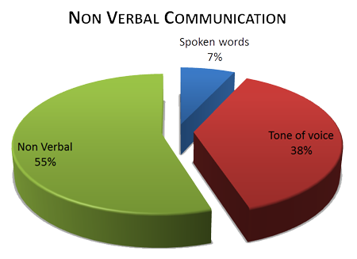

Slide 26
Actions Speak Louder than Words
If a person’s words say one thing and their nonverbal communication says another, you tend to listen to the nonverbal communication.
https://www.thebalance.com/tips-for-understanding-nonverbal-communication-1918459

Slide 27

Active Listening
Pose an open-ended question
Let the Person in Crisis speak
Give them time to talk and connect
Paraphrase
What you heard
What you see the Person in Crisis experiencing
Correct mistakes
Repeat the process

Slide 28
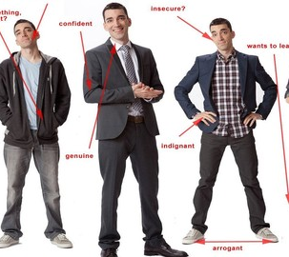
Posture
Open
Non-threatening
Keep moving to maintain safe distance
PERT hands

Slide 29

Posture
Sitting
If PIC is seated, remain seated
If PIC is standing, slowly stand
The goal is for you to be as equal to the PICs stature as possible

Slide 30
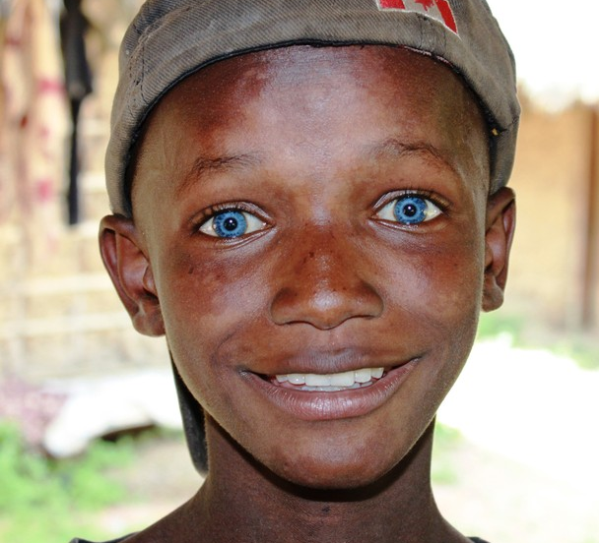
Eye Gaze
Social: Focus on a triangle area on the person’s face between the eyes and the mouth
Power: Focus on a triangle area on the person’s face between the eyes and center of the space between their eye brows
In most cultures: your gaze should meet the other person’s 60 to 70 percent of the time
Do not stare the person down

Slide 31
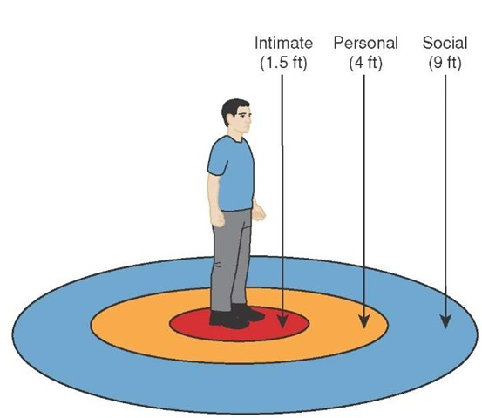
Proxemics

Slide 32

Proxemics
Close enough to be effective and far enough to be safe
Keep moving if necessary
Barrier between you and them
Do not touch them
Do not let them touch you
Do not turn your back on them

Slide 33
Verbals
Monitor yourself and the other person
Tone of Voice: Conversational/Commanding
Volume: Be heard over the ambient noise
Rate: Increases as agitation increased

Slide 34
The Process

Slide 35

Why this Model of Crisis Intervention?
Western State Hospital
Andy Prisco, Capt. PERT
Developed over a 10-year period
Empirically-based protocol
Final iteration developed by Prisco, Moss, & Pfeiffer 2015

Slide 36
I.N.S.E.R.T. Protocol
Identify the escalation type
Needs assessment
Safely approach
Engage (using I.R.P.D.)
Reinforce the self-regulation process
Teaching moment

Slide 37
Identify the Escalation/Aggression Type
Identify escalating behaviour
‘Size-up’ the situation to form a strategy
What is the individual’s clinical history?
What is the individual’s history with your agency?
3 types of Escalation

Slide 38
Reactive Escalation
Individual is unable to cope with steady or escalating pressures
Impulsive and maladaptive
No long-term goal in mind
No latency between trigger and escalation
Most often seen escalation type
Easiest to de-escalate

Slide 39
Instrumental Escalation
Usually preplanned
Usually little advanced warning
Seen in prison settings
More difficult to de-escalate
The person may be trying to “pick a fight” or get you to take a certain predetermined action.

Slide 40
Psychotic Escalation
Misperceives reality
Motivated by paranoia
Mostly seen on acute care hospital units
Schizophrenia
Flashbacks
Drug induced psychosis
Extreme mania

Slide 41

Needs Assessment
What are YOUR needs?
Contact/Cover
Route of egress?
Back-up support
Distance
Time
Shielding

Slide 42

Needs Assessment
What are the needs of the person in crisis?
Safety
Support
Space
Time

Slide 43
Safely Approach
Situational Awareness
All appearances must be non-judgmental
Connect… Use the person’s name
Establish that you want to help
Move to the zone of influence Use non-threatening posture Identify routes of escape
Leave person in crisis a way out (do not surround them)
Anticipate an attack

Slide 44
Engage Using IRPD
Issue a Validation Statement
Refer to a policy, law, rule, or standard or engender a shared value system
Propose a choice
Describe a desirable outcome

Slide 45
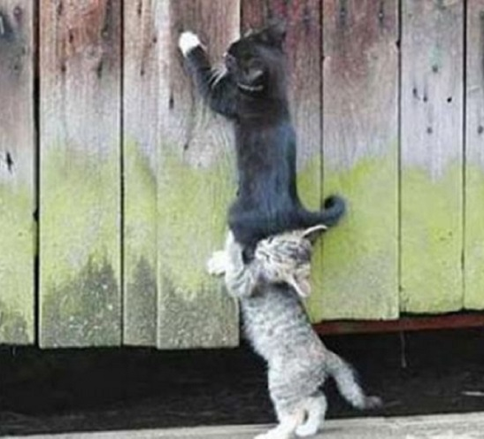
Reinforce the Self-Regulation Process
Fight/flight is still activated
Might still be in primitive brain
Not thinking clearly
Reactionary
Reward desired behaviour
“Thank you for moving out of the doorway”
“I appreciate your co-operation today”
Issue statements of hope and recovery
Remind them of past successes if applicable

Slide 46

Teaching Moment
What happened?
Who was involved?
What worked?
What did not work?
What do we need to improve?
What training do we need?
Avoid public criticism

Slide 47

Mental Illness

Slide 48
Statistics
In 2013, there were an estimated 10 million adults aged 18 or older in the U.S. with SMI
3.9 % of U. S. adults will be diagnosed with bipolar disorder in their lifetime
3.5% of the U. S. adult population has PTSD
National Institute of Mental Health, 2015

Slide 49
Statistics
9% of U. S. adolescents aged 13 to 18 have ADHD
9.1% of U. S. adults have a personality disorder
1.0% of U. S. adults have antisocial personality disorder
National Institute of Mental Health, 2015

Slide 50
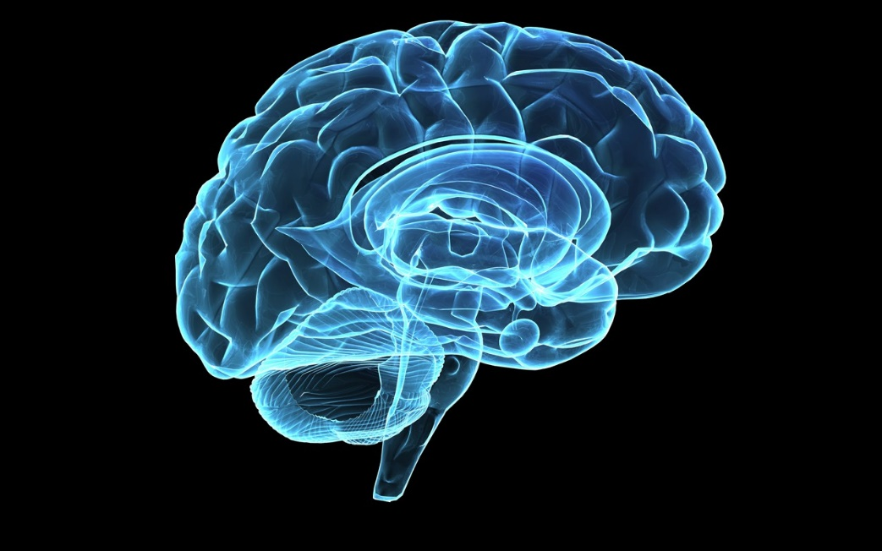
What is a Mental Illness?
A wide range of mental health conditions — disorders that affect your mood, thinking, and behavior
Stress-Diathesis Model
Causes:
Chemical imbalance
Electrical issues
Structural damage
Excessive stress

Slide 51
Psychosis
Psychosis is a symptom or feature of mental illness typically characterized by:
radical changes in personality
impaired functioning
distorted or nonexistent sense of objective reality
Available Online: http://medical-dictionary.thefreedictionary.com/psychosis

Slide 52
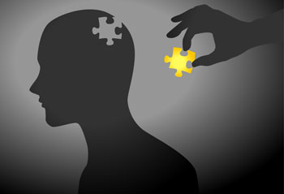
Psychosis
Disorganized thoughts
Confusion
Hallucinations
Delusional thoughts
Emotional Dysregulation
Fear/Vulnerability
American Psychiatric Association ( 2013), Diagnostic and Statistic Manual of Mental Disorders, 5th Edition

Slide 53
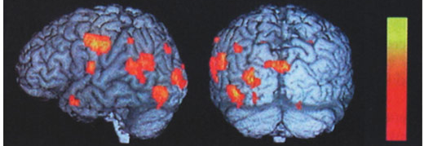
fMRI

Slide 54

Hallucinations
Auditory
Visual
Tactile
Olfactory
Gustatory
American Psychiatric Association (2013), Diagnostic and Statistic Manual of Mental Disorders, 5th Edition

Slide 55
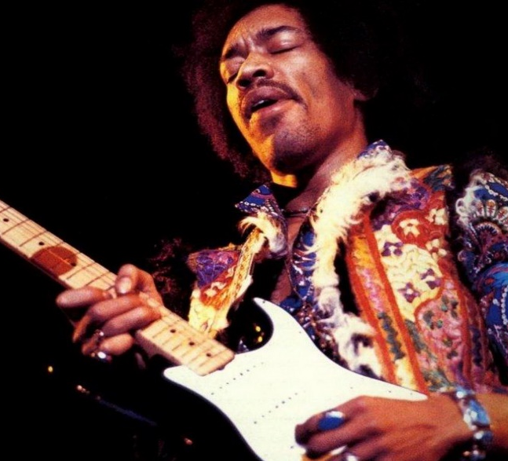
Communication
Establish Rationality
Listen for logical speech
Conversational tone
Loud noises can be overwhelming
Simple directives
Be predictable
Work within their reality
“I believe you see Jimi Hendrix standing next to you”

Slide 56
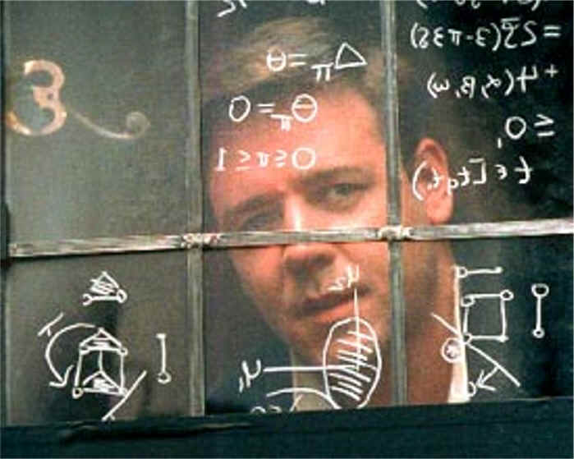
Delusional Thinking
Erotomanic
Grandiose
Persecutory
Religious
Jealous
Mixed
American Psychiatric Association ( 2013), Diagnostic and Statistic Manual of Mental Disorders, 5th Edition

Slide 57

Communication
Try to work within the individual’s reality
Difficult to change their delusions
Challenging the delusions might inhibit rapport
Avoid abstract and/or metaphorical speech
Avoid power struggles
NOTE:
You don’t have to believe the delusions, just work within them.

Slide 58
Paranoia
Paranoia is an unfounded or exaggerated distrust of others, sometimes reaching delusional proportions.
Paranoid individuals constantly suspect the motives of those around them, and believe that certain individuals, or people in general, are "out to get them.“
Available Online: http://medical-dictionary.thefreedictionary.com/paranoia

Slide 59
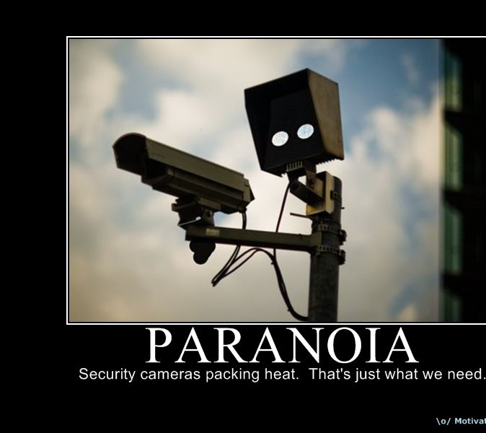
Communication
Person is experiencing fear
Work within their reality
Person feels vulnerable
Be predictable
Be reassuring
Provide space when possible
Reduce over-stimulation
NOTE:
You do not have to believe their paranoid delusions
Work within them

Slide 60
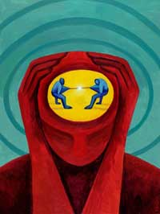
Mania: Bipolar
Agitation
Emotionally labile
Euphoria/Anger
Impulsive/Poor judgement
Hypersexual
Psychosis
Problem with medication compliance
American Psychiatric Association ( 2013), Diagnostic and Statistic Manual of Mental Disorders, 5th Edition

Slide 61

Communication
Safety:
Behavioural and emotional dysregulation
Simple, directive speech
Might have to repeat your request several times
Avoid abstract and metaphorical speech
Stick to your line of thought
Don’t chase the dragon
Be careful with humour
The mania can cause euphoria and inappropriate laughter
When touching the person, let them know first

Slide 62
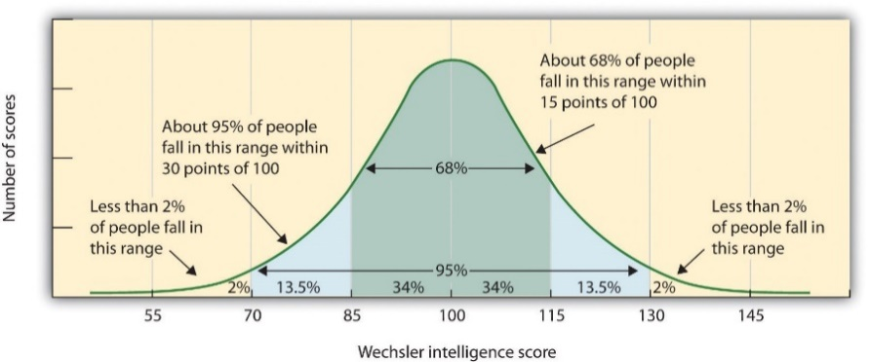
Intellectual Disability
Score below 70 on intelligence testing
Low score on functionality assessment
Difficulty getting needs met
impacts to cognitive functioning
American Psychiatric Association ( 2013), Diagnostic and Statistic Manual of Mental Disorders, 5th Edition

Slide 63
Communication
Conversational tone of voice
Simple requests
Concrete Speech
Be careful with humour

Slide 64
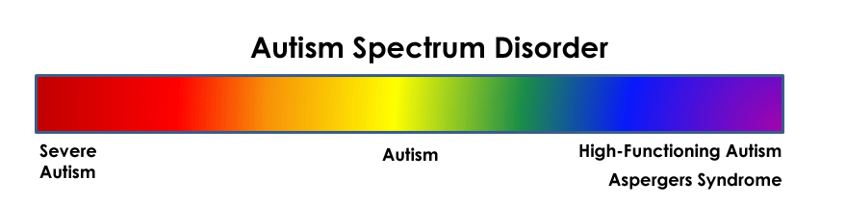
Below Average Average Above Average
American Psychiatric Association (2013), Diagnostic and Statistic Manual of Mental Disorders, 5th Edition

Slide 65

Autism Spectrum Disorder
Concrete thinking
Difficulty with humour
Disorganized thoughts
Slow cognitive processing
Magical thinking
American Psychiatric Association ( 2013), Diagnostic and Statistic Manual of Mental Disorders, 5th Edition

Slide 66

Communication
Conversational
Directive
Concrete
Simple
Decrease Stimuli
Touching
Let them know first
Shiny objects and water

Slide 67

High Functioning Autism
Asperger Disorder
Average to Above Average Intelligence
Socially awkward
American Psychiatric Association (2013), Diagnostic and Statistic Manual of Mental Disorders, 5th Edition

Slide 68
Communication
Conversational
Treat as you would any person
Be careful with humour

Slide 69

Post-traumatic Stress Disorder
Traumatic Experience
T and t
Re-Experiencing Symptoms
Flashbacks
Intrusive Thoughts
Nightmares
American Psychiatric Association ( 2013), Diagnostic and Statistic Manual of Mental Disorders, 5th Edition

Slide 70

Post-traumatic Stress Disorder
Affective Flattening
Avoidance Behaviours
Isolation
Trigger Avoidance
Hyperarousal Behaviours
Anxiety
Anger
Hyper-vigilance
Fight or Flight
American Psychiatric Association ( 2013), Diagnostic and Statistic Manual of Mental Disorders, 5th Edition

Slide 71

Communication
Clear, Direct, Speech
Safety
“You’re safe”
“How can I help make you feel safe?”
Breathing
Square Breathing
Grounding

Slide 72

Depression
Low energy
Low motivation
Sleep issues
Eating issues
Social Isolation
Hopelessness
Suicidal Ideations
American Psychiatric Association (2013), Diagnostic and Statistic Manual of Mental Disorders, 5th Edition

Slide 73
Agitated Depression
Feelings of irritation
Restlessness
Anger
Insomnia
Fidgeting
Racing thoughts
American Psychiatric Association ( 2013), Diagnostic and Statistic Manual of Mental Disorders, 5th Edition

Slide 74

Communication
Address as you would anger
I.N.S.E.R.T.
I.R.P.D.
Maintain Safety

Slide 75
Difficult Personalities

Slide 76
What is a personality?
Enduring pattern of behaviour that deviates from cultural expectations
The pattern is inflexible and pervasive across many social/personal situations
The pattern leads to clinically significant stress
Onset can be traced to adolescence or early adulthood
American Psychiatric Association ( 2013), Diagnostic and Statistic Manual of Mental Disorders, 5th Edition

Slide 77

What makes a personality disordered?
The personality negatively impacts the individual’s ability to achieve the Human Givens
Human Givens:
Security
Autonomy
Control
Attention
Intimacy
Community
Griffin J., & Tyrrell, I. (2013), Human Givens: The New Approach to Emotional Health and Clear Thinking

Slide 78
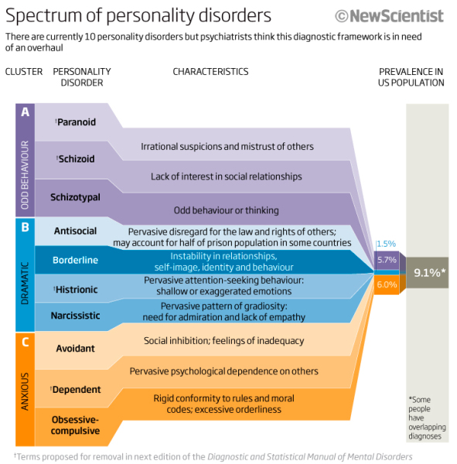

Slide 79

Borderline Personality Disorder

Slide 80
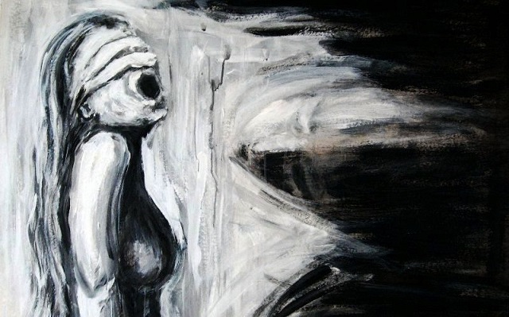
Presentation
“I will be very angry if you try to leave me”
Emotional dis-regulation
Emotions persist longer than average
Fear of abandonment
Unstable and intense personal relationships
Unstable self-image
Suicidal behaviour, gestures, threats or self-harm
Suicide
American Psychiatric Association ( 2013), Diagnostic and Statistic Manual of Mental Disorders, 5th Edition

Slide 81

Communication
Delay
Slow things down. Postpone the conversation if possible
Distract
Get their mind off the topic
Depersonalize
This is not about you, don’t take it personally
Detach
Remove yourself emotionally

Slide 82

Antisocial Personality Disorder

Slide 83
Presentation
Failure to conform to societal norms
Disregard for the wishes, rights, or feelings of others
Frequently deceitful and manipulative
May repeatedly use an alias
Decisions are made spur of the moment with little forethought
Tend to get irritable and engage in aggressive behaviour
Frequently engage in reckless behaviour
American Psychiatric Association (2013), Diagnostic and Statistic Manual of Mental Disorders, 5th Edition

Slide 84

Communication
Conversational or Commanding tone of voice
Clear directives
Clear expectations
Clear explanation outcome for failure to meet expectations
Avoid being condescending
Do not take anything personally

Slide 85
Narcissistic Personality Disorder

Slide 86
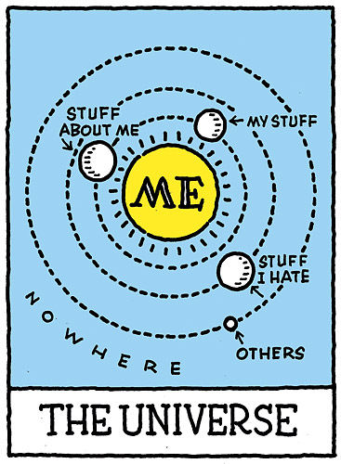
Presentation
Pervasive pattern of grandiosity
Lack of empathy
Need for admiration:
self esteem is very fragile
Sense of entitlement
Charming
No respect for boundaries
American Psychiatric Association (2013), Diagnostic and Statistic Manual of Mental Disorders, 5th Edition

Slide 87
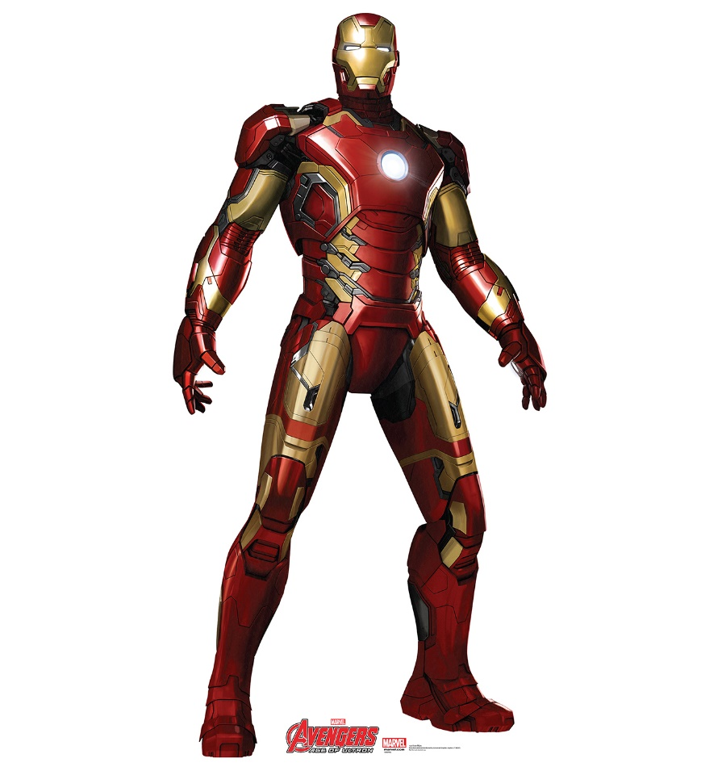
Self-esteem
Exceedingly fragile and vulnerable
Extremely sensitive to criticism
Humiliation
Degradation
Will respond aggressively
Overarching ambition: is achievement
Feeds the ego
You must be mindful about the
self-esteem and attacking the ego
American Psychiatric Association ( 2013), Diagnostic and Statistic Manual of Mental Disorders, 5th Edition

Slide 88

Communication
Define expectations
Be willing to listen a lot and listen carefully
Find ways to provide positive recognition frequently
If it is at all possible to do so, be honest and sincere in your acknowledgement, praise, and recognition
Avoid challenging the narcissist's wishes or desires
Do not take anything personally

Slide 89

Questions

Slide 90


Slide 91
Consultation
Kevin St. Jacques, PsyD, LMHC, CCIS-III, CAMS-III
www.stjacquesconsulting.com
Email: stjacquesconsulting@outlook.com
Desk: 425.780.4477
Mobile: 206.953.9837

