Slide 1
ANIMAL CONTROL ACADEMY
THE LEGAL BASICS

Slide 2
CHAPTER 1: THE LEGAL SYSTEM

Slide 3

WHERE CAN I FIND THE LAW?
Constitution
  United States Constitution
  Washington Constitution*
Case Law
  United States Supreme Court
  Washington State Supreme Court & Court of Appeals
Revised Code of Washington (RCW)*
Washington State Court Rules
  Superior Court Criminal Rules (CrR)
  Criminal Rules for Courts of Limited Jurisdiction (CrRLJ)
City Municipal Codes (_MC)*

Slide 4
ROLES WITHIN THE CRIMINAL JUSTICE SYSTEM
EVIDENCE GATHERING
  Animal Control
  Police Officers
REVIEWING + LITIGATING
  Prosecutors
  Defense Attorneys
DECISION MAKING
  Judge
  Jury

Slide 5
CHAPTER 2: EVIDENCE

Slide 6
WHAT TYPES OF EVIDENCE CAN I GATHER?
911 calls
Witness + defendant statements
Video, audio, and/or photo evidence
Veterinary reports
Animals themselves – may need a warrant first
Literally anything included in a search warrant

Slide 7
LAW PROTECTS AGAINST UNLAWFUL SEARCH AND SEIZURES
UNITED STATES CONSTITUTION –FOURTH AMENDMENT
  “The right of the people to be secure in their persons, houses, papers, and effects, against unreasonable searches and seizures…
WASHINGTON STATE CONSTITUTION –ARTICLE 1
  “No person shall be disturbed in his private affairs, or his home invaded, without authority of law”

Slide 8

WHY SHOULD WE CARE?
  YOU=the government/state
  CITIZENS=have a right to privacy
  If you seize a citizen and search them, their stuff, their house, their yard, their animals, etc …you better have a lawful reason.
  Consequences
    LAWSUITS
    Evidence gets suppressed…case dismissed
    Criminals go unpunished
    Media coverage
    Discipline within department
    Prosecutors unhappy

Slide 9

CHAPTER 3: SEIZURES
FACTORS TO DETERMINE WHETHER A SEIZURE OCCURRED
SEIZURE EXCEPTIONS
  TERRY STOP
  SOCIAL CONTACT
  COMMUNITY CARETAKING FUNCTION

Slide 10
WHAT IS A SEIZURE?
Unofficial definition: (1) stopping a person or (2) taking/collecting of property.
Official definitions:
  When a government employee, by physical force or by show of authority, restrains an individual’s freedom of movement.
Standard: would a reasonable person feel free to disregard the officer and go about his/her business?

Slide 11
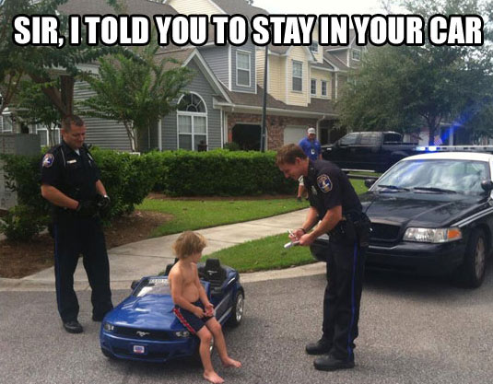
WHAT IS A SEIZURE?

Slide 12
When am I allowed to Seize Property
Search warrant …more on this later
Consent
Abandoned property

Slide 13
When can I seize property? Consent
Make sure that it truly is voluntary.
If inside a home = Ferrier Warnings
Don’t exceed the scope of consent
Ferrier Warnings:
1. You have the right to refuse to consent.
2. If you consent to the search, you have the right to withdraw the consent at any time.
3. You have the right to limit the scope of the consent to certain areas of the premises or vehicle.
4. Evidence found during the search may be used in court against you or any other perosn

Slide 14
When can I seize property? Consent Hypo
ACO Bob gets a call from a concerned citizen who claims that his neighbor Ned is engaging in dog fighting and has a whole bunch of dog fighting paraphernalia in his home.
ACO Bob goes to Ned’s home. How should he proceed?
Ned has a roommate named Ted. Ted’s room is unlocked. Ned says that ACO Bob can take a look. Should ACO Bob proceed?

Slide 15

When can I seize property? Consent -- Tricky Consent
Children
Landlord
Roommates
Houseguest
Hotel Management

Slide 16

When can I seize property? Abandoned
Hypo: Criminal is being arrested outside. He takes off jacket and puts on the roof of the patrol car. Can officers search?
Abandoned ≠ lost/mislaid

Slide 17
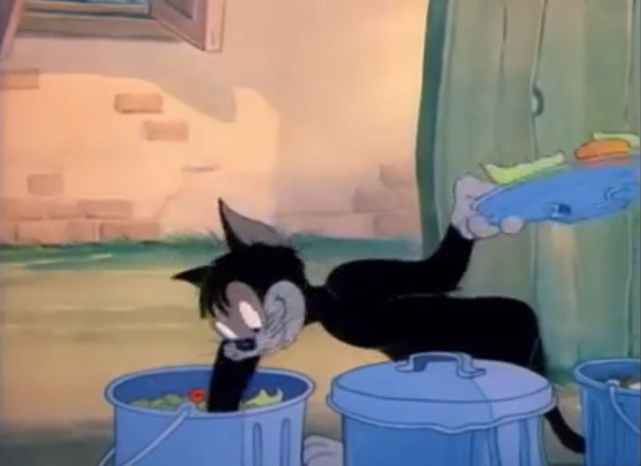
When can I seize property? Consent
Property=Public v. Private*
What is public?
  Factors
    Location
    Duration
    Item type
  Hypos---
    Suspect carrying a purse or backpack?
    Suspect’s jacket pocket?
    Item in vehicle
    Item on porch
    Item in trash for pickup

Slide 18
When can I seize property? Property in Private*
Officer may seize property located on private property if
  Officer is allowed to be where the property is; and
  Item is immediately recognized as contraband or as having some evidentiary value
Hypo:
  Walk up on porch = mail man rule
  Walk into backyard
  Item in the back seat of vehicle during a traffic or criminal stop

Slide 19

WHEN AM I ALLOWED TO SEIZE A PERSON?
1) Arrest Warrant
2)Probable Cause
Standard: based on the totality of the circumstances, the officer has sufficient facts to lead a reasonable and cautious person to conclude that there is a probability that the defendant is involved in criminal activity. Takes into consideration an officer’s expertise and experience.
To arrest=crime must occur in front of you, unless felony
Or
3) Exception Applies

Slide 20
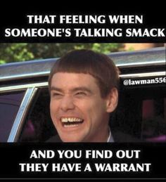
Seize a Person: Arrest Warrant
Do they have one?
Can I get one?

Slide 21
Seize a Person: Probable cause for crime*
Felony = rely on other people / physical evidence
Misdemeanor = rely on just yourself. Must have seen it!
ACO’s can’t directly arrest.

Slide 22
Exceptions
Social contact
Terry stop
Community caretaking

Slide 23
SOCIAL CONTACT
  Law enforcement allowed to converse with citizens, just like everyone else.
  Can approach people in cars, knock on people’s doors, visit person at work.
  No seizure if citizen freely and voluntarily participates in the conversation.
  Can contain an investigative component.
  Test: would a reasonable person feel free to terminate the encounter and walk away.

Slide 24

Hypo
ACO Boucher is on patrol at the local park. She sees a woman with a dog who looks emaciated and unwashed. ACO Boucher subjectively wants to speak to the person to investigate for animal cruelty in the second degree. She goes up to the woman and does the following:
  Picks up the dog, but ACO Boucher does not take the leash away from the owner. Social contact?
  Asks the woman for ID and takes ID to patrol car to run name. Social contact?
  Tells woman to wait for a responding officer. Social Contact?

Slide 25

Terry Stop
  Have reasonable and articulable suspicion that the person has engaged in or is engaging in criminal conduct
  Purpose is to investigate possible criminal activity
  Must be brief and minimally intrusive, but if you are gathering more evidence of a crime, then you can prolong the intrusion.
  Report writing matters!

Slide 26
Hypo
ACO Boucher receives a call from a concerned citizen, Eric. Eric was visiting his friend, Joe, and saw some items that concerned him. He saw that his friend’s basement had a bunch of benches surrounding a large pen. Inside the large pen were empty cages with feathers. ACO Boucher responds to the home and sees Joe walking on the sidewalk away from her vehicle. ACO Boucher asks Joe to stop but he ignores her. Can ACO Boucher stop Joe?

Slide 27
Community Caretaking
  Law enforcement allowed to respond to individuals requesting assistance. (Example 911 calls and individuals flagging down police).
  Law enforcement allows to assist vulnerable populations.
    Potential victim of violent crime → may enter and remain to eliminate the concern that a victim is in danger
    Intoxicated pedestrians → may transport to safety if moving along public roadway.
    Children→ may transport and call CPS if child is in danger
    Mentally ill → may transport to hospital if reasonably believe that the person presents an imminent likelihood of serious harm or is in immiment danger.
    Welfare checks → go to person’s residence to check on them (typically DV related or at request of friend or family member).

Slide 28
Overview
Seizure
Not A Seizure
Pulling over a vehicle
Blocking a vehicle or person’s exit
Activating sirens or lights
Giving commands (ex. Stop, don’t move, come talk to me).
Use of weapons and/or handcuffs
Taking someone’s property, including ID
Following a person after they say they won’t speak with you
Number of law enforcement officers
Telling someone that they are under arrest
Parking your vehicle away from person’s vehicle
Making requests (ex. Can I talk to you? Do you mind coming over here? Can I come inside and speak to you?, etc).
Informing the person that they are not under arrest
Terry stop
Social contact
Community caretaking

Slide 29
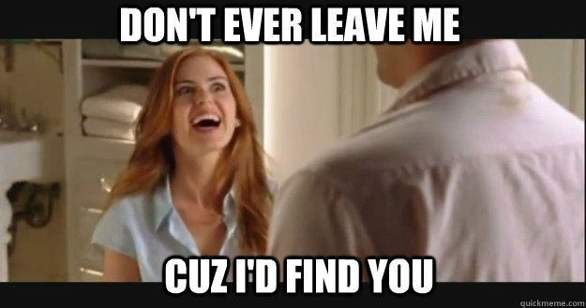
CHAPTER 4: SEARCHES

Slide 30
WHAT IS A SEARCH?
Official definition: a search occurs when the state intrudes upon an area where a person has a legitimate reasonable expectation of privacy.
What is considered reasonable?
  1) person must subjectively believe that thing/place is private; and
  2) Society recognizes that thing/place is private
Examples—persons, houses, papers, effects, vehicles, property, blood, shed, gardens

Slide 31
WHY SHOULD WE CARE?
Exclusionary rule – illegally obtained evidence is not admissible in court.
Fruit of the poisonous tree –everything following is not admissible in court.
YOU CAN BE CHARGED – without a warrant or an exception to the warrant requirement, it is unlawful to search a residence.

Slide 32
WHEN CAN I SEARCH?
WITH A WARRANT
IF A WARRANT EXCEPTION APPLIES

Slide 33
WHAT IS A SEARCH WARRANT?
Beautiful pieces of paper
  Affidavit in support of search warrant
  Search Warrant
  Return of Service
Signed by Judge
Directs law enforcement to search person, place, or thing
Directs law enforcement to seize evidence
Directs law enforcement to write out a list what they seized and to file that paperwork with the court within a specific time frame

Slide 34
WHO CAN REQUEST A SEARCH WARRANT? HOW?
Who can request?
How?
Peace officer
Prosecuting Attorney
Write an affidavit in support of search warrant.
Write actual search warrant
Write Return of Service
Take to Judge (in person or email/telephonic)
Submit to oath
Get Judge to sign

Slide 35
WHO CAN ISSUE SEARCH WARRANTS?
Justice of the Supreme Court (good luck with that!)
Judges of the Court of Appeals (same)
Superior Court Judges and Commissioners (felony)
District Court Judges and Municipal Court Judges
Pro Tem Judges (same powers as who they are substituting for)

Slide 36
WARRANT REQUIREMENTS
Specify the Place/Person/Object that you want to search.
List Crime(s)Under Investigation
Describe the type of search
  Evidence of crime;
  Contraband, fruits of crime, things otherwise criminally possessed
  Weapons or other things by means of which a crime has been committed or reasonably appears to be committed
Summarize your qualifications
Summarize your investigation so far (establish PC for crimes)
Summarize why you think the place/item to be search has relevant evidence (establish nexus)
List the evidence that you want to seize
Penalty of Perjury Language

Slide 37
Hypo
Sexually abused dog inside of a home. Your evidence includes a relative of the defendant who said that she walked in on D anally raping the dog. She also read his diary which is located in his bedroom. The diary describes his sexual acts. She also has a sneaking suspicion that there might be animal porn on his computer.
What evidence do you want?
How do you get it?

Slide 38
HOW TO SERVE A SEARCH WARRANT?
Law enforcement officer must serve (ACO can assist)
“Knock and Announce” = required for service of a warrant. May break open any door, window, or enclosure of a dwelling or building if refused entry after doing the following:
  Must have warrant (provide copy to person if present or leave on counter or front door if no one present)
  Announce identity
  Demand admittance
  State purpose of demand
  Wait (30 seconds is usually ok, can be sooner if hear furitive activity, signs of danger, or destruction of evidence).
  Be explicitly or implicitly denied admittance

Slide 39
HOW TO SERVE A SEARCH WARRANT?
ANIMAL CONTROL SPECIFIC
  PICTURES BEFORE MOVING ANYTHING!!!
  System for labelling animals (hoarder example)
  Health precautions
  Control scene – prevent tampering of crime scene
LAW ENFORCEMENT – if person obstructs service of search warrant, officer should arrest for obstruction.
Only can search and seize items listed in search warrant
If inadvertently find other evidence, back away immediately, control scene, apply for supplemental search warrant.
Animals → vet → impound
Inventory = must be performed in front of another individual (another officer is sufficient)
Return inventory within time frame

Slide 40
EXCEPTIONS TO THE SEARCH WARRANT REQUIREMENT
Consent – make sure it’s voluntary and person has authority to consent
Plain view – contraband of evidence but that item must be located where ACO is allowed to be.
Search incident to arrest – arrest must be lawful.
Canine sniff
Inventory search – have police do this

Slide 41
Questions??

