Slide 1
Criminal Procedure
&
Animal Cases in the Courts
Tali Smith and Lauren Burke
Deputy Prosecuting Attorneys, King County

Slide 2





Queen
Tacoma Humane Society

Slide 3
Overview
Initial Report
Investigation
Referral
Case Filed
Arraignment
Pretrial / Omnibus Hearing
Motion Hearing
Trial
Appeal, if any
Plea
Notes:
Appeal after a plea is unlikely

Slide 4
The Initial Report & Investigation
Miranda Rights
Talking to Witnesses
Gathering Evidence
What Crime applies
Civil or RCW
Veterinary Records
Photographs
Warrant
Report Writing

Slide 5

Applicable
State
Laws
  Cruelty to Animals
  Cost of Care/Financial Bonding/Pre-conviction
  Forfeiture
  Agriculture
  Animal Shelters/Facilities
  Child Abuse/Elder Abuse
  Fraud/Financial Crimes
  Veterinary Practice Act Violations

Slide 6
Municipal Ordinance/Code Violations
  Public nuisance
  Animal limits/licensing/rabies
  Vicious Dog

Slide 7
Serina
Tacoma Humane Society

Slide 8
The Investigation
  Witnesses
  Keep in mind Domestic Violence components and prior violence
  Treat as crime scene
  Look at defendant’s website, Facebook page or other social media site or blog
  Treat animal as victim
Notes:
Witnesses- civilian, officer, family, veterinary
Take photos, document smell, sounds, what you see
There is difference between the death/body score being a result of a health condition v. untreated obvious health condition v. starvation
Ask Law enforcement/prosecutors to help if DV component, elder abuse, etc.
Better to do it right first time, cannot always fix gaps later

Slide 9
Evidence Gathering
  Types of animals
  How you will identify the animals and label them?
  Injured v. critical conditions v. deceased
  Get a veterinary opinion and veterinary records
  Distinguish medical condition v. neglect for causation
  Use Body Condition Scoring charts

Slide 10
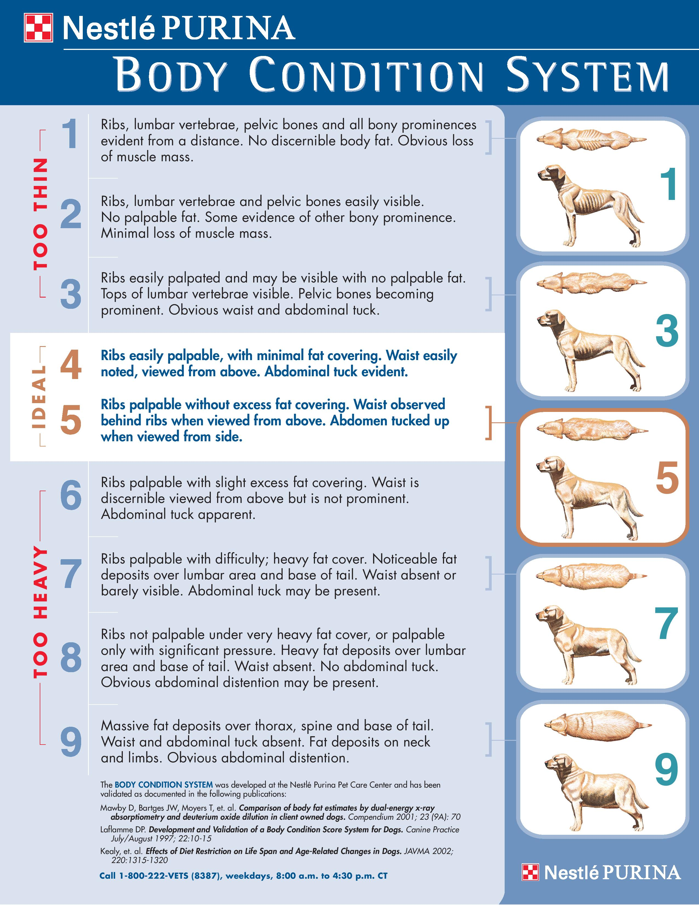

Slide 11
Warrants https://warrantportal.kingcounty.gov/justTemplates
Use warrant template
When possible have a prosecutor review the warrant
Requires a criminal warrant or a civil order?
Specificity:
  Place to be searched
  The suspect
  The suspected crime
  Supporting Facts
  **Watch out for overbreadth

Slide 12
Miranda Rights
Miranda v. Arizona,
384 US 436, (1966)
Right to remain silent
Right to talk to a lawyer
Right to have a lawyer during questioning
Right to have lawyer appointed
Right to stop answering at any time
***Be aware of these rights when talking with someone you suspect of committing a crime.***

Slide 13
Odin
Tacoma Humane Society

Slide 14
Referring Case
Consult with Prosecutor
Complete Reports
Witness Statements
Veterinary Records
Warrant documents
Be clear on date range, time, and location
Be clear on the crime-elements
Referring Felony v. Misdemeanor
Municipal, District Court, Superior Court

Slide 15
Advantagesof Prosecution
Evaluation, treatment, and services
  Humans
  Animals
Long-term monitoring
Restitution
Limits on animal ownership
Law enforcement record of arrest
Public record of conviction
Makes them “accountable”
Educates the public about the seriousness of the issue
Notes:
Humans-(elderly, children, disabled)
Animals-including veterinary evaluation, treatment, sheltering, re-homing, euthanasia)
Restitution-for costs of veterinary care, food, and shelter

Slide 16
“Don’t let the perfect be the enemy of the good.”
~Voltaire

Slide 17
Case Filed
Direct File
Upon the arrest of a Defendant, Officer files a citation with the court through SECTOR or another approved method
Referral
Officers write a report and send it to the prosecutor’s office for filing of charges
Prosecutor reviews discovery and compares to statutes
Probable cause v. beyond a reasonable doubt
Vertical v. horizontal prosecution

Slide 18
Best Practice for Charging
If the treatment (act or omission) of an individual animal results in a provable violation, then a charge should be filed involving that animal
Each animal should be specifically identified in some manner to the exclusion of all other animals involved in the same incident
ONE ANIMAL = ONE CHARGE
Each office will charge differently

Slide 19
Key Elements
Identification
Date
Venue / Location
Mental state
Acts / Omissions
Notes:
This will be the focus through out the case- can we or did we prove the elements of the crime

Slide 20
Burden of Proof:
Reasonable Doubt
WA Instruction 4.01
The State/City is the plaintiff and has the burden of proving each element of the crime beyond a reasonable doubt.
The defendant has no burden of proving that a reasonable doubt exists as to these elements.
A defendant is presumed innocent. This presumption continues throughout the entire trial unless during your deliberations you find it has been overcome by the evidence beyond a reasonable doubt.
Prosecutor always gets the last word because they have the burden
Notes:
Reasonable Doubt “A reasonable doubt is one for which a reason exists and may arise from the evidence or lack of evidence. It is such a doubt as would exist in the mind of a reasonable person after fully, fairly, and carefully considering all of the evidence or lack of evidence. If, from such consideration, you have an abiding belief in the truth of the charge, you are satisfied beyond a reasonable doubt.”

Slide 21

Kona
Thurston County Joint Animal Services

Slide 22
First Appearance: Arraignment
Speedy Trial Begins to Run
Entry of Plea: Guilty or Not Guilty
Bail
  Set based upon danger posed to the community, and/or warrant history

Slide 23
First Appearance: Arraignment
(continued)
Conditions of Release
  Specific to the facts alleged in the case
  ex. no new criminal law violations, no contact with or possession of animals, no contact order (think DV), forfeit weapons, no alcohol, pre-probation UAs, etc.
Appointment of Counsel OR Retaining Counsel
  Guaranteed by the 6th Amendment of the U.S. Constitution

Slide 24
What Happens Next?
Follow up from officers
Prosecutor sends evidence to Defense Counsel through Discovery process
Prosecutor’s Recommendation/Offer
Negotiate Case for Plea
  Defense Counsel may counter, raise probable defenses or mitigating circumstances.
  Prosecutor may or may not change the original offer based upon the new information
Notes:
Discovery-strict rules
Prosecutor’s recommendation-will make an offer for guilty plea, may be to plead as charged, to defer the sentence, or to amend the charge, depending on circumstances of each case

Slide 25
Length of time for a case
Negotiations
Continuance
  Speedy Trial Waiver
    Defense counsel can waive speedy in order to continue the case.
Setting Case for Trial
  Within time for speedy trial, unless waived
Notes:
Speedy trial: A defendant must be brought to trial within 60 days of Arraignment if in custody, and 90 days if out of custody.

Slide 26
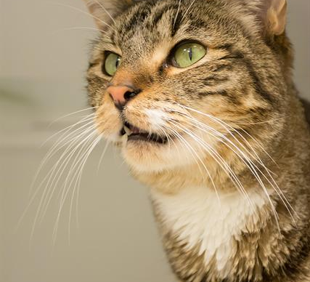
Elly
RASKC

Slide 27
Possible Pre-Trial Dispositions
  Plead Guilty, as charged
  Plead Guilty to amended charge
  Diversion Program
  Dismissal
  Only available in Municipal/District Courts:
    Deferred Prosecution - RCW 10.05.010
    Compromise of Misdemeanor - RCW 10.22.010
    Stipulated Order of Continuance

Slide 28
Trial Set
Defendant asserts right to trial
Trial date is set (but can be continued)
Prosecution sends out subpoenas for witnesses
Defense interviews State’s witnesses & Officers

Slide 29
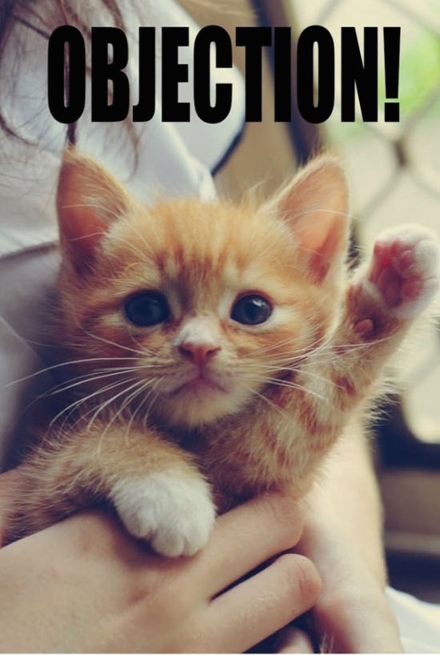
Motions
CrR 3.5
admissibility of statements
CrR 3.6
suppression of evidence
ER 404(b)
prior bad acts
Knapstad
dismissal

Slide 30
Motions Procedure
Defense files motion and Prosecutor responds
Testimony from officers or witnesses
Argument from Counsel
Court rules on motion
Notes:
Exception- 3.5 is Prosecution’s motion
Testimony-At the motion hearing, the officers and/or witnesses may need to address or clarify the specific issues of the motion
Argument-After testimony, both Prosecution and Defense are given the chance to present legal argument on the issue of the motion

Slide 31
Outcome of Motions
If Court grants the Defendant’s motion to dismiss, case is dismissed
If Court grants the Defendant’s motion to suppress evidence
  trial
  Negotiations, OR
  case is dismissed
If the Court denies the Defendant’s motion to suppress and/or dismiss
  the defendant pleads guilty OR
  the case proceeds to trial
Notes:
Grants motion to suppress-
-case either proceeds to trial without that evidence
-the parties negotiate a new offer for plea, OR
-case is dismissed because the City/State cannot proceed absent that evidence

Slide 32
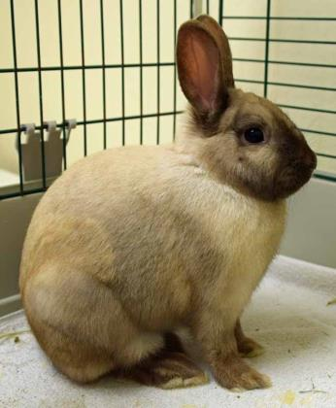
Dodie
Snohomish Animal Shelter

Slide 33
Bench Trial
  Defendant waives their Constitutional right to a jury trial,
  the case is heard before a Judge,
  attorneys often submit a trial brief to address legal issues that the judge may consider,
  officers and witnesses testify and are subject to cross-examination in a bench trial.

Slide 34
Jury Trial
Judge rules on objections (usually pertaining to evidence) and any legal motions made during trial
Jury
    determines the facts of the case and enters a verdict
    only hears evidence presented at trial by both sides
    only knows what the jury instructions tell them about the law
    can be biased about certain people or even types of animals

Slide 35
Trial Process
Motions in Limine
Voir Dire
Opening Statements
Prosecutor’s case
Half time motions (Green Motion)
Defense’s case
State’s Rebuttal
Closing Statements
Jury Instructions
Verdict

Slide 36
Trial Terminology
Motions in Limine
Before trial, both Prosecutor and Defense Attorney may submit motions to be considered before trial. Common MILs include exclusion of witnesses from the courtroom.
Voir Dire
Questioning jury pool to find jury panel-avoiding people with biases/prejudices
Exhibits
Any piece of evidence/physical item that is admissible at trial that a party wants the jurors to see, such as photos, videos, etc.
Jury Instructions
Prosecutor and Defense submit proposed instructions to the jury, that instruct the jury on the law. The Judge will choose which instructions are proper, and read them to the jury before or after closing argument, depending on jurisdiction.

Slide 37
Hearsay
Evidence Rule 801
A statement, other than one made by the declarant while testifying at the trial or hearing, offered in evidence to prove the truth of the matter asserted.
Exceptions:
  Present Sense impression
  Excited Utterance
  Existing Mental/Emotional/Physical Condition
  Statements for Medical Diagnosis/Treatment
  Recorded Recollection
  Business Record

Slide 38
Evidence Rule 404(b)
Evidence of a person’s character or character trait is not admissible to prove that on a particular occasion the person acted in accordance with the character or trait.
Evidence of other crimes- may be admissible for other purposes, such as proof of:
  motive, opportunity, intent, preparation, plan, knowledge, identity, or absence of mistake.

Slide 39
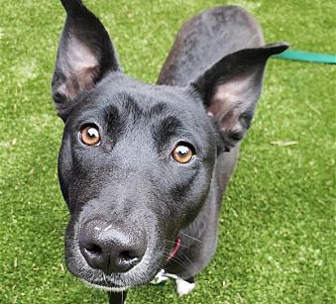
Alexa
Kitsap Humane Society

Slide 40
The Trial Begins
Opening Statements
Both Prosecutor and Defense give an overview of the case
Testimony from City/State Witnesses
Witnesses are called by City/State-known as direct testimony
Witnesses subject to cross-examination from Defense Counsel.
City/State rests their case
Half-Time Motion
Defense Counsel can make a “half time” motion to dismiss if they feel there is not enough evidence to prove the case
Court can dismiss at this time, although unlikely

Slide 41
Trial is underway
Testimony from Defense (if any)
Witnesses: Prosecutor has the opportunity to cross-examine
Defendant: Defendant has a Constitutional right to silence, so cannot comment on his/her refusal to testify
Defendant has no burden
Defense can present their defense and supporting evidence.
Notes:
Defense has no burden to call any witness or present any evidence
Defense has to declare certain defenses ahead of time

Slide 42
Defense Theories
It didn’t happen
  There’s no injury
  There’s no evidence
  Causation
  I didn’t know
It’s not my pet
Spouse had equal access
“Some dude” defense
I was disciplining / training
The animal was sick or dying
I couldn’t afford the veterinary bills
Attacks Witness (Eye, Confession, Expert); Science; Police; Prosecutor; Law
I did not realize what was happening (intoxicated; high)
It was an accident
I got all dressed up in a coat and tie and don’t look like someone that would do something like this and if I did I learned my lesson and will never do it again
Pit Bulls kill everything that get in their way
There’s a “reasonable doubt”

Slide 43
Issue to be aware of with Defendant
Sympathetic defendant
Seen as “rescuer” which seems like a better alternative to euthanasia at the local shelter
Intelligent and articulate, some are able to convincingly deny allegations
Evidence of mental illness – some appear pathetic, lack of intent to harm
May claim economic duress

Slide 44
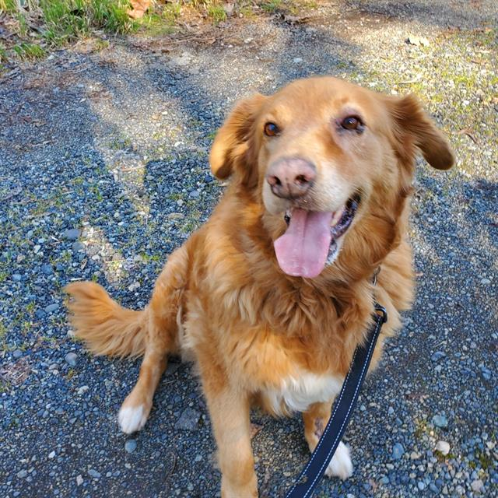
Marley
RASKC

Slide 45
Prep for Your Testimony
Write a Clear, Concise, and Detailed Report
Be Prepared
  Read your entire report and any witness statements ahead of time
  Review photos and evidence
  Consult with your prosecutor
  Practice your testimony
Know where the Court is and confirm your appearance with the Prosecutor
Dress appropriately
Arrive on time

Slide 46
Officer Testimony
You are under oath.
Direct your answers to the jury
Actively listen to the questions
Respond clearly and audibly
Formal atmosphere
Be truthful
Be confident, but not arrogant
During cross-examination, protect your credibility and correct any mistakes or misinterpretations
Remain calm
Notes:
Trust Your Prosecutor-don’t anticipate/try to fix something defense said/did
Attention-(or judge, if no jury present)
Formal atmosphere-use words like Sir, Ma’am, Miss, Your Honor
Truthful-If you don’t know or can’t remember, IT’S OKAY
Likable = credible
Avoid attempts at humor or sarcasm

Slide 47
Expert Testimony
WA Jury Instruction 6.51
A witness who has special training, education, or experience
Jury not required to accept expert’s opinion.
Jury determines the credibility and weight to be given to an expert’s opinions
Can consider:
  the education,
  training,
  experience,
  knowledge,
  ability of the witness,
  the reasons given for the opinion. and
  the sources of his or her information.
Notes:
Expert-may be allowed to express an opinion in addition to giving testimony as to facts
You are not, however, required to accept his or her opinion. To determine the credibility and weight to be given to this type of evidence, you may consider, among other things, the education, training, experience, knowledge, and ability of the witness. You may also consider the reasons given for the opinion and the sources of his or her information, as well as considering the factors already given to you for evaluating the testimony of any other witness.
Can consider the factors already given to you for evaluating the testimony of any other witness

Slide 48
How Jurors May View Testimony
**A juror may believe all of the testimony of a witness, part of it, or none of it.
Above all else: EXPERT MUST TELL THE TRUTH!
The expert knows more about their area of expertise than the attorneys or jurors
The jurors may have their own view about the value or characteristics of certain animals/species/breeds
They look at demeanor / body language
They look at means of knowledge; ability to observe; and strength of memory
They look at motive
Is their testimony supported or contradicted by other evidence in the case
Notes:
Everyone likes veterinarians
Unfortunately not everyone one likes animal control officers or law enforcement
They look at any relationship to either side of the case; motive

Slide 49
Value of Testimony
Educate the jury about:
  the animal – species, breed, gender, age
  the scene – quality of food, water, shelter, sanitation
  The disease, injury
  human-caused v. non-human caused (predation) injury
  intentional vs. nonintentional (accidental) injury/death
  what could have been done to prevent disease, injury/death
  pain and suffering

Slide 50
Dwight
Tacoma Humane Society

Slide 51
Jury Instructions
What the law is that the jury has to apply
Sets out the elements the prosecution has to prove
The Judge instructs the Jury on the law by reading the jury instructions and they get a copy
Jury then deliberates and have to be unanimous
**Getting a copy of the jury instruction for the crime you are investigating can help you gather evidence for each element the prosecutor will have to prove.
Notes:
Remember’s State’s burden of proof-reasonable doubt

Slide 52
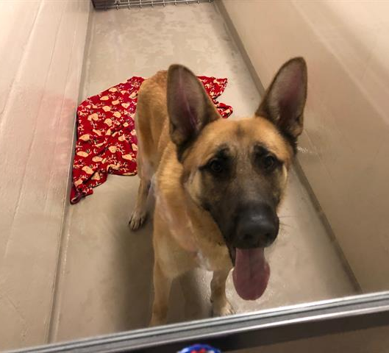
Sargento
RASKC

Slide 53
Verdict
Guilty
The defendant is found guilty of the crime as charged or a lesser included.
The defendant will be sentenced.
The conviction will show up on his criminal history.
Right to Appeal
Not Guilty
The case is closed, no conditions are imposed on the defendant.
Hung Jury
Jury could not reach a unanimous decision, case may be retried or not with a new jury pool at the discretion of the prosecutor.

Slide 54
Maximum Punishments
RCW 9A.20.021
*not likely to receive these sentences*
Simple Misdemeanor
90 days in jail, $1,000 fine
Gross Misdemeanor
364 days in jail, $5,000 fine
Class C Felony
5 years in prison, $10,000 fine
Class B Felony
10 years in prison, $20,000 fine
Class A Felony
Life imprisonment, $50,000 fine

Slide 55
Sentencing
Treatment/counseling
  “Court may…order (participation) in an available animal cruelty prevention or education program or available psychological counseling to treat mental health problems contributing to the violation’s commission.”
Restitution for costs of care
  “reasonable costs incurred pursuant to this chapter by LEO agencies, animal care and control agencies, or authorized private or public entities involved with the care of the animals. Reasonable costs include expenses of the investigation, and the animal’s care, euthanization, or adoption.”
Notes:
Tx/counseling-D pays,, look at underlying pathology
Restitution-(be able to break down and document all costs for care-food/treatment)

Slide 56
Sentencing
$1K Civil Penalty to county
  “used to prosecute (Cruelty) offenses…and to care for forfeited animals.”
Possession bans
Diversion
Consideration-need record of this crime/offense (thinking long term)
Consideration-probation-options for monitoring

Slide 57
Post-Sentencing Considerations
Post-conviction forfeiture
If repeat offender or conduct resulted in animal death->mandatory
Court may order forfeiture-upon finding treatment to have been severe and likely to reoccur
Post-conviction Possession ban
Ban on owning, caring for, or residing with
Animal of same taxonomic order > for mammals
Animal of same taxonomic class >for non-mammals
Notes:
Consideration-where does animal end up, distance from suspect, not allow family to adopt it/bring it back

Slide 58





Slide 59
Appeals
Defendants have the right to appeal a guilty finding by a jury to a higher court
Briefing Schedule
Court informs Defense and Prosecutor when briefs are due
  different than the attorneys at trial
Oral Argument
  Prosecutor and Defense Counsel appear before the court and argue the issues in the brief.

Slide 60

Appeals Decision
Court Ruling
Reverse conviction and remands case for new trial (restarts case to Pretrial Status)
Uphold Conviction
  Defendant can appeal to Supreme Court of Washington
Notes:
If the higher court takes the appeal, then the Prosecutor will go to argue the issues in the brief at the higher court, as well

Slide 61


