Slide 1



In depth look at Hoarding Disorder:
Objects Vs Animals
Ashley Kraft, BS, PSC
RSC- Housing Stability Specialist , SHAG’s CLF
Where your Friends Live.
Notes:
Been around for about 6 years. Raise awareness around hoarding to ethical and effective treatment around hoarding treatment
LeadingAge Washington is a state trade association serving not-for-profit and mission-driven organizations dedicated to providing quality housing and skilled long term services. LeadingAge Washington represents and promotes the common interests of its members through leadership, advocacy, education, and member services to enhance their ability to provide quality care and service to their residents and clients.

Slide 2
Todays Objectives
Introduction to Hoarding Disorder as Mental Health Diagnosis
What are the public health risks
Introduction to Animal Hoarding
Approaches to Home Visits
Tools to work with
Law, Treatment and Prevention
Questions

Slide 3

What’s the difference between clutter, collecting, and hoarding?

Slide 4
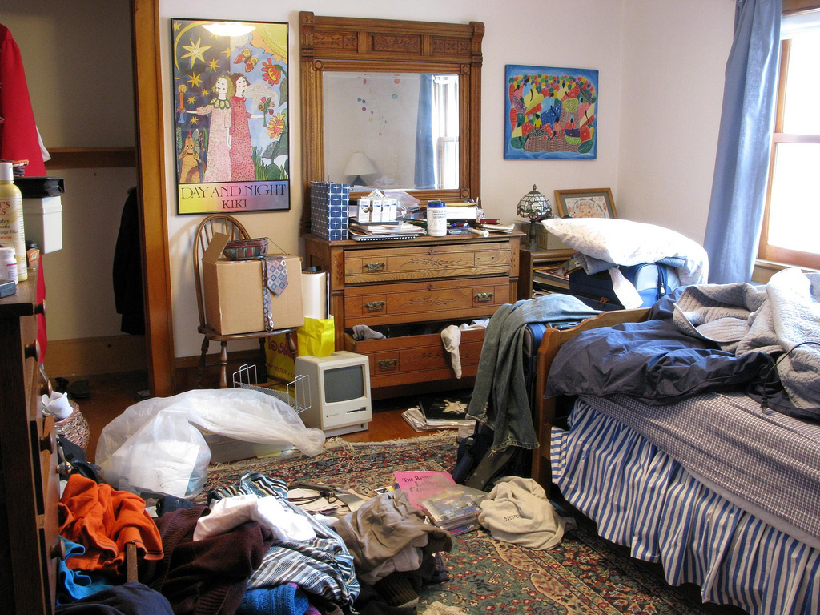
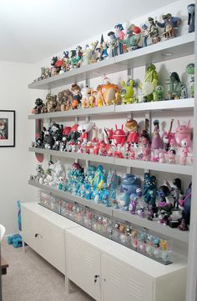
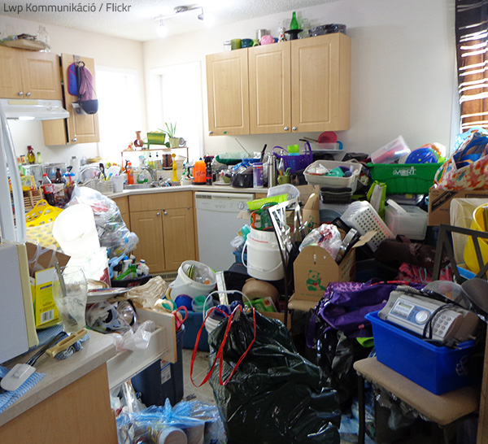
Collecting
Hoarding
Clutter

Slide 5

Hoarding Disorder and Mental Health

Slide 6
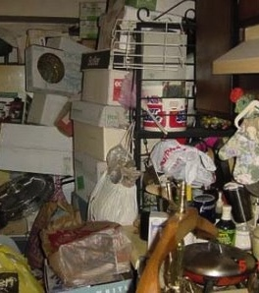
What is hoarding disorder?
With the DSM5 hoarding disorder commonly has a four part definition:
Excessive acquisition of stuff
Difficulty discarding or parting with possessions regardless of their actual value
Living spaces that can’t be used for intended purposes due to clutter
Causing significant distress or impairment(Frost & Hartl, 1996 )
Notes:
What is the DSM-5= Diagnostic and statistical manual tool for medial professional

Slide 7

One in Twenty Americans hoard
This equals to about 15 million people. (Iervolino et al., 2009; Samuels et al., 2008)
WACA Academy March 13, 2020 Presented by Ashley Kraft , PSC
Notes:
SHAG has 30 communities with 5,500+ residents and if you look at the 1/20 that would be roughly 250 residents in our buildings alone.

Slide 8

Beliefs about possessions
Sentimental
Utility/Opportunity/Uniqueness
Comfort/Safety
Identity/Self-worth
Socializing
Control
Mistakes
Responsibility/Waste
Notes:
(4 Carat Ring)

Slide 9
Emotional Response
Thoughts can lead to emotional responses
Thought: “I Could lose information forever”
Emotion - anxiety, fear, sadness, guilt
Thought: “I should save this for the right person/time”
Emotion - excitement, joy, satisfaction
Thought: “I’ll just deal with this later when I have time and energy”
Emotion - relief, and avoidance

Slide 10
Mental Health Issues Related to Hoarding?
92% of the time, hoarding disorder must be considered a co-occurring disorder and is associated with one or more of the following mental health diagnosis:
    Social phobia
    Major depressive disorder
    Generalized anxiety disorder
    Obsessive Compulsive Disorder
    Organic Brain Illness
    Personality Disorders
    Attention Deficit Hyperactivity Disorder
    Dementia
    Eating Disorders
    Substance abuse

Slide 11
What is Executive Functioning?
Cognitive abilities that control and regulate other abilities and behaviors. Executive functions are necessary for goal-directed behavior.
Include processes such as:
  Decision Making
  Planning
  Purposeful action
  Impulse Control
Eﬀective organization requires an individual be able to attend to the task, make decisions, problem-solve and be able to change plans or strategies when they are ineﬀective. (Lezak, Howieson, Loring, 2004
Attention
Organization
Categorization
Prioritizing
Notes:
Executive Function could affect …..

Slide 12

Public Safety

Slide 13
Risks Associated with Hoarding
Safety
Health
Fire hazard
Blocked exits
Risk of falls/items falling (avalanche)
Lack of routine home maintenance
Structural damage to building from increased weight and volume of clutter
Risk of eviction and homelessness
Impaired functioning (Executive Function)
  Poor hygiene and grooming, nutrition
  Inattention to medical needs
  Inadequate financial management
  Difficulty cleaning around clutter
  Sleeping on floor instead of bed
Increased Health Problems
  Molds, bacteria, dust, dirt
  Asthma, allergies, headaches
  Rodent/insect infestation
  Animal/human feces/remains
Mental Health
Notes:
So how do we address safety and health

Slide 14
Emotional/Psychological Impact on Clients during “Clean-outs”
Clean-outs can do more harm than good.
  Can be traumatizing
  Emotional Flooding
  Threats can be unhelpful
  Can ruin relationships and trust
  Cause death
    “In all three instances of going in and cleaning these places up, within weeks of relocating the individual back into a clean environment, the individual passed away…it was such a dramatic change for them because we didn’t realize the impact of the sociological change.” (Brace, 2007)
It’s not sustainable
BUT sometimes it’s necessary
Preferred Method – “Safety Days”
Notes:
Lets find another way that causes less distress

Slide 15
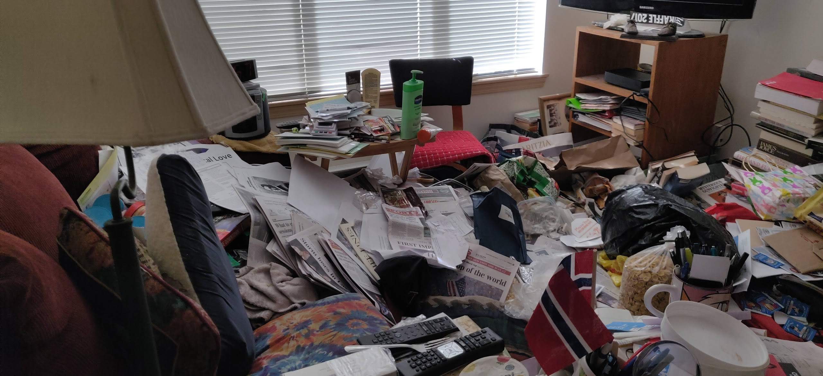
What this Looks Like
Notes:
Computer too close to water source
Pathway 3ft
Heater 8 inches
Bags and bags
Carpet/rugs

Slide 16
Changing the culture- hoarding Vs. high clutter
In order to respect the dignity of all individuals, SHAG has chosen to use the term “high clutter” instead of hoarding or hoarder when working with residents who may be experiencing high clutter.
We do not make the assumption that all individuals who experience high clutter have a hoarding disorder. We understand that there may be many other reasons why individuals experience high clutter.
As a non-clinical professional, we are not diagnosing our residents, we address all high clutter concerns with the knowledge of how HD works.

Slide 17
What is Animal Hoarding?

Slide 18
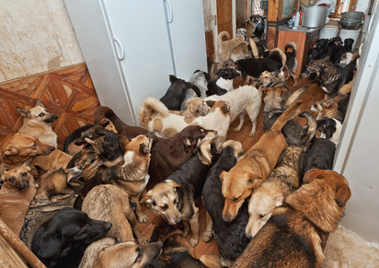
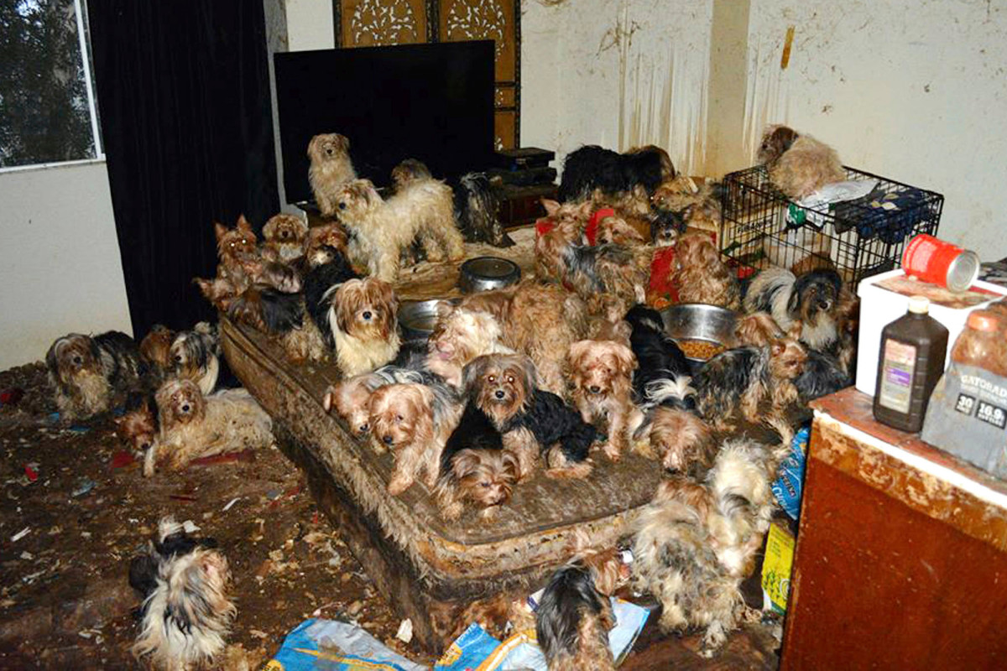
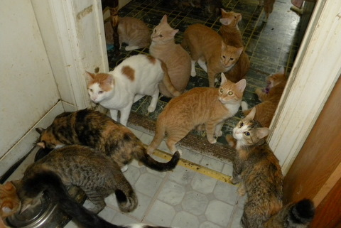
What this Looks Like

Slide 19
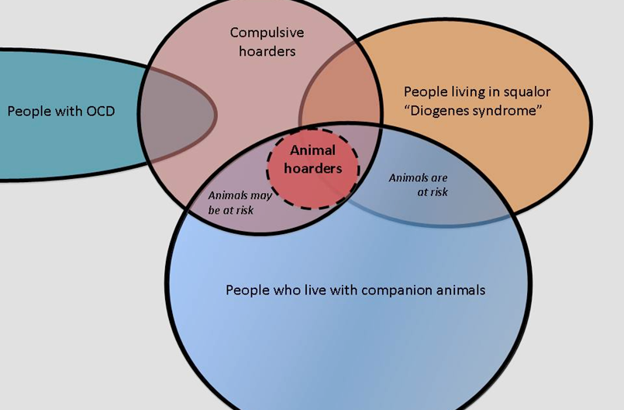
Is Animal Hoarding the same as Object Hoarding?
There are some similarities between the two, but they differ in several ways.
Research on animal hoarding is about 20 years behind object hoarding

Slide 20
Similarities
Differences
Acquisition, difficulty discarding, clutter, distress
Many people who hard animals also hoard objects
Co-morbidities
Animal hoarding: squalor (100% of homes)
Gender and age differences
Types of objects:
  Objects: variety
  Animal: one species
Lack of treatment for A.H
MAJOR mental health concerns (MH professional must be involved

Slide 21
Animal Hoarding Defined
Pathological human behavior that involves a compulsive need to obtain and control animals, coupled with a failure to recognize their suffering
Animal hoarding was formally defined in the public health literature in [1999] using the following criteria:
  Failure to provide minimal standards of sanitation, space, nutrition, and veterinary care for the animals
  Inability to recognize the effects of this failure on the welfare of the animals, human members of the household, and the environment
  Obsessive attempts to accumulate or maintain a collection of animals in the face of progressively deteriorating conditions
  Denial or minimization of problems and living conditions for people and animals

Slide 22
Health Effects to Animals and Humans
Health effects on animals
Malnourishment
Overcrowding
Owner neglect
Lasting consequences
Health effects on humans
Sanitation concerns
Zoonotic diseases
Self-neglect and child/elder abuse

Slide 23
Mental Health and Animal Hoarding
Delusional disorder
  Focal Delusional Disorder Model
    Involves a belief system is out of touch with reality.
    Claims that the animals are well cared for in the face of compelling evidence to the contrary
    May accompany paranoia about officials who are actually trying to help both the hoarder and the animals.
Attachment Disorder
    Preferer animal relationships to human beings
    Feeling safer and less threatening
Obsessive -compulsive disorder

Slide 24
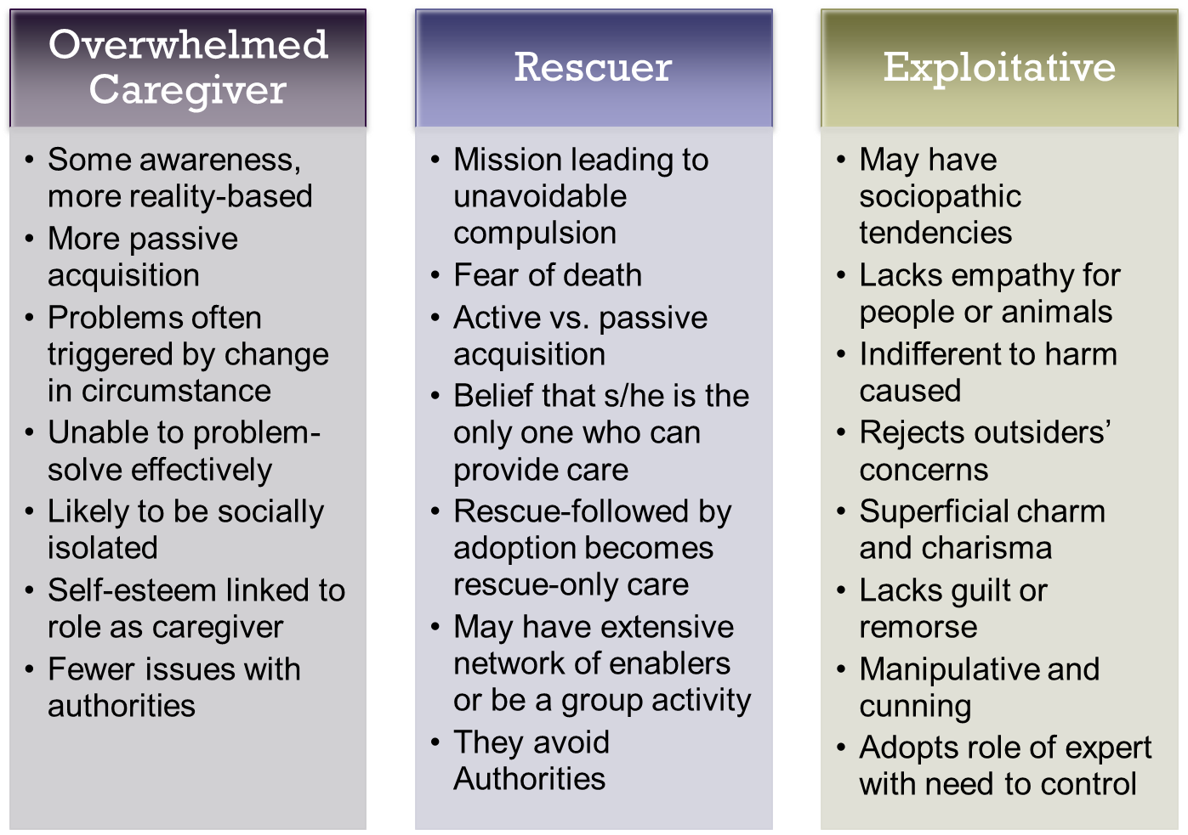
Types of Animal Hoarding

Slide 25

Approaches to Home Visits

Slide 26
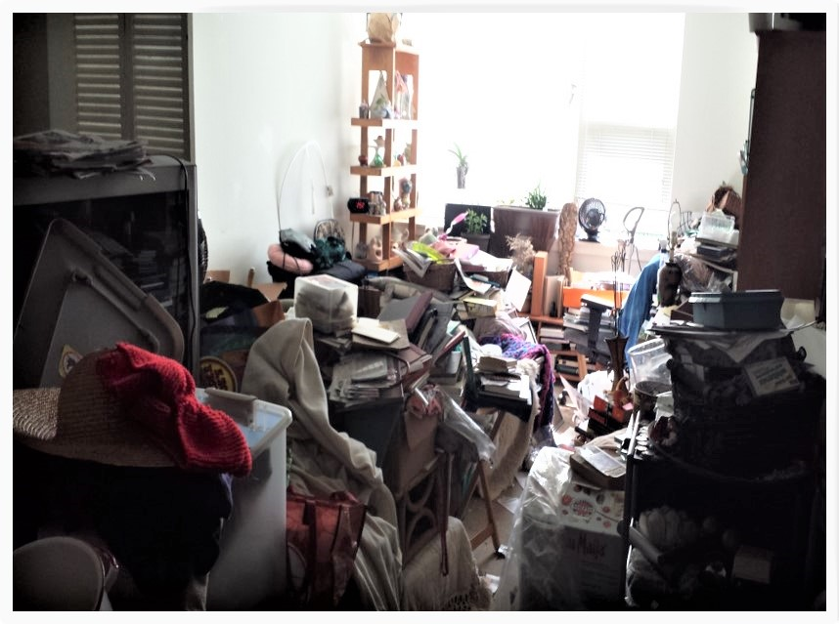
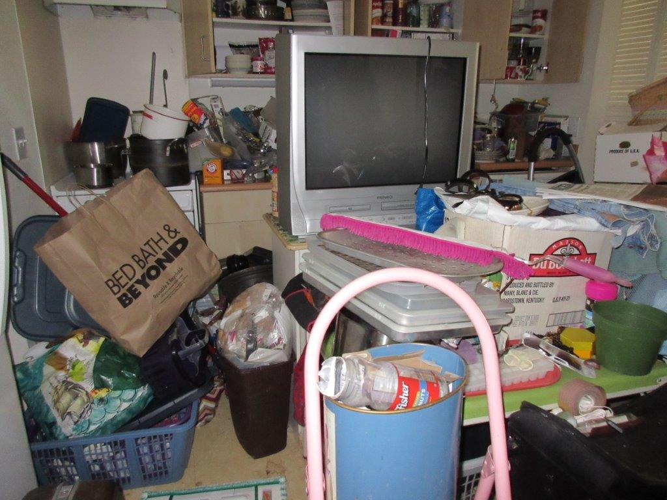
What that could look like

Slide 27
Manage Initial Reactions to Home
Use respectful language
  Avoid judgments
    “What a mess!”
  Be aware of non-verbal communication
Match person’s language
  Avoid using “trash”, “junk”, “hoarding”
  Use client words: “your things”, “your collections”, “my babies”…

Slide 28
Home Visit Initial Evaluation
Begins upon immediate entry into home
  Scan each room, attend to sensory cues (e.g. visual, odor, sounds)
May not be able to enter all areas of home, but when possible:
  Examine standard rooms of home (e.g. living room, bedrooms, kitchen, bathrooms)
  Examine additional spaces (e.g. basement, attic, garage, storage, yard, car)
    Owner may also have other storage spaces outside of home
Develop a comprehensive picture of living environment, potential safety risks, and overall scope of problem in order to determine types and extent of intervention
Done by as few people as possible (ideally, one professional, the client, and a support person
  Some others may insist on being there
    Speak ahead of time to discuss details (who will talk/observe; conditions of visit; goals for visit)

Slide 29
Building Trust During a Home Visit
Focus on immediate and urgent safety concerns
  Avoid discussing the “fate” of the residents possessions during initial visits
    Will be addressed later and may require input from other professionals
  Clarify safety and legal requirements
Dealing with Resistance and Set Backs
  How would you want others to help you manage your anger, frustration, resentment, and embarrassment?
  Remember that hoarding is a mental health problem
  Consider the behavior to be the person’s best attempt to protect him or herself against uncomfortable/painful feelings

Slide 30
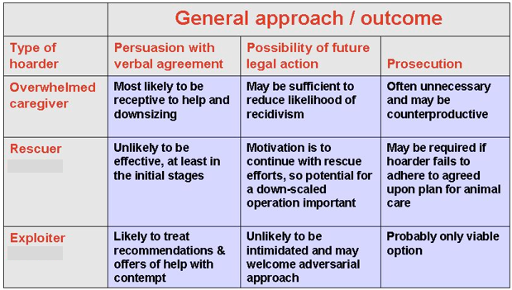
Interventions and Type of Animal Hoarding

Slide 31

Tools to Work With

Slide 32
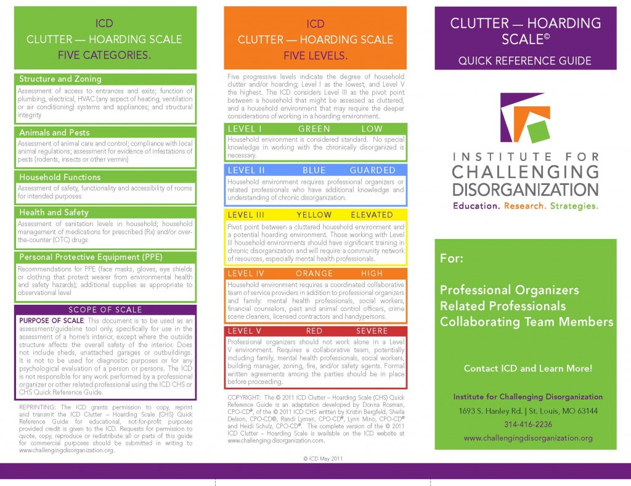
ICD Clutter-Hoarding Scale (CHS)
Assessment of home’s interior, except where outside structure affects overall safety of interior
Guideline tool by professional organizers
and related professionals
5 categories:
Structure and Zoning
Animals and Pests
Household Functions
Health & Safety
Personal Protective Equipment (PPE)
Available for free download: www.challengingdisorganization.org

Slide 33
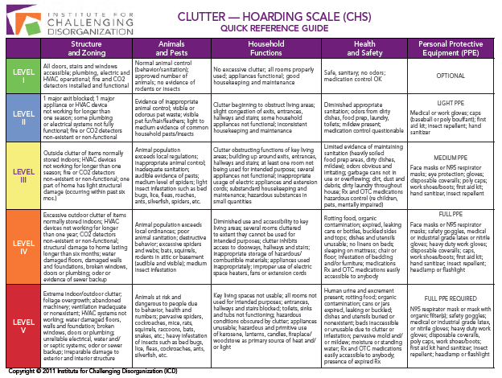
“Levels” of Hoarding (ICD Clutter—Hoarding Scale)

Slide 34
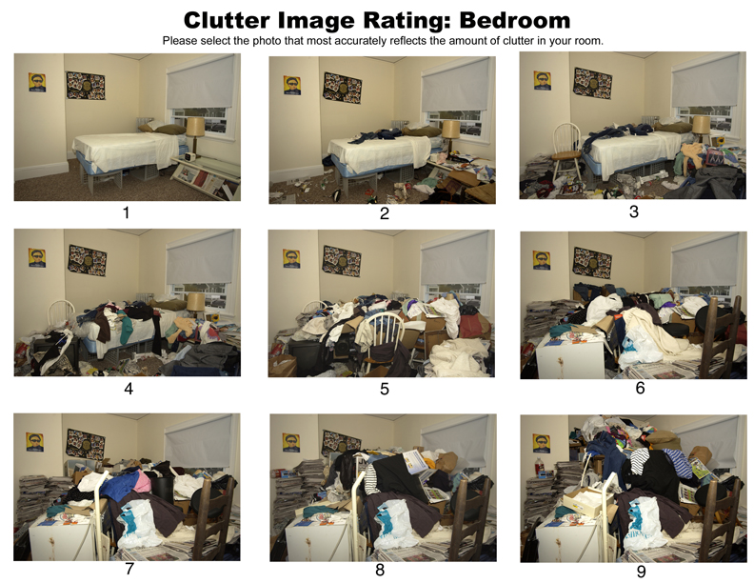
Clutter Image Rating (CIR; Frost, Steketee, Tolin, & Renaud, 2008)
Developed to overcome problems with over- and under-reporting
9 pictures for 3 main rooms
  Kitchen
  Living room
  Bedroom
1= no clutter to
9= severe clutter
Review room and select picture that
looks most like room in the home
Score of 4 or more: clinically significant
clutter problem

Slide 35
Uniform Inspection Checklist
www.masshousing.com
As a tool the UIC covers the minimum safety and sanitation standards required by multiple inspection sources such as:
  Housing authorities
  Property management companies
  Code enforcement
  Public health
  Fire
The UIC ensures all involved parties, including the resident, have clear and consistent expectations and guidelines for rectifying and maintaining a safe and sanitary home environment.

Slide 36
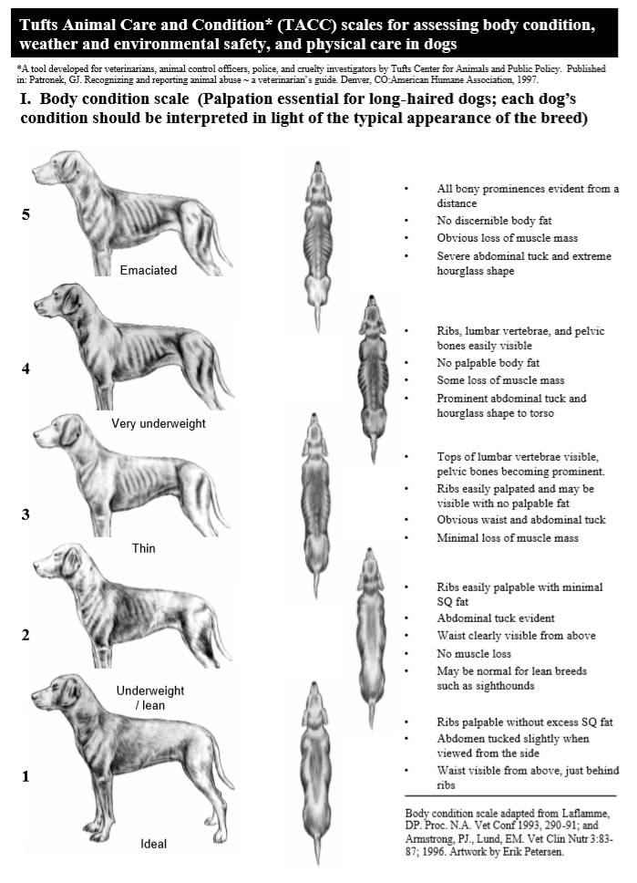
Tufts Animal Conditions and Care
The Tufts Animal Condition and Care (TACC) score is assessed from the number of points read off either the Body Condition, Weather Safety, Environmental Health, or Physical Care Scale. When multiple scales are evaluated, the highest score on any scale should be used to determine the risk of neglect.

Slide 37
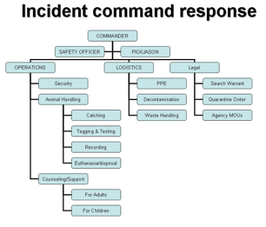
Large Scale Animal Rescue
Safety Day: Coordinated and Systematic Response to Mandatory Clean-outs
Harm reduction approach to mandatory clean outs
Best address the host of legal, logistical, health, safety, communication, and humane concerns present during these circumstances
Critical Incident Stress Management
  Preparatory Phase
  Critical Phase
  Recovery Phase

Slide 38

The Law, Treatment and Prevention

Slide 39
The Law
The Law
Allows for up to ten pets to be housed without a license. If over ten pets are owned, the house is regarded as a shelter and is subject to regular inspection without a search warrant.
In order to bring one charge of cruelty for each animal, prosecutors and animal agencies must provide proof of cruelty to each animal, matching each animal with its count number
Charging the AH with only one count reduces the burdens on the system, the prosecutors, and the animal agencies, but undermines the severity of the charges
The Problem
  pet limitation ordinances are inconsistent
  complex, time consuming, and costly
  the high cost of caring for animals rescued from hoarders (rescuer expense)
  Prosecutors don't really have the tools they need to fully go after these cases
  Don't have the support of other agencies

Slide 40
Treatment and Resources
Treatment
  Recidivism, the repetition of an offence, in animal hoarding is thought to be nearly 100% without intervention.
  Public awareness about animal hoarding and animal hoarding education can help authorities intervene before a case becomes extreme.
Resources
  The Hoarding of Animals Research Consortium is a good resource for in-depth learning about this phenomenon. Their information can be found on the Tufts University website
  The Hoarding of Animals Research Consortium tuft univ
  Inside Animal hoarding: The story of Barbara Erickson and her 552 dogs
  Animal Hoarding: Structuring interdisciplinary responses to help people, animals and communities at risk
  Animal Legal Defense Fund

Slide 41
Collaborative Work with Related Professionals
Why work collaboratively?
  Ethical – right thing to do
  Effective – bio-psychosocial problems
  Conserves resources: integrated care is less expensive
Identify stakeholders impacted by hoarding disorder
Housing
Public health & safety
Mental health
Protective services
Aging services
Legal
Fire and police
Medical Professionals
Animal control
Organizers
Cleaning companies

Slide 42


Questions?
WWW.SHAG.org
The SHAG Community Life Foundation centers its work on sustaining resident independence, housing stability and purpose in a focused and effective way. Its responsibility for our residents’ lives and in connecting them with local resources complements this commitment.
Ashley Kraft,
RSC-Housing Stability Specialist
206-549-2518
ashleyk@shag.org
Northwest Hoarding Coalition
Meet Third Wednesday of the month

Slide 43

Thank You for what you do!

