Slide 1

Washington Department of Fish and Wildlife
Sgt. Kim Chandler

Slide 2
Animal Control
Vs
Wildlife Control

Slide 3
Animal Control
Vs
Wildlife Control
City/County

Slide 4
Animal Control
Vs
Wildlife Control
City/County
State

Slide 5

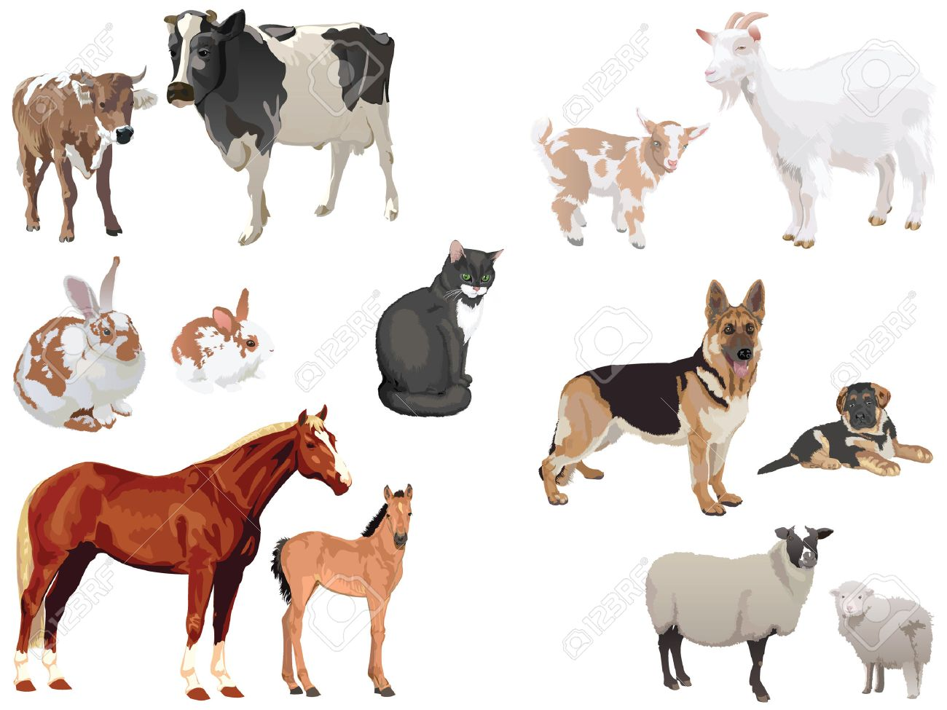
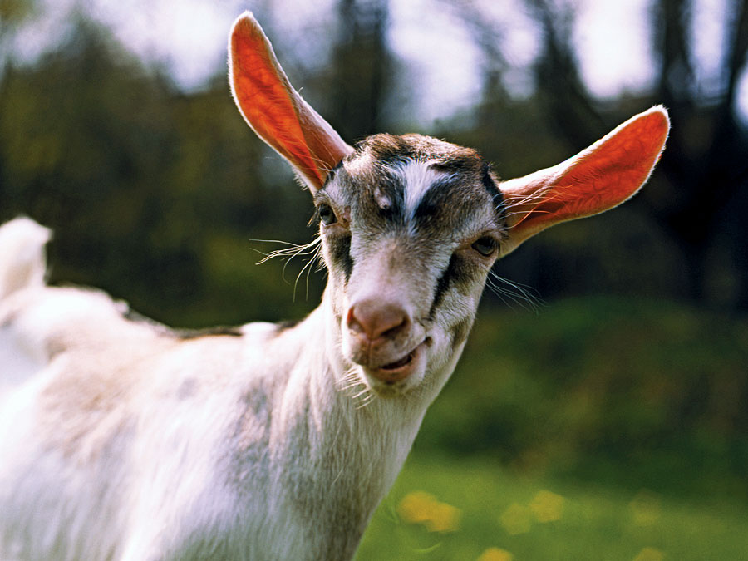
Domestics

Slide 6


Slide 7



Slide 8
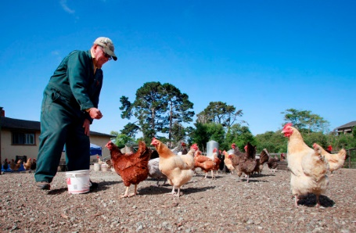
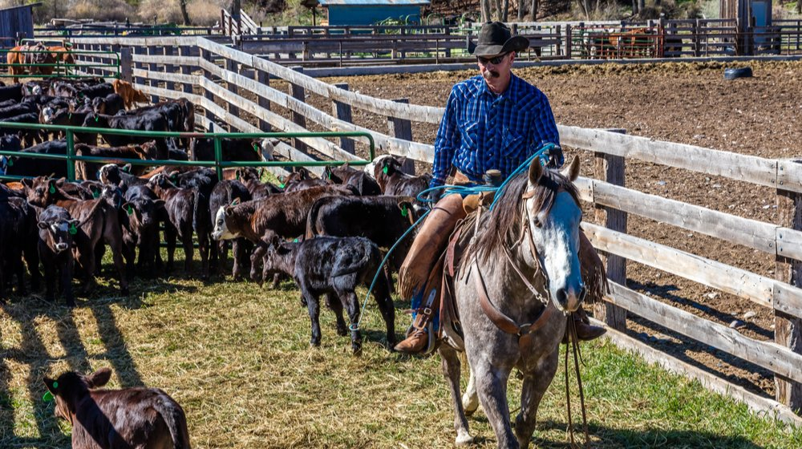
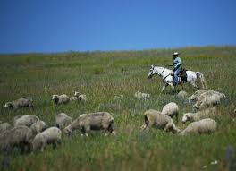
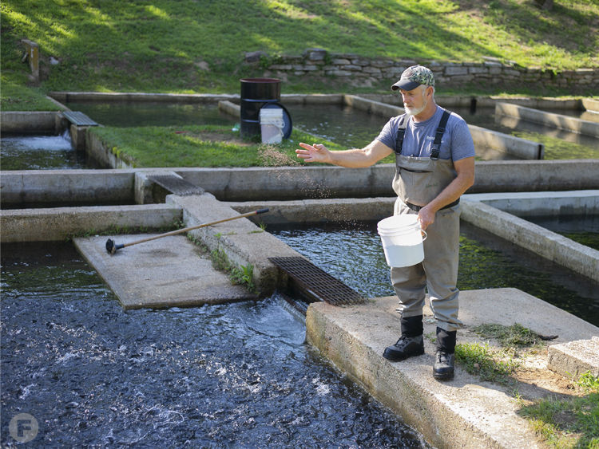

Slide 9
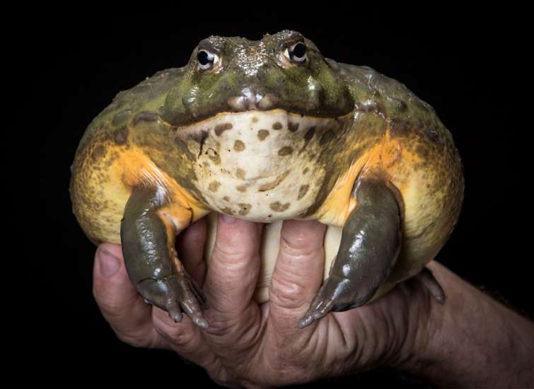
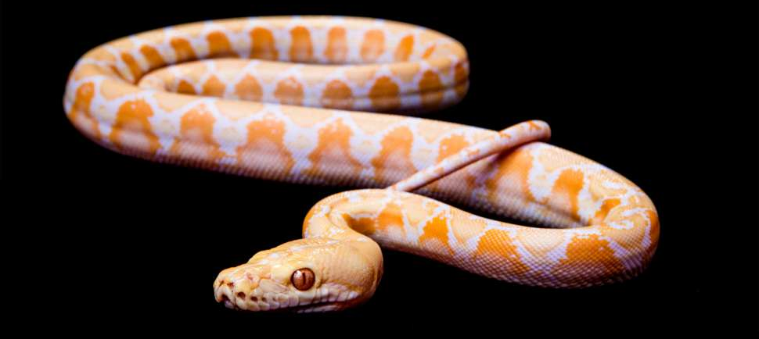

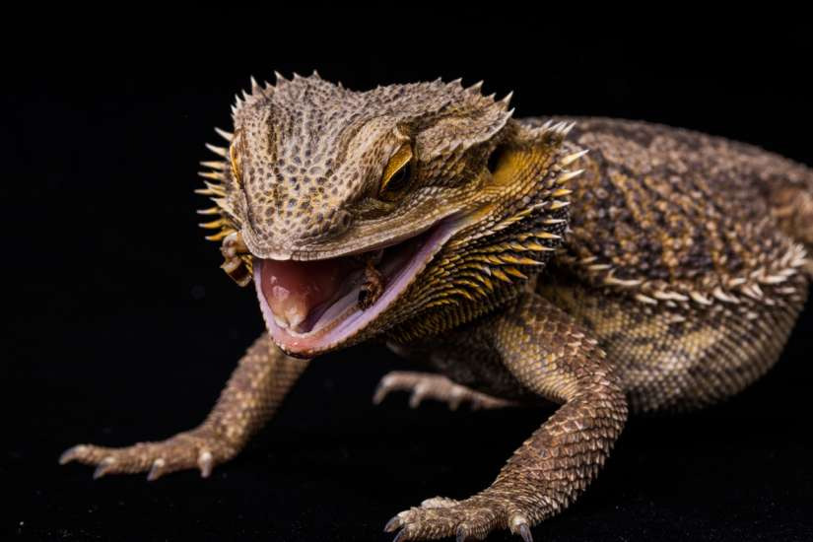

Exotics

Slide 10
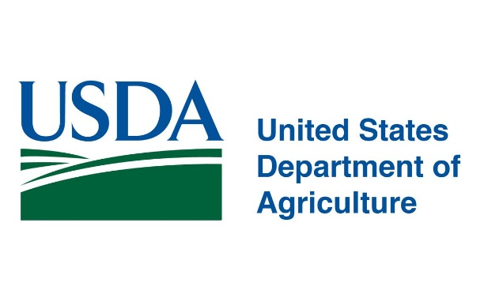
Exotics

Slide 11
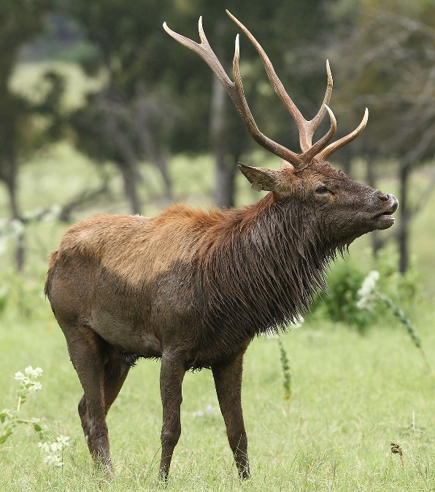
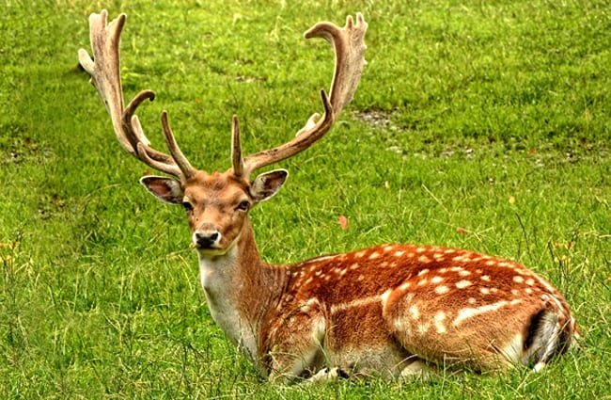

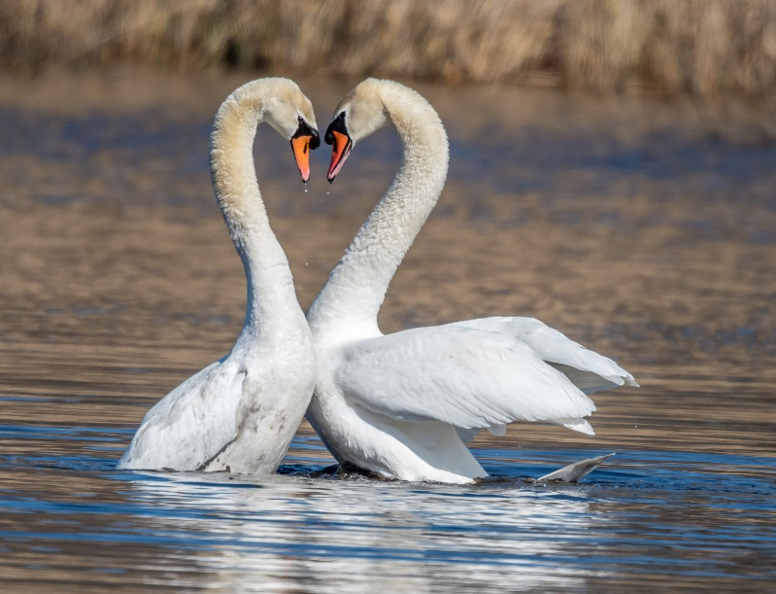
Deleterious Species
WAC 220.640.200

Slide 12
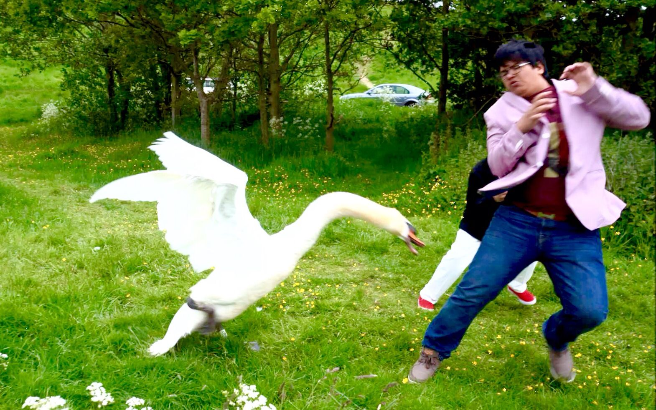
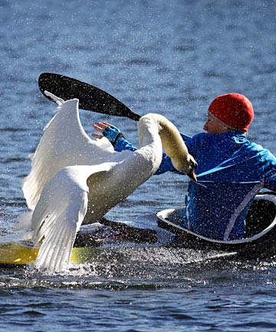

Slide 13
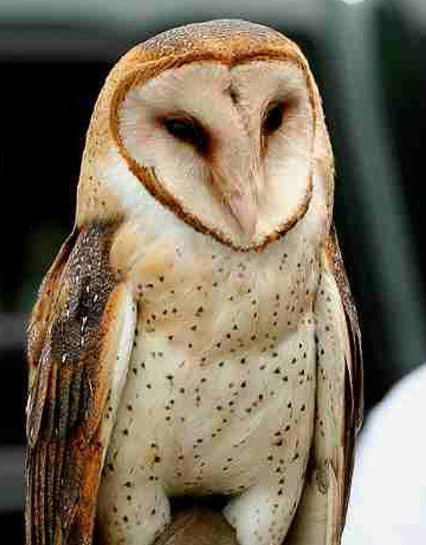
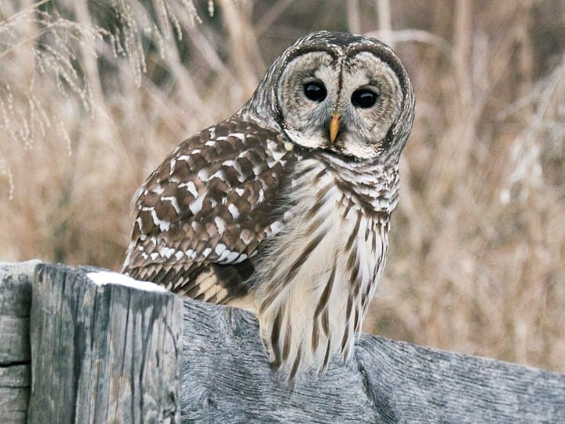
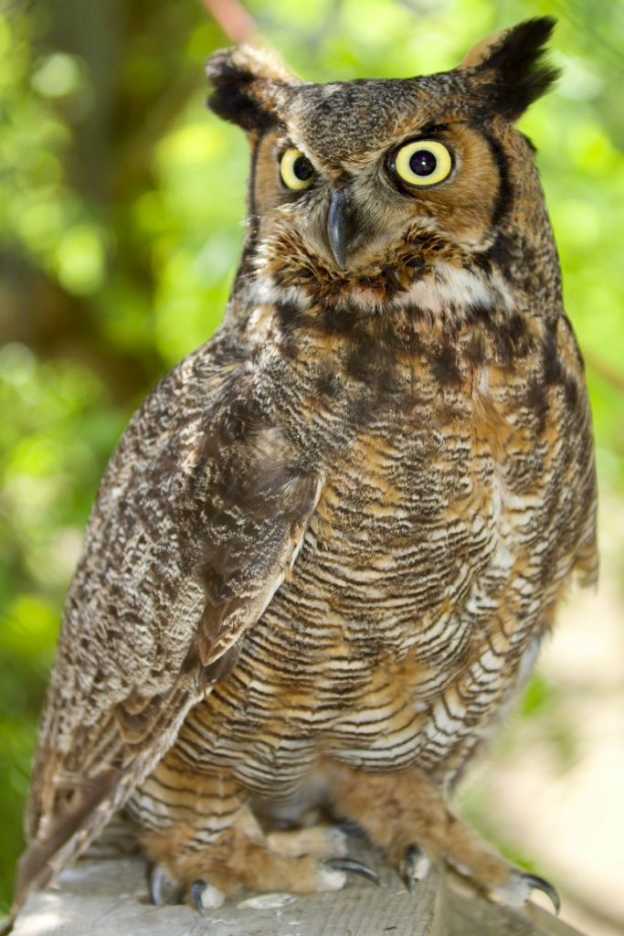
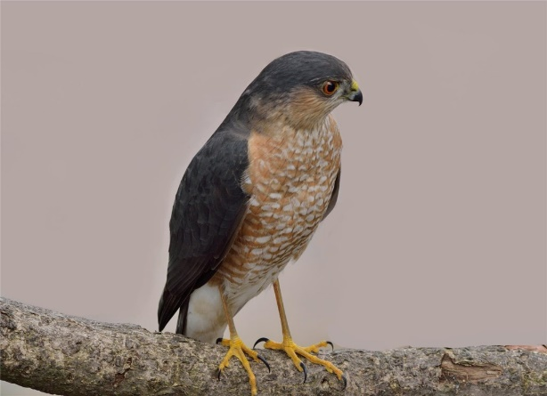
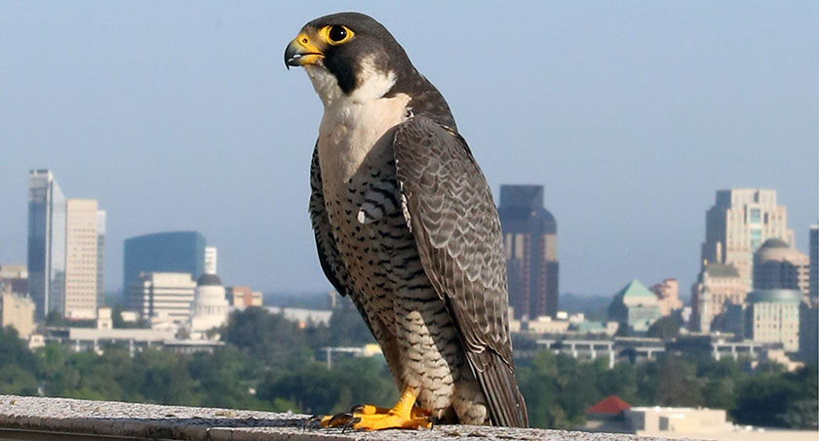
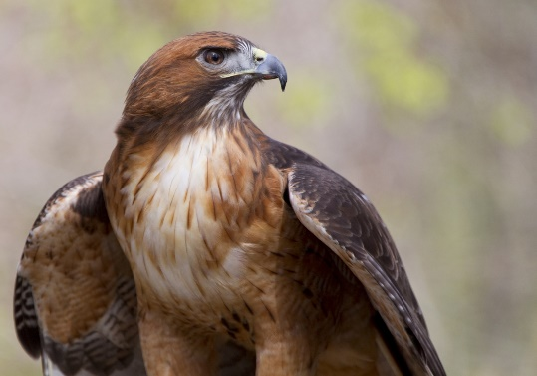
Raptors

Slide 14
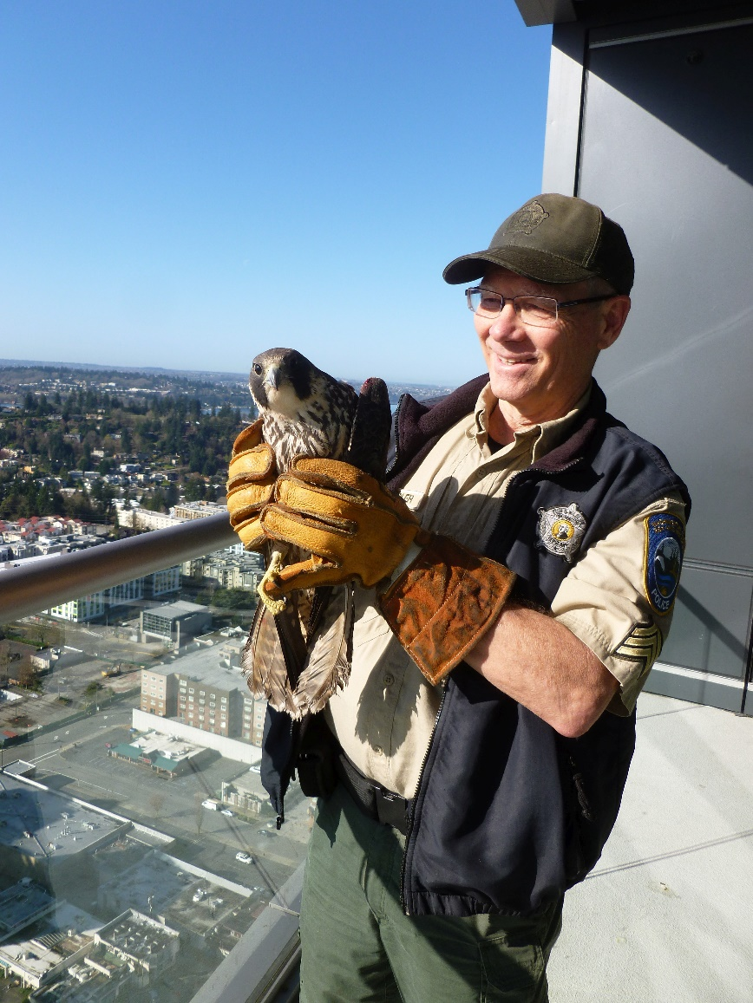
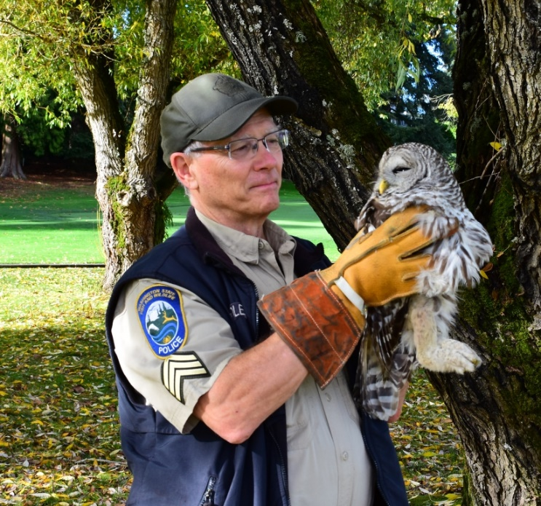
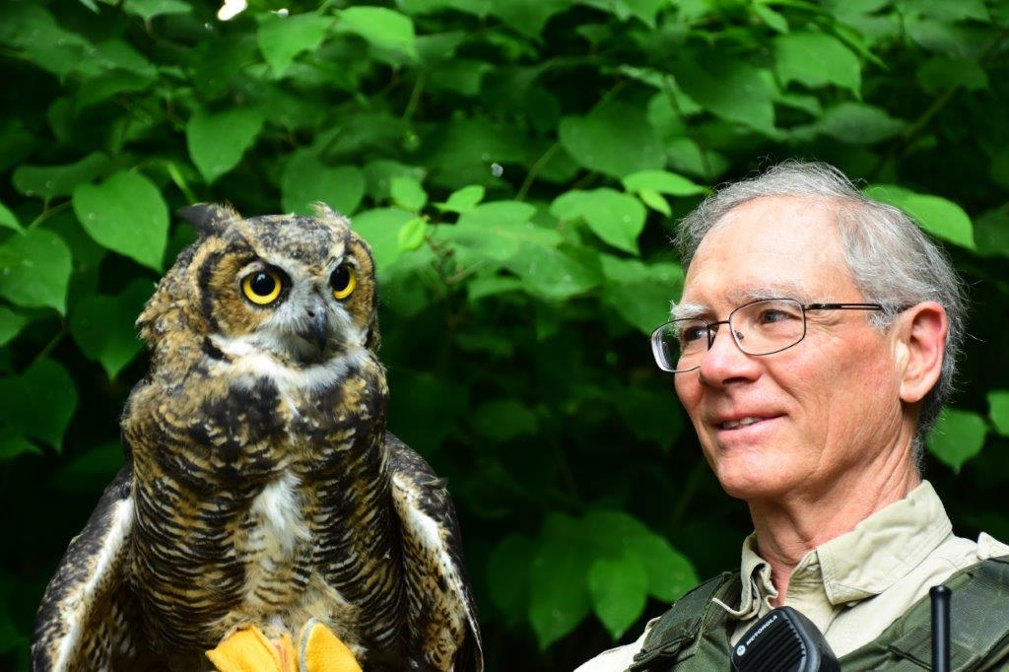

Slide 15
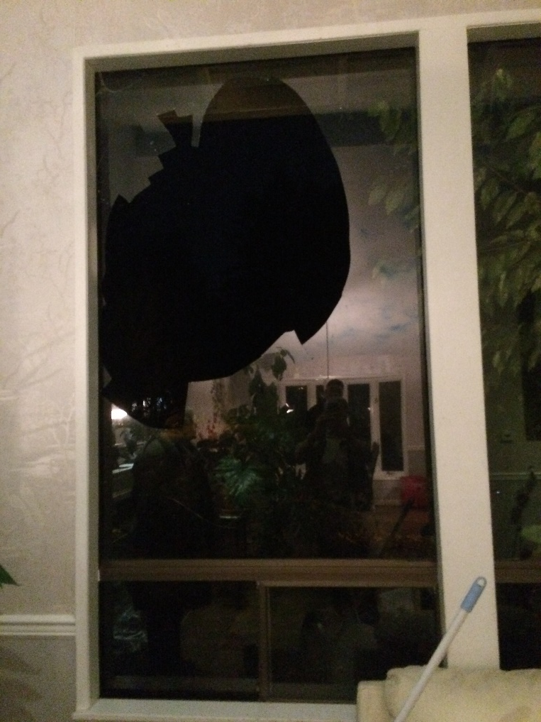

Slide 16
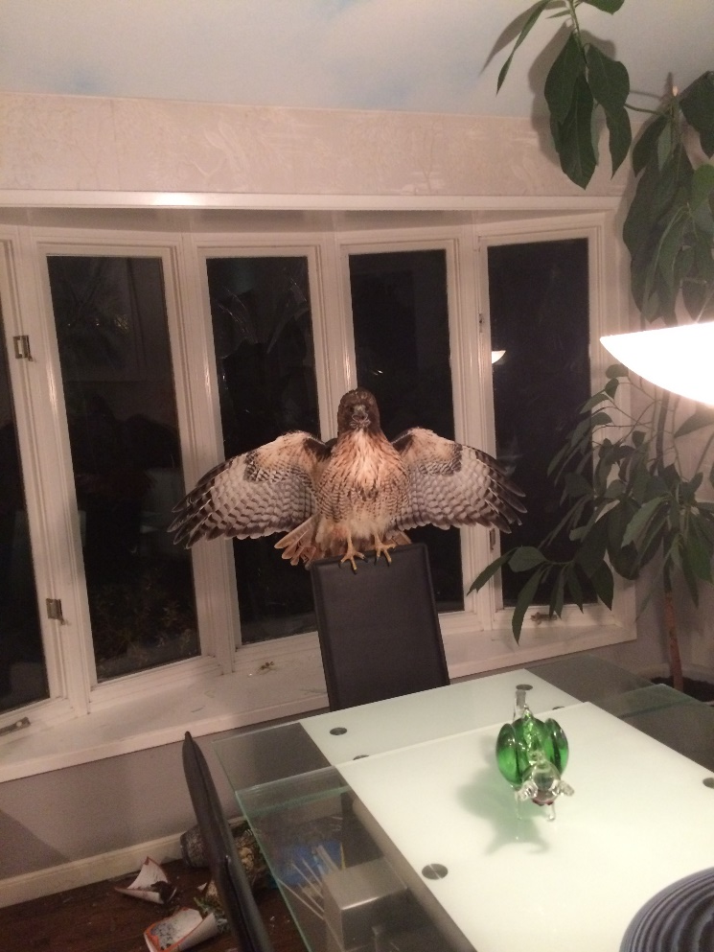

Slide 17
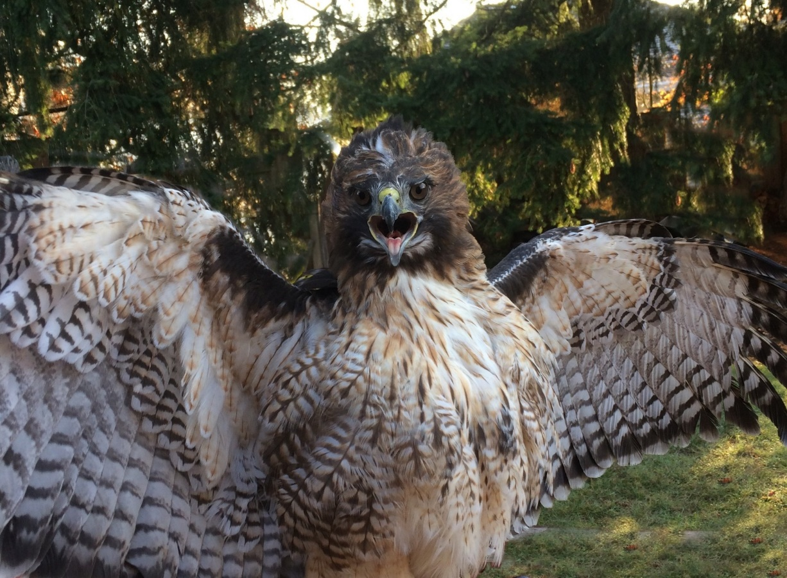

Slide 18
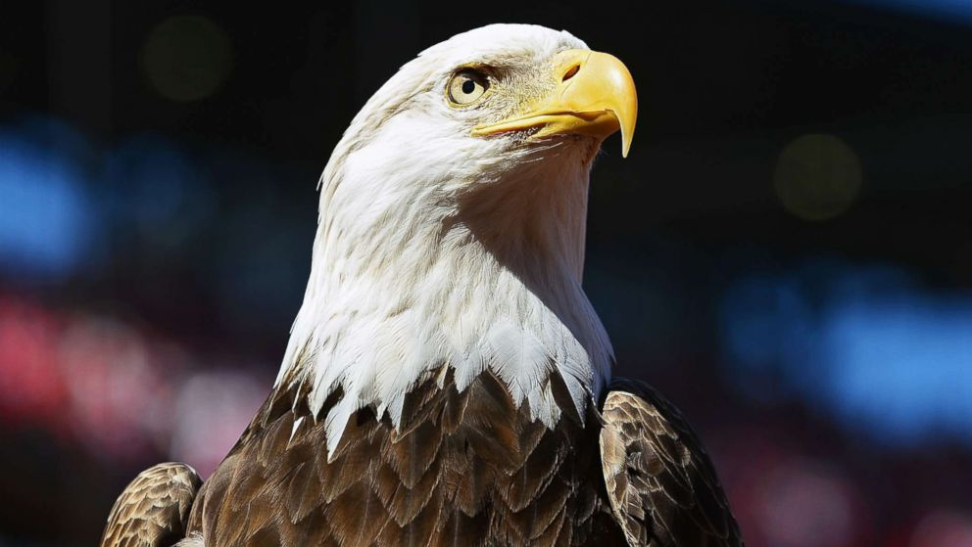
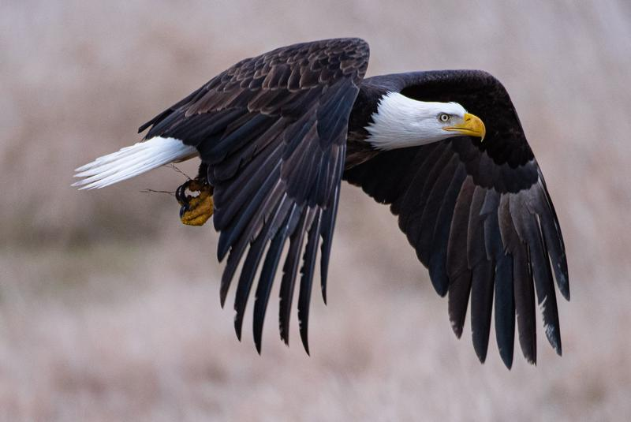

Slide 19
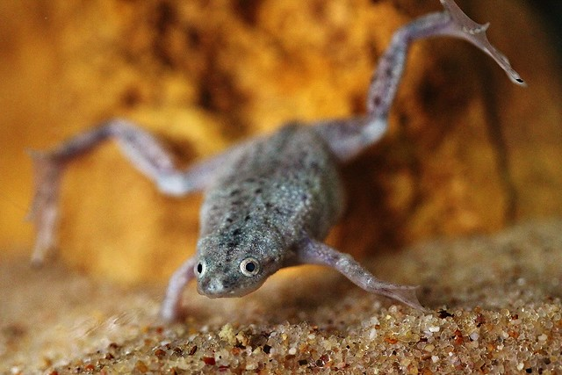
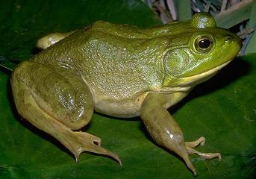
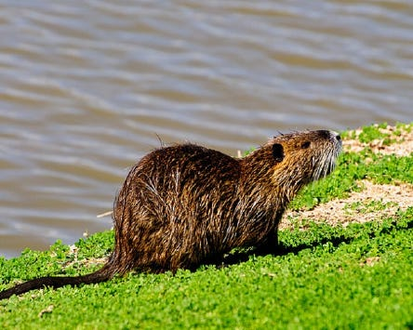
Invasive Species

Slide 20
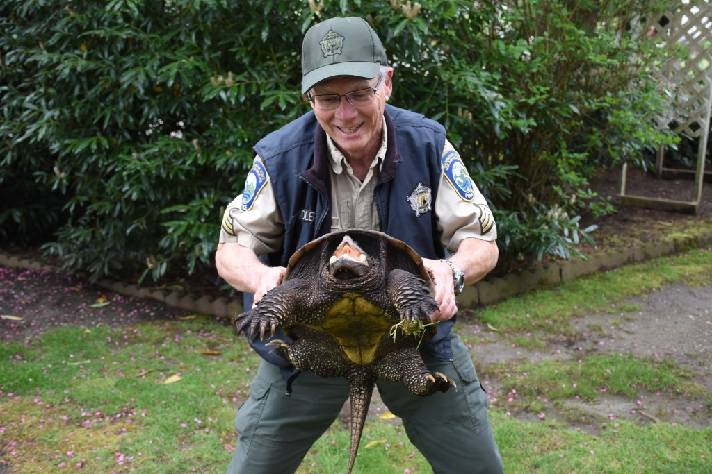

Slide 21
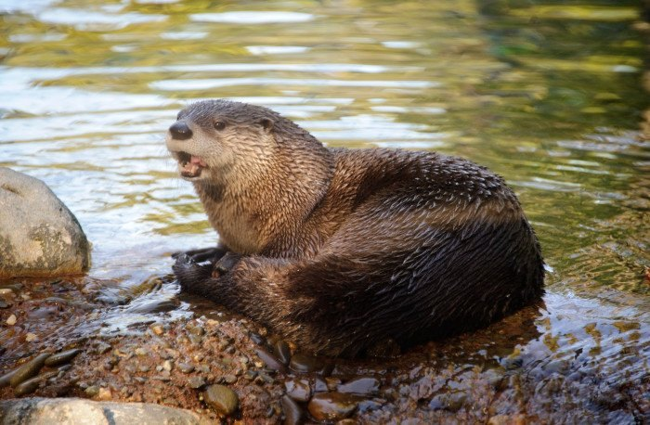
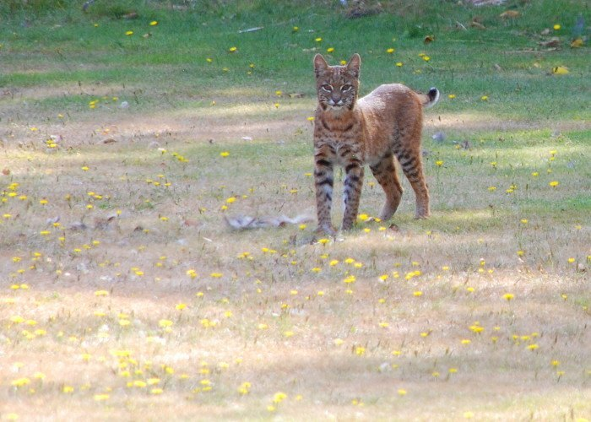
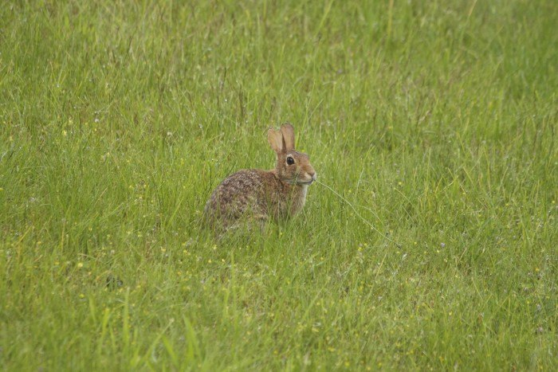
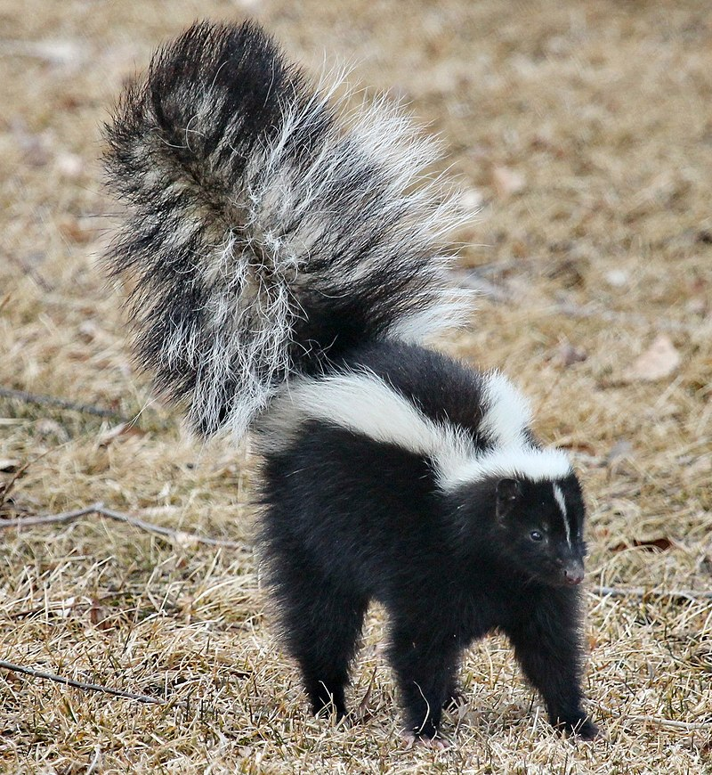
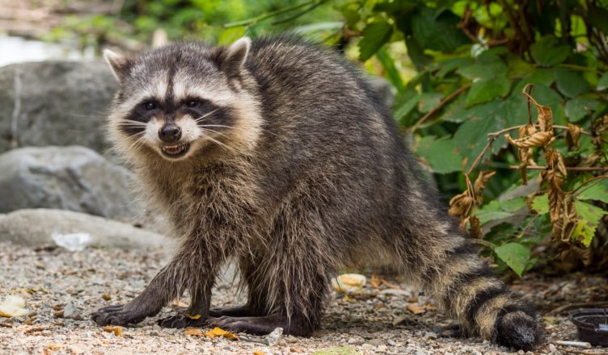
Wildlife

Slide 22
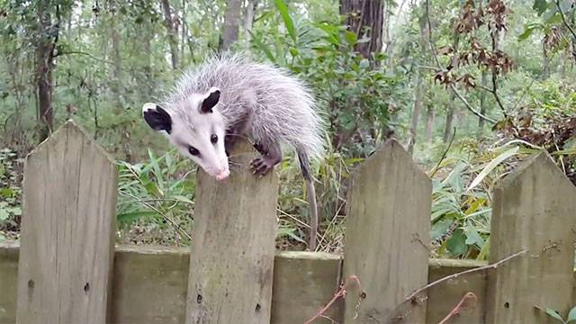
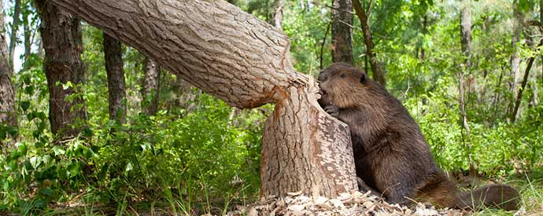
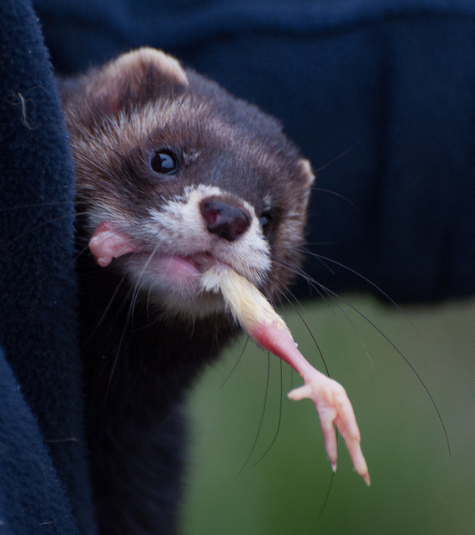
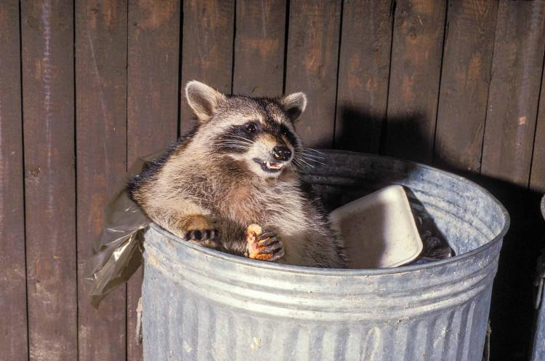
Problem Wildlife

Slide 23
Injured Wildlife

Slide 24
Injured Wildlife
Is it really injured?

Slide 25
Injured Wildlife
Is it really injured?
Is it contained?

Slide 26
Injured Wildlife
Is it really injured?
Is it contained?
Can it be fixed?

Slide 27
Injured Wildlife
Is it really injured?
Is it contained?
Can it be fixed?
Should you dispatch it?

Slide 28
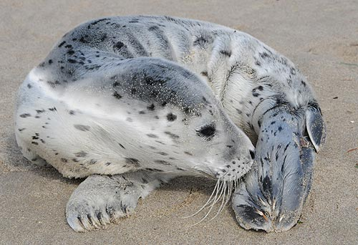

Slide 29


Slide 30
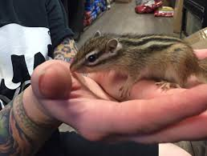
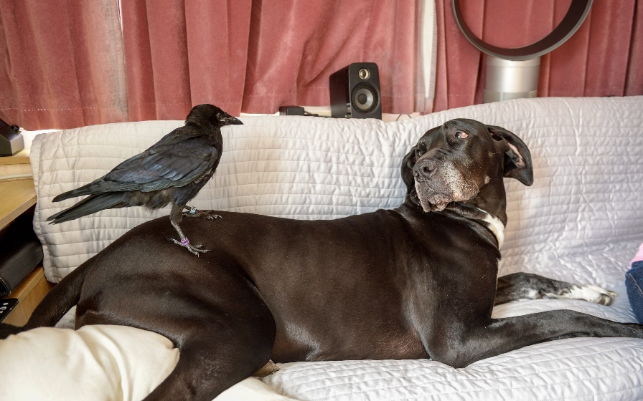
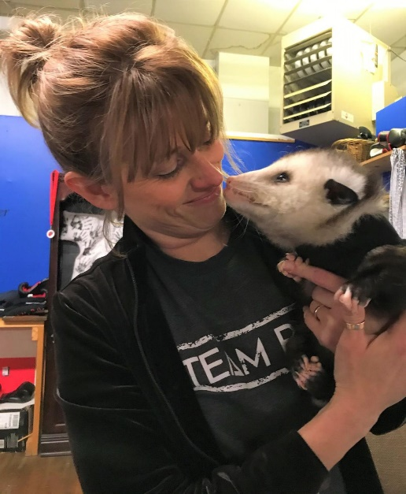
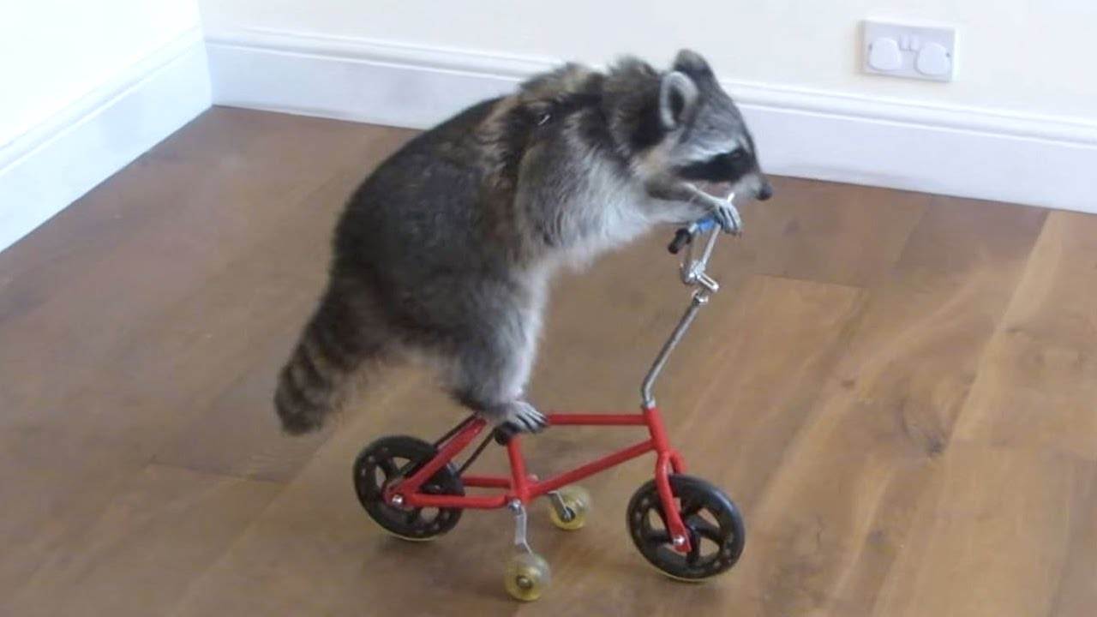
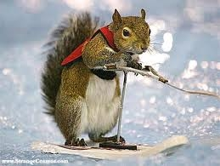

Holding Wildlife In Captivity

Slide 31
Holding Wildlife In Captivity
WAC 220-450-030

Slide 32
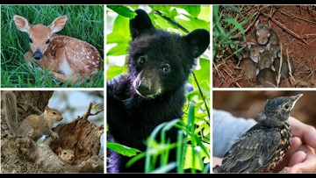
WILDLIFE
RCW 77.08.010
(72) “Wildlife” means all species of the animal kingdom whose members exist in Washington in a wild state. This includes but is not limited to mammals, birds, reptiles, amphibians, fish, and invertebrates. The term “wildlife” does not include feral domestic mammals, old world rats and mice of the family Muridae of the order Rodentia, or those fish, shellfish, and marine invertebrates classified as food fish or shellfish by the director. The term “wildlife” includes all stages of development and the bodily parts of wildlife members.

Slide 33
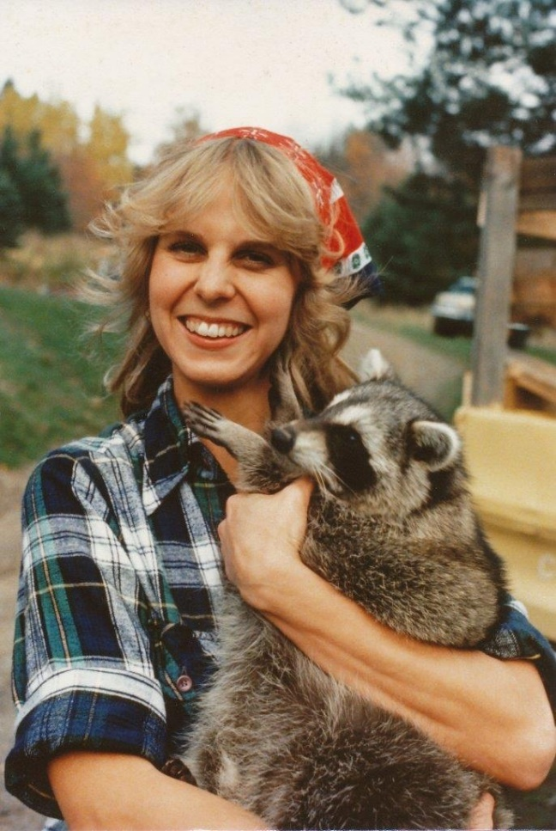


Slide 34
Unlawful use of body gripping traps
WAC 220-417-040

Slide 35




Unlawful use of body gripping traps
WAC 220-417-040

Slide 36




Live Trapping

Slide 37
Wildlife Control Operator
Licensed by WDFW
Allowed to use body gripping traps by permit
Special rules to follow
Only for certain species

Slide 38



MOLES

Slide 39
MOLES

Slide 40
Dangerous Wildlife

Slide 41


Slide 42

Dangerous Wildlife
One fatality in the past 100 years
Are responsible for livestock depredation

Slide 43

Dangerous Wildlife
One fatality in the past 100 years
Are responsible for livestock depredation
Unsecured garbage & food sources

Slide 44

Dangerous Wildlife

Slide 45
Dangerous Wildlife
Keep your dogs on a leash!!!

Slide 46


Slide 47


Slide 48



Slide 49


Slide 50



Slide 51


Slide 52



Slide 53


Slide 54


Slide 55

Dangerous Wildlife
2 fatalities in the last 100 years
Main source of food is deer and elk
Are responsible for livestock depredation

Slide 56


Dangerous Wildlife
No fatalities in Washington State
Main source of food is deer and elk
Livestock depredation is a concern

Slide 57

Dangerous Wildlife
No direct fatalities in Washington
Danger during mating and calving seasons

Slide 58

Dangerous Wildlife
No direct fatalities in Washington
Danger during mating and calving seasons

Slide 59


Dangerous Wildlife

Slide 60

Dangerous Wildlife
Two fatalities in North America
None in the lower 48 states

Slide 61

Dangerous Wildlife
Two fatalities in North America
None in the lower 48 states
Livestock depredation by packs

Slide 62
World’s deadliest animals

Slide 63
World’s deadliest animals
Mosquitoes

Slide 64
World’s deadliest animals
Mosquitoes
Snakes

Slide 65
World’s deadliest animals
Mosquitoes
Snakes
Dogs

Slide 66




MEDIA RELATIONS

Slide 67


Slide 68
THE END

