Slide 1
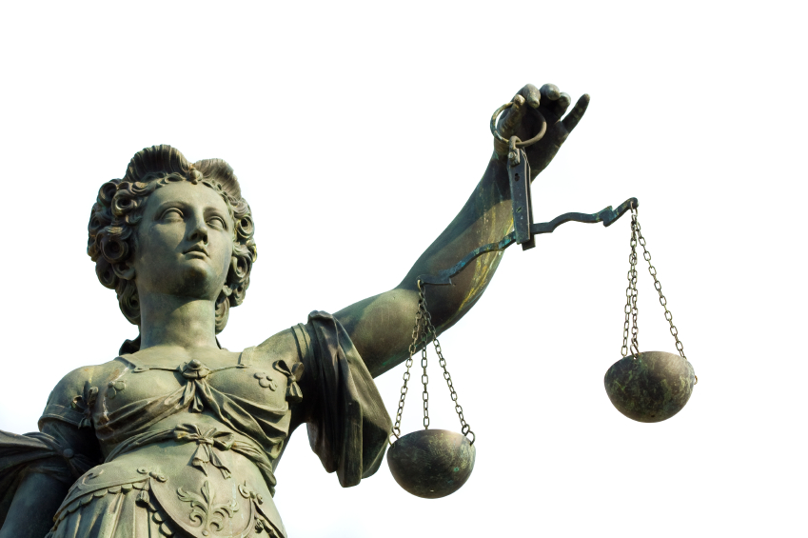
Criminal Procedures

Slide 2
Where Do They
Come From?
Criminal Procedures:
A network of laws and rules that establish the standards and limitations to be employed by the government and its agents. It addresses a variety of issues to include search and seizure, powers of arrest, interrogation, prosecutorial limitations, as well as bail and sentencing.
Notes:
Instructor should give the learner insight as to why criminal procedure is important.
Criminal Procedure is the way in which police officers lawfully do their job to ensure successful prosecution of offenders. This is the most argued block of instruction because there are many ways to conduct a lawful investigation. Procedures and case law are road maps for the police to standardize and guide our police authority. Policing in a free society is not easy.

Slide 3
Two Kinds of Crim Pro
Substantive Law
  legislated acts
  establish the acts and mental states necessary to commit a crime
  RCW 9A.52.030
Procedural Law
  legislated acts
  establish the procedures to be employed in governmental affairs
  RCW 10.31.100
Notes:
Substantive Law is best described as the laws and elements of the crimes being taught in criminal Law.
Procedural Law is best described by using a scenario to compare the two.
Example: As a police officer you respond to an assault. The suspect is in his residence. The victim greets you outside with a bloody nose. You know you are investigating an assault (Substantive Law “the rolodex of crimes in your head.”) but how do you investigate and detain the suspect? “What do you do and what are your limitations while investigating (this is procedural law.)
Have the class look up 9A52.030 and 10.31.100. Engage in a brief discussion on both.

Slide 4
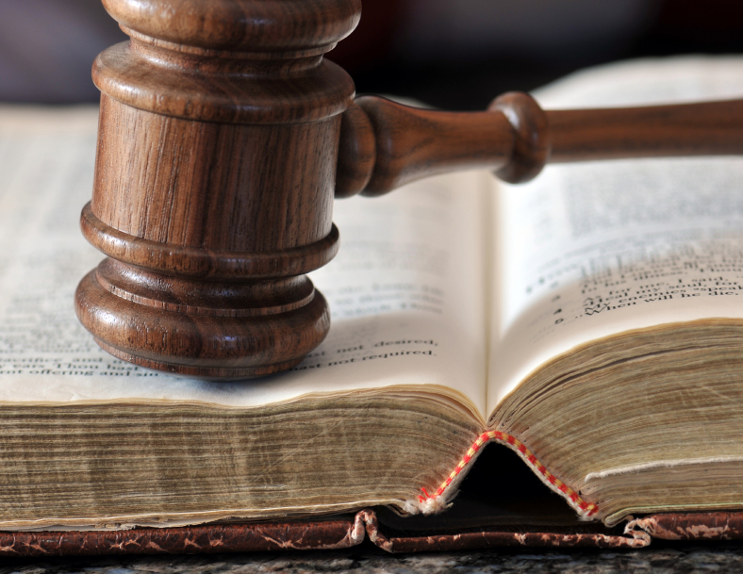
What’s the Significance?
Enhances the ability to successfully prosecute criminals
Reduces criminal liability to the officer
Reduces civil liability to the officer
Reduces likelihood of internal discipline
Enhances public cooperation in those “critical times”
Protects the rights of all citizens
Notes:
Q & A each bullet point in slide emphasizing the importance of knowing and applying procedures lawfully and reasonably.

Slide 5
Sources of
Criminal Procedures
Crim Pro
Constitutional Documents
RCW
WA Court Rules
Case Law
Agency Policies
Common Law
WA State Court Rulings
Federal Court Rulings
Law Enf. Agencies
Prosecutorial
Agencies
Washington State
United States
Notes:
Purpose of the slide is to illustrate that criminal procedures comes from many different sources and that as a police officer you have to know your police authority in regards to each source.
Examples may include: Federal search law VS Washington State case law regarding search. Another example is that there is no “Carroll Doctrine” in Washington state as opposed to California or other states where courts are applying the 4th amendment VS Washington State’s Article 1 section 7.
(State v. Ringer 100 Wn.2d 686 (1983)
Describe for learners a situation where a

