Slide 1
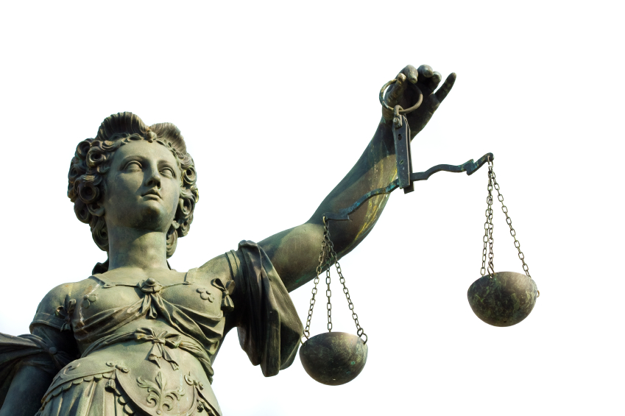
Police Liability

Slide 2
What if we deviate?
  There is NO absolute immunity!
    There IS qualified or good faith immunity
      Limited immunity
      Must be pleaded by the officer
      Two-part test:
      Did officer violate a clearly-established statutory or case law?
      Would a (different) reasonable officer have concluded your actions were reasonable?
  Police officers will not be personally liable when they “reasonably but mistakenly” arrive at a conclusion.
Notes:
Point out that officers only have qualified immunity if they can meet the two part test (listed on the slide.)
You can be sued for anything anytime by anyone even if you were acting in good faith (whether you are successfully sued is the question.)
Discuss that they should not be afraid to do their job and that they should follow the 99 out of 100 cop rule. No two situations are exactly the same and no one can predict the dynamic scenarios that arise in police work. As long as you are acting lawfully and within reason and do what 99 out of 100 cops would have done you will probably be fine.
Offer some personal examples of good police work where officers “reasonably but mistakenly” arriving at the wrong conclusion.
Judges and prosecutors (in most situations) have absolute immunity.

Slide 3
What if we deviate?
    The sanctions (punishments) are many and varied…
    Criminal Liability
      Example:
    Civil Liability
      Example:
    Departmental Liability
      Example:
  Can you be found liable in all three venues?
Notes:
YES you can be found liable in all three venues.
Give an example of a situation involving an officer (without giving a name or department) that illustrates this point.
Discuss the term “contempt of cop” and how that relates to liability.

Slide 4
“Public Duty” Doctrine
The idea that a duty to the general population
does not create a duty to any one individual.
Court-created doctrine intended to protect the government from lawsuits
No statute or formalized court rule setting forth this common law doctrine
Been developed by the courts case-by-case.
Was there a Duty Owed ?
EXAMPLE: The police generally can’t be sued for mistakes they make in failing to catch a murderer before he kills again.
Notes:
The public duty doctrine is a court created doctrine to protect the police from liability like in the example above.
Another example: The 10 year investigation of the Green River killer.

Slide 5
What if we deviate?
Police liability arises from police negligence.
  Do we have a duty owed?
    Examine the “Public Duty Doctrine”.
  And do we have a duty breached?
    Covers all acts and omissions.
  And were actual damages suffered?
  Was the duty breached the proximate cause for the damages suffered?
Notes:
Suggestions to illustrate the slide:
When the public calls 911 they expect the police to respond. Example of elderly person not seen in a week…...Duty Owed You have a duty to investigate.
Upon arrival the officer knocks on the door receives no response and does nothing else to investigate …..Duty Breached. Failure to do a thorough job.
Later that day a family member finds them dead in their house. An autopsy shows the person died over hours from internal bleeding received from a fall…..Actual Damages Suffered. Result is lawsuit and liability.
Another example is officers responding to domestic violence assault where probable cause is developed and officers fail to make a custodial arrest. As a result of the duty breached the victim sustains further injury by the suspect who should have been booked into jail.
Another scenario that works well to illustrate the point is the obvious DUI you see during a bar check who you have arrested several times before for DUI and their car is parked in the lot. Discuss an officers lawful options. Discuss why it is important to know what you can and can not do with that person. This usually results in a good discussion with new officers about their lack of authority in these types of situations but their community caretaking function and how they should manage situations to reduce liability.

Slide 6
Why Do We Get Sued?
The officer…
  excessive force
  lousy driving
  boot the wrong door
  arrest the wrong person
  arrest the right person without PC
  your dog bit someone
  harassment
The agency…
  negligent hiring
  negligent retention
  failure to train
  improperly training
  failure to supervise
  condoning sexual or racial harassment
  failure to treat employees equally.
Notes:
Give examples of bullet points.

Slide 7
What’s the
Bottom Line?
We in law enforcement can often be our own worst enemy!
  Think before
  you act.
  Think before
  you speak.
  Is my action:
    Reasonable?
    Necessary?
    Legal?
    Within Dept. Policy?
Notes:
Summarize the block.
Emphasize the importance of knowing criminal procedure and case law because it is ever changing.

