Slide 1

F.B.I.’s Role in Color of Law/Excessive Force Investigations
SSA Ethan Via
AUSA Bruce Miyake
Notes:
Points to Note:
“Protected rights” refers to the Federal rights
outlined in the Constitution and US law
“All persons” are protected, meaning anyone on
US soil regardless of citizenship

Slide 2
CIVIL RIGHTS PROGRAM
Hate Crimes, Color of Law, Human Trafficking and FACE Act
#2 Priority in CID
#5 Priority for FBI
Notes:
Priorities (1-10) under Director Comey:
1. Protect the United States from terrorist attack
2. Protect the US against foreign intelligence
operations and espionage
3. Protect the US against cyber-based attacks and
high technology crimes
4. Combat public corruption at all levels
5. Protect civil rights
6-10. Etc.
Thus, the Civil Rights Program is the Second priority of the CID, only after Public Corruption.

Slide 3
Civil Rights Subprograms
1. HATE CRIMES – 22%
2. COLOR OF LAW – 48%
3. HUMAN TRAFFICKING – 28%
4. FACE Act – 2 %
Notes:
3
These subprograms appear in priority order for the FBI’s Civil Rights Program. The impact hate crimes have on the entire community is the primary reason combating hate crimes is the number 1 priority within the CRP.
The size of the perceived crime problem of color of law is the justification for it being the number 2 priority. About 72 convictions nationwide.
Involuntary Servitude and Slavery is a fast growing crime problem, which has been recognized by the FBI, DOJ, ICE, the Department of State, and law enforcement agencies across the globe. This in part is the reason for ISS being elevated to the number 3 priority within the last few years.
Freedom of Access to Clinic Entrances (FACE) provides protection to those seeking services at reproductive clinics.

Slide 4
WHAT IS COLOR OF LAW?
Official actions taken by person(s) acting under the authority of local, state or federal laws to willfully deprive someone of a right or privilege or immunities secured or protected by the constitution or laws of the US
Notes:
3 main elements:
Official actions/Authority – person in a position of power
Willful deprivation – misuses that power to carry out a crime
Constitutional or legal right

Slide 5
18 U.S.C. 242
FBI must prove that the officer, acting under color of law, WILLFULLY deprived the victim of her civil rights (life, liberty)
The officer INTENTIONALLY committed acts that another officer, in the same circumstances, would have found UNREASONABLE
Notes:
Color of Law statute
Note that the officer has to act with specific intent to deprive someone of their rights. This is what would be unreasonable for another officer in the same situation.

Slide 6
Penalties:
Up to one-year term – no bodily injury and no use of a weapon
Up to ten-year term – bodily injury resulted or dangerous weapon used
Up to life imprisonment or death penalty – death resulted or involved an attempt to kill, kidnapping, aggravated sexual abuse
Notes:
Penalties for violating 18 USC 242

Slide 7
COLOR OF LAW ADDITIONAL FEDERAL STATUTES
Title 18 USC 1512
OBSTRUCTION OF JUSTICE
Title 18 USC 1001
FALSE STATEMENTS
Title 18 USC 1623
PERJURY BEFORE GRAND JURY
Notes:
Other violations that could be charged in a color of law investigation.
Obstruction – ex: supervisor destroys a report that is needed in the color of law investigation
False statements- ex: subject or witness gives a false statement during the color of law investigation
Perjury – ex: lying while testifying to FGJ during indictment process

Slide 8
MAIN ELEMENTS OF 18 USC SECTION 241- CONSPIRACY AGAINST RIGHTS
Two or more persons agree
To willfully injure, oppress, threaten, or intimidate any person
From enjoying constitutional rights
Notes:
Conspiracy charges can be used if 2 or more are involved in the color of law violation

Slide 9
WHO CAN BE INVESTIGATED FOR COLOR OF LAW?
1. State/Local Law Enforcement (Police, Sheriff, DA’s Investigators)
2. Federal Law Enforcement (FBI, DEA, ICE, USMS, BATF, DOJ)
3. Correctional Officers (Federal, State, Local)
4. Judicial Officers (Judges, Prosecutors, Defense Attorneys)
5. Other Public Officials (Mayors, Council Members)
Notes:
Examples of public officials who can be subject to this statute. Local, state, and/or federal employees.

Slide 10
WHO CAN BE INVESTIGATED FOR COLOR OF LAW? (cont’d.)
6. Miscellaneous officials (Security Guards, Nursing Home Proprietors)
7. A private citizen, who is a willful participant
with Federal, state, or local officials in the
commission of “Color of Law” violations
Notes:
Ex.: private citizen who gets carried away during a “ride along”.

Slide 11
Protected Rights
Excessive force (90%)
Sexual assault
Failure to keep from harm
Deprivation of medical attention
Deprivation of property
Presentation of false evidence
Planting of evidence
Notes:
Excessive force accounts for more than 90% of COL cases.
Sexual assault – element of coercion. Not when the victim offers sex to get out of a ticket.
Fail to keep from harm – if you can reasonably intervene to stop the victim from being harmed by a fellow officer
Deprivation of medical attn – must be aware that victim needs medical attention and deliberately fail to take reasonable steps to call 911/help
Deprivation of property – stealing property at a search that was not listed as an item to be seized in the warrant
Presentation of false evidence – make up evidence for use at court
Plant evidence – make up evidence found at crime scene

Slide 12
EXCESSIVE FORCE?
Force used during pretrial/admin detention? Due process clause prohibits the use of force amounting to punishment
Force used during an arrest? The Fourth Amendment applies to prohibit the use of unreasonable force
Force used against an inmate? The Eighth Amendment prohibits the use of “Cruel and Unusual Punishment”
Notes:
Where in the constitution are protections enumerated?
Due process – applies in the pretrial phase
4th Amend – applies during arrest, prohibits use of unreasonable force
8th Amend – applies during incarceration, prohibits cruel and unusual punishment

Slide 13
SOURCES OF COMPLAINTS
Complainant or victim (no history of false information)
Request from DOJ or US Attorney
Legitimate news/media reports
Law enforcement agencies
a. Witnessing officers/management
b. County Attorney’s office
Congressional Inquiry
Notes:
Listed above are some of the sources of complaints on civil rights cases. Of note is the fact that the FBI is mandated (by DOJ) to initiate investigations if the allegation would constitute a civil rights violation.
The criteria used is “any source not known to be unreliable”.

Slide 14
Conducting Color of Law Investigations
Assessment, Preliminary Inquiry or Full Investigation?
Complainant with no history of providing false information. Specific and credible info provides predication.
No corroborating statements or evidence necessary to open assessment or PI.
Notes:
Credibility of complainant is key.
Is corroborating evidence available? Video, eyewitnesses, cooperating police officer…
Is there a significant community impact?

Slide 15
Investigative Techniques
1. Advise agency, obtain/review agency reports (Garrity caution)
2. Conduct interviews of victim(s), subject(s), witnesses, medical personnel (if doesn’t interfere with local prosecution).
3. Photograph/Diagram scene
Determine if local prosecutive action taken
Obtain USAO/DOJ CRU prosecutive opinion
Notes:
Basic investigative techniques used.
First step is to notify the officer’s department.
Discuss Garrity concerns in a later slide.

Slide 16
The premise of a Federal Civil Rights investigation is to act as a backstop to a local/state investigation and subsequent adjudication.
Each state has the primary responsibility to investigate civil rights violations occurring within its jurisdiction.
Notes:
Guiding principle is that color of law cases should be resolved in accordance with local standards. Local or state government will be given initial opportunity to investigate and prosecute color of law case. Federal investigation only takes place when the local or state prosecution has not been successful, and there is a positive indication of success at the federal level.

Slide 17
PARALLEL INVESTIGATIONS
Investigation initiated regardless if a local or state investigation is being conducted
When/if state/local charges filed, monitor investigation and contact AUSA and DOJ Attorney
Notes:
HOWEVER, typically, the FBI will open a parallel investigation at the outset.
It is important to conduct the joint investigations, when possible, rather than simply monitor the state and local investigations. Often, the state and local investigators may have to prove different things than is required in the federal investigation.
If the state and local investigators refuse to work the case jointly, unless instructed by the CRU, the FBI should conduct a parallel investigation. The parallel investigation could terminate at such time as local charges are filed.

Slide 18
Double Jeopardy
No person shall “be subject for the same offense to be twice put in jeopardy of life or limb”
Dual Sovereignty Doctrine: Different government’s law by definition cannot describe the “same offense”

Slide 19
DOJ’s Petite Policy
Precludes the initiation of a federal prosecution following a state prosecution based on the same acts
UNLESS, there is a compelling federal interest unvindicated, AND
A conviction in the successive proceeding is anticipated
Civil Rights cases more likely to meet this “compelling interest” standard
Notes:
DOJ will only prosecute something the state has prosecuted if there is:
A compelling federal interest that has not been vindicated
Federal conviction is likely.

Slide 20
WHAT IS GARRITY?
SUPREME COURT: Garrity v. New Jersey, 385 US 493, 1967
Regarding: Statements given by public employees under express threat of disciplinary action for failure to answer
Ruling: These compelled statements, as well as the fruits of these statements, CANNOT constitutionally be used against the employee in a subsequent criminal proceeding.
Notes:
Privilege came about as a result of Officer Garrity who solicited bribes from drivers for $30.00, not to submit a ticket. Ticket fixings were suspected, and an internal investigation was conducted. The officer cooperated with the internal investigation in providing a compelled statement. The proceedings shifted to a criminal violation and this statement was the only evidence. His defense attorney claimed that this violated Garrity’s 5th Amendment rights against self incrimination. The Judge stated that the state has a right to know Employee vs. government interest. As such, the employer has right to compel an employee to make a statement. In 1967, the Supreme Court ruled that the employer has the right to compel/coerce an employee to cooperate in order to take administrative action. A statement taken under those circumstances CANNOT LATER BE USED IN CRIMINAL PROCEDURES. An employer can fire or suspend, but not criminally prosecute on this information.
THE FBI CANNOT look at this compelled statement if the subject does not waive his Garrity privilege.

Slide 21
PATTERN OR PRACTICE INVESTIGATIONS 18 U.S.C. 14141
Unlawful for any governmental authority, or any agent thereof, or any person acting on behalf of a governmental authority, to engage in a pattern or practice of conduct that deprives persons of rights protected by the Constitution or laws of the U.S.
aka “Police Misconduct Statute”
DOJ seeks civil remedies against agency not individual
Notes:
The FBI is not often involved in these civil investigations. This is conducted by DOJ and the civil AUSAs.
Only civil remedies against agency, not the individual. The individual may be charged with incidents within the pattern or practice investigation.
Looking for patterns or practices that foster misconduct among officers, such as supervisors turning a blind eye to excessive use of force.

Slide 22
PATTERN OR PRACTICE RESULTS
Increased training/increased supervision
Development of detailed use of force guidelines
Mandatory reporting in use of force incidents
Restructure internal affairs program
Independent compliance monitoring for any settlement agreement
Notes:
Possible results of a Pattern/Practice investigation

Slide 23
U.S. v. Jon Bartlett
October 24, 2004
Bay View (Milwaukee), Wisconsin
Frank Jude and Lovell Harris
Notes:
Officer Andrew Spengler had a housewarming party-lots of alcohol, mostly off duty PD
-Katie Brown and Kirsten Antonissen were invited, they brought Frank Jude and Lovell Harris as guests (2:30am)
-Spengler accused Jude and Harris of stealing his badge
-surrounded the car and hurled racial epitaphs and threats (“we can kill you” “this is our world”,) dragged from car, Jude taken to ground and searched
-Clausing slices Harris’ face sliced, who escapes while beating of Jude commenced
-Antonissen calls 911, thrown against the truck which is dented, phones confiscated
-Schabel and Martinez (on duty) respond to 911, calls Jude MFer and stomps his face
-dragged up off the ground by Masarik and kicked in crotch (left the ground)
-Bartlett then shoves pen into his ears and then cuts his clothes off
-Spengler holds gun to Jude’s head “I’m the f’ng police. I can do whatever I want to do. I could kill you.”
-3:09a, more officers respond. Jude is arrested and taken to hospital for injuries

Slide 24
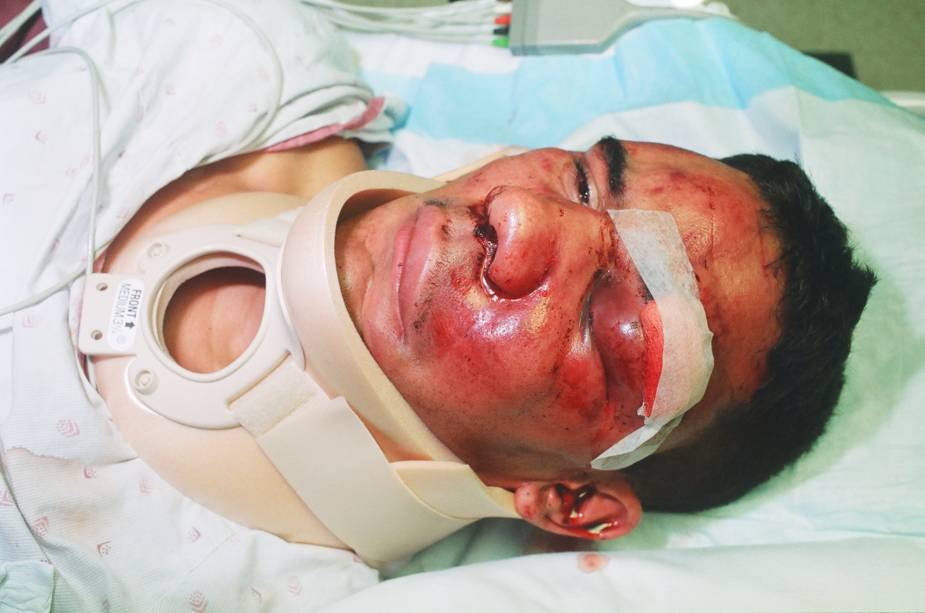

Slide 25
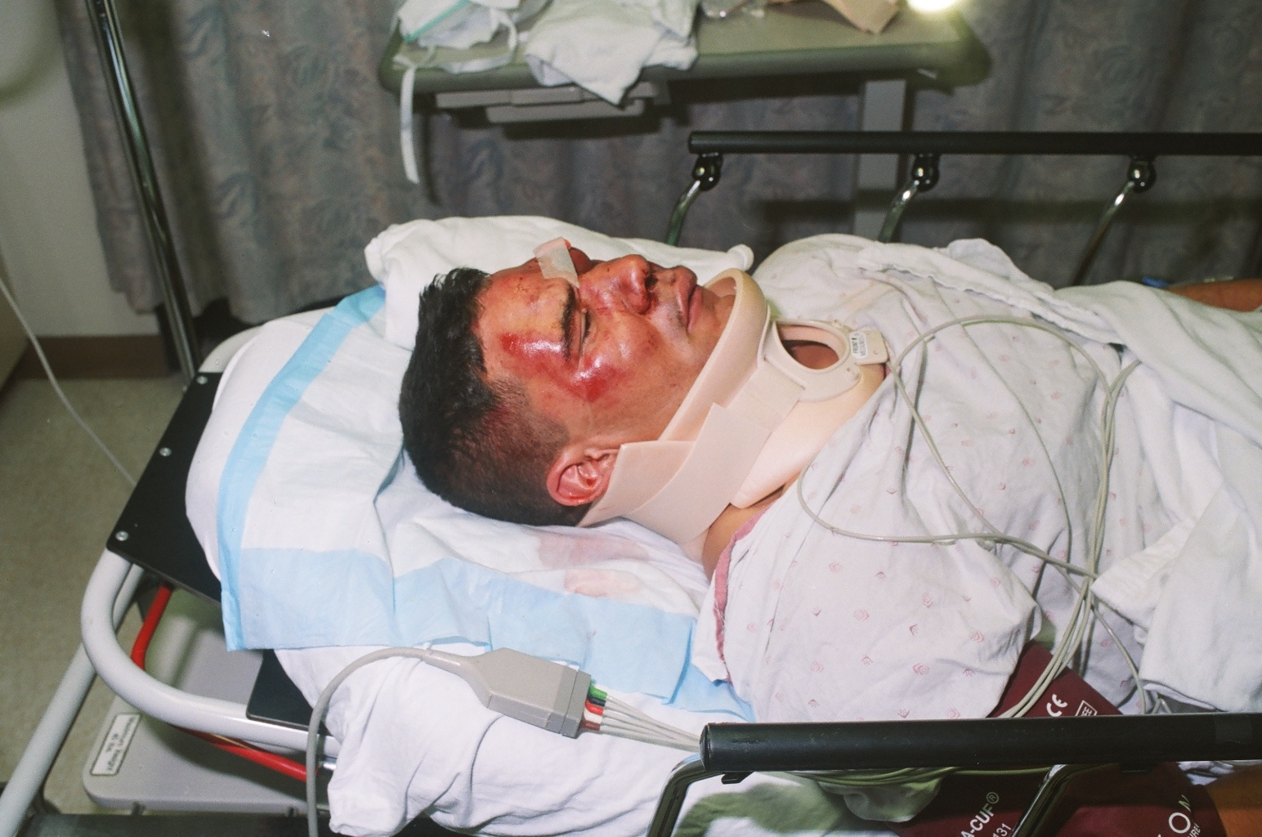

Slide 26
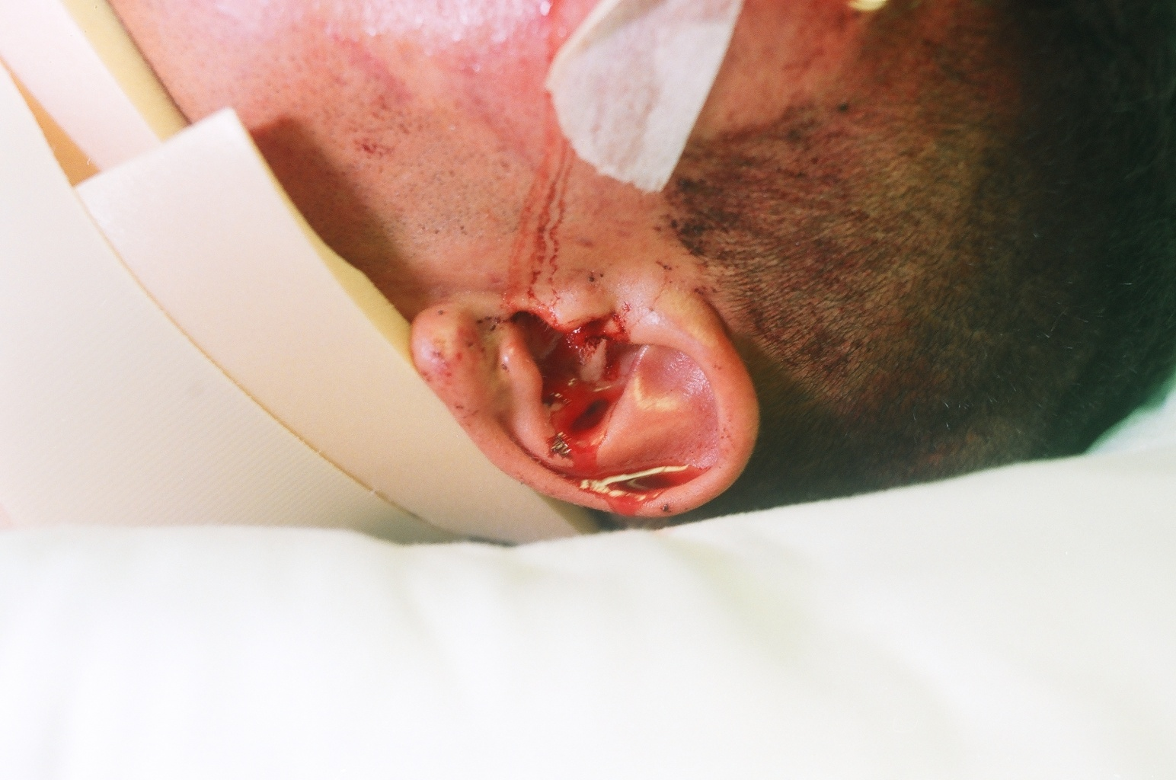

Slide 27
All officers were acquitted of all state charges
*It was the only trial the DA lost
in 38 years as a prosecutor
Notes:
-Claimed highly intoxicated so fuzzy memories or flat out lying
-All “put themselves on duty” to respond to burglary --- gave DOJ/FBI strong predication

Slide 28

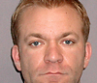

Former Officers
Officer Jon Bartlett
Officer Andrew Spengler
Guilty
Used a knife to cut off Jude’s clothes & shoved pens into Jude’s ear canals
17 years, 4 months federal prison
Guilty
Placed his service pistol against Jude’s head and threatened to kill him
15 years, 8 months federal prison
Notes:
-Bartlett called in a bomb threat to his old district station and was already serving time when the case was taken Federally

Slide 29

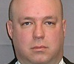
Former Officers
Officer Joseph Schabel
Officer Jon Clausing
Plead Guilty:
Responded to 911 call, on duty, admitted to stomping on Jude’s head
2.5 years federal prison
Plead Guilty:
Cut Harris’ face with a knife
2.5 years federal prison
Notes:
-Stomped on Judes head, witnesses later said bones could be heard braking

Slide 30
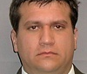

Former Officers
Officer Ryan Lemke
Officer Joseph Stromei
Plead Guilty
2 years federal prison
Plead Guilty
1 year federal prison
Notes:
-Stromei: lied throughout the state investigation/trial, confessed to the FBI that he held Jude down during the assault

Slide 31
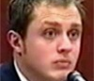
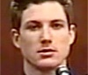
Former Officers
Officer Daniel Masarik
Officer Ryan Packard
Guilty
Lifted Jude off the ground and kicked him in the crotch
15 years, 8 months federal prison
Acquitted
Admitted to taking Jude to the ground
Suspended 23 days
Notes:
Packard: was in pursuit of Harris during most of the assault

Slide 32
Hated Cops Are NOT Respected Cops
Officers who rely on unreasonable force, brutality, or intimidation make the country more dangerous
Civilians oftentimes do not distinguish among different police uniforms
All officers come to be defined as brutal and thus targets for civilian retaliation
Notes:
Law enforcement officers rely on cooperation from the public to make successful cases. Without trust and an understanding that officers are to protect and serve citizens, citizens will be less likely to report crimes, testify in trials, and voluntarily provide needed information. Instead, an atmosphere of fear is created in which neither side trusts the other.

Slide 33
As law enforcement officers everything we do is examined with 20/20 hindsight and by someone using a video camera!
Law enforcement
Notes:
Caveat: excessive force is a matter of serious public concern in WA as evidenced by media coverage, protests, and recent cases. The public is very interested in what we do and how we carry out our mission. Keep in mind the very real possibility that someone is videotaping you during interactions with the public.

Slide 34
INTENTIONAL + UNREASONABLE USE OF FORCE
NOT ACCIDENTS OR MISTAKES!
Notes:
Very high specific intent standard needed to provide a color of law case. INTENT + UNREASONABLE use of force.
An officer who made a mistake, was fearful, negligent, or accidentally acted in a situation has not violated the color of law statute.
Encourage you to take advantage of the training in defensive tactics and de-escalation techniques that will be taught in the academy and by your departments. Practice, Train, and Know your use of force policies! Know your personal limits, when your buttons are getting pushed, and what your strengths and weaknesses are. Be aware so that you can practice and control your response.

