Slide 1
Use of Force Part 2
Detective Jeff Paynter
Officer Sean Hendrickson

Slide 2
Basis for Lethal Force
State Law RCW 9A.16.040
Federal Law 471 U.S. 1
Department Policy

Slide 3
Deadly force defined
RCW 9A.16.010
“"Deadly force" means the intentional application of force through the use of firearms or any other means reasonably likely to cause death or serious physical injury.”

Slide 4
What is a deadly weapon?
Means any explosive or loaded or unloaded firearm, and shall include any other weapon, device, instrument, article, or substance, including a vehicle as defined in this section, which under the circumstances in which it is used, attempted to be used, or threatened to be used, is readily capable of causing death or substantial bodily harm. (RCW 9A.04.110)

Slide 5
Legal Definitions
Substantial Bodily Harm: Bodily injury which involves a temporary but substantial disfigurement, or which causes a temporary but substantial loss or impairment of the function of any bodily part or organ, or which causes a fracture of any bodily part. (RCW 9A.04.110)

Slide 6
Necessary (RCW 9A.16.100)
“No reasonably effective alternative to the use of force appeared to exist and that the amount of force used was reasonable to effect the lawful purpose intended.”

Slide 7
Reasonable belief:
Facts, circumstances, or knowledge present to the office sufficient to justify a feeling or thought

Slide 8
Great Bodily Harm (RCW 9A.040.100)
Injury which creates a probability of death or which causes significant serious permanent disfigurement, or which causes a significant permanent loss or impairment of the function of any body part or organ.

Slide 9
Substantial Bodily Harm (RCW 9A.04.110)
Bodily injury which involves a temporary but substantial disfigurement, or which causes a temporary but substantial loss or impairment of the function of any bodily part or organ, or which causes a fracture of any bodily part.

Slide 10
Tennessee v. Garner ~ 471 U.S. 1 (1985)
Basis for: - Federal law - Washington State law – RCW 9A.16.040 Allows for the use deadly force in two separate and specific instances

Slide 11
Tennessee vs Garner (1985)
Discussion…

Slide 12
Tennessee vs Garner (1985)
Night time residential burglary
Officer was “reasonably sure” the suspect was unarmed
Officer stated he shot the suspect to prevent escape

Slide 13
Tennessee vs Garner (1985)
Garner’s father sued alleging Fourth, Fifth, Sixth, Eighth and Fourteenth Amendment violations.

Slide 14
Tennessee vs Garner (1985)
US Supreme Court ruled that deadly force to effect arrest constitutes a seizure under the Fourth Amendment.
The Court ruled that deadly force against unarmed and non-dangerous fleeing felons was unconstitutional.

Slide 15
Tennessee vs Garner (1985)
The Supreme Court held that Officers can use deadly force to seize a fleeing suspect.
They made an outline of what would make lethal force in such a situation reasonable (4):

Slide 16
Tennessee v. Garner
Officers are authorized to use deadly force against any person as necessary in self defense or the defense of another, when they have reason to believe they or another are in immediate danger of death or serious physical harm. - Any person - Self-defense - Reason to believe - Immediate danger of serious physical harm

Slide 17
Tennessee v. Garner
Officers are authorized to use deadly force to capture or seize a dangerous suspect when there is probable cause to believe that the suspect has committed a crime involving the infliction or threatened infliction of serious physical harm, and there is no reasonably safe means of preventing the suspect’s escape. - Capture or seize - Probably cause - Crime inflicting/threatening serious physical harm - No reasonably safe means - AND -

Slide 18
When officers are about to use deadly force, they will, when feasible, issue a verbal warning to the suspect.
Factors: - Availability of cover - Persons in vicinity at risk - Likelihood that subject will surrender - Nature of threat posed

Slide 19
Deadly Force
RCW 9A.16.040 Justifiable homicide or use of deadly force by public officer, peace officer, person aiding.

Slide 20
Project
In groups highlight the key points of RCW 9A.16.040
You have 10 minutes…

Slide 21
Justifiable Homicide
When can we use lethal force?
How can LEO and CO use force differently from a citizen?
Police officers do not have a duty to retreat
Citizens can only use force in self-defense or defense of another

Slide 22
It’s a Balancing Act
Governmental Interests vs Interests of Citizens
Enforcing the Law vs Constitutional Rights

Slide 23
Important Considerations
Officers cannot justify a tactic based solely on convenience and that which exposes the officer to the least amount of risk.
Fear alone does not justify deadly force.

Slide 24
Important Considerations
Officers must interpret actions of suspect/violators in the context of the totality of the evolving circumstances and situation.

Slide 25
Quiz
Parents call 911 and report their 20 year old suicidal son, John, is in the bathroom with a knife.
You show up and John won’t come out of the bathroom.
What do you do?

Slide 26
Forced Use of Force?
A suspect is fleeing the scene in a vehicle.
An officer draws his/her pistol, jumps in front of the car and says, “Stop! Or I’ll Shoot!”
The car does not stop
What do you do?

Slide 27
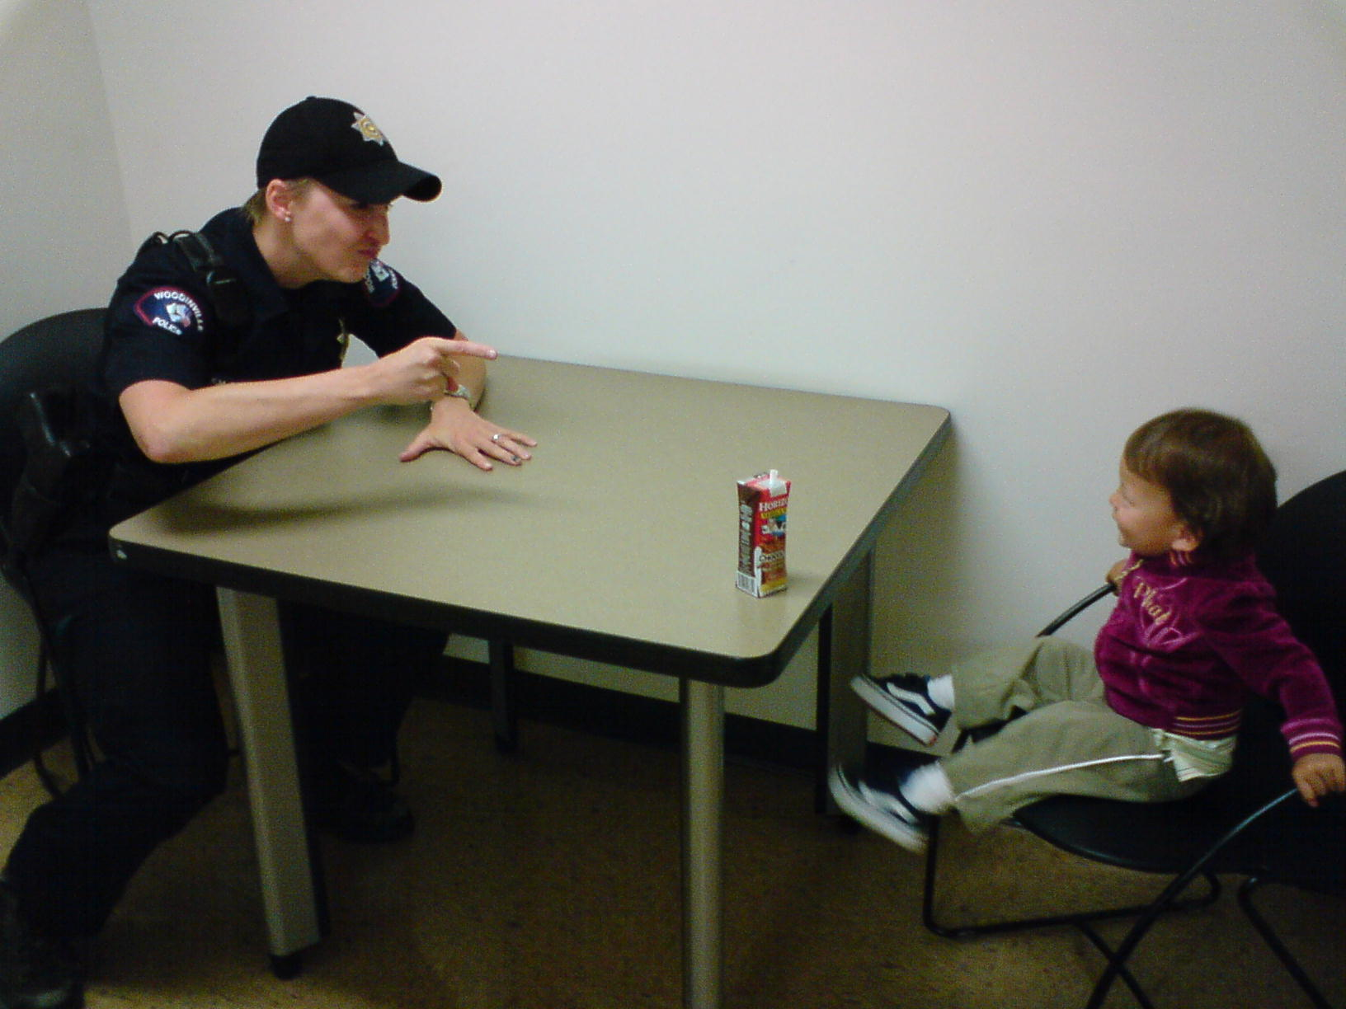
Questions?

