Slide 1
Crisis Intervention Response to Stress

Slide 2
WANTED!
Men & women to serve in a largely thankless job for modest pay & significant risk. Must be willing to work nights, weekends, holidays, swing shifts, emergencies & natural disasters. Please have will & family affairs in order. Ample opportunity to attend funerals marking the untimely death of your colleagues. Be prepared for verbal & physical abuse from those you serve. Legal scrutiny will be made of your decisions, especially those made under the most dire of circumstances. For more information, contact 1-800-GOT-HIBP
Notes:
Talk about the episode Jess Pitts experience. Talk about how doing the best job in the world does not mean you won’t experience unfairness, injustice, frustration and anger on a very personal level

Slide 3
Learning Objectives
Name & give examples of the 4 types of stress.
Identify nine ways stress immediately impacts us.
Identify three long-run results of unmanaged stress.
Identify three ways to prepare for & counteract stress.

Slide 4
3 Sources of Stress
Environmental
Psycho-social
Personality
Notes:
Environmental Stress - the minor irritations and frustrations of every day life.
Ex. trying to get things done amongst clutter and disorganization, being late for work or an appointment and then getting caught in a traffic jam, being interrupted when trying to concentrate or aches and pains from sitting all day in an uncomfortable patrol car, the quality of the air we breathe, the type of lighting that we have to work in, and the level of noise.
Psychosocial Stress - exhausted, feeling besieged, and simply unable to deal with the added time and energy of a long day. Feeling trapped and hopeless destroys that sense of excitement and happiness for the future that usually helps with motivation for the day.
Ex. Depression
Personality Stressor – your personality causes your stress
Ex. Always having to win or be the best, over planning, inability to relax without feeling guilty, compulsion to overwork.

Slide 5
Hyper-vigilance
A law enforcement specialty for survival:
Improved peripheral vision
Improved hearing
Faster reaction times
Increased blood sugar
Elevated heart rate
Increased blood pressure
A general sense of energy to meet and overcome the situation

Slide 6
Hyper-vigilant State
Energetic & Witty
Alert & Decisive
Adrenaline-feeding
typical range of risk
Notes:
Brain firing on all cylinders.

Slide 7
Depressed State
typical range of risk
Tired & Detached
Apathetic & Indecisive
Notes:
My spot on the couch

Slide 8
The “Biological Roller Coaster”
hyper-vigilant state
depressed state
typical range of risk
Notes:
Hypervigilance, necessary for street survival, all the same, creates destructive stress

Slide 9
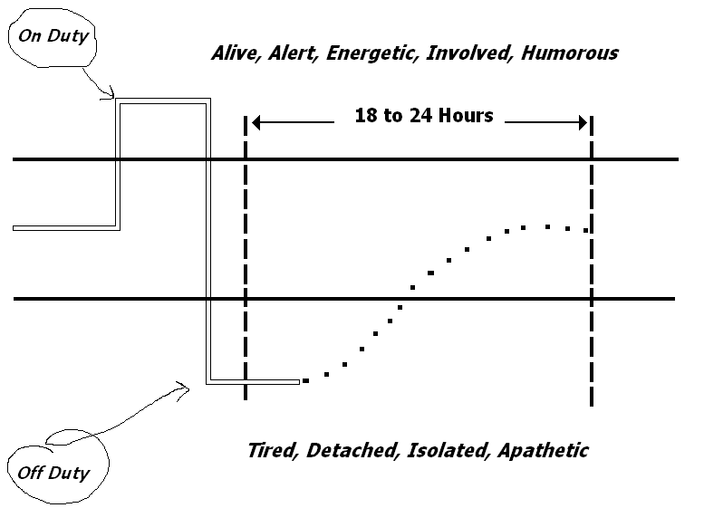
Notes:
The black lines in the middle are the normal levels. You can see the on duty officer is at a very level. When he gets home it drops way below the normal laves. It take 18 to 24 hours to get back to the normal level. How may hours of sleep do you get? I’m sure its not 18-24.

Slide 10
Four Types of Stress
Acute
Chronic
Accumulative
Delayed
Notes:
Acute - Stressor that is happening right now.
Ex. Suspect tells you he is not going to jail without a fight.
Chronic – Stressor is repetitive.
Ex. Dealing with a bad FTO, night after night.
Accumulative – all stressors collectively.
Ex. Bad FTO, nagging spouse, bills, no sleep, reports being kicked back.
Delayed – the effects of stress is brought on much later that the event that caused stress.
Ex. Nightmares, night sweats, during a similar situation the officer freezes in steed of shooting the suspect.

Slide 11
Examples
Gun in your face
Contacting the same suspect night after night
Problems with work, finances, spouse, & kids
PTSD

Slide 12
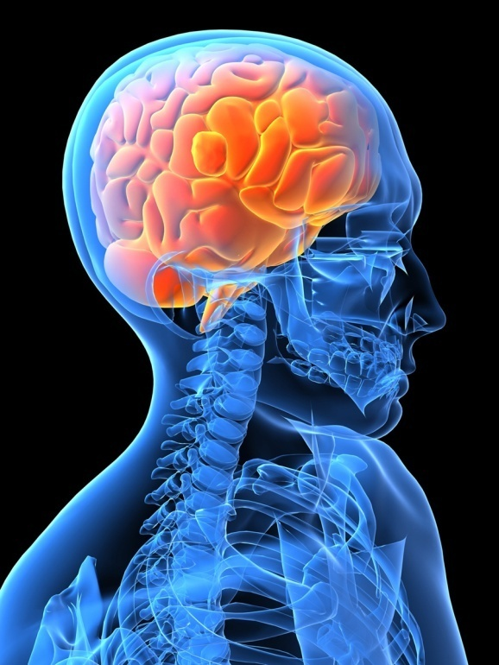
Immediate Impacts on the Brain
1) less logical and rational thinking
2) less ability to concentrate
3) initiates body responses
4) disassociation … out of body sensation
5) memory block for 24-48 hours, usually

Slide 13
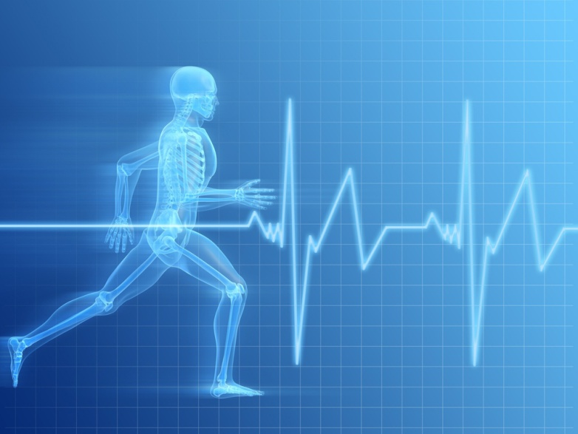
Immediate Impacts on the Body
1) adrenaline dump
2) higher heart rate
3) higher b.p.
4) faster respiration
5) more muscle tension
6) blood pools around vital organs

Slide 14
Immediate Impacts on the Body
7) slowed digestive activity
8) decreased fine motor skills
9) say goodbye to bowel & bladder control
10) tachypsychia: “Slow motion”
11) tunnel vision
12) auditory exclusion
13) auditory distortion

Slide 15
Immediate Impacts on Behavior
A person may:
1) become task oriented
2) whirl around in a frenzy
3) cower in fear & panic
4) violently act out in anger
5) deny the situation

Slide 16
Long-run Results of Unmanaged Stress
Being an out-of-touch spouse
Being an ineffective parent
Straining other relationships
Being a “burnt-out cop”
Abusing substances
Committing suicide
Dying early
Suicide
Notes:
End of hour one

Slide 17
Preparing for Stress
Train until the muscle remembers
Image
Be physically fit – nutrition; strength; endurance; flexibility; alertness.
Live below your means.
Notes:
Train your brain – story about weapon retention with neighborhood kid.
Nutrition- Green burtorito

Slide 18
Sleep
30” minimum (as in a nap)
must be uninterrupted
dark room = maximum value
Caffeine = temporary aid if a tolerance isn’t already present
Nicotine = no value
Try to get at least 8 hrs to recharge fully

Slide 19
Sleep Deprivation & Peak Performance
20 physically demanding days with:
7 hrs./day = 87%
6 hrs./day = 50%
5 hrs./day = 28%
4 hrs./day = 15%
24 hours without sleep = drunk
Notes:
Story about Army FTX

Slide 20
Counteracting Stress
Talk.
Live outside the “blue” world.
Take your vacation time.
Self-monitor.
Balance your life.
Train (mental and physical)

Slide 21
Counteracting Stress
LIVE BELOW YOUR MEANS!
This means don’t go out and buy a new car, boat, house, or any new toys while on probation
Also means don’t count on overtime or an off-duty job as your normal wage

Slide 22
Review
Name & give examples of the 4 types of stress.
Identify nine ways stress immediately impacts us.
Identify three long-run results of unmanaged stress.
Identify three ways to prepare for & counteract stress.

