Slide 1

Drugs Of Abuse
History
Identification
Investigation

Slide 2
Objectives
Identify various illicit drugs.
Identify current drug trafficking trends.
Identify components and dangers of a clandestine lab site.
Learn the value and methodology of conducting “Field Testing”.

Slide 3
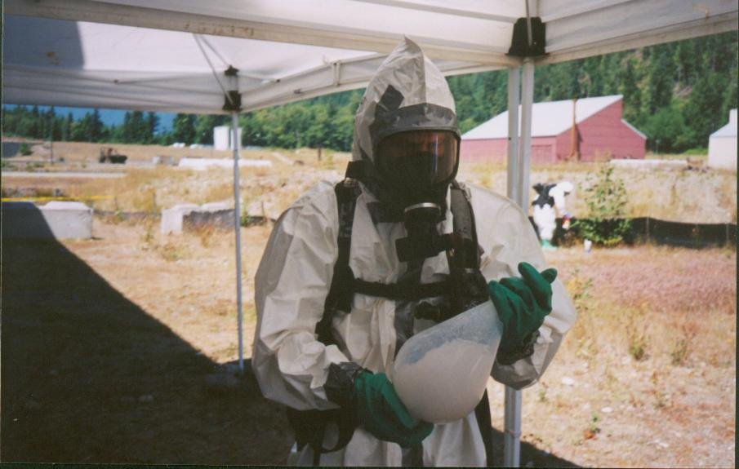
Your Instructor
Master Police Officer
Bill Shepard
Des Moines Police Department
KCSO/DMPD Special Enforcement Unit
DMPD Crime Task Force

Slide 4
History of Drug Enforcement
1800’s - No control over any substance.
Addictive drugs were found in various tonics, wines and medications.

Slide 5
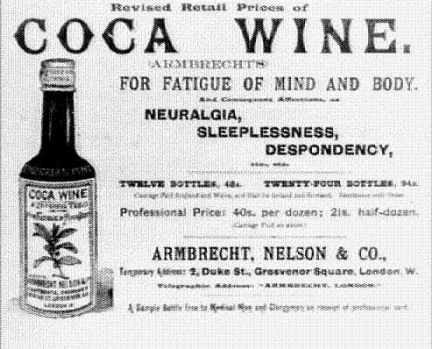
History of Drug Enforcement
According to the Sears, Roebuck and Co. Consumers' Guide (1900), their extraordinary Peruvian Wine of Coca...
"...sustains and refreshes both the body and brain....It may be taken at any time with perfect safety...it has been effectually proven that in the same space of time more than double the amount of work could be undergone when Peruvian Wine of Coca was used, and positively no fatigue experienced....."

Slide 6
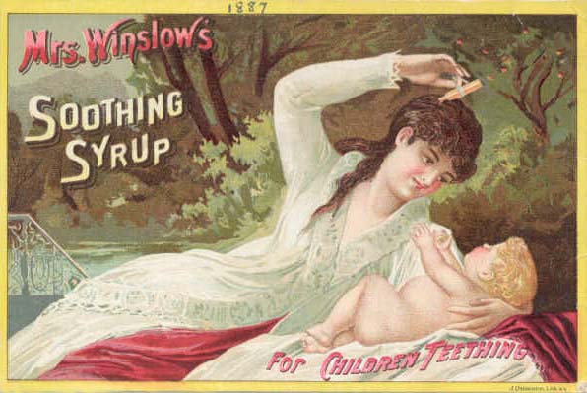
Advertisement

Slide 7
History of Drug Enforcement
1800’s - No control over any substance.
Addictive drugs were found in various tonics, wines and medications.
1906 - Pure Food and Drug Act
Department of Agriculture
Contents of medications and elixers must be printed on the label
No misleading claims about the product.

Slide 8
History (continued)
1914 - Harrison Act
Beginning of modern drug enforcement.
Tax violation to possess any untaxed narcotic.
Could possess with prescription.
1929 - Drug treatment programs started.
1930 - Bureau of Narcotics.
Focus changed to “big dealers” (Henry Anslinger - first drug czar)

Slide 9
History (continued)
1937 - Marijuana Tax Act
Reefer Madness
1965 - Bureau of Narcotics and Dangerous Drugs (later DEA)
1970 - Nixon declares “War on Drugs”
1970 - Comprehensive Drug Abuse Act
Later changed to Uniform Controlled Substances Act

Slide 10
History (continued)
Comprehensive Drug Abuse Act
Found in our state in RCW 69.50
Establishes five “Schedules” for placement of controlled substances
Three prong examination for schedules
legitimate medical use
potential for abuse
likelihood of physical and/or psychological harm

Slide 11
RCW Title 69 Food, Drugs, Cosmetics, Poisons
69.50 - Uniform Controlled Substances Act
Establishes Schedules
Rules of manufacture, distribution, dispensing
Offenses and Penalties
69.50.401 - Prohibited Acts
Administrative Articles
Seizure rules
Hazardous substance cleanup
Diversion reduction

Slide 12
RCW Title 69 (continued)
69.50.401
All drug violations felony
exception - Possession MH (between 28.3 and 40 grams)
violations involving paraphernalia
Includes:
Possession
Possession With Intent
Delivery
Manufacture

Slide 13
Schedule I - V
I - No Medical Use
Heroin, LSD, Marihuana
II - Limited medical use / high abuse
Cocaine HCL
Amphetamines
Morphine, Oxycontin
III - Steroids, Ketamine ….
IV - Diazapam (Valium), Prozac ….
V - Atropine ...

Slide 14
Possession…..with intent?
Indicators
packaging
tally or pay/owe sheets
Quantity / multiple packages
money
scales
tools of trade - cell, firearms, digital storage
Statements - post or pre arrest

Slide 15
Civil Forfeiture
RCW 69.50.505
Establishes the guidelines for seizure and forfeiture
Property or proceeds may be seized for drug “trafficking” crimes under two theories:
Facilitation
Proceeds
Currently legislative / activist scrutiny.

Slide 16
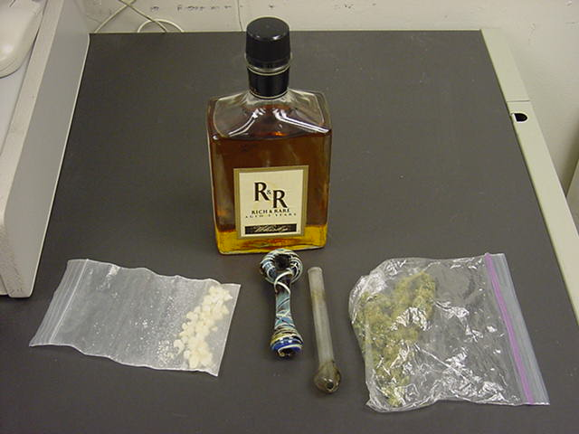
Video
Drugs are bad….m’kay

Slide 17
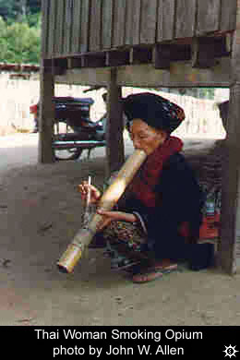
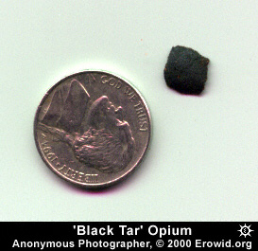
Drugs of Abuse
Opiates

Slide 18
History
2500 BC - reference to opium poppy is found in ancient medical tablets
900 BC - Homer in The Iliad writes of the “Cup of Helen”... “a person under the influence may not be dismayed nor sorrowful even though his parents die and his brother or son were slain”

Slide 19
History (continued)
1803 - “Morhphium” is identified and named after Morpheus…the goddess of sleep.
Introduced as a cure for opium addiction
1821 - Confessions of an English Opium Eater expounds on the virtue of opium calling it the “Alpha and Omega of Life”
book resulted in huge increase in addiction

Slide 20
History (continued)
1839-1842 - The Opium War
war between England and China
stemmed from opium imports
England forced China to expand imports of opium, addiction tripled
1853 - Hypodermic syringe invented
1865 - Civil War…used to relieve pain
Soldier’s Disease

Slide 21
History (continued)
1875 - Two British researchers discover and produce diacetylmorphine (heroin).
1898 - Bayer Company markets heroin and combines it with aspirin.
Introduced as cure to morphine addiction.
1925 - International Opium Convention
limits the manufacture and distribution

Slide 22
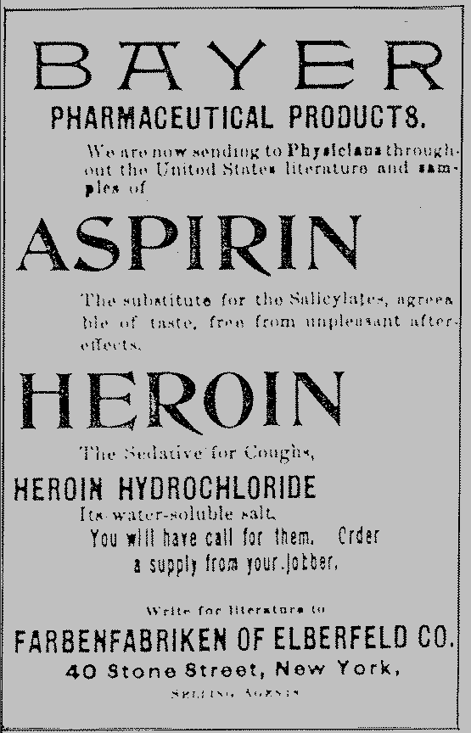
Actual Advertisement

Slide 23
Opiate Derivatives and Analogs
Derivatives:
Analogs:
Heroin
Morphine
Coedine
Vicodin
Percodan
Percoset
Demerol
Darvon
Darvocet
Methadone
Oxycontin

Slide 24
Medical Uses
Pain control (analgesic)
Cough suppressant (antitussive)
induce sleep (sopoforic)
induce vomiting (emetic)

Slide 25
Indicators of Use
droopy eyelids
impaired attention
slow speech
sleepy (on the nod)
constipation
euphoria
cigarette burns
heroin 4-6 hours
constricted pupils
non-reactive pupils
unhealthy looking
injection marks
discharge at site
abscesses

Slide 26
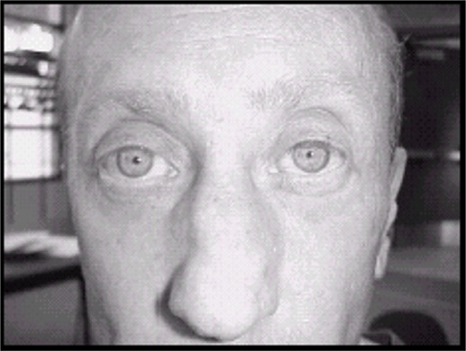


Constricted Pupils

Slide 27
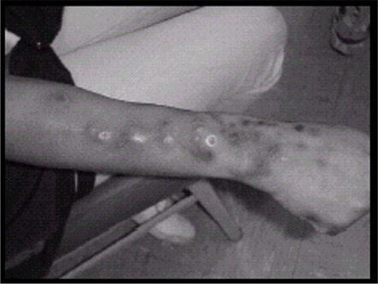
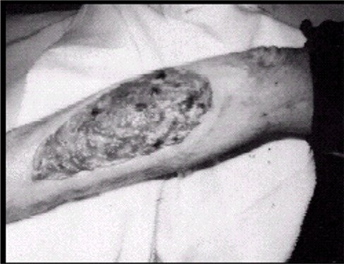
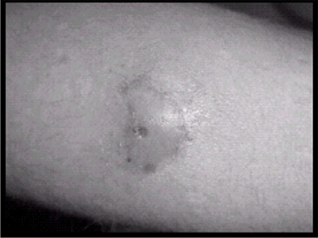
Injection Sores/Abscesses

Slide 28
Symptoms of Overdose
Slow, shallow respiratory rate.
Cyanosis
bluish skin tone
Frothy pink foam at mouth.
Pulmonary Edema
Unconsciousness
Death
needle often still beside or in body

Slide 29
Heroin Production
Opium Poppy
grown in Mexico, Turkey, Golden Triangle, Golden Crescent, Colombia
Raw opium drawn from seed pod

Slide 30
Heroin: H, Chiva, black, smack, ...
White
Southeast Asian 95+%
Southwest Asian 70-90%
Colombian 60-90%
Mexican Brown 40-85%
consistency of cocoa
Black Tar 20-60%

Slide 31
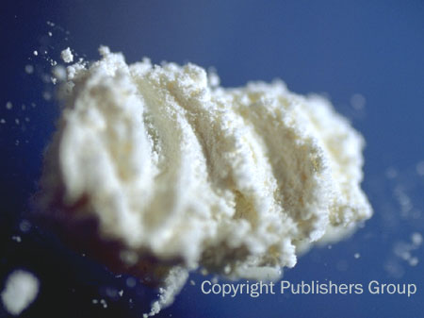
Asian White

Slide 32
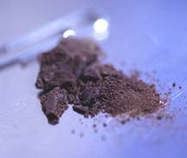
Mexican Brown

Slide 33
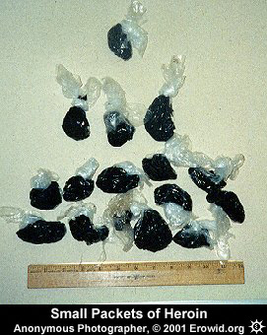
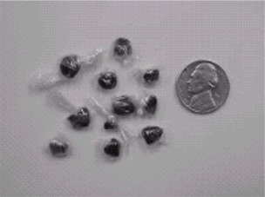
Black Tar Heroin

Slide 34
Modes of Ingestion
Oral
Smoking
Injection
subcutaneous
intramuscular
intravenous
IV is by far the most popular form of ingestion

Slide 35
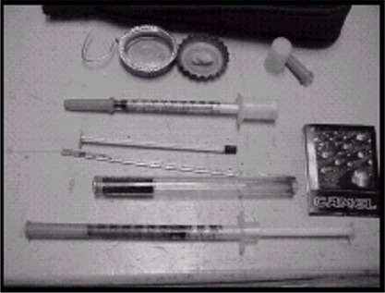
Paraphernalia
Syringe
26-28 gauge insulin syringe
generally re-used
Spoon or metal cap
Cotton or cigarette filter
Water
small vial with screw top

Slide 36
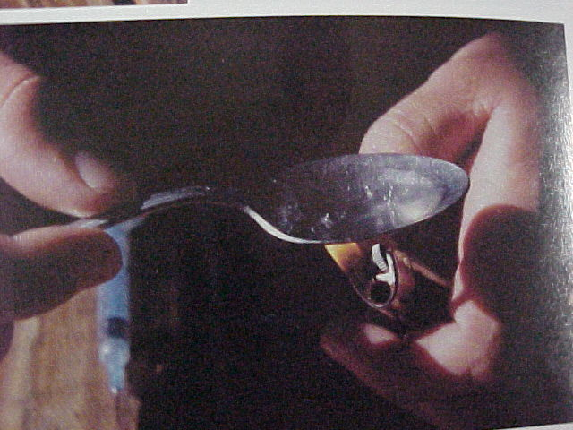
Intravenous Injection

Slide 37
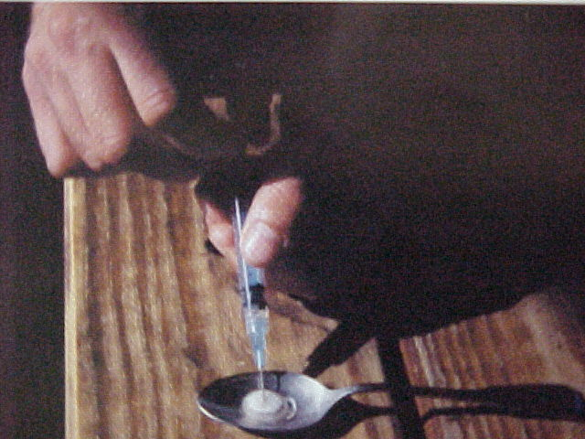
Intravenous Injection

Slide 38
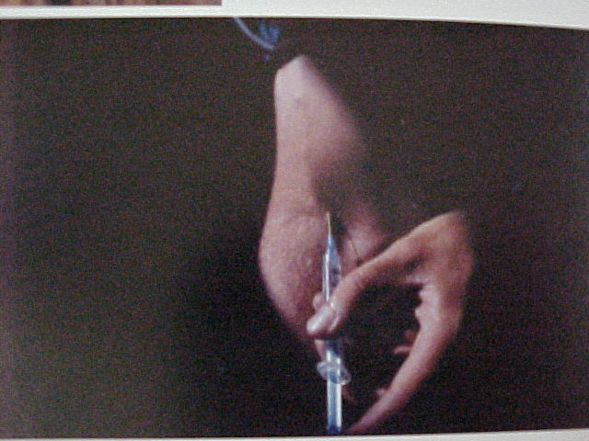
Intravenous Injection

Slide 39
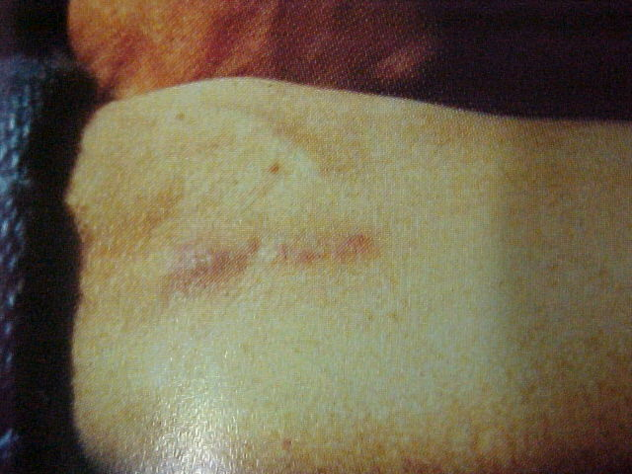
Injection Tracks

Slide 40
Street Prices
.25 gram (dose) $25-$40
1 gram $60-$90
1 piece $600-$1000
1 kilo (tar) $25,000-$40,000
1 kilo (white) $80,000-$100,000

Slide 41
Enforcement Clues
Tar has strong vinegar odor
Mexican National Traffickers
Often bury larger amounts
Very ingenious in smuggling methods
Usually work in family organizations
“Milk Route”
Addicts are creatures of habit

Slide 42

Drugs of Abuse
Stimulants

Slide 43
Types of Stimulants
Cocaine
Cocaine HCL (hydrochloride)
Base Cocaine
Amphetamines and Analogs
Methamphetamine

Slide 44
Medical Uses
Cocaine
eye surgery
Amphetamines
weight control
ADHD
Methamphetamine
none

Slide 45
Indicators of Use
hyperactive
impaired attention
insomnia
easily agitated
violence
over talkative
dilated pupils
difficulty concentrating
anxiety
paranoia

Slide 46
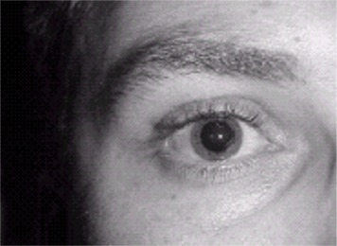
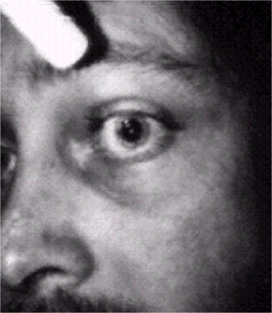
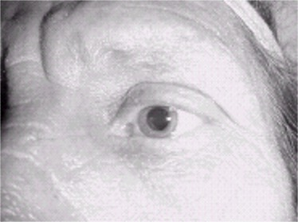
Dilated Pupils

Slide 47
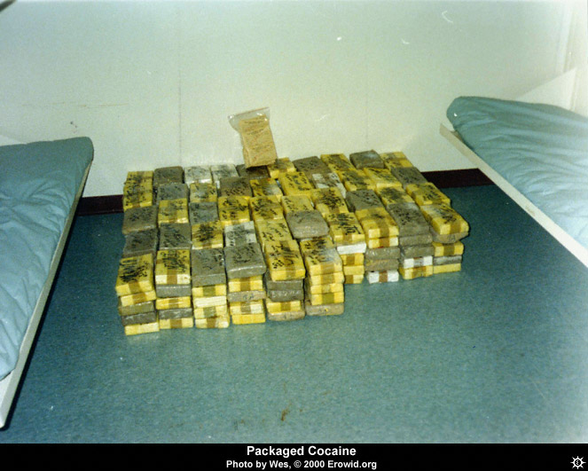
Cocaine HCL
Coke
Blow
Powder
Soft
Blanca

Slide 48
History
Coca Plant
high elevations of Amazon slopes
500 kilos of leaves = 1 kilo of cocaine HCL
500 AD - Leaves of the coca plant used as a dietary supplement.
1860 - Cocaine HCL isolated
1880’s - experimented in various uses

Slide 49
Cocaine HCL
Ingestion
inhalation
IV injection
Indicators
nasal sores
Tracks, abscesses
Duration
30 minutes to 1 hour

Slide 50
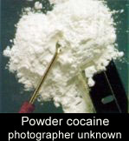
Paraphernalia
Syringe and “works”
snorting tubes
“coke” spoon
mirror
rolled up bills

Slide 51
Street Prices
Teener - 1.75 grams $60-$100
8-Ball - 3.5 grams $100-$150
Ounce - 28 grams $500-$900
1/4 Kilo - 250 grams $6500-$7000
Kilo - 1000 grams $18,000-$22,000

Slide 52
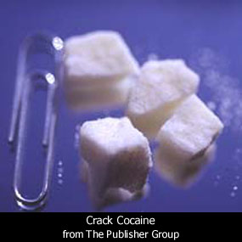
Base Cocaine
Freebase
Rock
Crack
Soup
Chemical conversion of cocaine making it no longer water soluble.

Slide 53
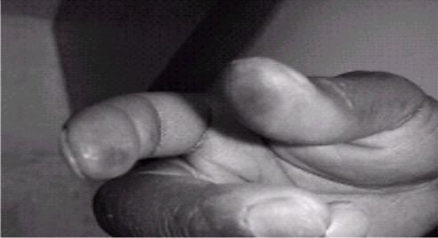
Base Cocaine
Ingestion
smoking
Indicators
blackened gums (not teeth)
burned fingers or lips
Duration
about 10 minutes
“crack run”

Slide 54
Base Cocaine
Paraphernalia
crack pipe - straight glass tube
often with flexible rubber tubing
copper scrub pads
torch / modified lighter
Pyrex cookware
Prices
rock .1-.2 grams $20
seldom sold in quantity above one ounce

Slide 55
Enforcement Clues
Most dealers above 1/4 kilo will be Mexican National or Central/South American
cornered the market on distribution
Base Cocaine is very street level
strong ties to prostitution
can be carried in mouth

Slide 56
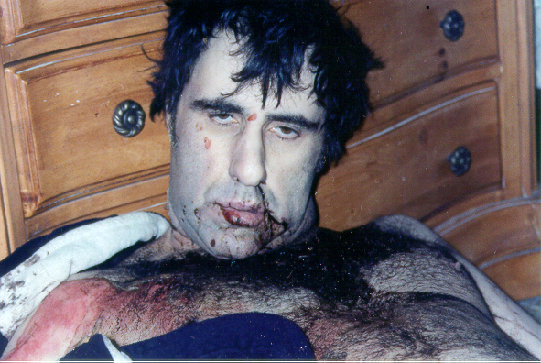
Methamphetamine
Crank
Meth
Crystal
Ice
Speed

Slide 57
History
Ephedra used in tea in China for centuries
1887 - Amphetamine discovered in Germany
1919 - Methamphetamine is synthesized in Japan
1924 - Ephedrine is used in medicine
1932 – Smith-Kline and French make the Benzadrine Inhaler
1936 – Spanish Civil War is the 1st recorded non medical use
1940’s – 39 clinical uses for amphetamine

Slide 58
History cont.
Currently there are only 3 uses for amphetamines
ADHD
Narcolepsy
Certain types of depression
1971 – Amphetamine is made a controlled substance

Slide 59
History (continued)
1970’s - amphetamine use declined
crack down on dispensing
drug of choice became cocaine
1990’s - steady gain in popularity
duration 4-12 hours vs 10 min-1 hr (cocaine)

Slide 60
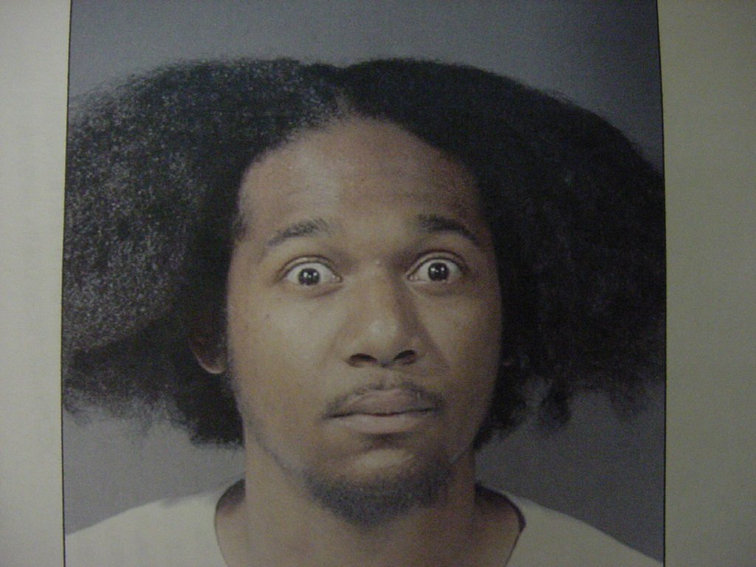
Methamphetamine
Ingestion
inhalation
IV injection
Smoking
Indicators
blackened teeth
prone to violence
extreme paranoia

Slide 61
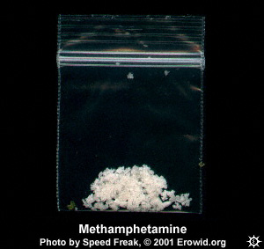
Methamphetamine
Paraphernalia
syringes
pipe - glass with enlarged end
torch or modified lighter
Street Prices
.25 gram $25
1 gram $75-$100
1 ounce $350-$700
1 pound $3500-$6500

Slide 62
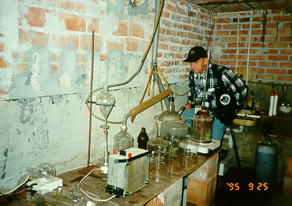
CLANDESTINE LABS

Slide 63
Conversion
3 chemical reactions to create methamphetamine:
Hydriotic Acid / Red Phosphorous (REI)
Birch Reaction (Nazi Lab)
Phenyl 2 Propanone (P2P)

Slide 64
Historical Background
In the Year 1990 there were 38 lab responses in the state of Washington.
In 1995 there were approximately 60 labs “Reported”
In 2002 there were 1,698.
Lab responses are way down

Slide 65
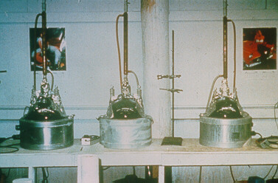
Active Lab

Slide 66
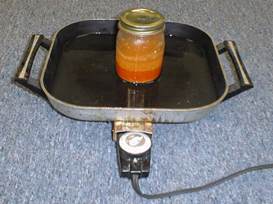
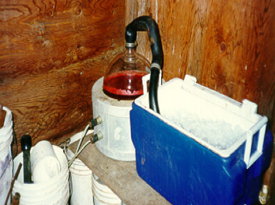
Active Lab

Slide 67
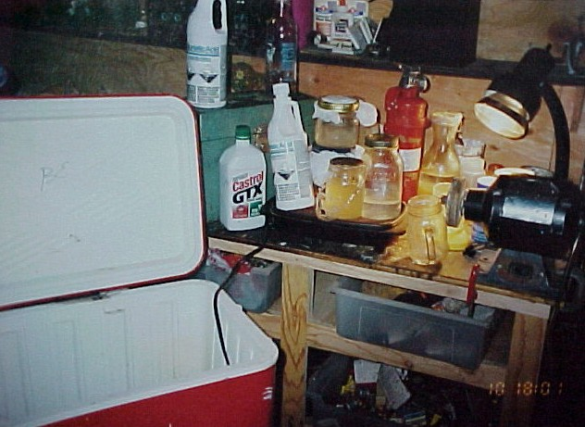
Boxed Lab

Slide 68
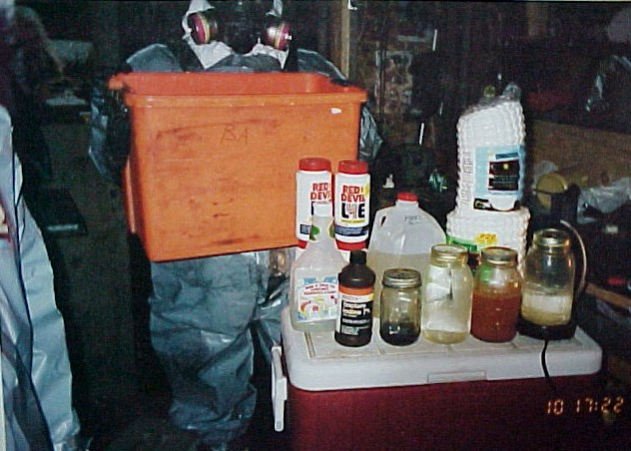
Boxed Lab

Slide 69
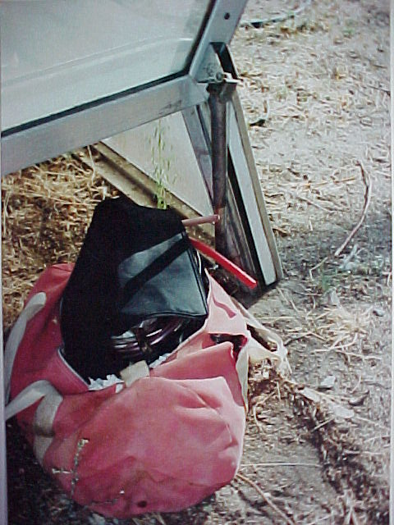
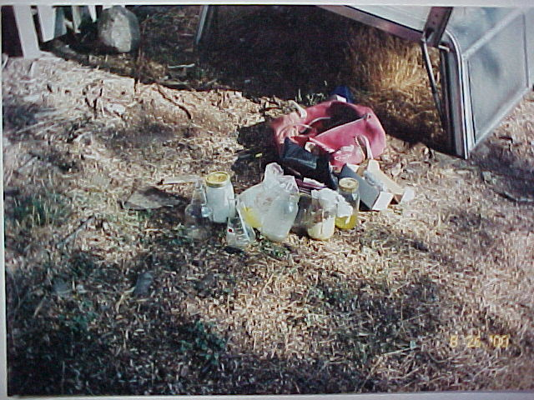
Boxed Lab

Slide 70
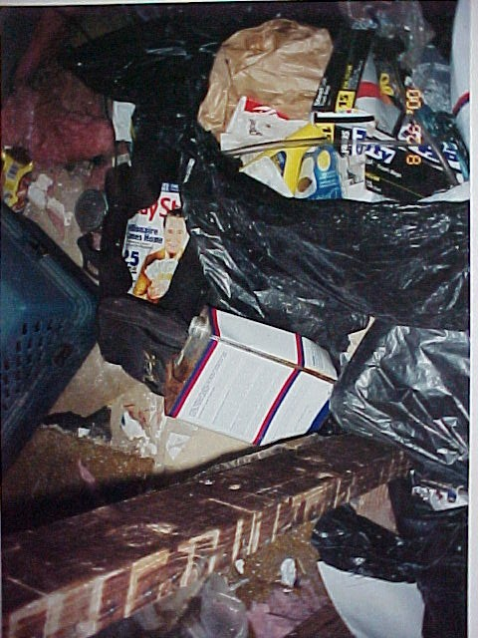
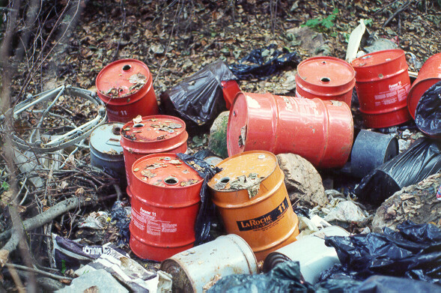
Dump Site

Slide 71
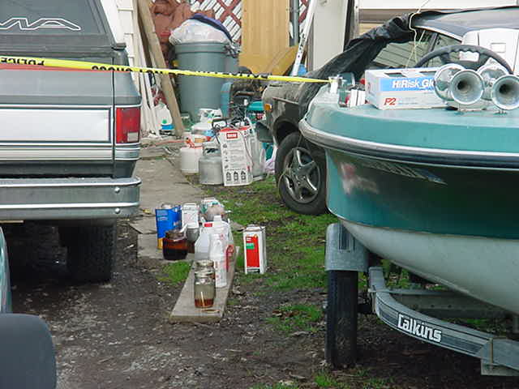
Meth Chemicals

Slide 72
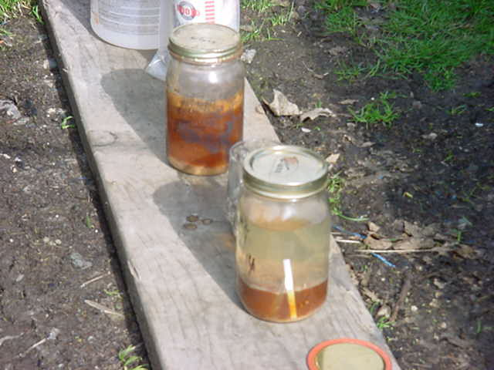
Layered Liquid

Slide 73
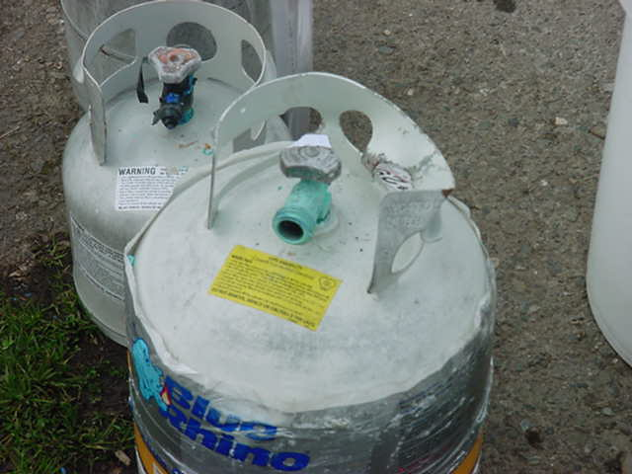
Annie Tanks

Slide 74
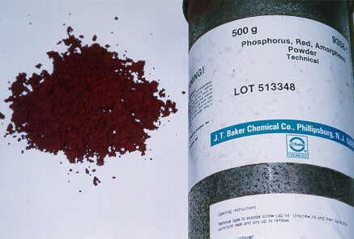
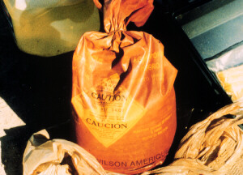
Red Phosphorous

Slide 75
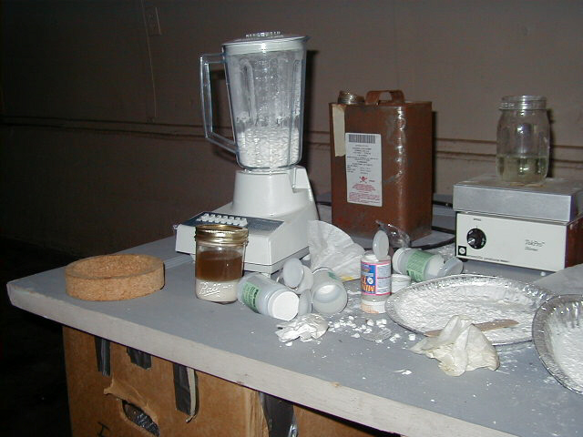
Pseudo-ephedrine Extraction

Slide 76
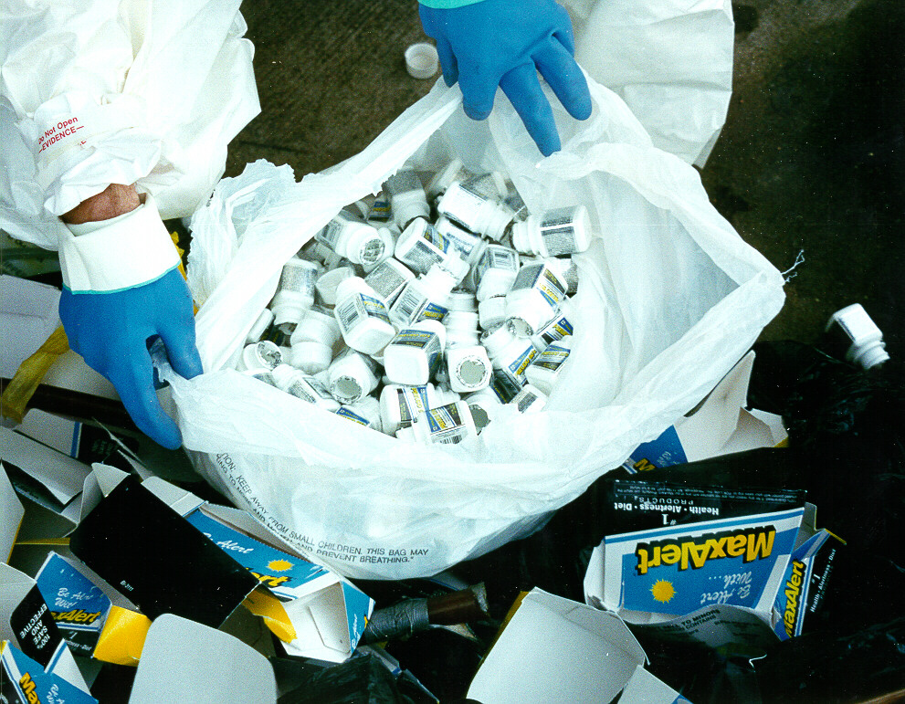
Pseudo-ephedrine

Slide 77
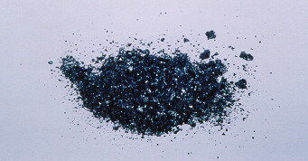
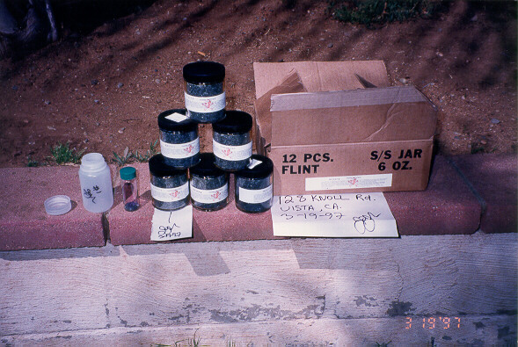
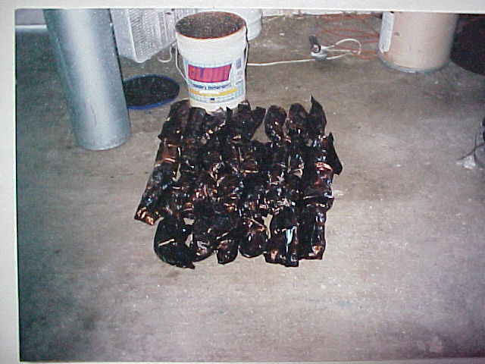
Iodine

Slide 78
Hydriotic Acid/Red P
Pseudo-Ephedrine
Red Phosphorous
Iodine Crystals
Water
Heat to 180 degrees

Slide 79

Super Lab

Slide 80

Super Lab (Prosser, Wa)

Slide 81

Super Lab (Prosser, Wa)
Methamphetamine suspended in solution
Bottom 2/3 is waste material
Top 1/3 product

Slide 82

Super Lab (Prosser, Wa)
34 pounds finished product

Slide 83

Tweaker Lab

Slide 84
Birch Reaction
Birch = “Nazi” Method
Pseudo-ephedrine, Lithium Metal, Anhydrous Ammonia, HCL Gas, Solvent
Huge jump in lab numbers
One hour reaction time vs 12 hours
Small yields (1-2 ounces)
All ingredients readily accessible

Slide 85


Pseudo-ephedrine

Slide 86


Lithium Metal
Discarded Battery Casings

Slide 87

Sodium Metal

Slide 88

Anhydrous Ammonia

Slide 89


Hydrogen Chloride Gas
244 cubic feet HCL Gas
HCL Gas Generator

Slide 90


Nazi Lab (Bickelton, Wa)

Slide 91

Nazi Lab (Bickelton, Wa)
HCL Generator
Sulfuric Acid and Rock Salt

Slide 92

Nazi Lab (Bickelton, Wa)
Reaction in progress
Methamphetamine and lithium hydroxide

Slide 93

Transportation
456 grams methamphetamine

Slide 94

Paraphernalia

Slide 95

At What Cost?
Human Suffering
Societal suffering
Sarah Raddatz
Age 23
2nd generation addict
5 children – pregnant
5 different fathers –all involved in the meth culture

Slide 96

At What Cost?
3 dead in motel room
Phosphine Gas exposure

Slide 97

At What Cost?
Fatal alcohol fire
Pseudo-ephedrine Extraction process

Slide 98

At What Cost?

Slide 99
Enforcement Clues
Odd hours
lots of traffic and activity
Tweaking
Odors
ammonia or solvents
Unusual purchases or amounts
Heavily involved in forgery and stolen cars
Knives and porno

Slide 100

Marihuana
Weed
Bud
Grass
Blunt
Chronic
420
Nugs

Slide 101
Marihuana
Product of the Cannabis plant
can differ greatly in size and appearance
Sativae - 5’-18’, fully branched
Indica - 4’ or less, bushy
Ruderalis - 1’-2’, sparse
Tetrahydrocannabinol (THC) (Must be at least 0.3%)
active ingredient in marihuana
level of THC = potency of marihuana

Slide 102

Indicators of Use
under active
watery, bloodshot eyes
difficulty concentrating
droopy eyelids
giddy, laughing
lack of motivation
sleepy
odor

Slide 103
I-502
What is legal?
Persons twenty-one (21) years and over may possess up to one ounce of marihuana. (28 grams)
Sixteen (16) ounces of marihuana-infused product in solid form; or
Seventy-two (72) ounces of marihuana-infused product in liquid form.
The possession, use, and sale of paraphernalia, pertaining to the consumption of marihuana, is legal. (All other paraphernalia is still illegal.)

Slide 104
I-502
What is Illegal?
Home growing without a valid prescription.
Delivery and Possession with Intent, unless a qualifying patient, a designated provider, or has a retail license. (Licenses will not be issued until December 2013)
Persons under twenty-one (21) years, possession of any amount is illegal, unless they have a prescription.
Amounts between 28.3 grams and 40 grams is still a misdemeanor.
Possession over 40 grams is a Class C Felony. (Check your filing standards)
Driving under the influence of marihuana.

Slide 105
Penalty
It is a class 3 civil infraction ($103) to open a package containing marihuana, useable marihuana, or a marihuana-infused product, or consume marihuana, useable marihuana, or a marihuana-infused product, in view of the general public.
NOTE: Possession in public view is not illegal, only opening a package or consuming the marihuana.
Check your municipality to see if it has adopted the new state law, otherwise a case would have to be filed in district court.

Slide 106
DUI
The new limit is 5.0 nanograms for persons over 21 years and 0.00 for persons under 21 years.
Blood evidence is top priority, as the THC concentration drops rapidly in the first hour after consuming.
Consent or a warrant is required for the blood draw.

Slide 107
Medical Marihuana RCW 69.51a
Qualifying patient or primary caregiver may possess not more than 15 mature plants or 24 ounces of dried marihuana.
Qualifying Patient: Diagnosed with terminal or debilitating medical condition
Valid Documentation: Signed stmt of MD that benefits outweigh the potential risks

Slide 108




Paraphernalia

Slide 109

Testing

Slide 110
Field Testing
Presumptive test
establishes probable cause
can be done in the “field”
Several manufacturers
NIK, ODV, Valtox
all work on similar premise

Slide 111
NIK System
Designed as a poly-testing system
more than one test reduces chance of a false positive
Test generally starts with “A”
except brown heroin or marihuana
Small sample
never more than the circle on the packet

Slide 112
NIK System (continued)
Place substance in packet
Break vials left to right
Agitate for about 1 minute after each vial
Hold against white paper for reading
After reading, introduce soda ash if available and discard
Don’t place in evidence

Slide 113
NIK System (continued)
Do NOT test liquids!
place drop of liquid on small piece of paper
allow to dry
test the paper
Tablets
ground to powder
test portion of powder

Slide 114
Questions???

