Slide 1
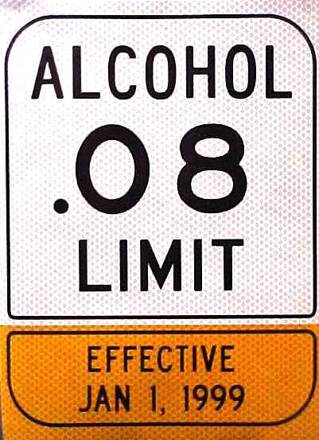
Driving while
Under the
Influence
DUI updates
Rev 7/2014

Slide 2
DUI STATS
In 2008 there were 40,205 people charged with DUI in the state of Washington.
That is a 5% drop from 2006
17,000 convicted, 18,000 plead to lower charges, 8500+ went deferred prosecution, and some are still pending.

Slide 3
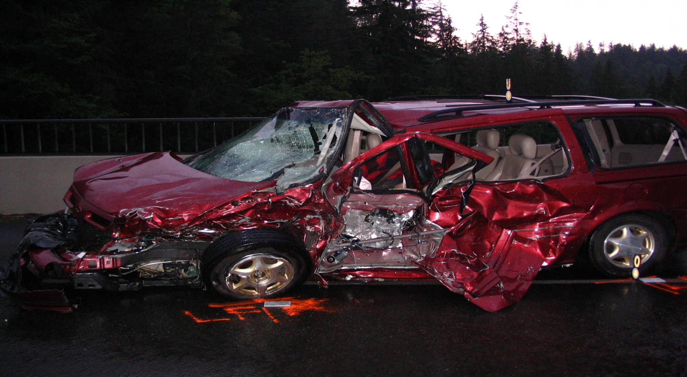
Fatalities

Slide 4
DUI STATS
In 2010 there were 10,000 deaths directly linked to alcohol related crashes nation wide.*
That doesn’t include drugged driving
*NHTSA 2013

Slide 5
RCW 46.61.502 DRIVING UNDER THE INFLUENCE
(a) and the person has,
within 2 hours after driving
an alcohol concentration of
.08 or higher
(b) or the person has a THC concentration of 5 ng or higher
Mental State:
None Required
Act:
(1) Drive a vehicle
within this state
(c) or while the person is
under the influence of
or affected by intoxicating
liquor, marijuana, or any drug
(d)or while the person is under
the combined influence
of or affected by
intoxicating liquor, marijuana, and any drug.

Slide 6
RCW 46.61.502 DUI Statute cont.
  (2) Charged with this violation or entitled to use a drug under the laws of this state shall not constitute a defense against a DUI charge.
  (3) Affirmative defense for 1(a):
    defendant must prove by a preponderance of the evidence
      they consumed a sufficient quantity of alcohol after the time of driving and before the breath/blood testing causing the alc concentration to be a .08 or higher w/I 2 hours after driving.

Slide 7
RCW 46.61.502 DUI Statute cont.
(4) Analyses of breath or blood samples obtained after 2 hours of alleged driving:
  Maybe used as evidence that within 2 hrs of driving a person’s BAC was .08 or higher in violation of 1(a).
  And any case w/BAC above .00 maybe used as evidence of a person being under the influence of intoxicating liquor or drug in violation of 1(b and c)

Slide 8
46.61.502 DUI statute and Collisions
  RCW 10.31.100 Arrest w/o warrant 1(d):
    Must have PC
    Violation committed in presence or have collection of impairment evidence
        Witness statements
        Prove driving
        Other indicators of impairment.
        CAD log from dispatch
Notes:
Student Participation: State v. Hamrick 1978
Question:
“How do we prove driving?”
What are some other ways of showing impairment besides SFST’s?

Slide 9
RCW 46.61.504 PHYSICAL CONTROL OF VEHICLE
UNDER THE INFLUENCE
(a) the person has,
within 2 hours after being in actual physical control
an alcohol concentration of
.08 or higher
Mental State:
None Required
(b) or a THC concentration of 5ng or higher
(c) or while the person is
under the influence of
or affected by intoxicating
liquor or any drug
Act:
(1) Be in actual physical control of a motor vehicle
within this state
(d) or while the person is under
the combined influence
of or affected by
intoxicating liquor and
any drug

Slide 10
Physical Control
RCW 46.61.504
(2) No person may be convicted under this section if, prior to being located by a law enforcement officer, the person has moved the vehicle safely off the roadway.
(3)(a)An affirmative defense, which the defendant must prove by a preponderance of the evidence, that the defendant consumed a sufficient quantity of alcohol after time of the stop and before breath/blood testing.

Slide 11
Mandatory DUI Booking
Updated RCW 10.31.100: Arrest w/o warrant
This statute covers restraining orders, protection orders, and DV arrests that require mandatory booking
(16) As of 9-28-2013, it now requires mandatory booking if there are any prior DUI convictions

Slide 12
FELONY DUI (class C)
1st DUI is a Gross Misdemeanor
5th DUI w/in last 10 years is Felony DUI

Slide 13
What is a prior offense*?
RCW 46.61.5055
DUI or Physical Control
Vehicular Homicide or Vehicular Assault
Above charge that was reduced to Neg 1st, Reckless driving, or reckless endangerment
*Convictions
5. Conviction for DUI amended to Neg 1st, Reckless driving,
reckless endangerment

Slide 14
Prior offense cont.
Deferred prosecution of DUI or Physical Control
Out of state DUI convictions
An out of state offense comparable to Vehicular Homicide or Vehicular Assault

Slide 15
Implied Consent
RCW 46.20.308
Test Refusal-Procedures.
Any person who operates a motor vehicle within this state is deemed to have given consent, to a test or tests of their breath for the purpose of determining the alcohol concentration, THC concentration, or presence of any drug in his or her breath if arrested for any offense where,
  At the time of arrest
  Officer has reasonable grounds person was driving or in physical control of the motor vehicle
  While under the influence
  Intoxicating liquor or any drug or violation of RCW 46.61.503
  Neither consent or nor this section precludes an officer from obtaining a search warrant for blood.

Slide 16
DUI – Breath sample
Read Implied Consent Warnings for breath
Obtain breath samples if consent given
If consent is not given enter a refusal*
*refer to dept. policy on search warrants

Slide 17
Negligent Driving-1st degree
RCW 46.61.5249
(1)(a) Person operates a motor vehicle in a manner that is both negligent* and endangers or is likely to endanger any person or property, and exhibits the effects of having consumed liquor or an illegal drug.
Notes:
Negligent means: failure to exercise ordinary care and is doing some act a reasonable person would not do.
You may have someone that is showing mild effects of consuming but is under an .08

Slide 18
Negligent* Driving
1st degree
(b) Affirmative defense:
  Proven by preponderance of evidence by defense
  Driver has a valid prescription for drug and is consuming according to prescription directions and warnings

Slide 19
Negligent* Driving
1st degree
(c) misdemeanor
  * failure to exercise ordinary care and doing some act that a reasonably careful person wouldn’t do under same circumstances

Slide 20
Negligent Driving 1st degree
  (2)(b)Exhibiting the effects of having consumed liquor, marijuana, or any drug
    person has the odor of liquor, marijuana, or any drug on his or her breath
      or that by speech, manner, appearance, behavior, lack of coordination, or otherwise exhibits that he or she has consumed liquor, marijuana, or any drug
      and is in possession of liquor, marijuana, or any drug
      or is shown by other evidence to have recently consumed liquor, marijuana, or any drug.

Slide 21
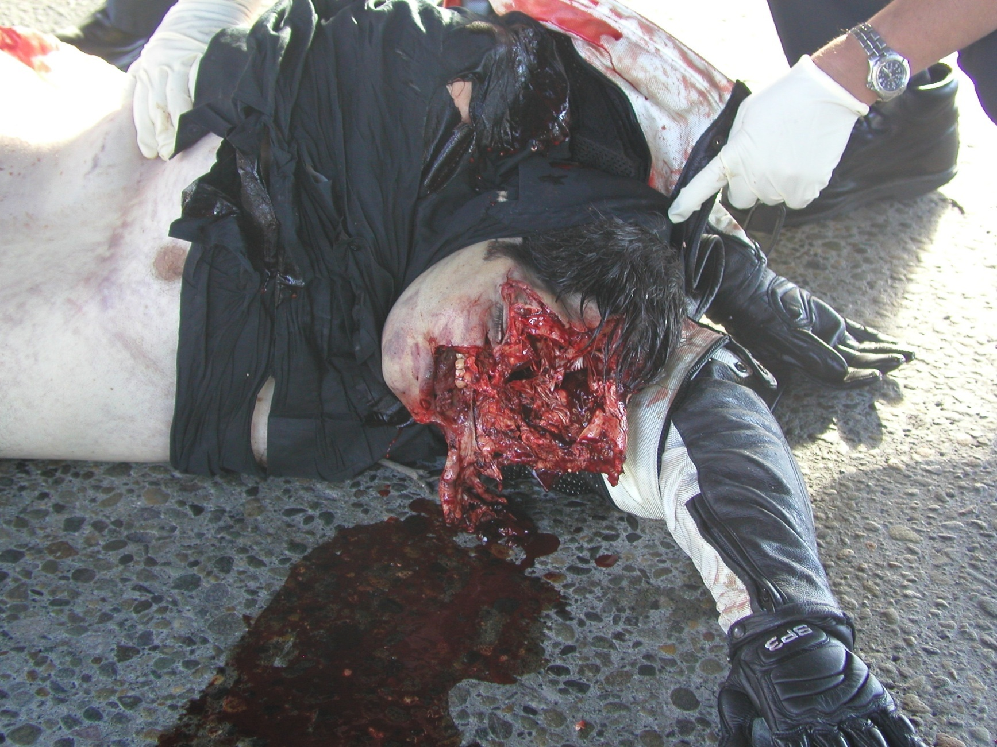

Slide 22
Vehicular Homicide
RCW 46.61.520
Class A Felony
(1) Death of a person ensues within 3 years as a proximate result of injury proximately caused by the driving of any vehicle by any person, the driver is guilty if the driver was operating a motor vehicle;
    (a) while under the influence of intoxicating liquor or any drug; as defined by 46.61.502;
    OR in a reckless manner
    OR with disregard for the safety of others (negligence)

Slide 23
Vehicular Assault
RCW 46.61.522
Class B Felony
(1) Person is guilty if he/she operates or drives any vehicle:
  (a) in a reckless manner and causes substantial bodily harm to another; OR
  (b) while under the influence of intoxicating liquor or drug and causes substantial bodily harm to another
  With disregard for the safety of others and causes substantial bodily harm to another (DSO)

Slide 24
Substantial bodily harm
RCW 9A.04.110 (b)
  bodily injury which involves
    Temporary but substantial disfigurement, OR
    Causes temp but substantial loss or impairment of the function of any bodily part or organ, OR
    Causes a fracture of any bodily part.
Notes:
What are some of the injures that might be considered substantial bodily injuries?

Slide 25
Scenario
You have a 2 car collision, driver had 1 beer, shows no signs of impairment, passenger is seriously injured, he is also not responsible for collision.
Driver of other vehicle ran red light and was speeding.
Who do you take for Vehicular Assault?

Slide 26
Missouri v. McNeely
US Supreme Court decision
Natural dissipation of alcohol in blood “alone” is insufficient to establish an exigency to justify a warrantless search for blood
Notes:
Missouri v. NcNeely, 358 S.W.3d 65 (Mo. 2012)cert granted (September 25, 2012). Whether a LEO may obtain a nonconsensual and warrantless blood sample from a drunk driver under the exigent circumstances exception to the Fourth Amendment warrant requirement based upon the natural dissipation of alcohol in the bloodstream.
Defendant arrested for basic DUI, ICW for breath and refused, LEO drove to hospital and took blood w/o warrant

Slide 27
Exigent Circumstances
Emergency situation requiring swift action
Prevent imminent danger to life or serious damage to property
*Forstall the imminent destruction of evidence
Blood draw must be determined based on the totality of the circumstances

Slide 28
Totality of Circumstances
Time of day
Remoteness of area
Unable to contact judge
Delay during transport to hospital
Blood adulterated by meds on board
Extensive investigation and
no other officers available to assist

Slide 29
Reminders
Exigency will be determined according to each particular case
Exigent circumstances aren’t necessarily unusual circumstances
Circumstances outside our control
Exigencies created by LEO will not be considered exigent

Slide 30
Search Warrant for Blood
Vehicular Assault
Vehicular Homicide
Felony DUI
Unconscious DUI
DUI crash with serious bodily harm

Slide 31
Breath to Search Warrant for Blood
Low BAC doesn’t match impairment
At BAC & unable to give Breath sample
Defendant being treated in hospital

Slide 32
Search Warrant for Blood…
SEARCH WARRANTS FOR BLOOD
Current (post-McNeely & Cobb) search warrant templates available from WSP Impaired Driving Section or your local prosecutors
www.wsp.wa.gov/breathtest
  Refer to your policies on warrants or contact local prosecutor for advice.

Slide 33
Medical care required?
The LEO should remain with defendant at the hospital until they are medically cleared
If extended wait consider a court release of the defendant on personal recognizance
Consult your superiors

Slide 34
Voluntary Blood
Defer to your agency policy but consider
Takes time to transport to hospital etc.
Defendant can change their minds at any time!
What if it’s not their 1st DUI but 5th/felony?

Slide 35
Driver Under 21 Consuming Alcohol
RCW 46.61.503
Misdemeanor
A person is guilty of driving a motor vehicle after consuming alcohol or marijuana if the person operates a motor vehicle within this state
  Is under 21 years old
  Has within 2 hours after operating or being in physical control of the motor vehicle an alcohol concentration of at least .02 , THC above 0.00
  It is an affirmative defense which the defendant must prove by a preponderance of the evidence that the defendant consumed a sufficient quantity of alcohol within 2 hours of driving.

Slide 36
Furnishing liquor to minors-possession
RCW 66.44.270
(1) furnishing to minor is gross misdemeanor
(2)(a) Minor in Possession
  It is unlawful for any person under the age of 21 years to possess, consume, or otherwise acquire any liquor.
  (Gross Misdemeanor)
Notes:
This does don’t apply if the person is in the presence of a parent or guardian, being used for medicinal purposes given by a doctor or dentist, or for religious reasons and the amount is minimal for the religious service.

Slide 37
Minors and Alcohol
RCW 66.44.270(2)(b) Exhibiting Effects
  Unlawful for a person under 21 yrs to be in a public place, or to be in a motor vehicle in a public place, while exhibiting the effects of having consumed liquor.
  Exhibiting the effects of having consumed liquor:
    person has the odor of liquor on his or her breath and either:
      Is in possession of or close proximity to a container that has or recently had liquor in it; or
      by speech, manner, appearance,behavior, lack of coordination, or otherwise, exhibits that he or she is under the influence of liquor.

Slide 38
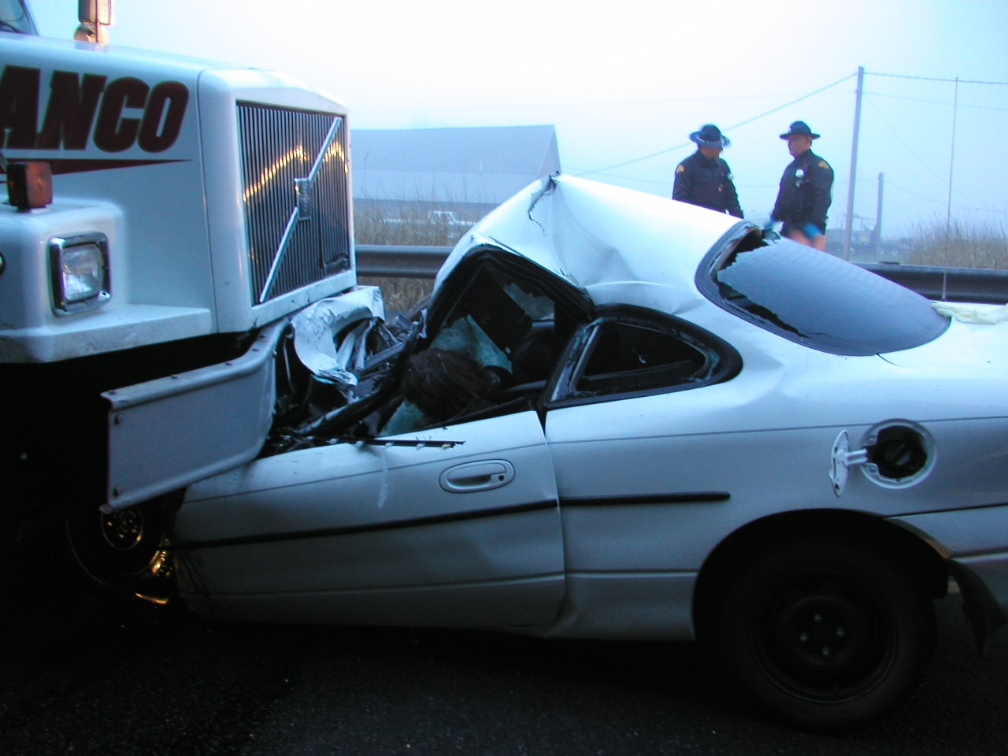
Notes:
DRT

Slide 39
Commercial Motor Vehicles
RCW 46.25.110
Driving with alcohol or THC in system
  (1) a person may not drive, operate or be in physical control of a commercial motor vehicle while having alcohol or THC in his or her system.
  (2) Law enforcement or appropriate official shall issue an out of service order valid for 24 hours against a person who drives, operates or is in physical control of a commercial motor vehicle while having alcohol or THC in his or her system or who refuse to take a test to determine his or her alcohol content or THC as provided by RCW 46.25.120. GROSS MISDEMEANOR
Notes:
Remember this is only the driver that is being put out of service for 24 hours, not the truck itself. Try and make arrangements with owner to come get the truck instead of impounding it ( perishables).
Also remember that if they refuse the BAC then you still put them out of service for 24 hours.
Also this only applies when the driver is driving a commercial vehicle.

