Slide 1
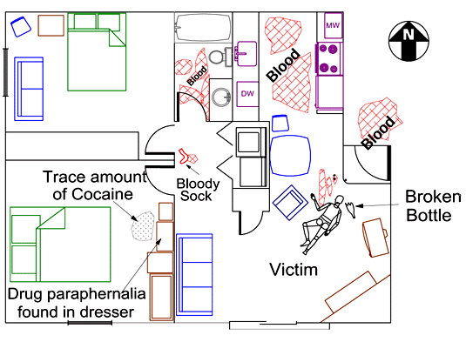
Criminal Investigations Crime Scene Diagrams
Crime Scene Diagrams

Slide 2
Learning Goals:
List the items that a diagram should include
Identify the basic methods of placing objects at a scene
List the three types of sketching
List the common errors when diagramming a crime scene
Given a scenario, perform measurements and complete a diagram of a scene

Slide 3
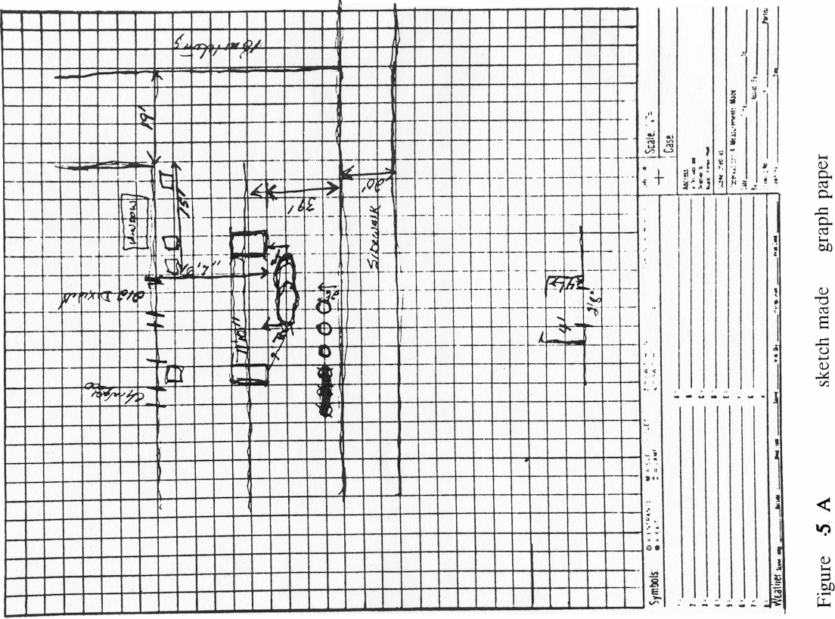
Rough Draft

Slide 4
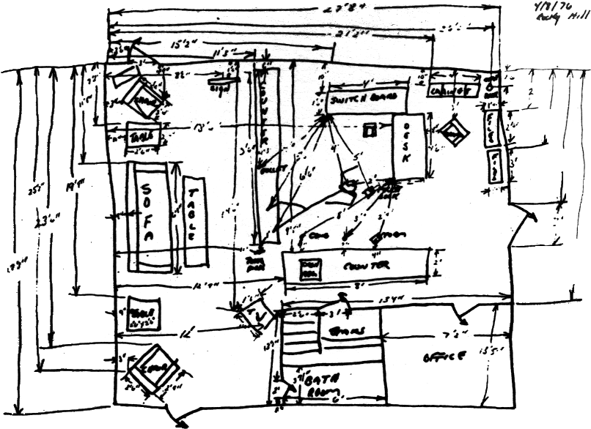
Too Much, Unreadable!
Notes:
Bill would normally give suggestions here about using overlays and putting the legend on another page…

Slide 5
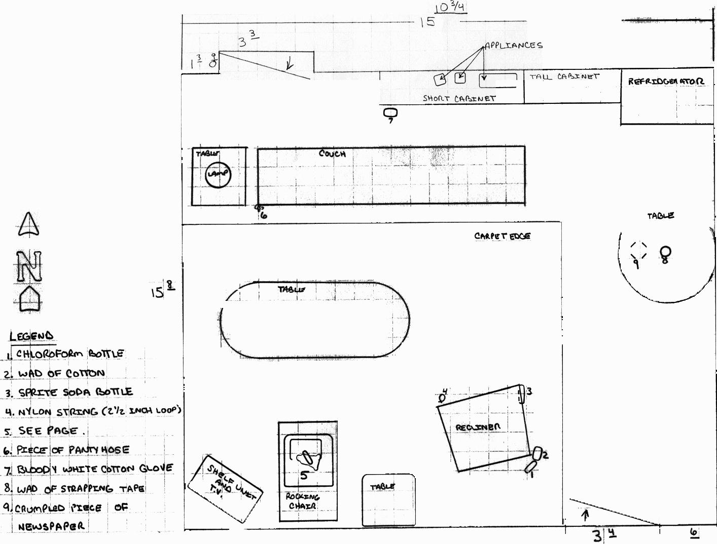
Finished Diagram (graph paper)

Slide 6
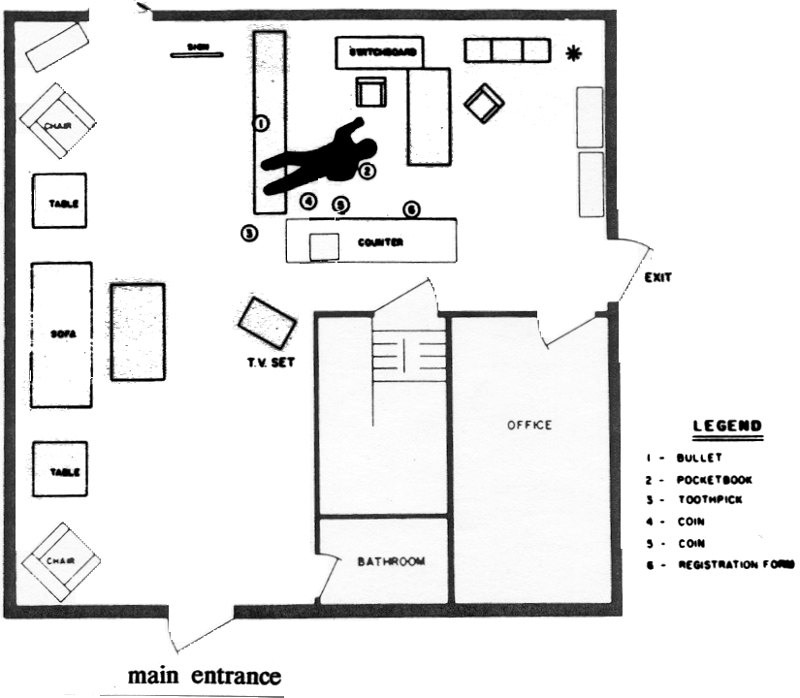

Slide 7
Diagrams Should Include:
Case number
Date, time, location
Weather and lighting conditions
Identity and assignments of personnel

Slide 8
Diagrams Should Include:
Dimensions of rooms, furniture, doors, windows
Distances between objects, persons, bodies, entrances, exits
Measurements showing location of evidence
Key, legend, compass orientation, scale (or disclaimer)

Slide 9
Methods of Measuring
Rectangular Coordinate (Baseline Method)
Triangulation Method

Slide 10


Rectangular (Baseline)
RP
6’6.5”
6’8”
5’5.5”
5’8.5”
A
B

Slide 11
LEGEND/SITE MEASUREMENTS
Case#: _____________ Measuring Device Used: _______________
Date:_______________ Victim’s Name: ______________________
Location: _______________________________________________
Drawn By: ______________________________________________
Measured By: ____________________________________________
RP to: | Description/Item | N | E | S | W
RP | NW Corner of Room
Point A | Center Receiver, Phone |  | 6’6.5” | 5’5.5”
Point B | Center Transmitter, Phone |  | 6’8” | 5’8.5”

Slide 12

Body Placement (6 points)
RP

Slide 13
Triangulation Method
RP1
RP2

Slide 14
Projection Methods
Overview Projection
Cross Projection

Slide 15
Overview Projection

Slide 16
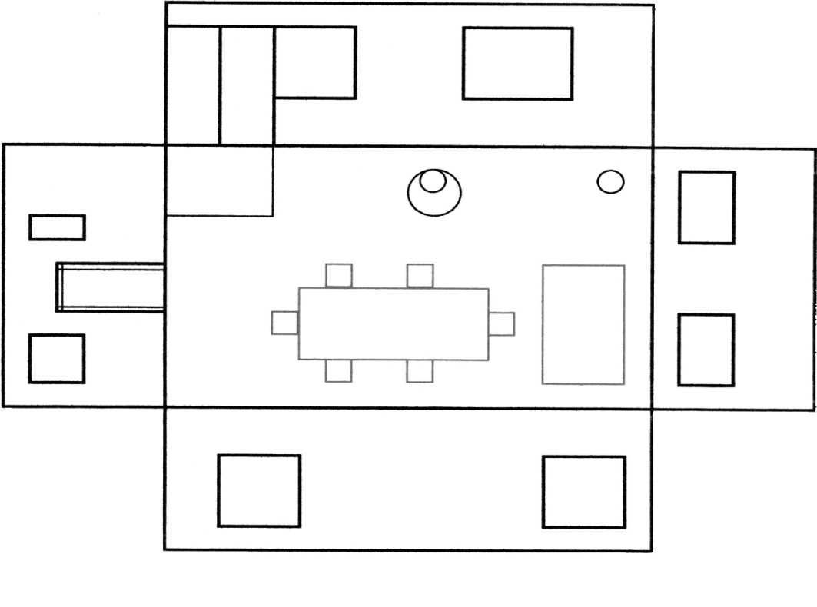
Cross Projection

Slide 17
Three Types of Sketching
Sketch of Locality
Sketch of Grounds
Sketch of Details

Slide 18
Technological Advances
Computer Aided Drawings (CAD)
Global-Position Satellite Devices (GPS)
Total Station (laser guided measurements)

Slide 19
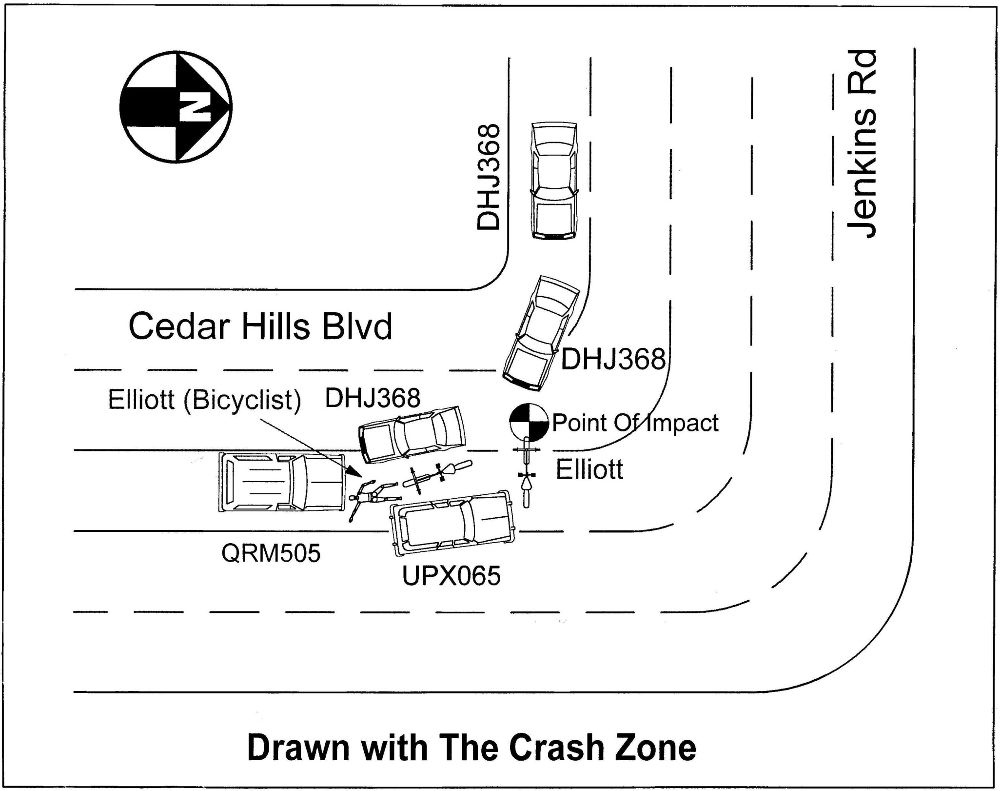

Slide 20
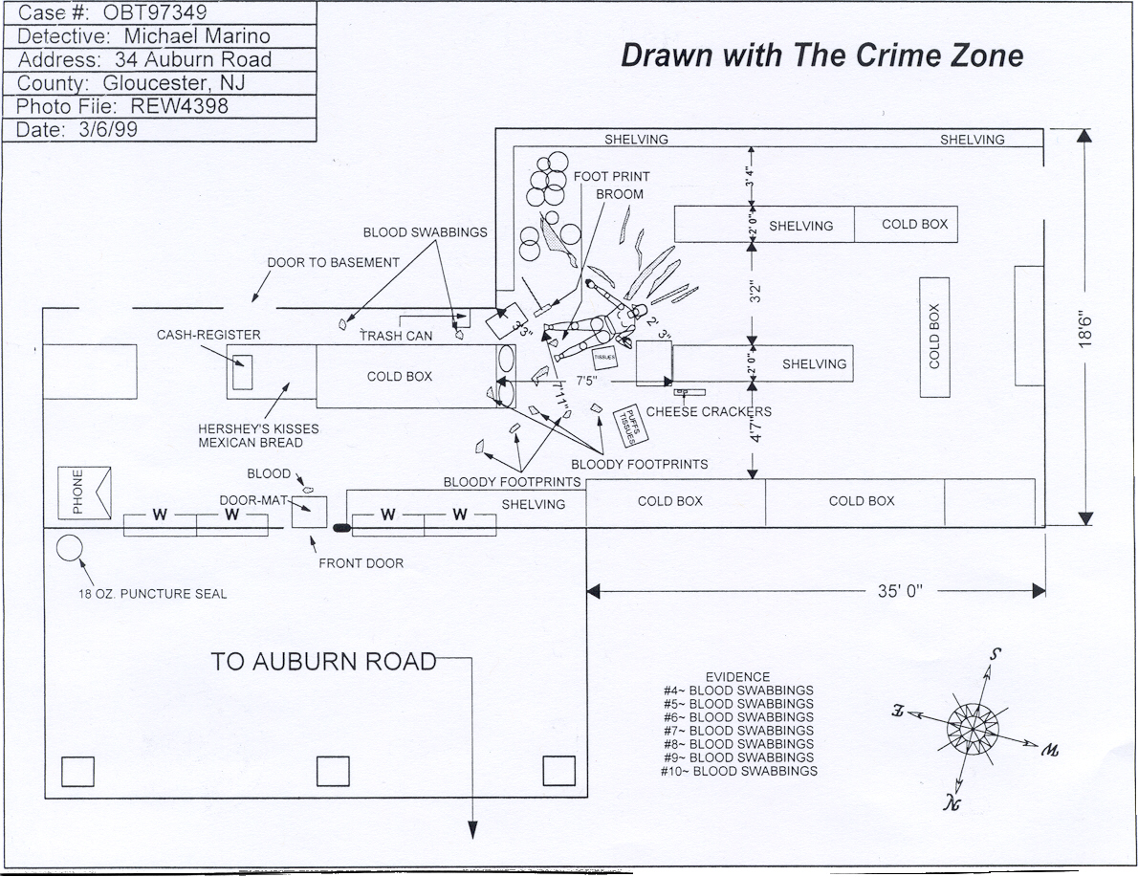

Slide 21
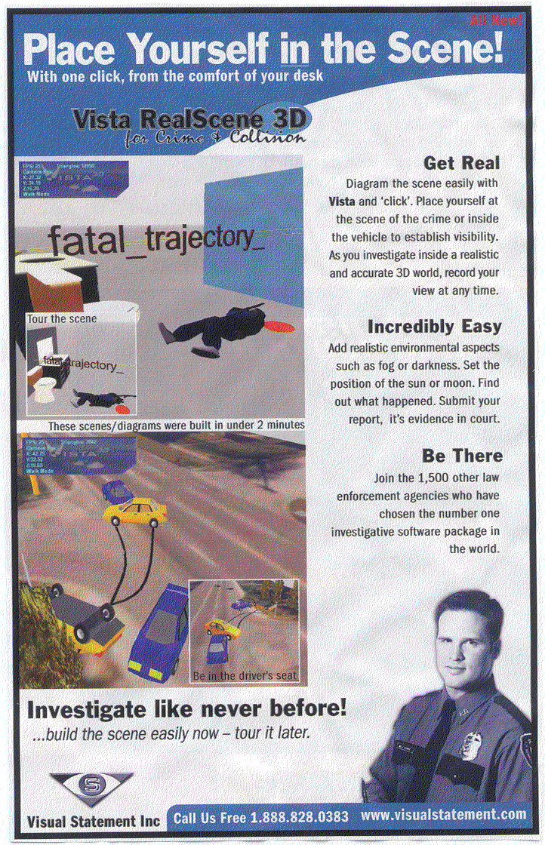
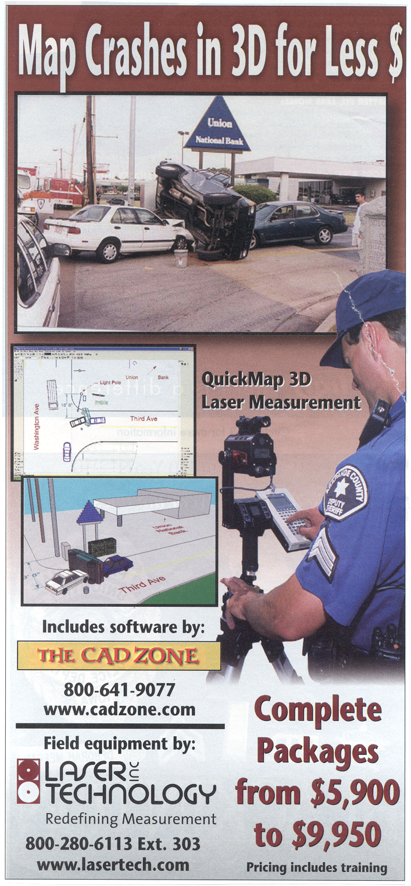
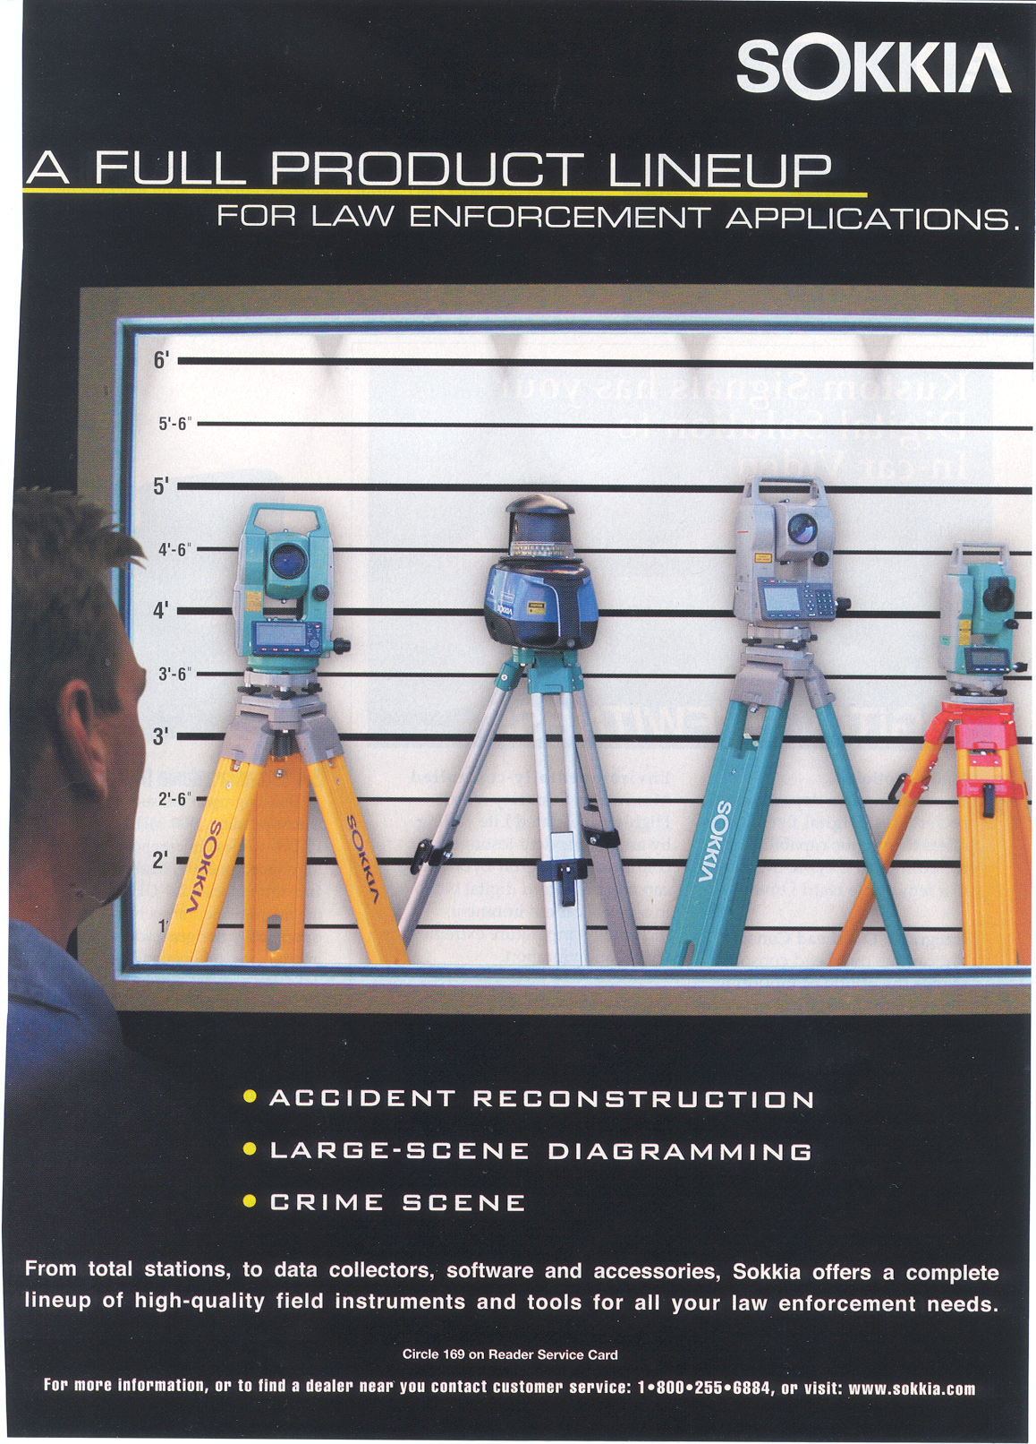

Slide 22
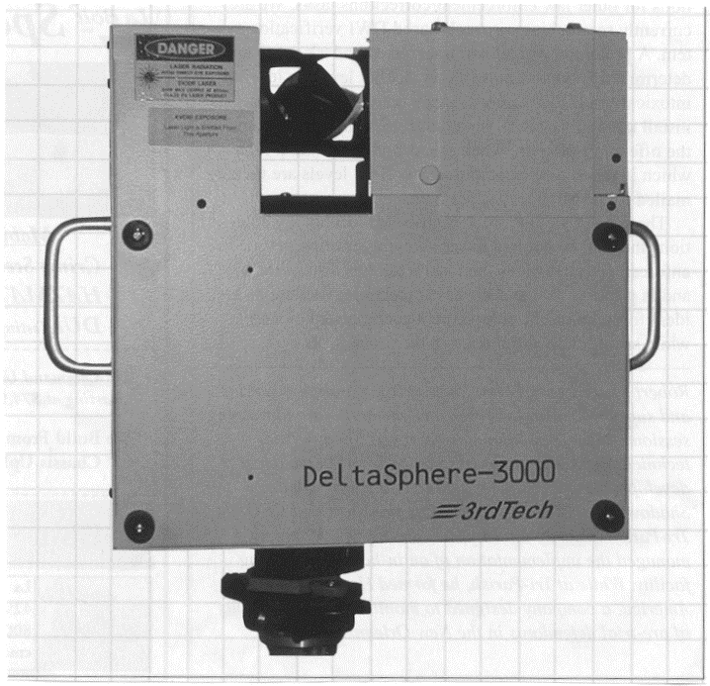
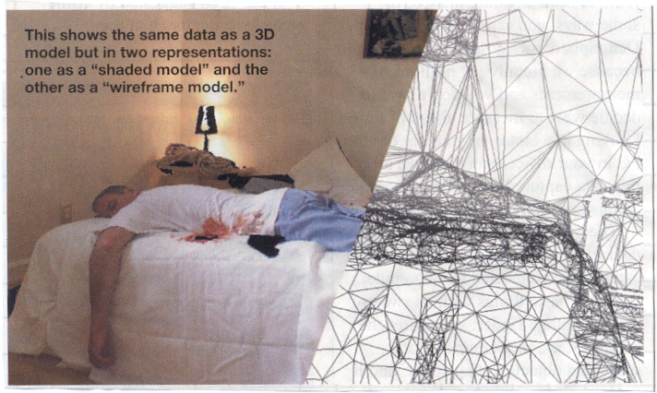
3D Scene Digitizer

Slide 23
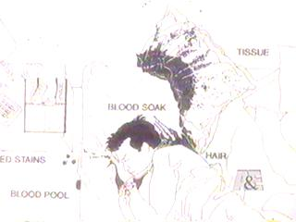
Artist’s sketch of scene

Slide 24
Errors when Diagramming
Measuring a distance by pacing and then recording results in feet and inches
Relying on memory alone
Correctly outlining the dimensions of a room and then placing objects within by mere visual means (no measurements)
Not being able to read your measurements
Improper measuring device or technique

Slide 25
Practical Exercise
In your teams, practice measuring objects within the classroom using the methods given in class

Slide 26
Considerations
Decide what is to be sketched beforehand
Don’t sketch until familiar with the scene
Leave out objects not relevant to the case
Include only essential information
Your diagrams will not be exact, they will be approximate
Rough sketch to be included with the case file as well as the finished copy

Slide 27
Review
Purposes of crime scene diagrams
General rules
Methods of measuring
Types of sketches
Computer sketching software
Artist sketching

Slide 28
Journal Reminder
Observations
Insights
Key Learning
Remaining Questions

