Slide 1

Seizing Electronic and Digital Evidence
Presented by Jim Dibble, CFCE, SCERS, DFCP
Special Agent, Washington State Gambling Commission
Notes:
Good Morning/Afternoon –
I’m Jim Dibble, assigned to the agency Criminal Intelligence Unit.
(Give BRIEF history of forensic computer qualifications):
Law Enforcement for roughly 25 years
Forensic Computer qualifications include:
Certified Electronic Evidence Collection Specialist
Seized Computer Evidence Recovery Specialist
Certified Forensic Computer Examiner
Trained in use of EnCase & Access Data Forensic Software
Welcome to this presentation on “Electronic Evidence Seizure”. The goal of this training is to provide you with a practical overview of electronic evidence. Specifically, we’ll spend some time discussing what constitutes electronic evidence and then we’ll discuss the procedures used in the search and seizure of computers and computer-related electronic evidence.
[NEXT SLIDE]

Slide 2

Electronic Evidence Seizure
Why should we care?
Today it is more likely than not that a computer was used during the commission of a crime
Crimes involving computers
are increasing
Evidence
A new generation of criminals
Notes:
“In this age of technology”…
In this age of technology, it is more likely than not that a computer was used to commit or during the commission of a crime. Today, some 95% of all documents are created using a computer. Daily electronic mail or email traffic far outstrips postal mail and telephone usage combined. Computer technology impacts every facet of our modern life, and the crimes, torts and disputes which carry us to the courthouse are no exception.
“Crime involving”…
The fact is, computers are used in virtually every type of crime you can imagine. Can you think of some of the gambling-related crimes where electronic evidence may be involved? Fraud, Forgery, Theft, Extortion, Embezzlement, to name a few, and that doesn’t even include other more heinous cyber-crimes like child exploitation and pornography.
“Evidence”…
Many times critical evidence is unwittingly left behind at the crime scene. Agents routinely walk right past the “smoking gun” because agents/officers don’t consider the computer or electronic storage devices as containers of evidence. (Hold up thumb drive) Why? – probably because the evidence is not readily visible. This is where we must be creative and spend some time thinking about what electronic evidence could be available.
“The new generation…”
As criminal become more sophisticated, so do their schemes…and their tools. A whole new generation of cyber-criminals has grown up with computers, which are a part of their culture. This new generation of criminals are computer literate and we need to be also, if we are to mitigate the impact of electronic crime.
“Civil vs…….”
As law enforcement professionals, we must be aware of the law regarding the seizure and examination of electronic evidence, as civil and criminally liability may result if evidence is not seized properly.
[NEXT SLIDE]

Slide 3
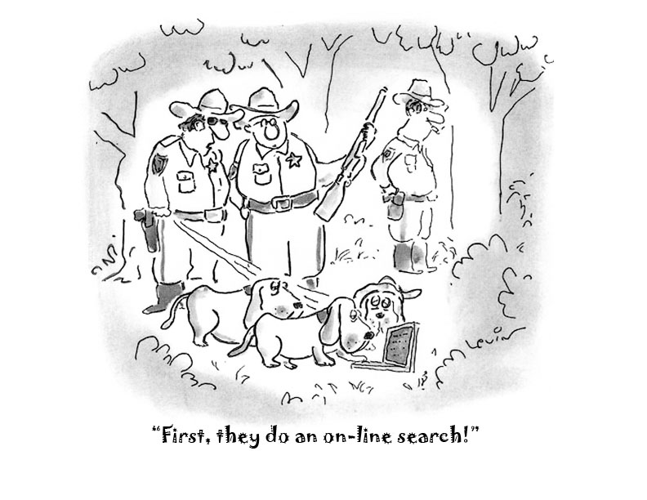
Notes:
No one can deny that computers have revolutionized our professional and personal lives. As law enforcement professionals, it is imperative that we all adapt to this dynamic, emerging technology, if we are to be effective in identifying crime and bringing the culprits to justice.
(NEXT SLIDE)

Slide 4

Seizing Electronic and Digital Evidence
GEEK QUIZ #1
HOW MANY BITS ARE IN ONE BYTE?
8

Slide 5


Seizing Electronic and Digital Evidence
You’ve been trained to handle this…
What about this?

Slide 6
Seizing Electronic and Digital Evidence
COURSE OBJECTIVES
Why this training is important
What is a Computer and/or Computer Equipment
Consent to Search & Search Warrant Issues
Explain how to recognize and properly seize computer evidence
Explain why a trained specialist is needed for seizing electronic evidence
Examples of common situations that a forensic examiner may encounter

Slide 7
Seizing Electronic and Digital Evidence
Cases that may involve Digital Evidence
Child Porn
Fraud
ID Theft
Threats
Suicide
Homicide
Sexual Assault
Computer Trespass
Narcotics Investigations
Burglary
Extortion
Stalking
DV Violations
Internet Gambling

Slide 8
Seizing Electronic and Digital Evidence
Why train to seize electronic evidence?
To prevent the loss or destruction of digital evidence
Defense Attorney’s are becoming tech savvy
Prosecutions are lagging nationwide

Slide 9

Seizing Electronic and Digital Evidence
Who are you investigating?
Computer user:
Novice
Expert
Hacker
Is the computer:
In a business or home?
Used by someone other than the suspect?
Technically capable of criminal use?
Internet Access
Necessary Software or Hardware

Slide 10
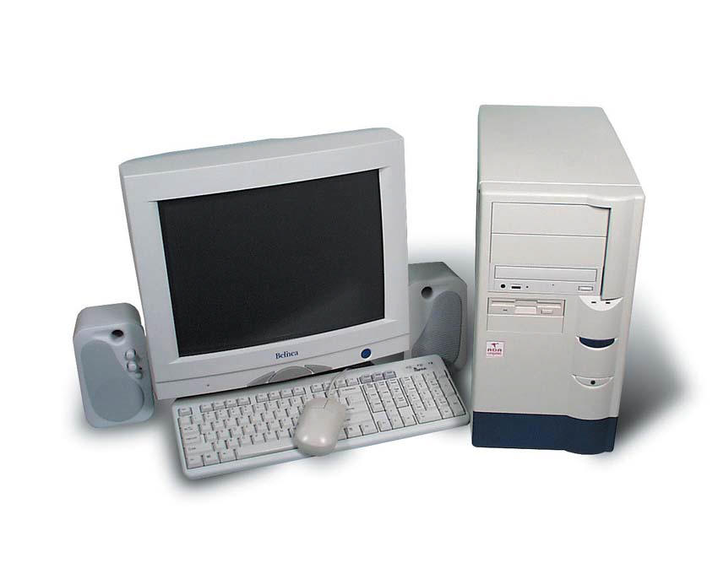
Seizing Electronic and Digital Evidence
What is a computer?
According to RCW 82.04.215:
(1) "Computer" means an electronic device that accepts information in digital or similar form and manipulates it for a result based on a sequence of instructions. .

Slide 11
Seizing Electronic and Digital Evidence
What is Computer Equipment?
Computer hardware consists of all equipment, which can collect, analyze, create, display, convert, store, conceal, or transmit electronic, magnetic, optical or similar computer impulses or data.
Hardware includes:
any data-processing devices (such as central processing units and self contained “laptop” or “notebook" computers or "Personal Data Assistant" handheld computer/organizers)

Slide 12
Seizing Electronic and Digital Evidence
What is Computer Equipment? (cont)
internal and peripheral storage devices (such as fixed disks, floppy disks, external hard disks, floppy disk drives, floppy disks, and diskettes, tape drives and optical storage devices, and other memory storage devices)
peripheral input/output device (such as keyboards, printers, scanners, plotters, video display monitors and optical readers) and related communication devices (such as modems, cable and connections, recording equipment, speed dialers, programmable telephone dialing or signaling devices), the cables, cords and connectors for the above devices including battery charging devices for any of the above devices

Slide 13
Seizing Electronic and Digital Evidence
What is Computer Equipment? (cont)
as well as any devices, mechanisms or parts that can be used to restrict access to computers hardware (such as physical locks and keys).

Slide 14
Seizing Electronic and Digital Evidence
Can the evidence be seized by consent?
Is there a need for a search warrant?

Slide 15
Seizing Electronic and Digital Evidence
Consensual Search of Computer and Electronic Media
CONSENT CONSIDERATIONS
Who can provide the consent?
Where will the “search” be conducted?
Can the consent be withdrawn or limited?
Does your agency have a consent form?
When in doubt….”WRITE IT OUT”

Slide 16
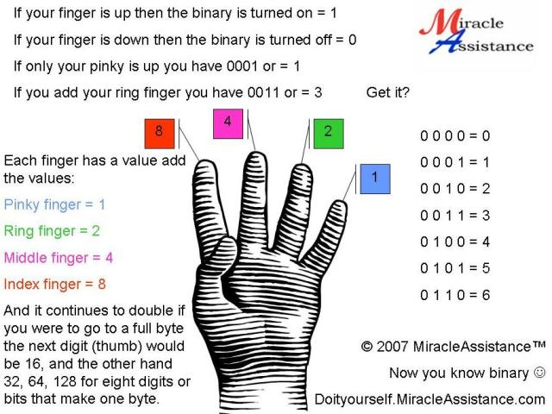
Seizing Electronic and Digital Evidence
GEEK QUIZ #2
WHAT IS THE NAME FOR HALF A BYTE?
A NIBBLE

Slide 17
Seizing Electronic and Digital Evidence
SEARCH WARRANTS
Is there probable cause to seize hardware?
Is there probable cause to seize software?
Is there probable cause to seize data?
Where will the search be conducted?
Who will conduct the search?
Who will recover the evidence?
Consult a specialist for technical assistance.

Slide 18
Seizing Electronic and Digital Evidence
Search Warrants
You must ensure the search warrant is valid for the computer(s) being seized and for the subsequent exam.
Huge difference between “taking” and “taking and examining”
Example 1: Search for and seize all pictures, documents, computer’s and disks
Example 2: Search for and seize any and all pictures and documents whether printed in paper format or digitally stored (briefly explain need to take and examine computer equipment)

Slide 19
Seizing Electronic and Digital Evidence
Wording For Search Warrants
Describing with particularity what is to be seized and what is to be searched….
Documentation, whether in paper form or digital (electronic) form, therefore including any papers as noted above or; Any and all computer hardware, software, and data storage media including but not limited to, central processing units (CPU), hard disks, and disk drives, floppy disk drives, tape drives, DVD-ROM, DVD-R, DVD-RW, DVD+CD-RW, or DVD-RAM drives, CD-ROM, CD-R, or CD-RW drives, display screens, keyboards, printers, modems, removable media, including but not limited to removable or “floppy” diskettes, magnetic tape cartridges, DVD disks, CD disks, Compact Flash Cards, Memory Sticks, Multi-Media Cards, USB Pen Drives, PCMCIA Storage drives, and any other media capable of storing data in electronic, magnetic, optical or other digital form, whether found together or separately from one another. Blah…bah..blah…
The bottom line - contact your computer forensics expert for current language and tips!

Slide 20
Seizing Electronic and Digital Evidence
Legal Considerations
Steve Jackson Games vs. USSS
Judge Sparks awarded more than $50,000 in damages to Steve Jackson Games, citing lost profits and violations of the Privacy Protection Act of 1980. In addition, the judge awarded each plaintiff $1,000 under the Electronic Communications Privacy Act for the Secret Service seizure of their stored electronic mail. The judge also stated that plaintiffs would be reimbursed for their attorney's fees

Slide 21
Seizing Electronic and Digital Evidence
Legal Considerations
Privacy Protection Act of 1980 – PPA
The PPA prohibits government officials from searching or seizing any work product or documentary materials held by a "person reasonably believed to have a purpose to disseminate to the public a newspaper, book, broadcast, or other similar form of public communication," unless there is probable cause to believe the publisher has committed or is committing a criminal offense to which the materials relate.

Slide 22
Seizing Electronic and Digital Evidence
Legal Considerations
Privacy Protection Act of 1980 - Remedies
Victims of a search cannot move to suppress the results, but they can sue for damages. The statute specifically precludes the government from asserting a good faith defense to civil claims.
For any person aggrieved by a search or seizure of materials in violation of the PPA, the act provides a cause of action for damages against … “each state officer or employee, individually, if that officer or employee violated the chapter while acting within the scope of or under color of their office or employment.”

Slide 23
Seizing Electronic and Digital Evidence
Legal Considerations
Title III, Omnibus Crime Control and Safe Streets Act of 1968
also known as the "Wiretap Act“
prohibits the unauthorized, nonconsensual interception of "wire, oral, or electronic communications" by government agencies as well as private parties,
establishes procedures for obtaining warrants to authorize wiretapping by government officials, and
regulates the disclosure and use of authorized intercepted communications by investigative and law enforcement officers.

Slide 24
Seizing Electronic and Digital Evidence
Legal Considerations
Electronic Communications Privacy Act - ECPA
The ECPA extended Title III privacy protection to both the transmission and storage of digitized textual information exemplified by electronic mail.
The Act was designed to protect the contents of stored electronic mail, voice mail and remote computing services.
It was also intended to prohibit providers of the electronic communication services from disclosing the contents of communication that has been stored electronically without the lawful consent of the person who originated the communication.

Slide 25
Seizing Electronic and Digital Evidence
Legal Considerations
Healthcare Information Patient Privacy Act of 1996- HIPPA
Expands the traditional rules of patient confidentiality to the physical office environment, computer systems and the work of clinical staff such as nurses.
Requires procedures for storage, retrieval and backup of protected data in computers.
Motivated by the increasing exchange of medical information on the Internet and establishment national standards for electronic health care transactions.
Penalties for HIPPA violations include civil penalties of $100 per incident, up to $25,000 per person, per year.

Slide 26
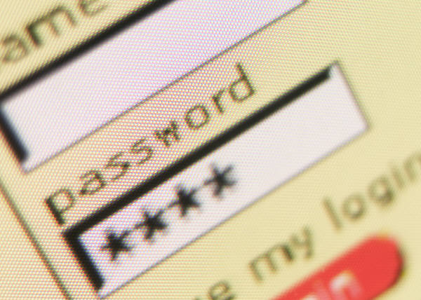
Passwords

Slide 27
Password Considerations
Password Identification:
Social Engineering:
ask suspect
interview/interrogation of suspect
Search desktop and surrounding areas
(look under keyboard, sticky notes, organizers)
Obtain personal information
Children names
Pets
Friends
Relatives
Hobbies

Slide 28
Password & Encryption Considerations
Password Protected Files vs. Encrypted Files
Password Protected Files
Easy to bypass
Data is intact and intelligible
Encrypted Files
Much more difficult to bypass
Data is scrambled

Slide 29
Encryption Considerations
Types of Encryption Programs
Best Crypt
True Crypt
Drive Crypt
PGP
ScramDisk

Slide 30
Encryption Considerations
Levels of Encryption
Name | Bits
RC4 | 40 up to 256
DES | 56
2DES & 3DES | 112-168
IDEA | 128
Blowfish | 32 to 448
AES | 128, 192 or 256
RSA | 1024 to 4096

Slide 31
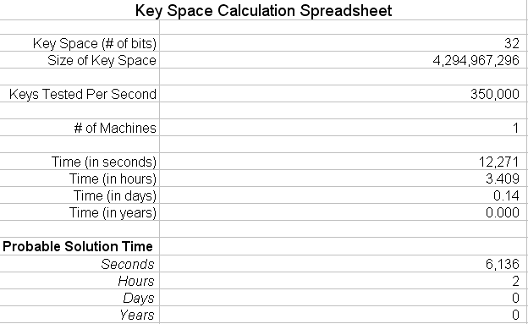
What does it mean?

Slide 32

What does it mean?

Slide 33
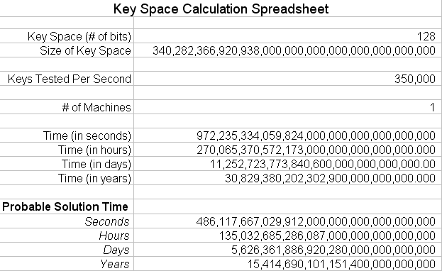
What does it mean?

Slide 34
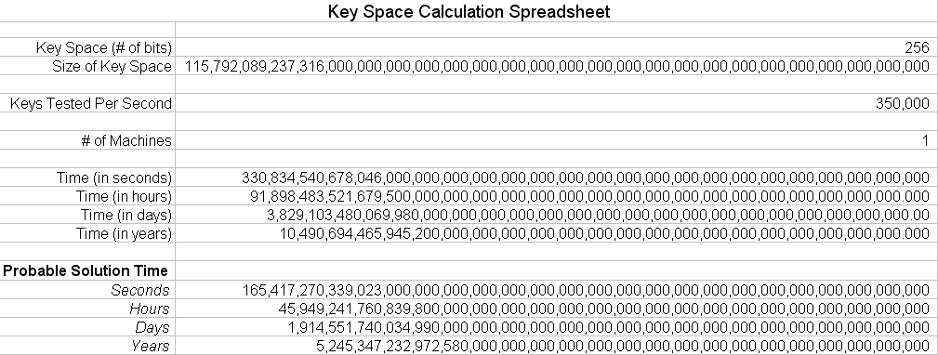
What does it mean?

Slide 35
Where will the Search be Conducted?
On site or in the lab?
Business
Doctor’s office
Attorney’s Office
SOHO
Personal Computer
What about 3rd party rights to a system?

Slide 36
Seizing Electronic and Digital Evidence
Who should recover evidence?
Someone trained in the collection and preservation of electronic evidence
Or
Computer Forensics Examiner

Slide 37
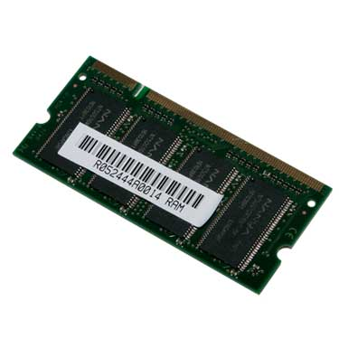
Seizing Electronic and Digital Evidence
GEEK QUIZ #3
WHAT DOES, “RAM” STAND FOR?
RANDOM ACCESS MEMORY

Slide 38
Seizing Electronic and Digital Evidence
Recognizing potential evidence
Contraband or fruits of a crime?
A tool of the offense?
Only incidental to the offense?
Both instrumental to the offense and a storage device for evidence?

Slide 39
Seizing Electronic and Digital Evidence
Contraband or Fruits of the Crime
Stolen Computer Equipment
Stolen Software
Pirated Software

Slide 40
Seizing Electronic and Digital Evidence
Tool of the Offense
Criminal offense committed using computer
Theft
Fraud
Extortion/Harassment
Unlawful e-mail sent from a computer
Sex offense committed after being arranged on computer
Fraudulent money or ID’s made with computer

Slide 41
Seizing Electronic and Digital Evidence
Incidental to the Offense
Drug dealer maintaining records or ordering supplies
Child molester keeping records/photos of children
Suicide notes or pictures of the crime stored online
Victim keeping diary or electronic journal
Suspect searching the web for info about crime
Credit card fraud records/images being kept on computer
Child pornography being stored on computer

Slide 42
Seizing Electronic and Digital Evidence
Both Instrumental and a Storage Device
Hacker uses computer to attack another system and stores the information on their computer.
Child pornographer uses computer to manufacture, distribute and store pornography.

Slide 43
Seizing Electronic and Digital Evidence
What to Seize
Scope of search warrant:
Software
Hardware
Manuals
What are the needs of investigation?
Hardware - Equipment used to view, manufacture or reproduce
Software/Data - Floppies/CD’s/DVD’s/zip disks/external HDD’s/removable devices
Manuals - Accounting programs, unusual software, specific programs used in the crime, etc

Slide 44
Seizing Electronic and Digital Evidence
So, what do I search for?

Slide 45
Seizing Electronic and Digital Evidence
Components & Devices
Smart Card
Dongle
Biometric Scanner
Answering Machine
Digital Camera
Personal Digital Assistant
Electronic Organizer
Memory Card
Modem
Network Interface Card
Router, Hub & Switch
Server
Pager
Printer
Removable Storage
Scanner
Telephone & Cell Phone
Copier
Facsimile
Global Positioning
Notes:
“Components & devices……..”
Today there are a multitude of system components and electronic devices. Many of them can contain valuable evidence. The guide you have been provided will describe many of them in detail. Although I don’t expect you all to become experts in automated devices, you should be able to identify some of the more common ones, which include
Smart Cards
Dongles
Biometric Scanners
Answering Machines
Digital Cameras
Personal Digital Assistants
Electronic Organizers
Memory Cards
Modems
Network Interface Cards
Routers, Hubs & Switches
Servers
Pagers
Printers
Removable Storage Devices & Media
Scanners
Telephones & Cell Phones
Copiers
Facsimile Machines
Global Positioning Systems
[NEXT SLIDE]

Slide 46

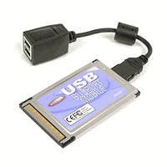
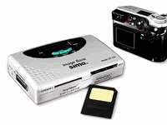
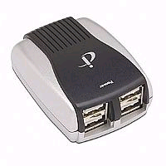
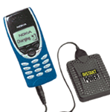

Seizing Electronic and Digital Evidence
What to Look For
Card Readers
Digital Cameras
PCMCIA
Cell Phone
USB HUB
USB HUB

Slide 47
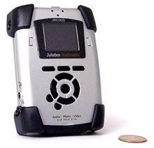
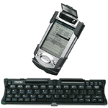
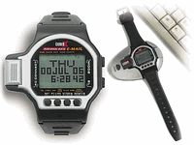

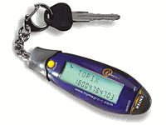
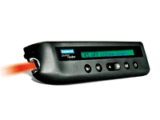
Seizing Electronic and Digital Evidence
What to Look For
PDA
Watch PDA
MP3 player
PDA
Mini PDA
Mini Text Scanner

Slide 48


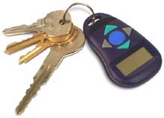
Seizing Electronic and Digital Evidence
What to Look For
DVD w/ dual 80 GB HDDs
USB 2.0 removable 20 GB HDD
Password Manager

Slide 49



Seizing Electronic and Digital Evidence
What to Look For

Slide 50
Seizing Electronic and Digital Evidence
All those items were pretty distinguishable
You probably would have recognized them as an electronic device or storage system for digital files
HOW ABOUT THESE ??

Slide 51
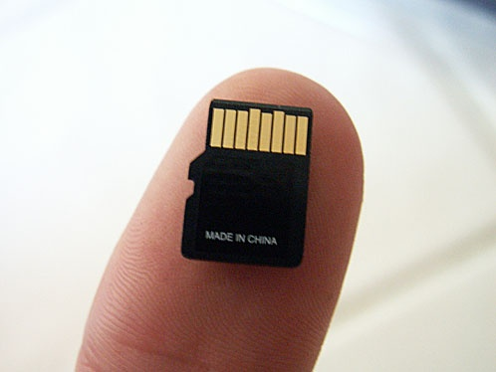
Seizing Electronic and Digital Evidence
What to Look For
Micro SD Card
15mmx11x1
Roughly the size of a
human fingernail
Can hold up to 2 GB (for now)

Slide 52


Seizing Electronic and Digital Evidence

Slide 53


Seizing Electronic and Digital Evidence

Slide 54


Seizing Electronic and Digital Evidence

Slide 55

Seizing Electronic and Digital Evidence
It depends on how big of a GEEK your suspect is

Slide 56
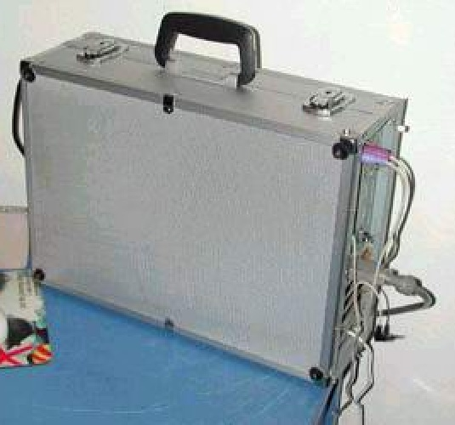
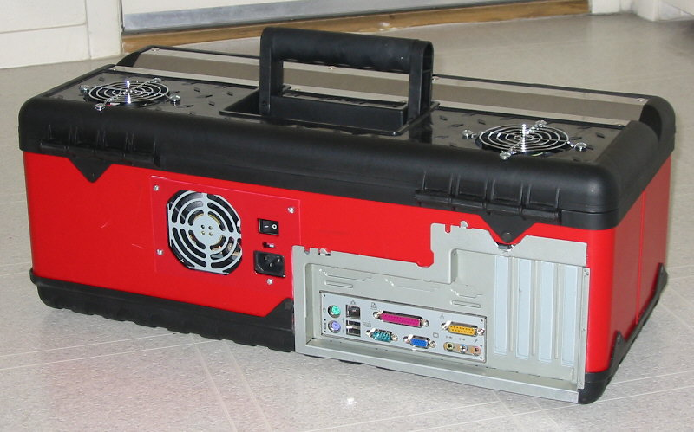
Seizing Electronic and Digital Evidence
Don’t overlook the “unusual”
“Tool-Time” PC
“Samsonite” Special
Notes:
“Don’t overlook the unusual….”
Not every PC you encounter will LOOK like a common PC...
In fact -- Given enough time, you will LIKELY encounter computer monsters disguised like THESE !!!
[NEXT SLIDE]

Slide 57


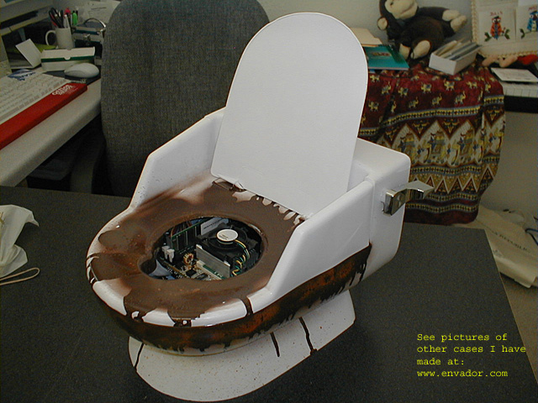
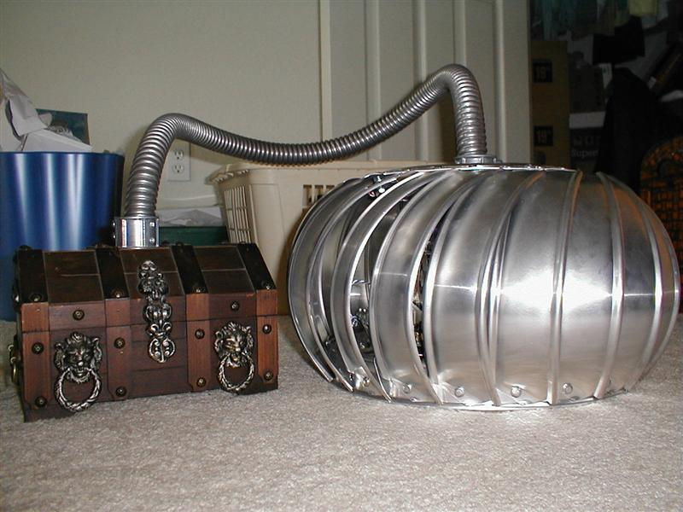
Notes:
Not every PC you encounter will LOOK like a common PC...
In fact -- Given enough time, you will LIKELY encounter computer monsters disguised like THESE !!!
[NEXT SLIDE]

Slide 58

Seizing Electronic and Digital Evidence
Yeah Ok …This one is Fake
But don’t overlook the obvious!

Slide 59
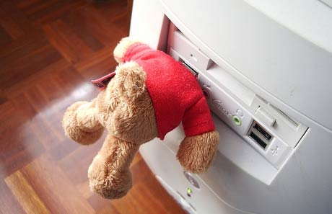
Seizing Electronic and Digital Evidence
Be aware that storage devices can be found
anywhere and come in many shapes and sizes

Slide 60
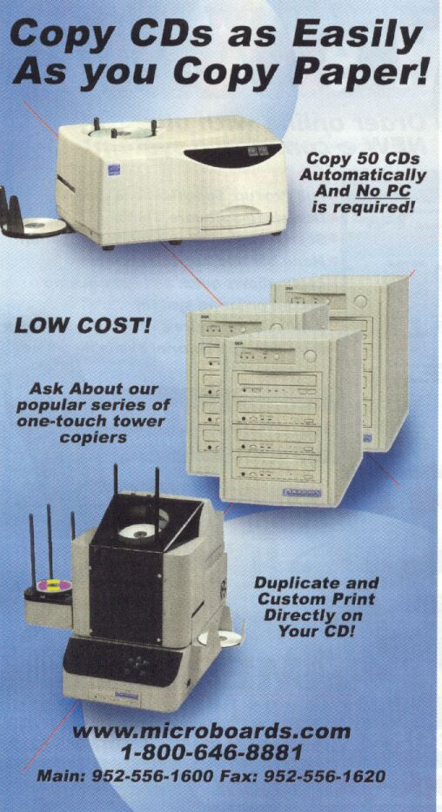
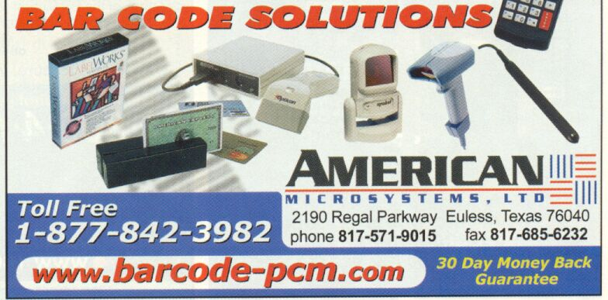
Seizing Electronic and Digital Evidence
What else can be used for criminal purposes?

Slide 61
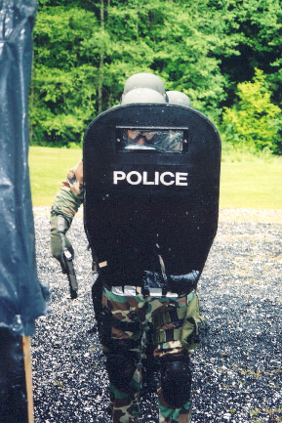
Seizing Electronic and Digital Evidence
Securing the Scene
and
Equipment Seizure
Notes:
“Securing & Evaluating the Scene…..”
When executing a search warrant…remember that all of the standard protocols involving a search warrant scene apply – officer safety comes FIRST. Follow established protocols to ensure your safety and that of your team members.
Additionally, you’ll want to consider establishing and following sound procedures to ensure successful execution of the warrant and seizure of all pertinent computer-related devices.
[NEXT SLIDE]

Slide 62
Seizing Electronic and Digital Evidence
Steps to A Successful Seizure
Notes
Photograph
Sketch
Disconnect Power / Label
Confirm Connections
Evidence Tag
Package
Photos Again
Transport
Store
Report

Slide 63
Seizing Electronic and Digital Evidence
Before getting there……
Who else is going to be there?
Who has what responsibility
Who’s in charge?
Who’s going to seize the electronic evidence?
Notes:
“Before you get there…..”
In your pre-raid briefing, be sure and assign specific areas of responsibility
Who is operating as the search team leader?
Who will conduct the suspect interviews?
Who will operate as the search team ?
Who will be responsible for the seizure of the computer and related media?
Be certain this is someone who has been trained in the best practices for electronic media search & seizure
Remember – you can always call for assistance!
[NEXT SLIDE]

Slide 64
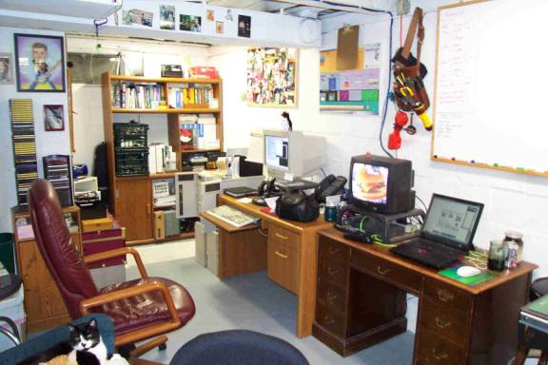
Seizing Electronic and Digital Evidence
Before getting there…
Physical location of the equipment
What and how much?
PC
Mac
Laptop
External / loose media
Notes:
“Before you get here….”
Before executing the warrant, do your homework and learn as much as you can about your suspect!
If you have an informant – ask lots of questions about what to expect at the scene...
If it’s a business – you may want to establish contact with the network administrator (assuming he/she is not a suspect) and ask for their cooperation...
[NEXT SLIDE]

Slide 65

Seizing Electronic and Digital Evidence
Before getting there…..
Learn as much as you can about the suspect’s computer abilities
Novice
Power user
Programmer
Network administrator
Notes:
“Before you get there….”
Determining the suspect’s level of computer knowledge is often a great resource
– not only to the search team, but also to the forensic examiner during the analysis of the media.
[NEXT SLIDE]

Slide 66
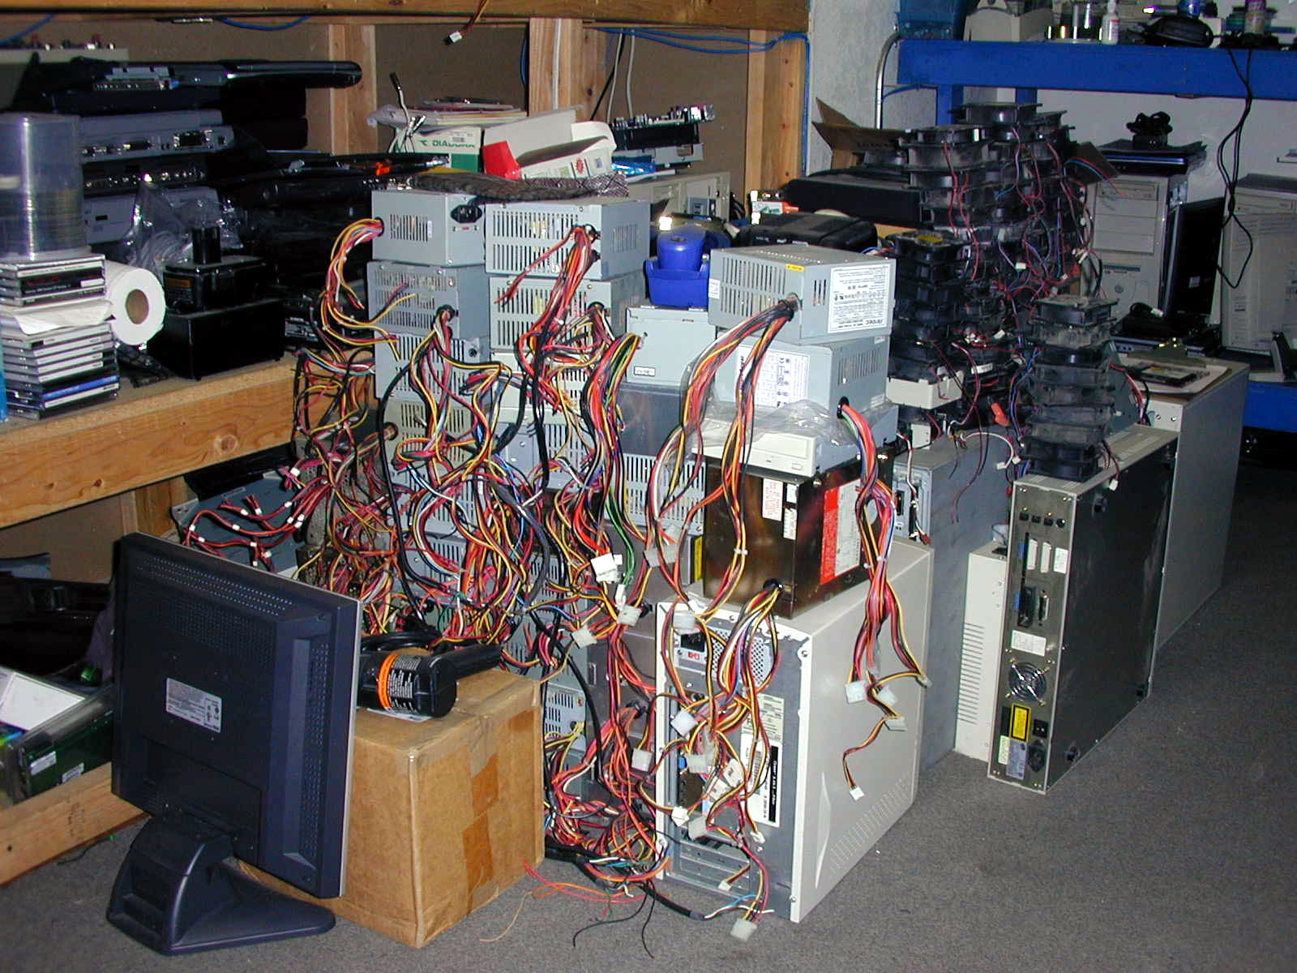
Seizing Electronic and Digital Evidence
What will you find?
Notes:
“What will you find?…..”
What should you expect to encounter at the crime scene? As with any criminal investigation, be prepared for anything! Don’t be overwhelmed or intimidated by what you might find.
[NEXT SLIDE]
Just remember to be systematic and thorough in your search, using appropriate collection techniques so as to avoid altering, damaging or destroying evidence.
[NEXT SLIDE]
After securing the scene and all persons at the scene, a visual check must be made to identify potential evidence,
[NEXT SLIDE]
both conventional (physical) and electronic, and determine if fragile and/or perishable evidence exists. It is imperative that the scene is evaluated and a search plan formulated.
[NEXT SLIDE]

Slide 67
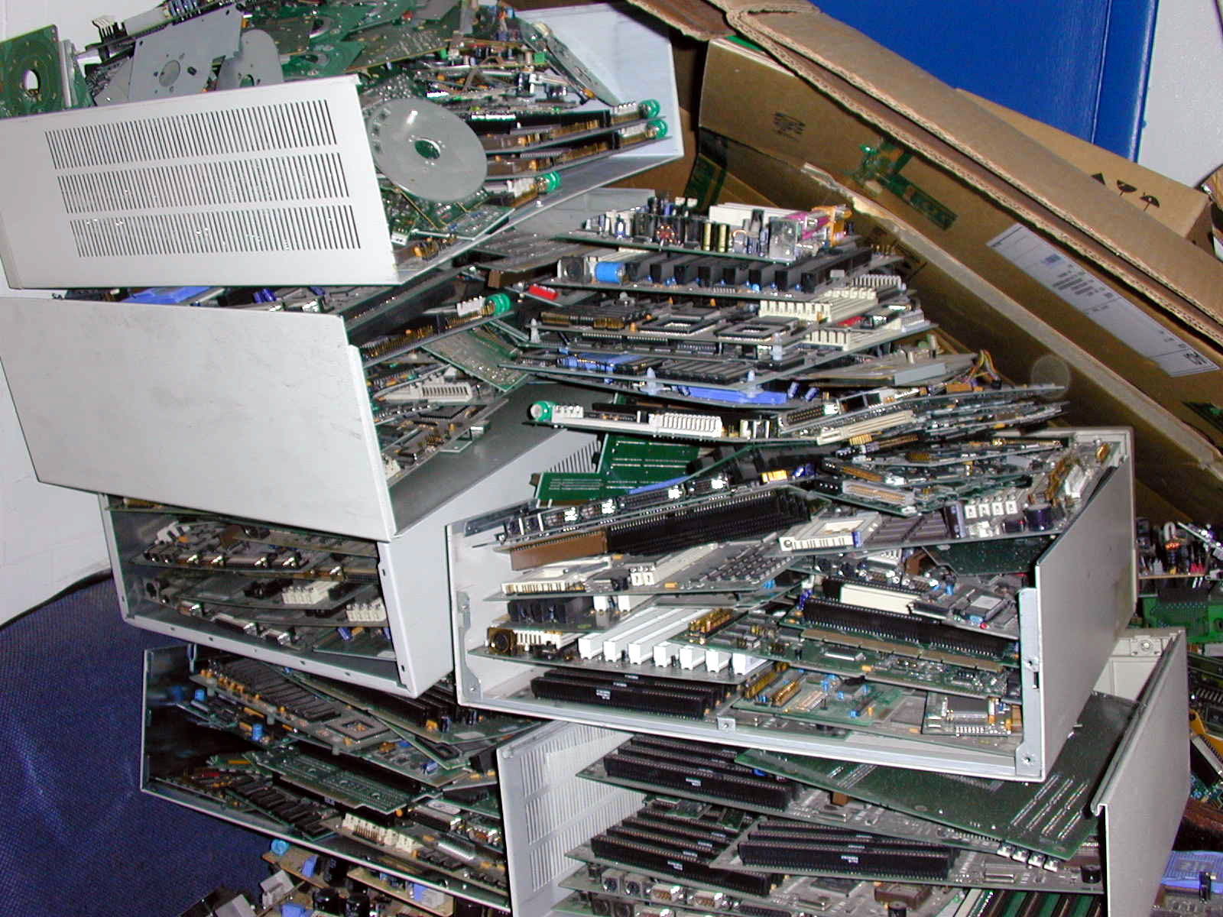
Seizing Electronic and Digital Evidence

Slide 68
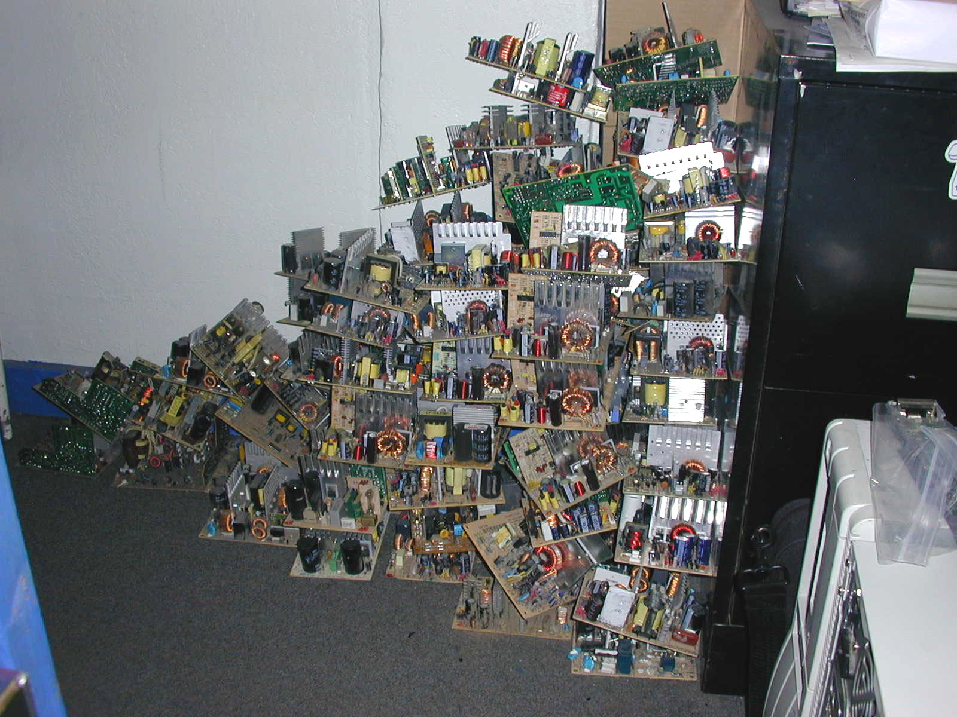
Seizing Electronic and Digital Evidence

Slide 69
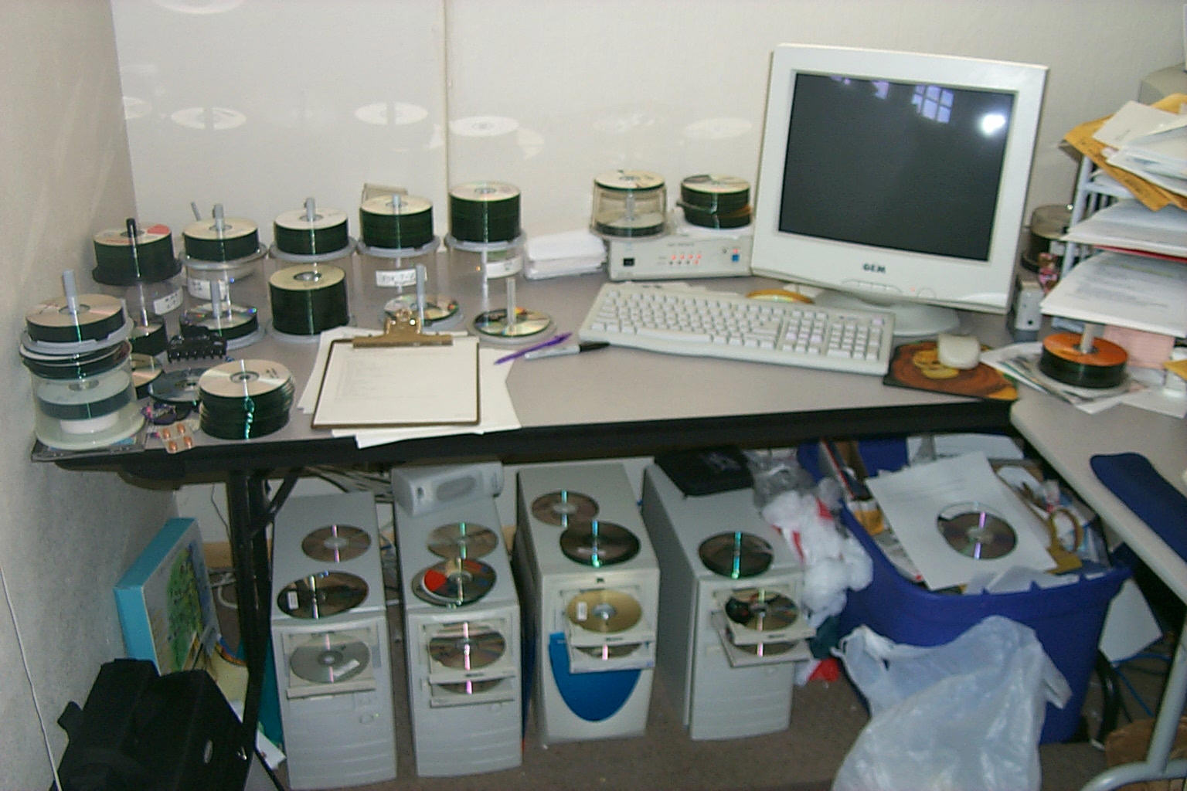
Seizing Electronic and Digital Evidence

Slide 70
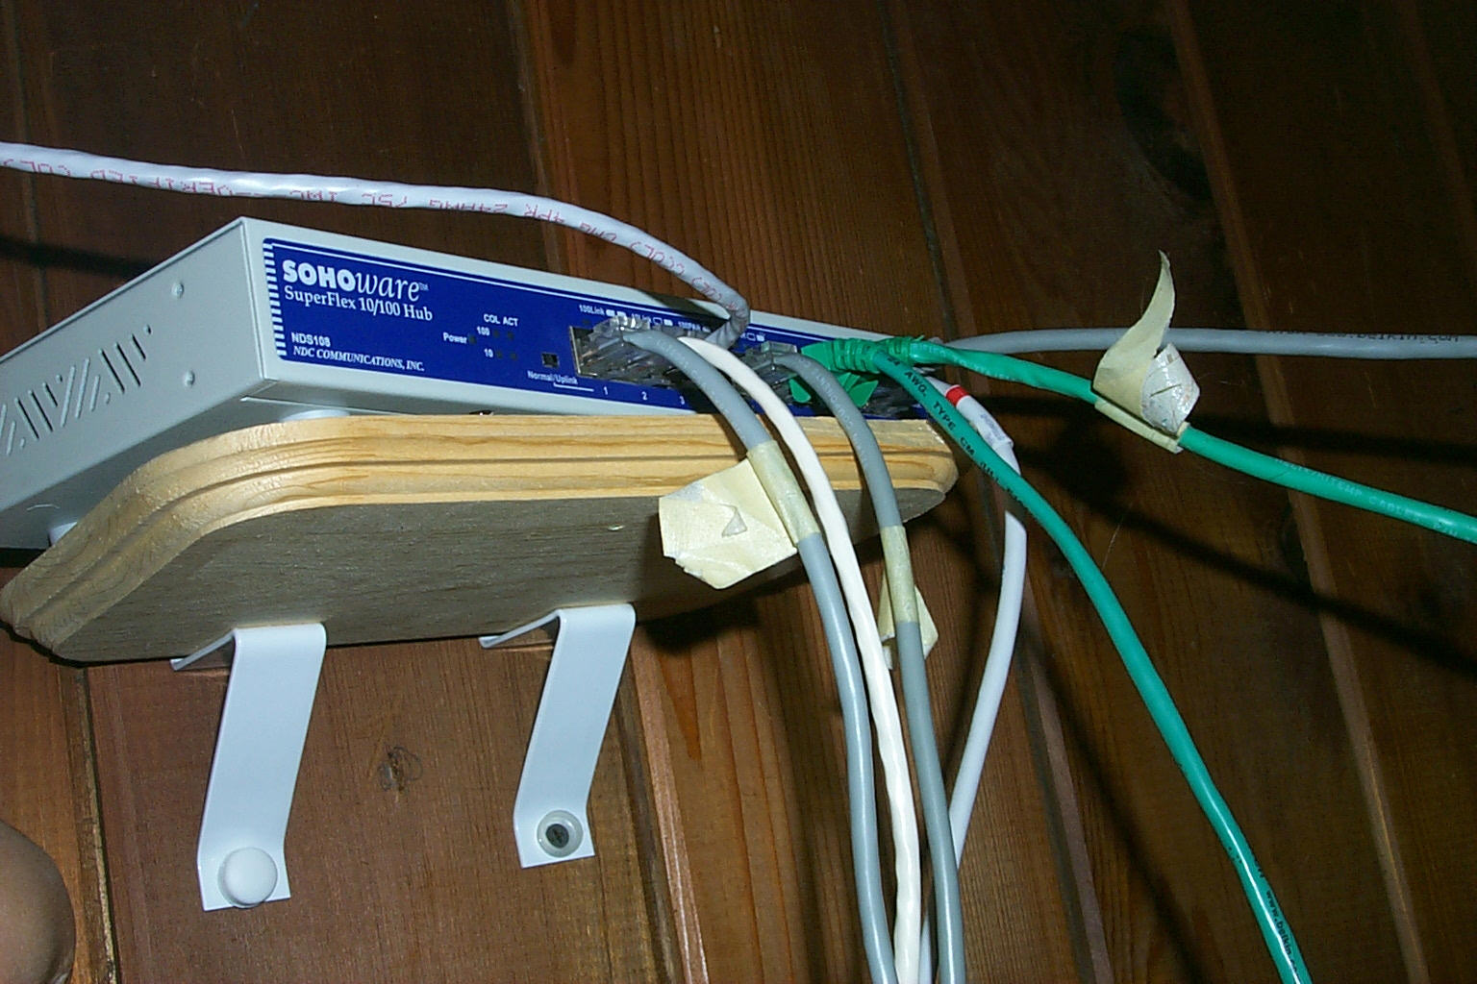
Seizing Electronic and Digital Evidence

Slide 71
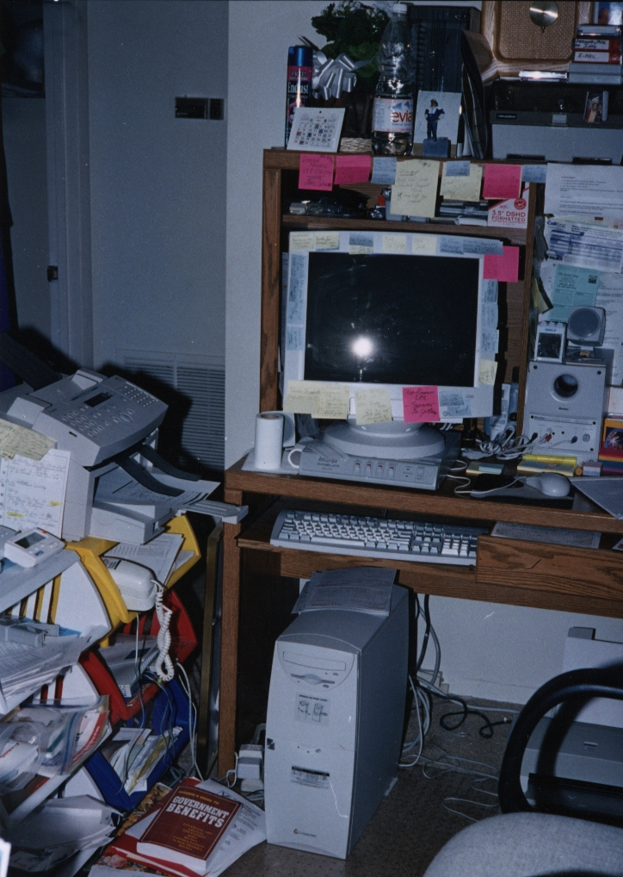
Seizing Electronic and Digital Evidence

Slide 72
Seizing Electronic and Digital Evidence
OFFICER SAFETY!
Secure the scene immediately
DO NOT allow suspect to access computer
Identify and isolate phone lines and network connections
If the computer is Off – DO NOT turn it on
Remember - data can be accessed remotely
NOTE: If you have remote access to your computer – NOT a good idea to scare the SH#!% out of your spouse!

Slide 73
Seizing Electronic and Digital Evidence
Secure the Seized Items
Don’t leave the computer unattended
Maintain a chain of custody of evidence
Treat it as if you will have to testify on your findings and methods
Take all floppy diskettes, CD’s, tapes and all documentation that may contain evidence

Slide 74
Seizing Electronic and Digital Evidence
Importance of taking good notes
Times are changing - defense attorneys are arguing specifics and details in recoveries and exams.
Detailed notes on steps taken during the recovery
Location/date/time/case numbers
Who was there
Where computer or media was located
If pictures were taken
If sketch was done
Connections/labeling
Packaging/transport/storage

Slide 75
Seizing Electronic and Digital Evidence
Importance of taking good notes
Remember Dibble’s Axioms:
#1
If it ain’t written down – it didn’t happen!
#2
A short pencil is better than a long memory!

Slide 76

Seizing Electronic and Digital Evidence
Photographs & Videos
Overall Crime Scene

Slide 77
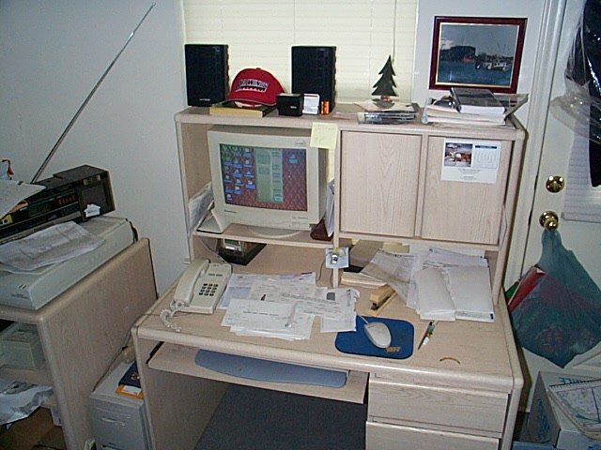
Seizing Electronic and Digital Evidence
Photographs & Videos
Close-ups of all evidence

Slide 78
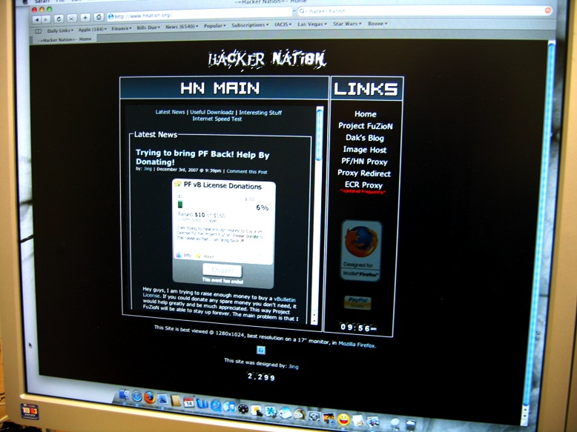
Seizing Electronic and Digital Evidence
Photographs & Videos
Any images on the desktop

Slide 79
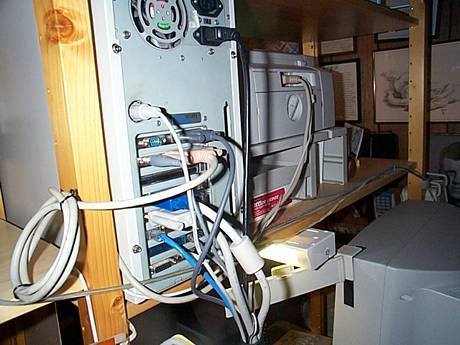
Seizing Electronic and Digital Evidence
Photographs & Videos
Cable connections on the back of the computer

Slide 80
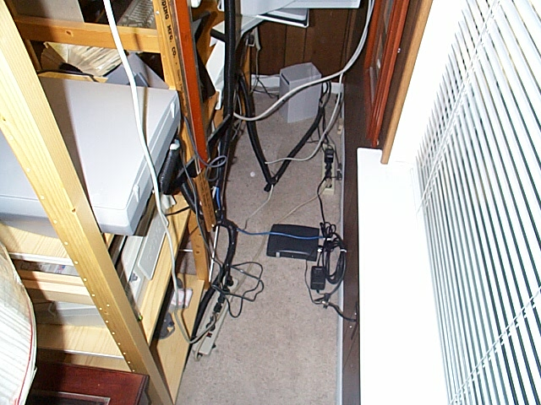
Seizing Electronic and Digital Evidence
Photographs & Videos
Connections to outlets (power, phone, cable, etc)

Slide 81
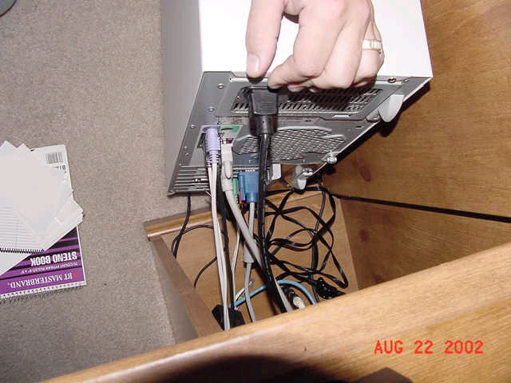
Seizing Electronic and Digital Evidence
Disconnecting Power
Stand alone computer:
Remove power cord from back of machine because there may be a UPS between the computer and wall outlet.

Slide 82
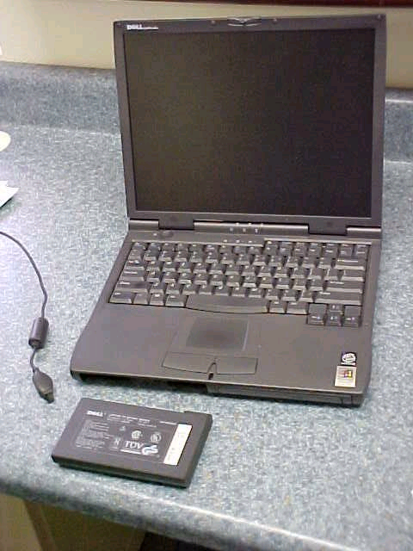
Seizing Electronic and Digital Evidence
Disconnecting Power
Laptop computer:
Remove power cord and battery/batteries

Slide 83
Seizing Electronic and Digital Evidence
What About Networked Business Computers?
GET HELP!

Slide 84
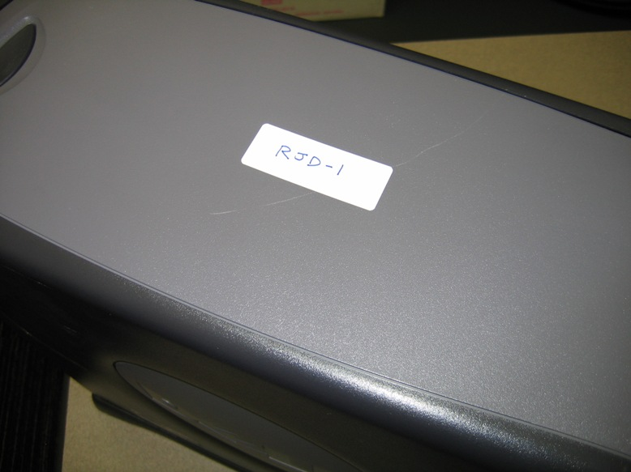
Seizing Electronic and Digital Evidence
Label Evidence items and Connections
Label primary system parts with an evidence number

Slide 85

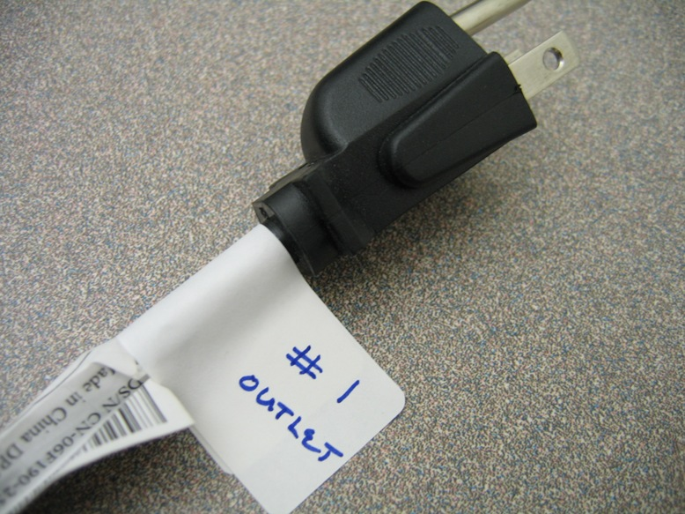
Seizing Electronic and Digital Evidence
Label Evidence items and Connections
Label each connection and cable before removing

Slide 86
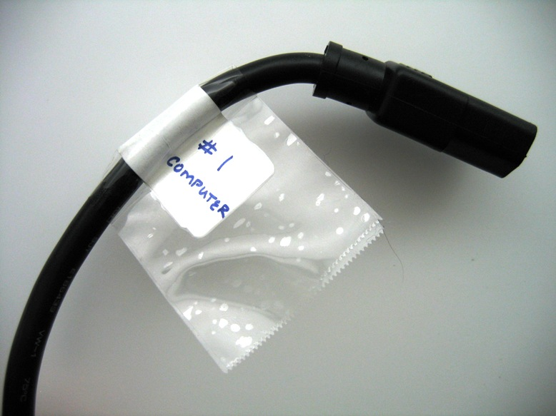
Seizing Electronic and Digital Evidence
Use clear tape to reinforce label

Slide 87
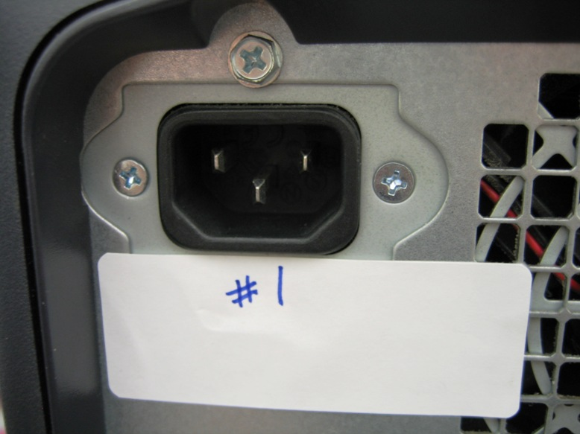
Seizing Electronic and Digital Evidence
Label Evidence items and Connections
Label each connection and cable before it is removed

Slide 88
Seizing Electronic and Digital Evidence
Confirm WiFi Connectivity
Use a device or utility to check for wireless access point connectivity to the Internet:
Smart Phone like an iPhone
Laptop with wireless card
WiFi Detector Device

Slide 89
Seizing Electronic and Digital Evidence
BONUS GEEK QUIZ FOR A WIFI DETECTOR
A WIRELESS NETWORK USES ____ WAVES TO TRANSMIT SIGNALS?
RADIO WAVES

Slide 90
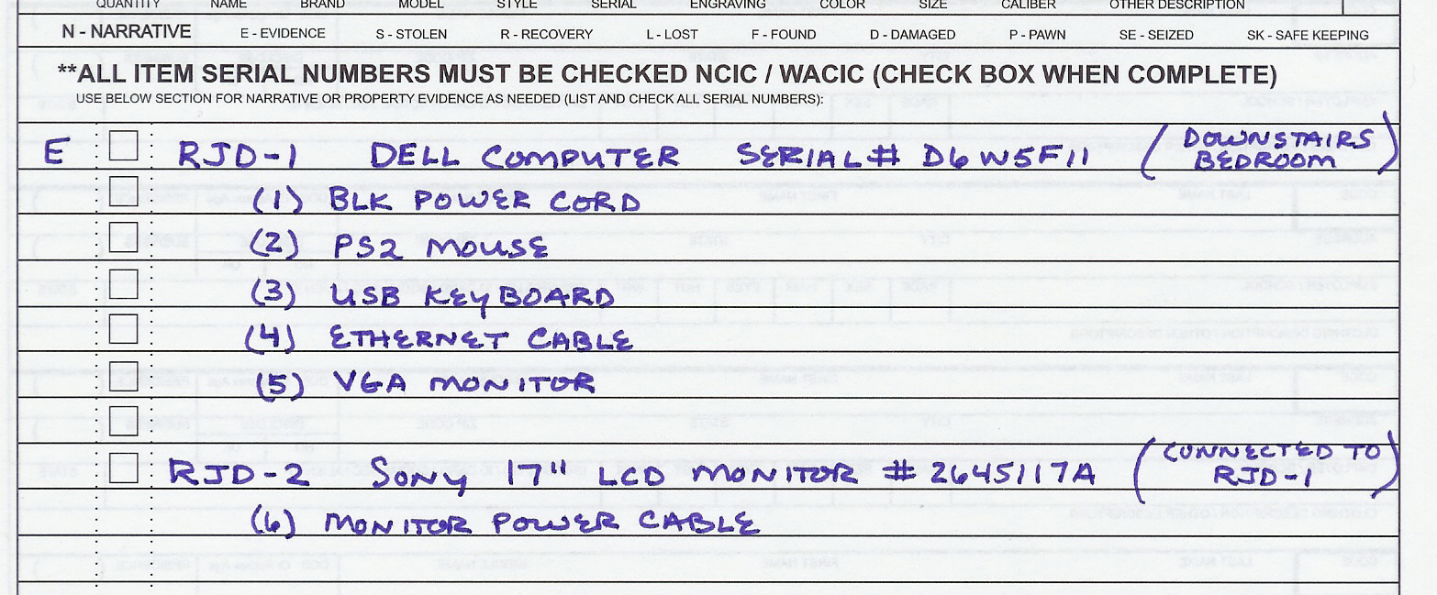
Seizing Electronic and Digital Evidence
Label Evidence items and Connections
Make evidence list and connection notes
You may also use a Search Warrant Inventory List form

Slide 91
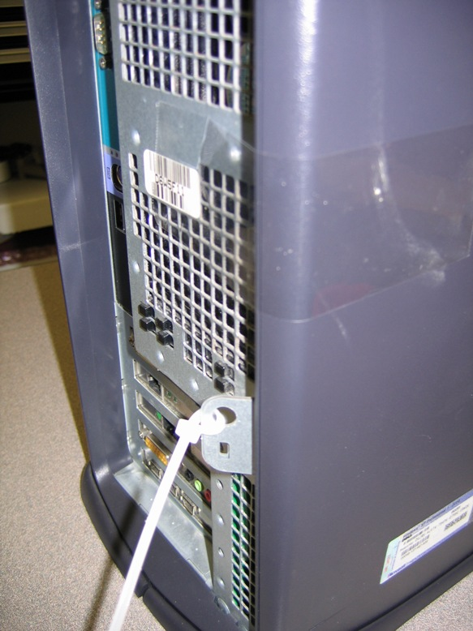

Seizing Electronic and Digital Evidence
Secure Bays and Computer Case
Zip lock ties work well to secure computer cases.
Use evidence tape to seal media bays

Slide 92
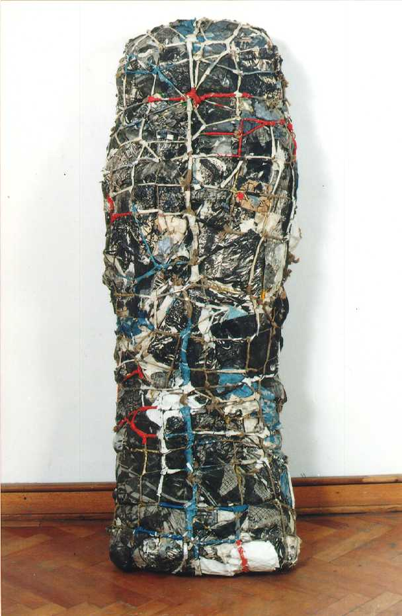

Seizing Electronic and Digital Evidence
DO NOT go crazy with the Evidence Tape !!
It’s not necessary to tape every nook and cranny
Be careful with the type of tape you use
Avoid permanent marks if possible

Slide 93

Seizing Electronic and Digital Evidence
Some of these systems are extremely expensive.
The system may end up being returned to the owner.
Avoid liability caused by damaging the system.
The evidence is usually in the Hard Drive (hint).

Slide 94
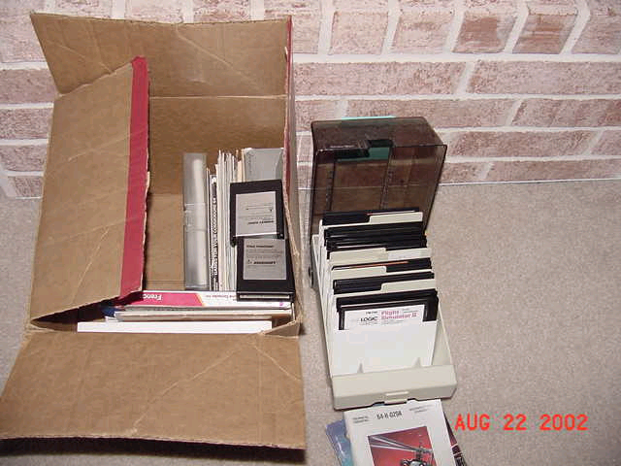
Seizing Electronic and Digital Evidence
Evidence Handling
Package items to protect from dust, static, magnets, etc

Slide 95
Seizing Electronic and Digital Evidence
Photographs and Video
Let Me Repeat!
Photograph/video:
the evidence taken as it is packaged
the overall crime scene before and after search to protect against claims of “trashing the place”
Archive pictures in original format without changes
Note the camera make and model, film or digital, as well as the form of storage (Memory Stick, DV Tape, etc.) and method of archiving

Slide 96
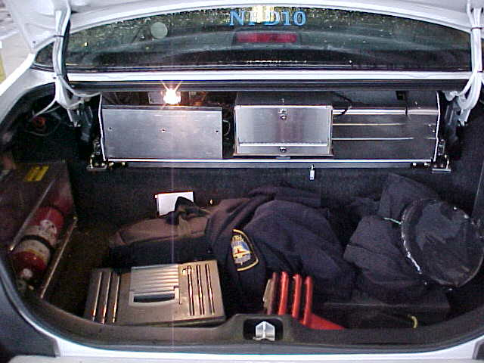
Seizing Electronic and Digital Evidence
Evidence Handling
Avoid using the trunk of a patrol car. Why?
Electronic interference from radios, strobes, video recorders, and other magnetic sources may damage your media.
When transporting items – protect from dust, static, magnets, extreme temperatures and rough handling

Slide 97
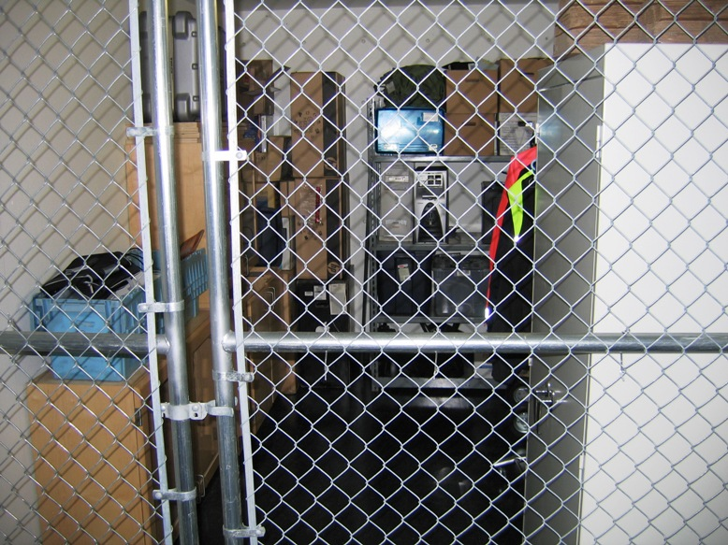
Seizing Electronic and Digital Evidence
Store in a dry, cool, dust free place
Avoid static and magnets
Follow Department Policy for storage

Slide 98

Seizing Electronic and Digital Evidence
Evidence Processing
Submit a request for forensic analysis of the seized evidence through your chain of command.

Slide 99
Seizing Electronic and Digital Evidence
Quick Overview
Consult a specialist! If none available:
IF COMPUTER IS OFF - LEAVE IT OFF
IF COMPUTER IS ON:
Stand alone (Non-networked):
Photograph screen
Remove power from the back of the computer
Label all connectors/cables to allow reassembly
Package equipment as fragile cargo
Keep away from magnets, radio transmitters, etc.

Slide 100
Seizing Electronic and Digital Evidence
Create a very detailed report
Where were you
Who was there
Where & how was the evidence discovered
How was power removed
If and why the computer accessed
Was there an internet operable connection
How was the evidence packaged
How was the evidence transported
Who transported the evidence
Where was the evidence stored
Who created pictures and sketches

Slide 101
Seizing Electronic and Digital Evidence
Recovering “Other” Evidence
FAX MACHINE
May contain speed dial lists, stored faxes, and fax transmission logs
Turning off may cause loss of last dialed number and stored faxes
Manually record any information and take pictures
Seize all manuals.
DIGITAL CAMERAS
May contain flash memory cards like: SD, Memory Stick, Compact Flash ….
The storage media can store various types of data

Slide 102
Seizing Electronic and Digital Evidence
Cellular Phones/Devices
May contain:
Phone ownership
Numbers dialed
Directory
Pictures
Videos
SMS (text messages)
Voice mail access number
Passwords
Credit card numbers
Calling card numbers
If off – leave it off
If on, do not turn off - prevent contact with the network (discuss)
Take power and data cables
Call specialist to analyze ASAP

Slide 103


Seizing Electronic and Digital Evidence
CelleBrite UFED System
Mobile Forensics

Slide 104


Seizing Electronic and Digital Evidence
Special problems encountered
Fires
Usually only affects the exterior of the system unit
The HDD data is usually recoverable

Slide 105

Seizing Electronic and Digital Evidence

Slide 106
Seizing Electronic and Digital Evidence
What happens next?
The evidence needs to be protected from ANY alteration.
The seized items need to be analyzed for potential evidence.
This process is called “Computer/Data Forensics”.

Slide 107
Seizing Electronic and Digital Evidence
Computer What?
Computer Forensics is:
The preservation, identification, extraction and documentation of computer evidence recovered using scientific methods
Protection of digital evidence to prevent it from being altered, destroyed, damaged or compromised,
Presentation and explanation of digital evidence recovery in courtroom testimony.

Slide 108
Seizing Electronic and Digital Evidence
So, when I discover a computer or other electronic device at the scene, can I browse through it to look for notes or possible evidence?
ABSOLUTELY NOT!!

Slide 109
Seizing Electronic and Digital Evidence
Why Not…What’s the big deal?
When you browse through a computer some undesirable things happen:
You alter last access dates/time of the files you touch/access
You modify the information in the SWAP files, temp files and other system files
You may delete incriminating or exculpatory evidence in unallocated space of the hard drive
You may prevent any “tainted” evidence you accessed from being admitted in court
You may be humiliated on the witness stand (assuming it makes it that far)
Your examiner may kill you!
If you do anything – please report it!

Slide 110
Seizing Electronic and Digital Evidence
QUESTIONS
Is a file actually gone from my computer when I delete it?
NO
Is a file actually gone from my computer when I empty the recycle bin?
NO
Are files permanently removed from my computer when I format the hard drive?
NO...well MAYBE
Are files actually deleted from my computer after I load SPADA 3.1 Knoppix OS and use the forensic tools option to zero disk the HDD and receive a checksum wipe log??????????
NO……WHAT??

Slide 111
Seizing Electronic and Digital Evidence
Who can do computer forensics for my case?
Remember –
Only someone trained in computer forensics should
ever access the data inside a suspect computer

Slide 112
Seizing Electronic and Digital Evidence
What do I need to submit?
A copy of your search warrant or written consent
Digital Forensics Lab Request Form
Keyword list is optional but should be provided to the examiner
Don’t ask for a “Print Out Of Everything”….consider first……

Slide 113

Seizing Electronic and Digital Evidence
12 GB HDD
Average Volume 12gb
Bytes 12,884,901,888 bytes
Pages size 3000 bytes
Pages 4,294,967
Ream 500 pages
Reams 8,590 Reams
Ream height 2”
Total height 17,180”
Height in feet 1431’
Height of Sears
Tower (Chicago) 1450’
(Note these figures are conservative!)

Slide 114
Seizing Electronic and Digital Evidence
12 GB HDD - could you print that?
536,871 minutes at 8 pages per minute
(Average Departmental printer)
8947 Hours 51 Minutes
372 Days 19 Hours 51 Minutes
1 Year 7 Days 19 Hours 51 Minutes (Non Stop)

Slide 115
Seizing Electronic and Digital Evidence
12 GB HDD - could you print that?
2500 pages per Toner Cartridge
1718 Toner Cartridges
$24 per Toner Cartridge
$41,232 In Toner
$2 per Ream of Paper
$17,180 in Paper
Total Amount - $58,412

Slide 116
Seizing Electronic and Digital Evidence
What happens after the analysis?
The investigating officer will receive an analysis report and CD/DVD detailing the evidence found on the computer.
Testimony at trial will be provided by the examiner as needed.

Slide 117
Seizing Electronic and Digital Evidence
Key things to remember:
You must have a legal right to seize the evidence and legal permission to conduct the analysis.
If the device is OFF - Leave it OFF.
Don’t browse through the evidence.
Document everything you do.
CALL FOR ASSISTANCE IF YOU HAVE ANY QUESTIONS

Slide 118


Slide 119
Seizing Electronic and Digital Evidence
QUESTIONS?

Slide 120
Seizing Electronic and Digital Evidence
Time for a group practical exercise!

Slide 121
Problem Statement
You have been dispatched to your local community college and asked to contact John Edwards, Chair of the Information Technology Division. Upon interviewing the RP, you are informed that Mr. Edward’s IT Technician had grabbed Professor Mitchell’s computer from his office in anticipation for the deployment of new computers. While going through Professor Mitchell’s computer child pornography was discovered.
Handout Problem Statement – 1 per squad.

