Slide 1
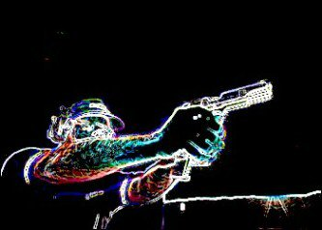
Shooting Investigations

Slide 2
Learning Objectives
Knowledge of the anatomy of a gunshot wound
Identify the markings of different gunshot wounds
Identify suicide and murder indicators
Identifying evidence associated when a gun is used

Slide 3
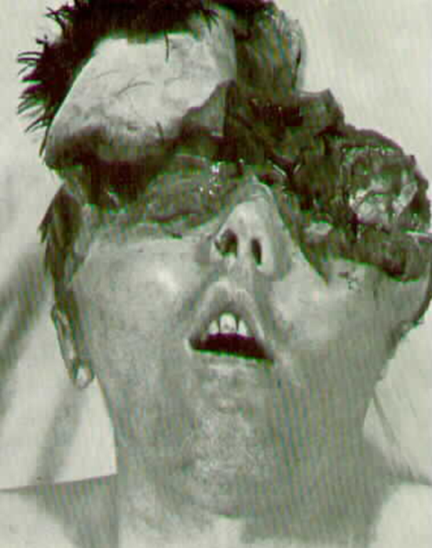
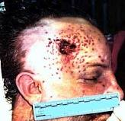
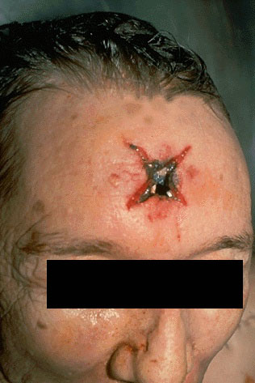
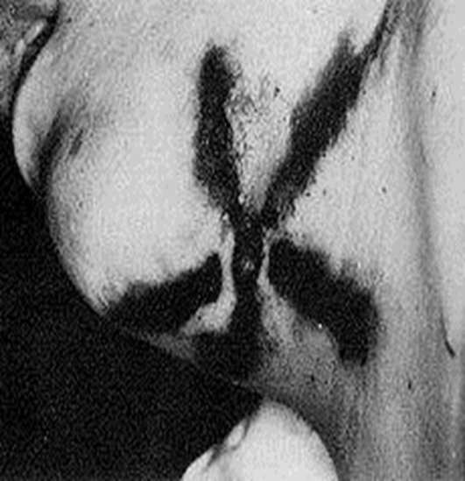
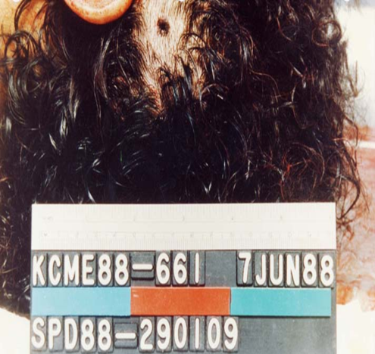
What does a gunshot wound look like?

Slide 4
Types of wounds continued
Stellate – Entry wound that is caused by either a close or contact shot over a bone/skull
Smudging – occurs when smoke, soot, or powder is found on the skin
Searing – is a yellow singeing due to the discharge of flame from the muzzle
Tattooing/ Stippling – when powder and pieces of metal are driven into the skin and cannot be wiped off. Indicative of close proximity shot.

Slide 5
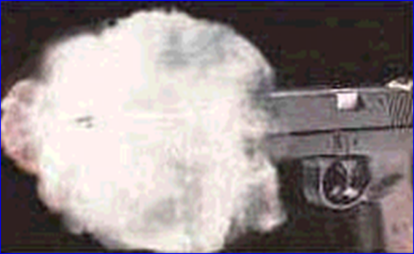
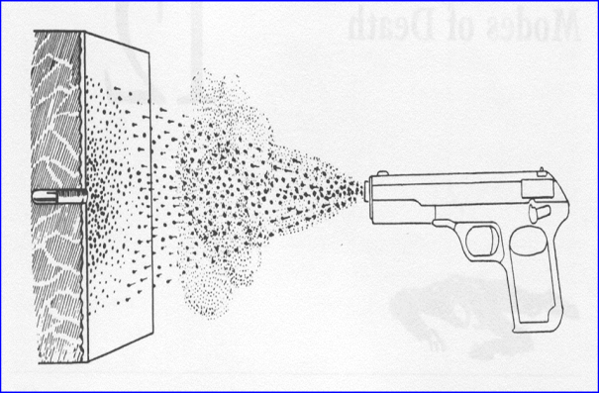
Anatomy of a gunshot wound
Four things occur when a firearm is discharged
  Fire or flame is emitted from the barrel
  Smoke follows the flame or fire

Slide 6

Anatomy Continued
  The bullet emerges from the barrel
  Additional smoke and grains of burned and unburned gunpowder follow the bullet out of the barrel.

Slide 7
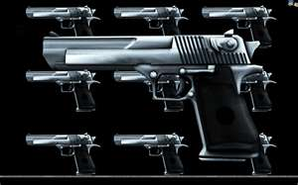
What will affect characteristics of a gunshot wound?
Take 3 minutes in your squad and write down what variables your team believes will affect the characteristic of a gunshot wound.
Notes:
Write these up on the board as class covers them. Should hit on:
Type of weapon, type of ammunition, distance from target, ricocheting, passage through body, passage through clothing, part of the body affected

Slide 8
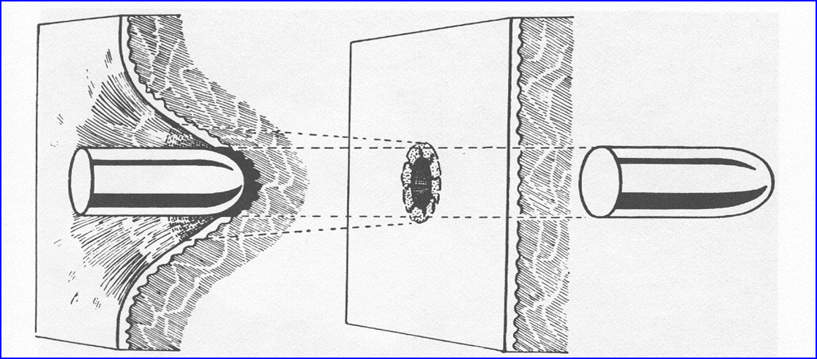
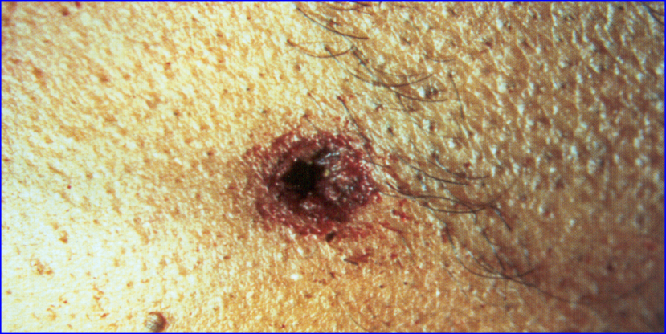
Type of Wounds
Entrance Wound: Typically smaller than exit wound. WHY?
Rim of abrasion on entry wound:
Notes:
Gunshot wounds can be misleading.
Rim of Abrasion is an area of dark discoloration around the entry wound.
The exit wound may be larger and more ragged as the bullet, impacted tissue, and bone push their way through and out.

Slide 9
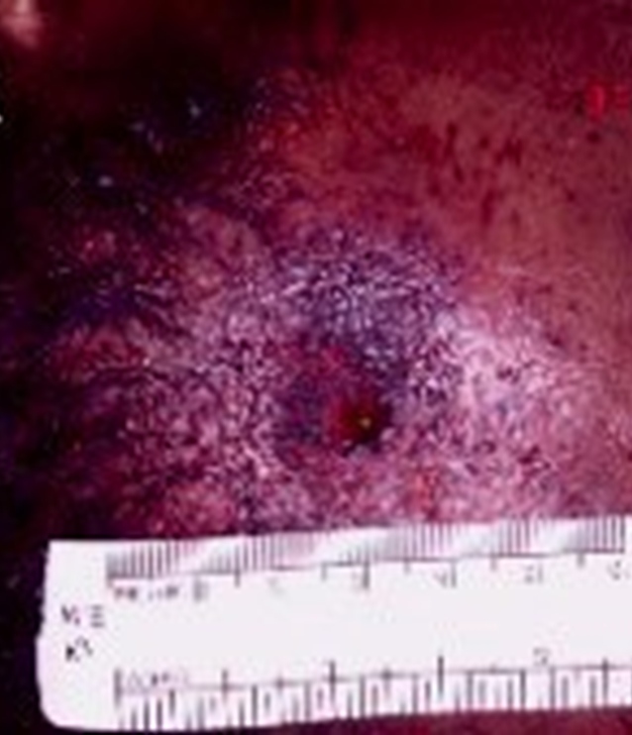
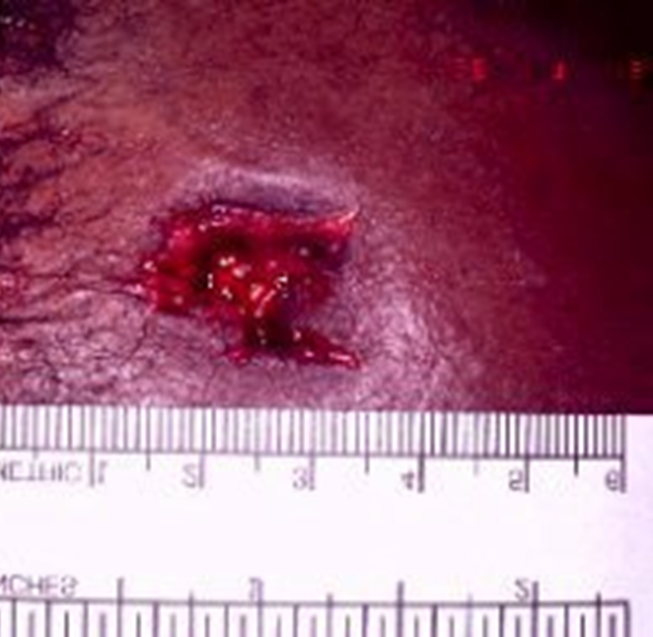
Entry/ Exit Wound Comparison

Slide 10
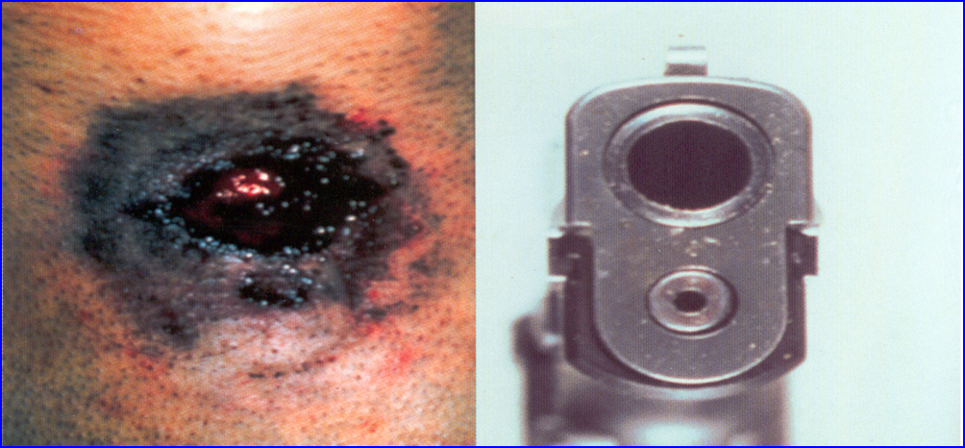
Muzzle Stamp
The muzzle imprint may be visible in a contact shot.
The result is an abrasion outlining the muzzle or the slide of a semiautomatic.

Slide 11
Suicide vs Murder Indicators
Suicide Indicators:
  Gun held against skin
  Wound in mouth or in right temple for right handed victims, left temple for left handed victims
  Not shot through clothing unless in the chest
  Weapon present, especially if tightly held in hand.
Murder Indicators
  Gun fired from more than a few inches away
  Angle or location that rules out self-inflicted
  Shot through clothing
  No weapon present
Notes:
Prior to showing to class, have class throw out ideas that they think may be indicators.

Slide 12
Evidence in gun related crimes
The “gun”
Ammunition/Shell Casings
  Fingerprints
  Striations
Gunshot residue (GSR)
Shooter ID Kits (for officers in the field)
Glass
  High-velocity will not normally shatter glass, leaving a small hole.
Remember the Golden Rule of any Crime Scene!
Notes:
Discuss how bullets and casings receive a signature:
Weapon’s firing pin strikes the primer
Gunpowder in the brass casing explodes, forcing the bullet down the barrel of the weapon
The bullet picks up lengthwise scratches from barrel’s rifling as well as from any nicks inside the barrel
Those scratch patterns, which are unique to each gun, are then used to compare bullet against bullet.
(Hess, K, & Orthmann, C. (2010) Criminal Investigation, p. 157).
Shooter ID Kits – can be used to conduct GSR tests in the field. Absence of GSR on victim can indicate homicide, where as abundance can indicate suicide.
Glass – Sequence of bullets fired through glass can be determined by pattern of cracks. Direction and angle can also be determined. When bullet hits glass, glass bends, which causes radial fractures on side of glass opposite of point of impact. (Hess, K, & Orthmann, C. (2010) Criminal Investigation, p. 157).

Slide 13
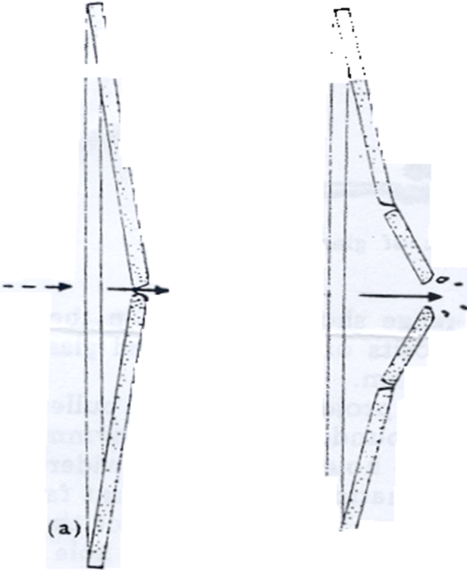
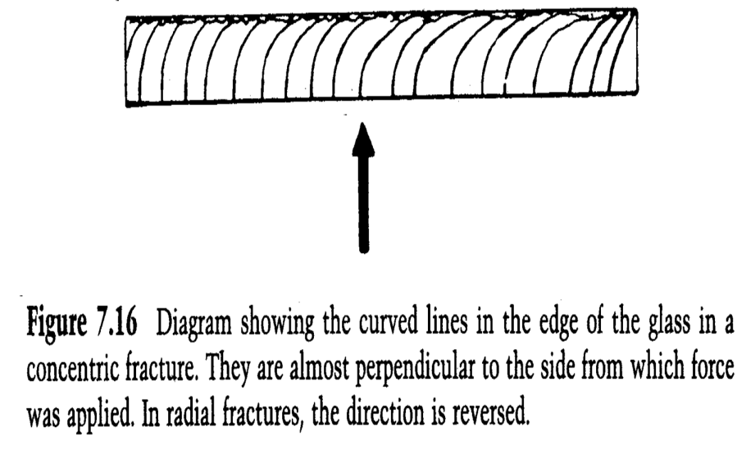
Glass Evidence
Notes:
Glass will “bow” a bit before breaking. The radial fractures occur first due to the bowing of the glass and then the concentric fractures. Radial fractures first occur on the side opposite of the force. Concentric fractures occur on the same side of the applied force.

Slide 14
QUESTIONS?

