Slide 1

HAZARDOUS MATERIALS
BASIC LAW ENFORCEMENT ACADEMY
WASHINGTON STATE
CRIMINAL JUSTICE TRAINING

Slide 2

FIRST RESPONSE

Slide 3
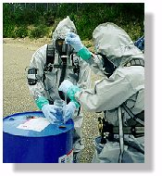
You get hundreds of chances to do it right, only one to do it wrong !

Slide 4
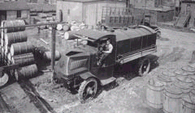
In the the old days. . . . .

Slide 5
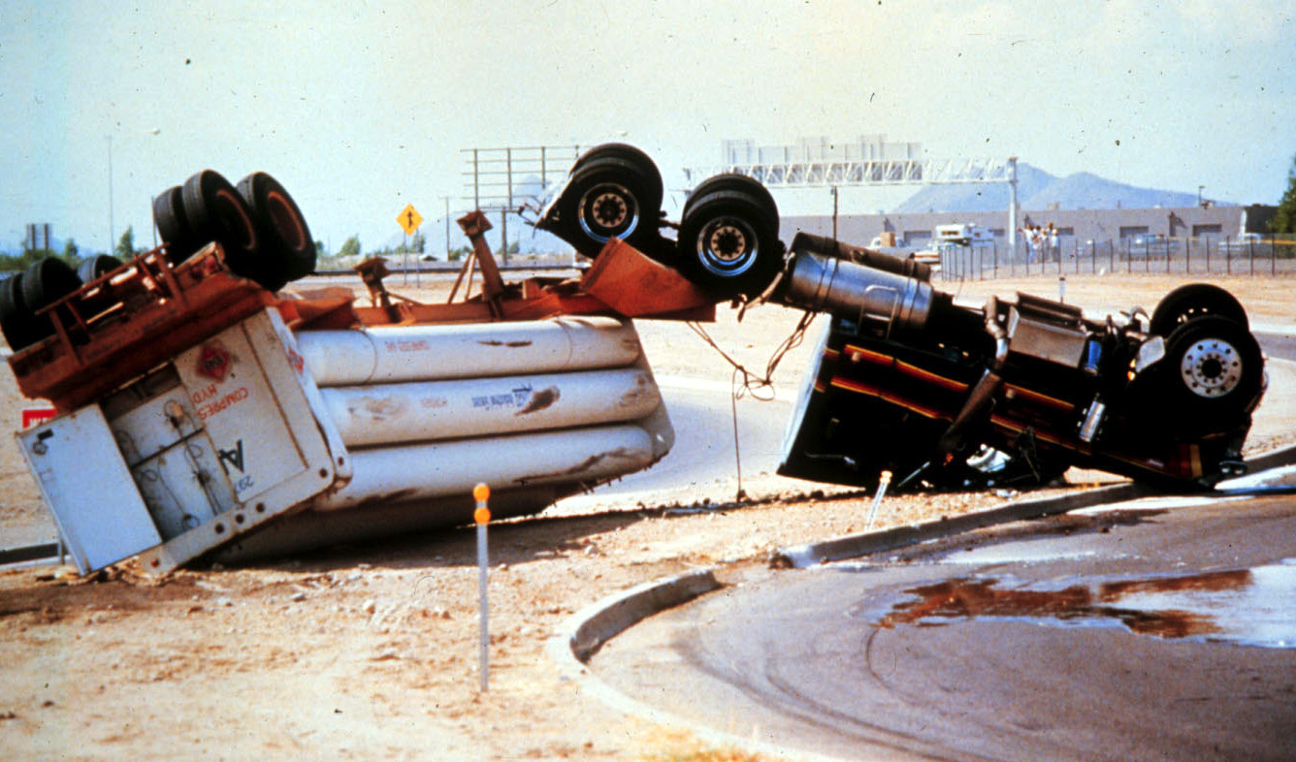
What Do I Do Now ?

Slide 6
Common Sense ?
Upwind
Uphill
Upstream

Slide 7
More common sense
Isolate
Deny Entry
Evacuate
Shelter in Place

Slide 8
Isolate and Deny Entry:
Establish control of the scene by keeping everyone away from the area if they are not directly involved in the emergency response operation.

Slide 9
Evacuate:
Move all people from a threatened area to a safer place. To perform the evacuation you must have enough time for:
1. Warn people of the evacuation.
2. Allow the people to get ready to evacuate.
3. Leave the area

Slide 10
Shelter in Place:
Retaining people inside a building until the danger of a short-term spill or toxic vapor cloud passes. Personnel are moved to the center of the building and the HVAC system is turned off. Shelter in place is used when evacuating the public would cause greater risk than staying where they are, or when an evacuation cannot be performed.

Slide 11
The Key Learning Goals for The First Responder
1. Protect your health and safety during a HAZMAT incident.
2. Recognize hazardous materials.
3. Prevent or minimize exposure to hazardous materials.
4. Come home alive and live to collect a well earned retirement.

Slide 12
Emergency Response Regulations
Environmental - U.S. Environmental Protection Agency
Washington Department of Ecology
USEPA: 33 CFR and 40 CFR
Health & Safety - U.S. Department of Labor (OSHA)
Washington Department of Labor & Industries
(DISH-WISHA) DISH: WAC 296 - 62 OSHA: 29 CFR
Transportation - U.S. Department of Transportation
USDOT: 49 CFR
Fire Protection - National Fire Protection Agency
NFPA 471, 472, 474

Slide 13
Common Alarms Summary
Key Learning Goals :
1. Define learning goals for the course.
2. Identify four major categories of sites where HAZMAT emergencies occur.
3. Name at least five different substances classified as hazardous materials.
4. Explain how an incident’s location indicates the type and quantity of hazards present.
5. Identify hazards involved with sites such as schools, hospitals, and manufacturing plants.
6. Apply the APIE process to management of hazardous materials incidents.

Slide 14
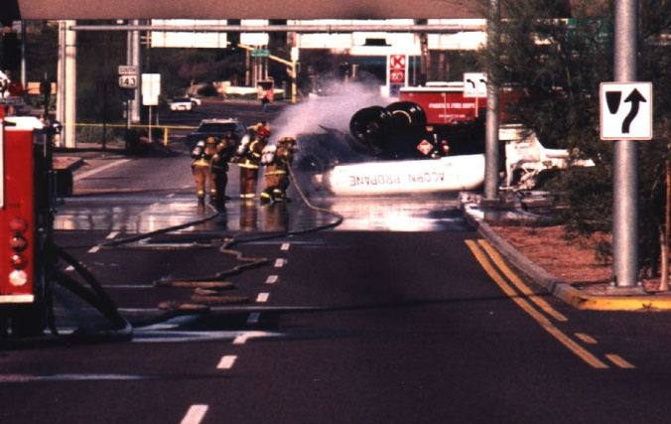
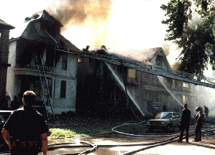
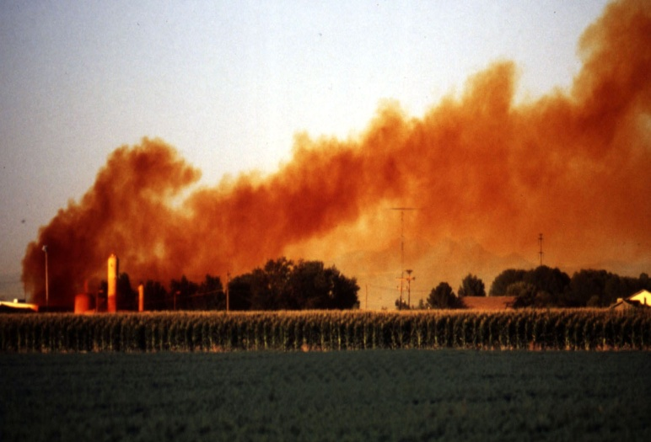
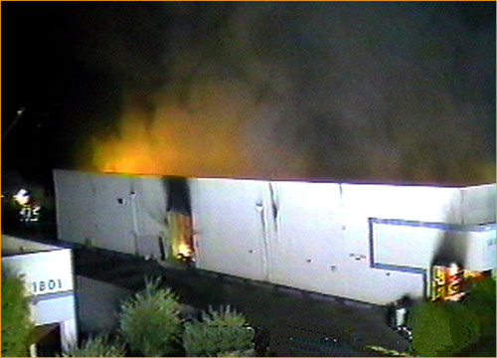
2
1. Why is this section called Common Alarms?
… because common alarms are HAZMAT incidents. You can be exposed to hazardous materials any time you respond to any incident.
2. Name the four main categories where HAZMAT emergencies may occur.
Transportation Corridors
Residences
Non-Structural Locations
Commercial Fixed Sites

Slide 15
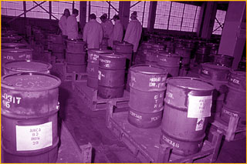
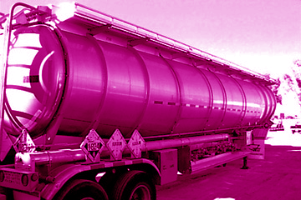
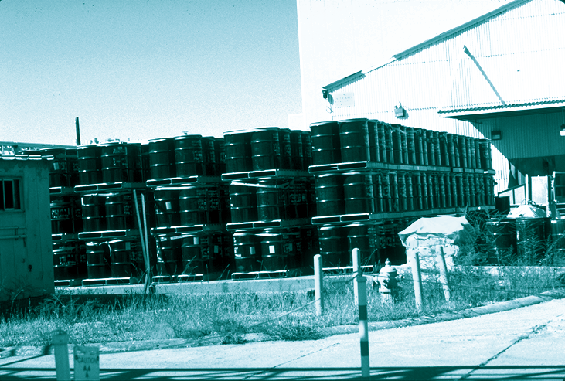
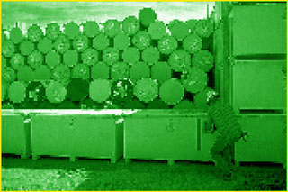
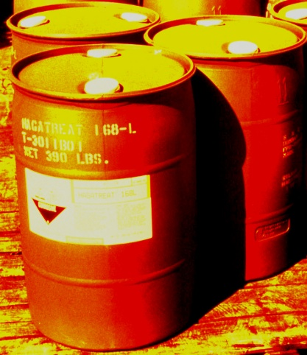
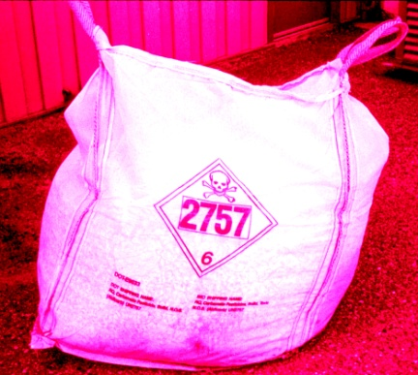
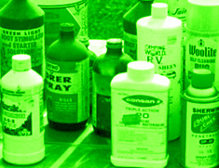
1
Name at least five substances classified as hazardous materials.
Gasoline
Propane
Chlorine
Acids
Benzene
Pesticides
Fertilizers
Paint
Explosives
?

Slide 16
0
Here is an incident at a Commercial Fixed Site.
1. What hazardous materials might be involved at these sites?
2. What are the health and safety challenges at this type of site?

Slide 17
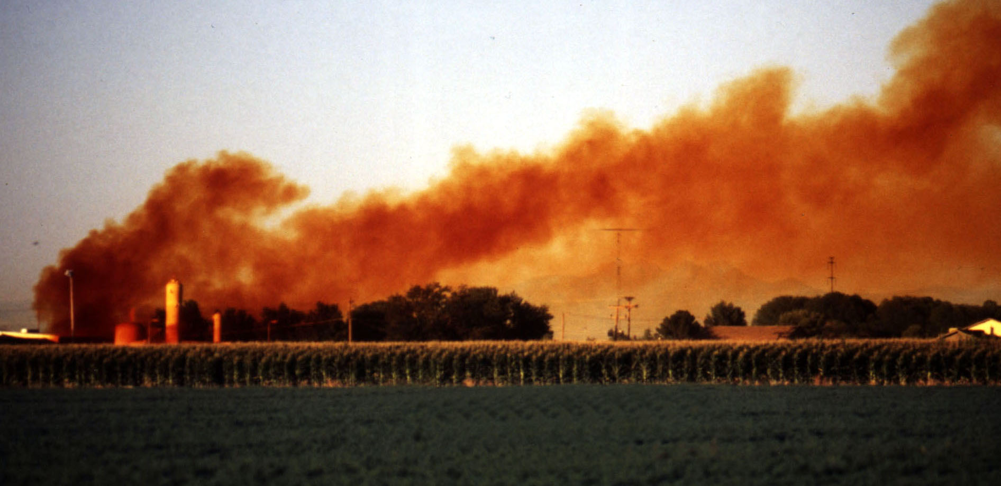
0
Here is an incident at a Non-Structural Location.
What are the health and safety challenges at this type of site?
What hazardous materials might be involved at this type of site?

Slide 18
0
Here is an incident at a Residence.
What hazardous materials might be involved at these sites?
What are the health and safety challenges at these sites?

Slide 19

0
Here is an incident in a Transportation Corridor.
What are the health and safety challenges at these sites?
What hazardous materials might be involved at these sites?

Slide 20
4
The APIE Process is a four-step process.
First Responder Actions (FRAs) define this process.
This process repeats itself until the mission is accomplished.
STEP 1. Analyze the Problem
FRAs:
• Establish command
• Survey the scene
STEP 2. Plan the Response
FRAs:
• Collect and interpret information
• Assess vulnerable population
• Identify container damage
STEP 4. Evaluate the Progress
FRAs:
• Continue to evaluate
STEP 3. Implement the Plan
FRAs:
• Create and implement a specific plan
• Isolate the hazard

Slide 21

http://www.youtube.com/watch?v=VO3rwU74xN0

Slide 22
http://www.youtube.com/watch?v=pw_bnS-qcds

Slide 23
Recognition & Identification
Key Learning Goals :
1. Identify four basic clues for the presence of hazardous materials.
2. Use occupancy and location clues to identify hazardous materials.
3. Identify highway cargo tanks and
rail tank cars.
4. Identify HAZMAT marking systems.
5. Use 2012 ERG and shipping papers to identify hazardous materials.
6. Identify basic physical properties of hazardous materials.

Slide 24
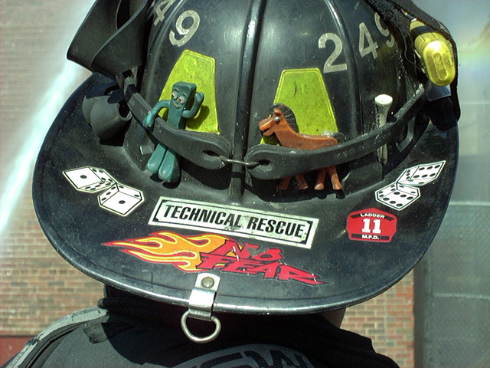
General precautions
Don’t “rush in” Think First
Be Selfish
Approach from up-wind, up-hill. Up stream
Stay clear of all spills, vapors, fumes & smoke.

Slide 25
More Safety Precautions
Approach cautiously from up-wind.
Secure the scene, deny entry.
Identify hazards.
Perform a “Risk Assessment”.
Obtain assistance.
Decide upon site entry.
Respond. IN AN APPROPRIATE MANNER.

Slide 26
More Safety Precautions
DO NOT !
WALK INTO or TOUCH SPILLED MATERIALS.
AVOID INHALATION OF FUMES, SMOKE AND VAPORS.
ODORLESS GASES OR VAPORS MAY BE HARMFUL.

Slide 27
Who you gonna call…hazbusters
Your local response organization.
State, County emergency groups.
Shipper, transporter, or receiving party.
National assistance: CHEMTREC, CANUTEC.

Slide 28
What Information do you need to have?
Your name, call back telephone or FAX number.
Location & nature of the problem.
Name & UN identification number.
Shipper, consignee/point of origin.
Carrier name, rail car or truck number.
Container type & size.
Quantity of material transported or released.
Local conditions.
Injuries & exposures.
Local ERP that have been notified.

Slide 29
Information Sources

Slide 30


Important Phone Numbers
911
CHEMTREC : 1-800-424-9300
CANUTEC : 613-996-6666
DEFENSE DEPT. : 703-697--0218
INFOTRAC : 1-800-535-5053
CHEM-TEL : 1-800-255-3924
3E COMPANY : 1-800-451-8346

Slide 31
Emergency Response Guide
Department of Transportation
Updated every Four (4) Years

Slide 32
The ERG is updated every four years to accommodate new products and technology. The 2012 ERG will have new, revised and expanded sections, including:
An updated dangerous goods list that includes all hazardous materials added to the UN Recommendations on the Transport of Dangerous Goods since the last edition of the book
An index of dangerous goods in order of ID number
An index of dangerous goods in alphabetical order
A rail car identification chart
A road trailer identification chart
Information on pipeline safety

Slide 33
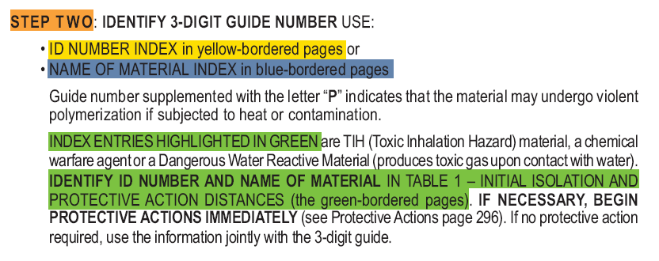
How to Use the Guidebook

Slide 34
Guidebook Contents
Yellow-bordered pages : index list of dangerous goods in numerical order of ID number.
Blue-bordered pages : index of dangerous goods in alphabetical order of material name.
Orange-bordered pages : emergency response guides.
Green bordered pages : isolation & evacuation tables.

Slide 35
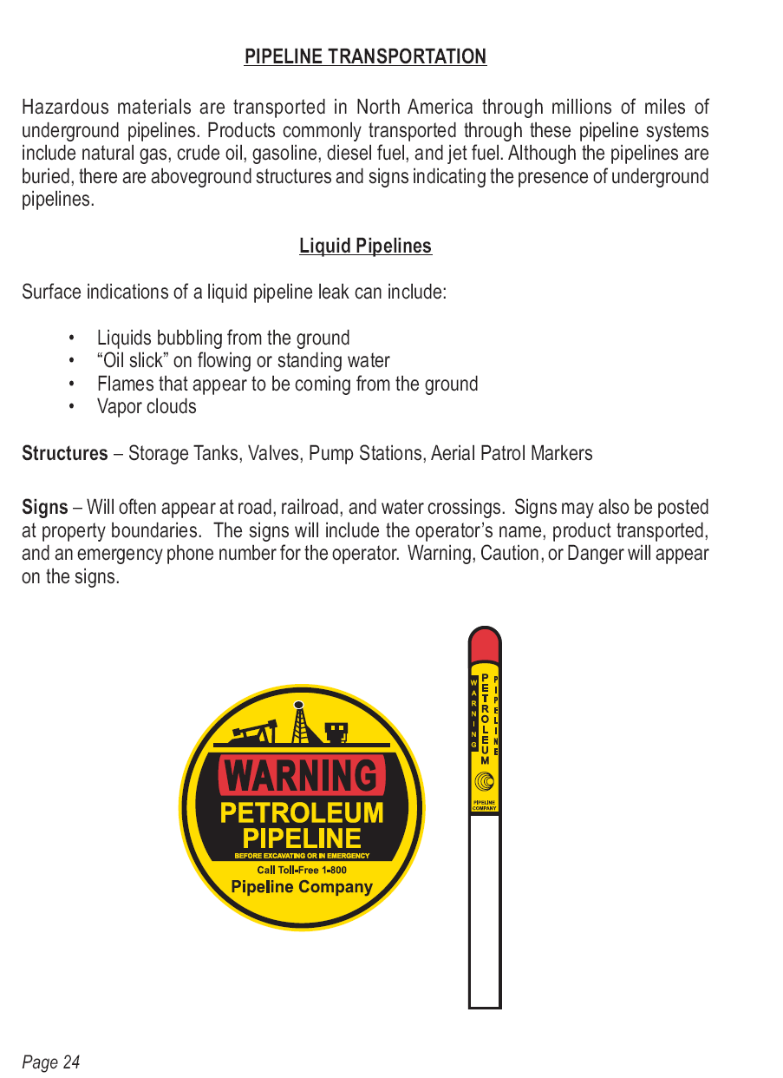
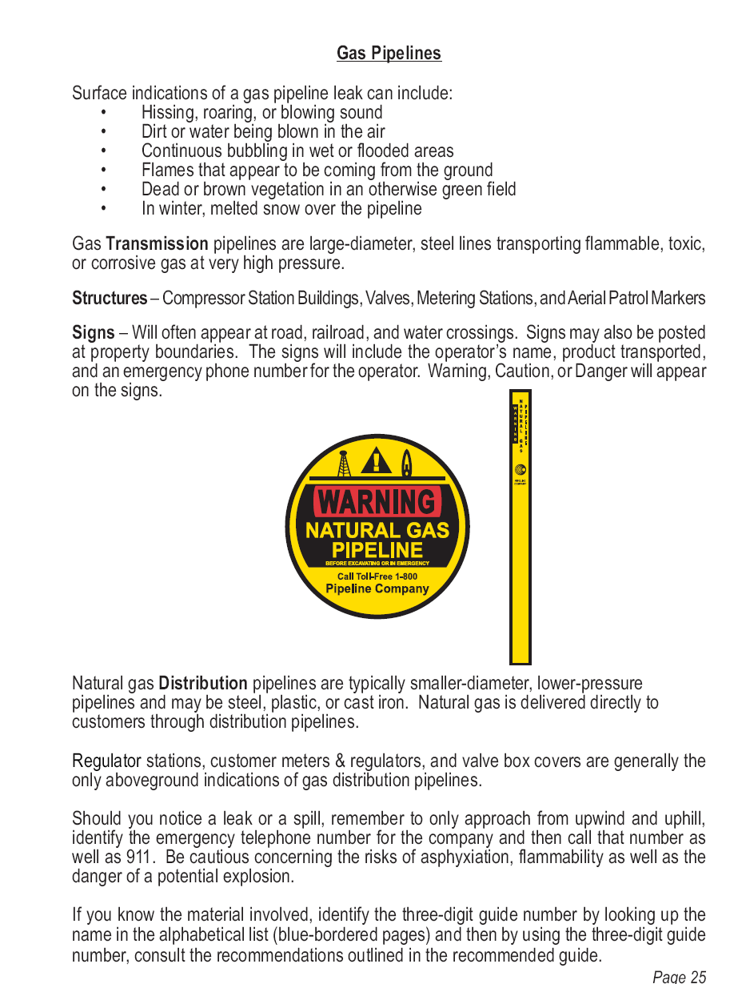
Pipeline Safety Information

Slide 36
The “Yellow Pages”
List of chemicals by UN Identification number.
Highlighted entries indicate materials that are found in the green pages.
If these materials are on fire, or a fire is involved, go to the orange guide book pages.

Slide 37
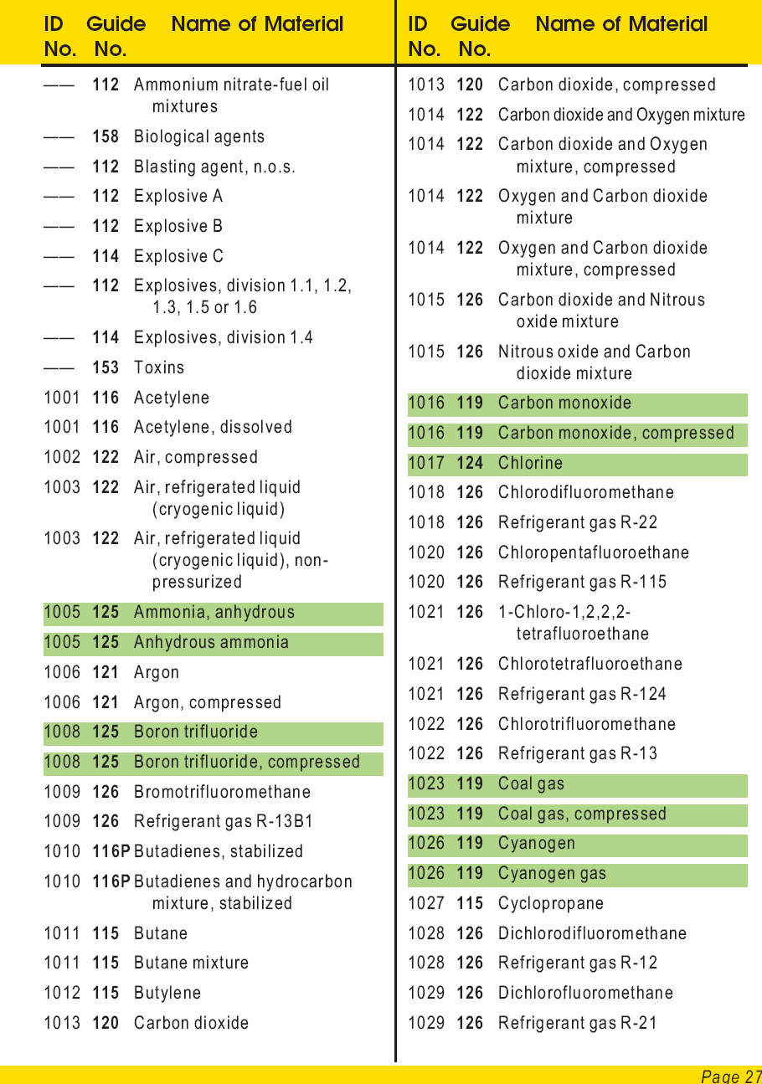
The “Yellow Pages”

Slide 38
The “Blue Pages”
List of chemicals by alphabetical order.
Highlighted entries indicate materials that are found in the green pages.
If these materials are on fire, or a fire is involved, go to the orange guide book pages.

Slide 39
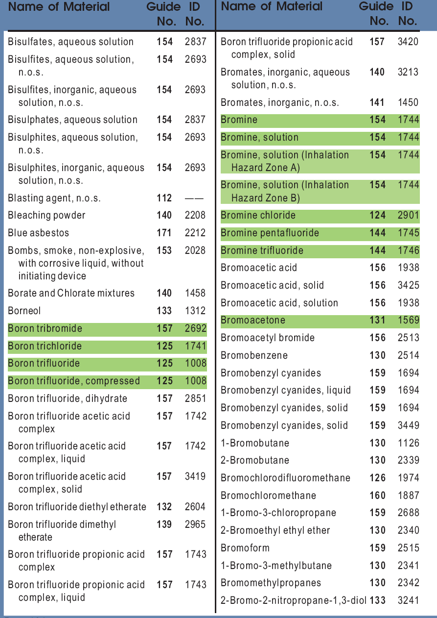
The “Blue Pages”

Slide 40
Exercise
What guide is used for a spill of caustic soda ?
What is the UN # ?
What type of extinguishing agent can be used on a large metal-hydride fire ?

Slide 41
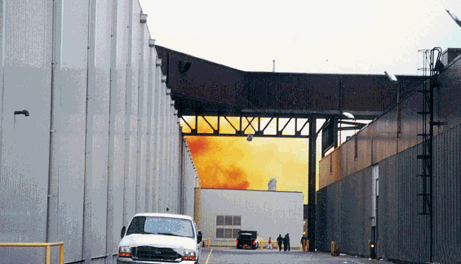
The “Orange Pages”
The emergency action guide pages, the meat and potatoes of this resource guide.

Slide 42
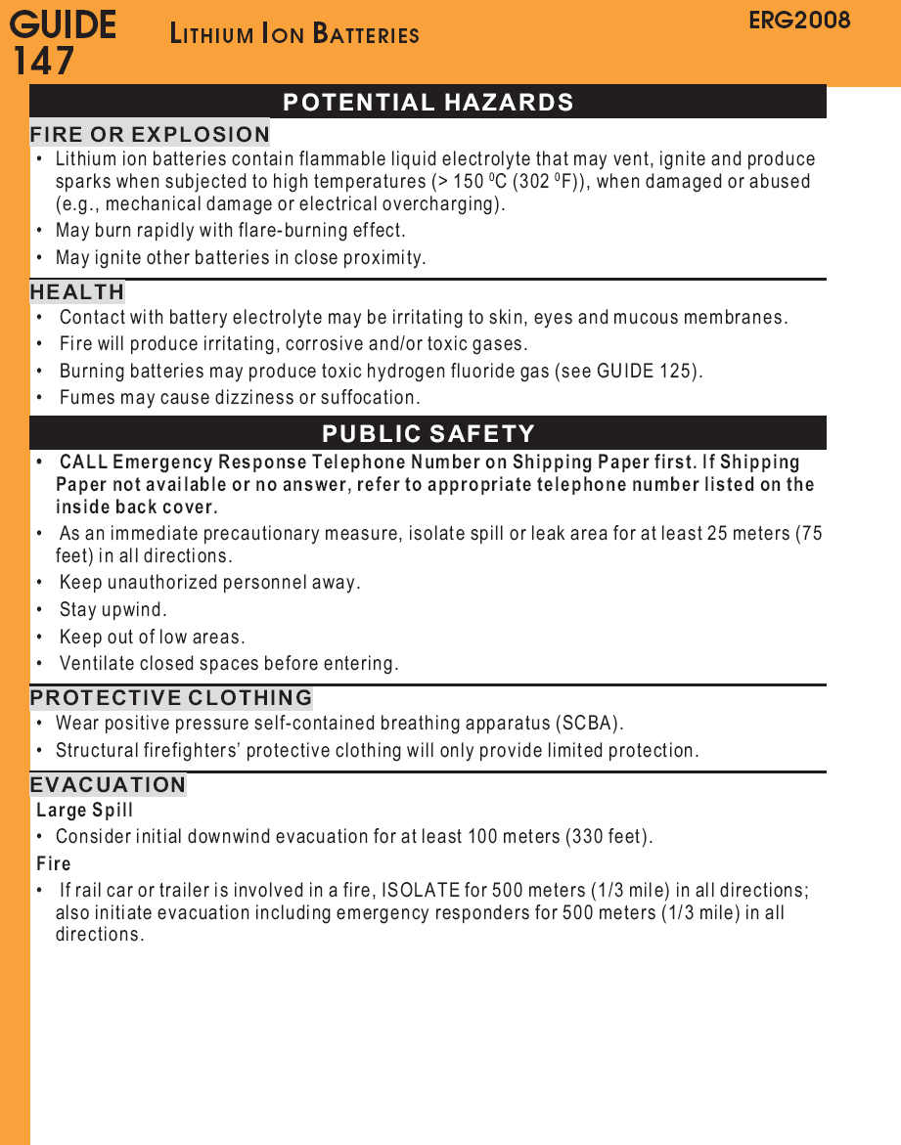
The “Orange Pages”

Slide 43
Green-bordered Pages
Lists by ID # “toxic inhalation hazard” ( TIH ) materials.
Initial and protective action distances.
Distances listed for small & large spills.
Sub-divided into daytime & night time events.

Slide 44
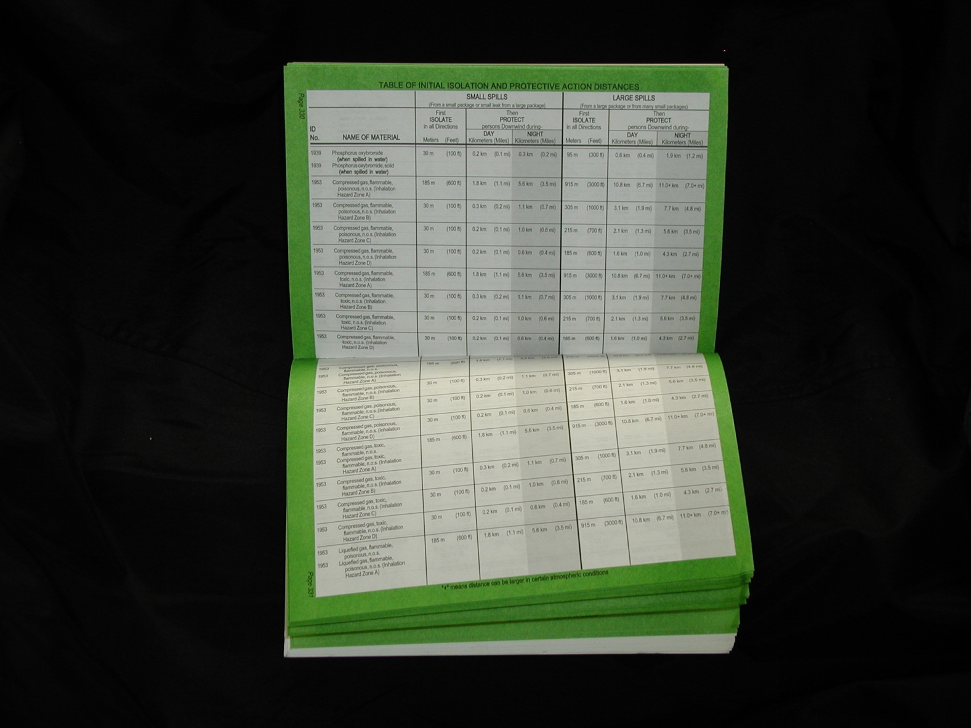
Green-bordered Pages

Slide 45
Initial Isolation Distance
860 meters
Compressed gas,
toxic, n.o.s., ID 1955,
Inhalation zone A.
Small spill = 430 meters,
therefore representing an
evacuation circle of 860 m.
That distance within which all persons should be considered
for evacuation in all directions from the actual spill or leak source.

Slide 46
Protective Action Distance
Compressed gas,
toxic, n.o.s., ID 1955,
Inhalation zone A.
daytime spill = 4.2 kilometers,
nighttime spill representing
an evacuation zone of 8.4 km..
4.2 Km
That distance within which all persons should be considered
for evacuation downwind from the actual spill or leak source.

Slide 47
The Rule of “Double Double”
Whenever the Incident Commander, in the interest of public safety deems it necessary to expand the listed isolation distances, he or she should do so.
The rule of Double Double may apply.

Slide 48
The “Green Pages”
Isolation and protective action guide.
Likely effected area 30 minutes after spill occurs.
Initial isolation zone - surrounding area.
Protective action zone - downwind area.
When in doubt - “Double Double”.

Slide 49
The “Green Pages”
The dangerous goods.
Degree of health hazard, amount involved, containment/control of release, rate of vapor movement.
The population threatened.
Location, time available to evacuate or shelter in-place, ability to control evacuation or shelter in-place, building types/availability, special populations.
Weather conditions.
Effect on vapor/cloud movement, potential for change, effect on evacuation or shelter in place.

Slide 50
Exercise
You arrive on location and observe an orange placard on the rear of a smoking cargo container. What is the material classification ?
What guide pages do you reference ?

Slide 51
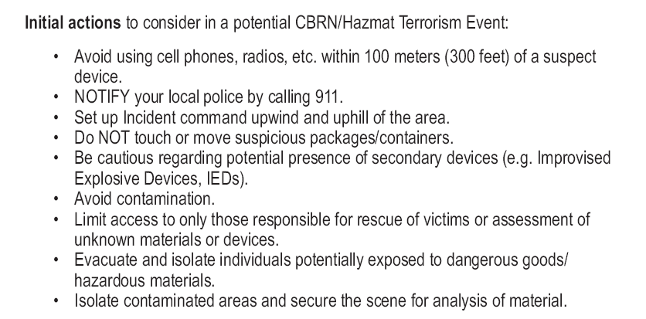
Self Preservation

Slide 52
The “Back of the Book”
Definitions of Personal Protective Clothing.
Fire and Spill Control.
Chemical and Biological agent events.
Differences between them.
Indicators of their presence in an event.
Personal Safety Considerations.
Glossary

Slide 53
EMERGENCY RESPONSE TELEPHONE NUMBERS
UNITED STATES
1. CHEMTREC® 1-800-424-9300 (Toll-free in the U.S, Canada, and the U.S. Virgin Islands) 703-527-3887 For calls originating elsewhere (Collect calls are accepted)
2. CHEM-TEL, INC. 1-800-255-3924 (Toll-free in the U.S, Canada, and the U.S. Virgin Islands) 813-248-0585 For calls originating elsewhere (Collect calls are accepted)
3. INFOTRAC 1-800-535-5053 (Toll-free in the U.S, Canada, and the U.S. Virgin Islands) 352-323-3500 For calls originating elsewhere Collect calls are accepted)
4. 3E COMPANY 1-800-451-8346 (Toll-free in the U.S, Canada, and the U.S. Virgin Islands) 760-602-8703 For calls originating elsewhere (Collect calls are accepted)
5. MILITARY SHIPMENTS 703-697-0218 - Explosives/ammunition incidents (Collect calls are accepted) 1-800-851-8061 - All other dangerous goods incidents

Slide 54
CONTAINER SHAPES & SIZES
Type 1: Bulk Containers
Bulk container capacities, except for watercraft are:
A maximum capacity of more than 119 gallons of liquids
A maximum net capacity of more than 882 pound of solids
A water capacity greater than 1,001 pounds for gases
The Department of Transportation (DOT) classifies three types of containers:
Type 1.
Bulk Containers
Type 2.
Non-Bulk Containers
Type 3.
Intermediate Bulk Containers (IBCs)

Slide 55

0
Tube Trailers
Tube trailers carry from 2 to 20 long cylinders that are permanently mounted on a semi-trailer.
Transport compressed gases such as:
Argon
Helium
Carbon dioxide
Hydrogen
Oxygen
Permanently Mounted Cylinders

Slide 56
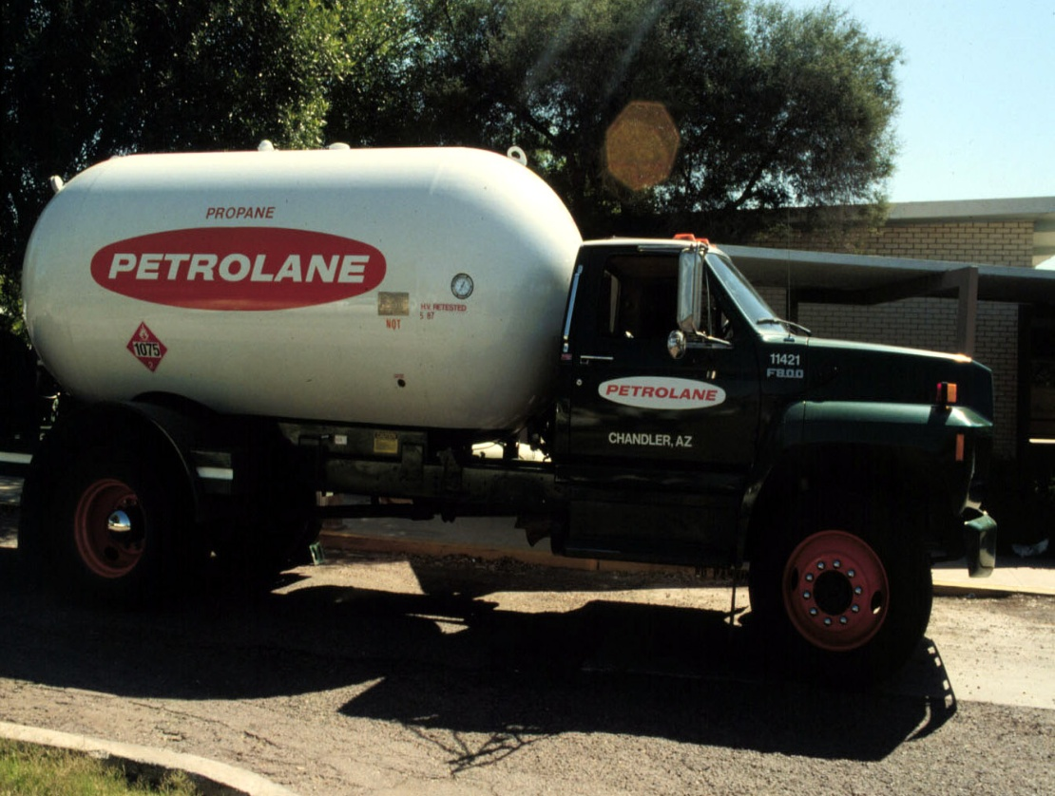
Pressure Cargo Tanks
0
Circular cross-section and round ends
Top 2/3 of the tank is highly reflective or painted white
Tanks transport liquefied gases, such as:
Anhydrous ammonia
Butane
Propane
Chlorine
Reflective or Painted White
Circular, Rounded End

Slide 57
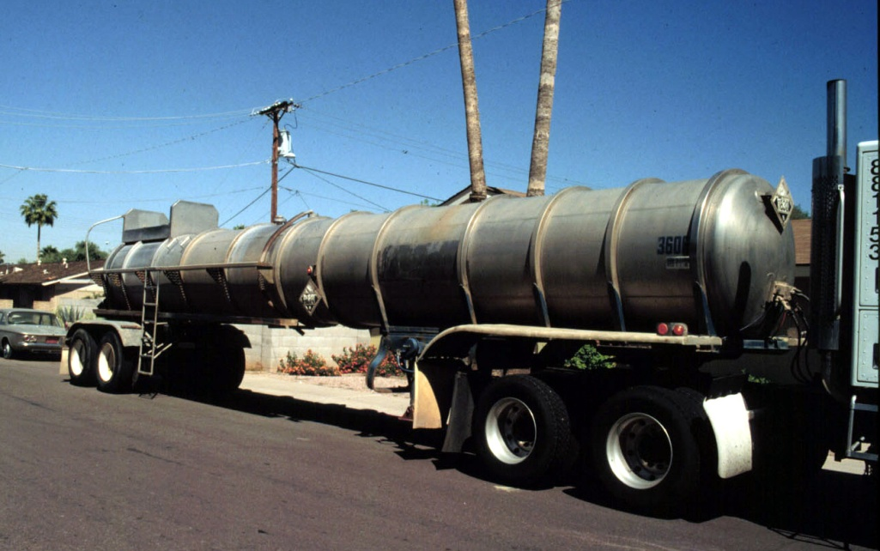
Corrosive Liquid Cargo Tanks
0
Circular cross-sections and flat ends
Relatively small diameter
Tanks usually have visible ring stiffeners, although an outer metal “skin” may be present
Tanks transport high-density liquids, such as:
Sodium hydroxide
Sulfuric acid
Hydrochloric acid
Circular, Flat End
Stiffening Rings

Slide 58
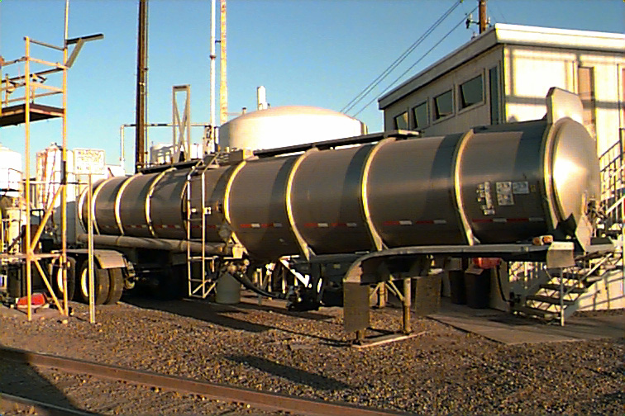
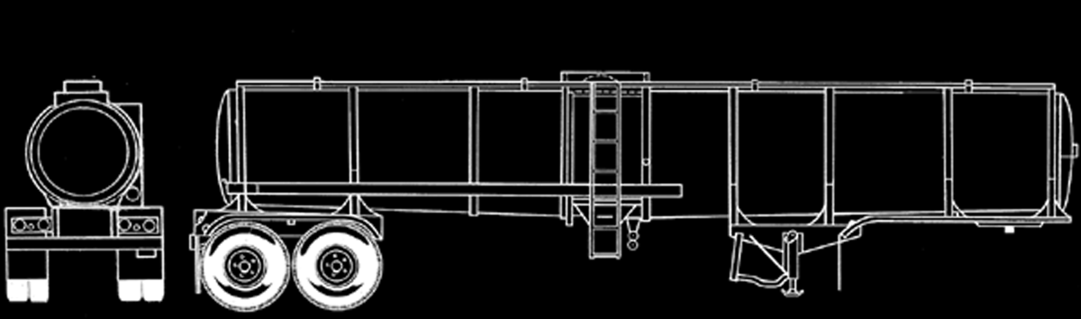
Low Pressure Cargo Tanks
0
Horseshoe shaped cross-sections with circular, flat ends May have rollover protection
Tanks transport:
Flammable or
combustible liquids
Mild corrosives
Poisons
Many other liquids
Rollover Protection
Circular, Flat End
Stiffening Rings

Slide 59
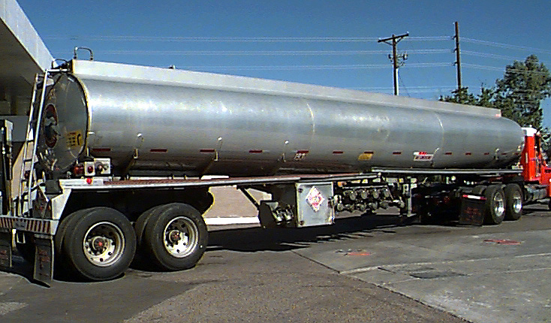
Non-Pressure Cargo Tanks
0
Elliptical cross-section with flat ends
Usually has more than one compartment
Tanks transport petroleum products such as:
Gasoline
Fuel oil
Jet fuels
Elliptical Cross-Section, Flat End
Compartment 1
Compartment 2
Compartment 3

Slide 60
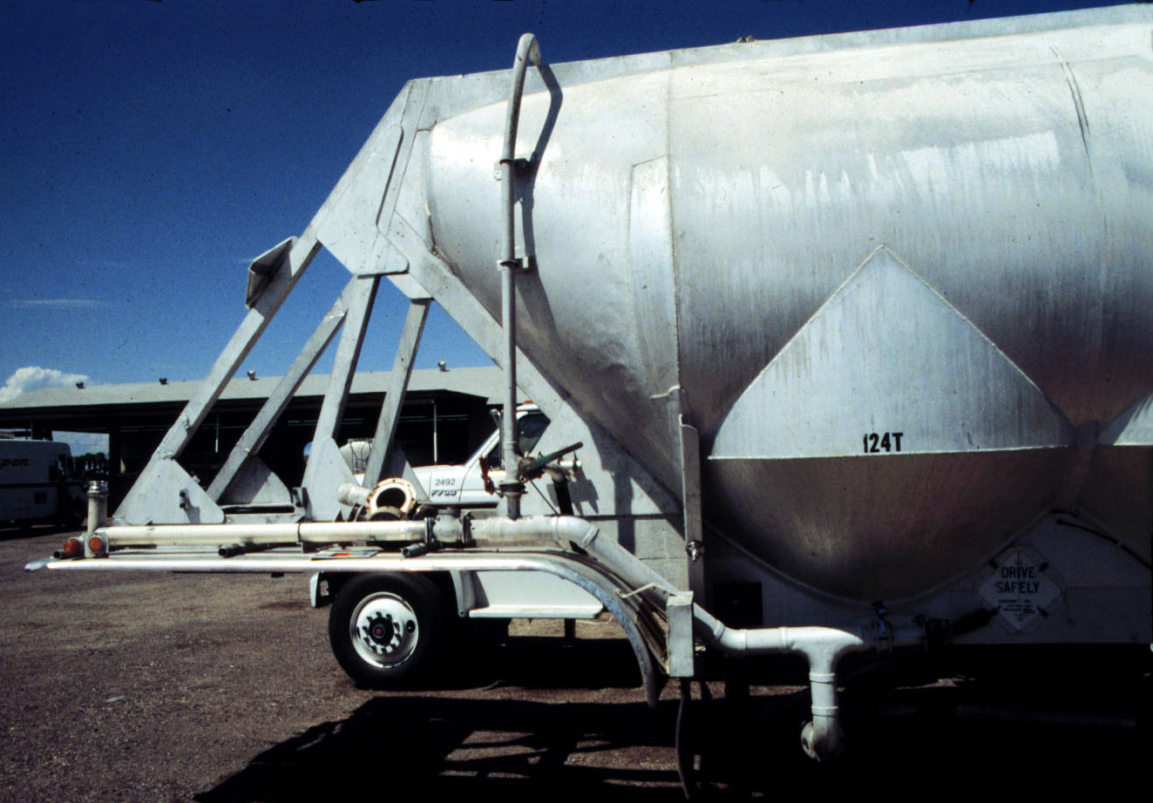

Dry Bulk Commodity Carriers
0
Carriers have large sloping, v-shaped unloading compartments. Transport dry chemicals such as:
Fertilizers
Oxidizers
V-Shaped Unloading Compartments

Slide 61
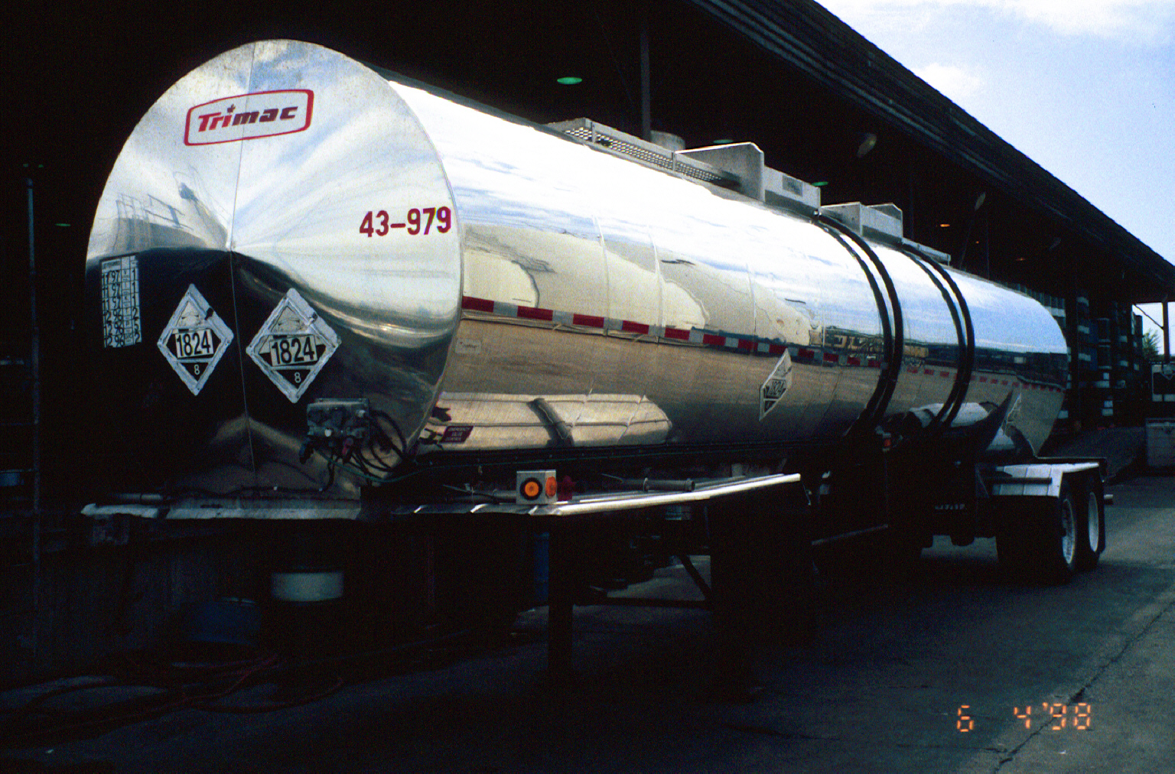
ROAD TRAILER IDENTIFICATION CHART

Slide 62
CONTAINER SHAPES & SIZES
Type 1: Bulk Containers -
Railroad Tank Cars
Railroad tank cars transport hazardous and non-hazardous materials.
Most carry only a single commodity.
Railroad personnel are the best source of information during rail incidents.
The Department of Transportation (DOT) classifies three types of containers:
Type 1.
Bulk Containers
Type 2.
Non-Bulk containers
Type 3.
Bulk Portable Containers and Intermediate Bulk Containers

Slide 63
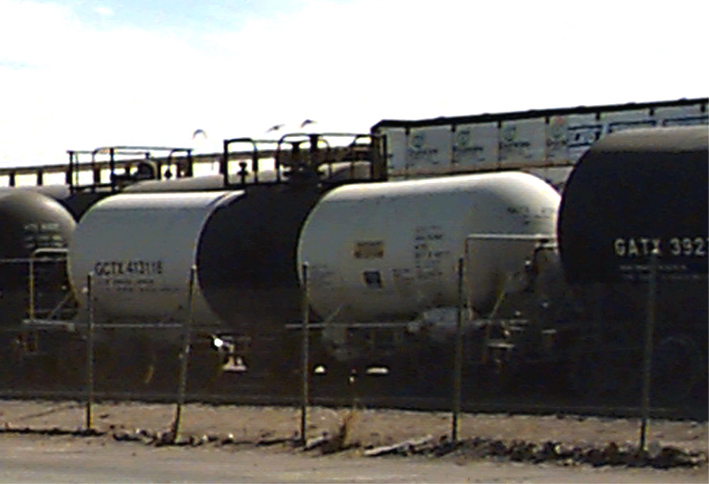
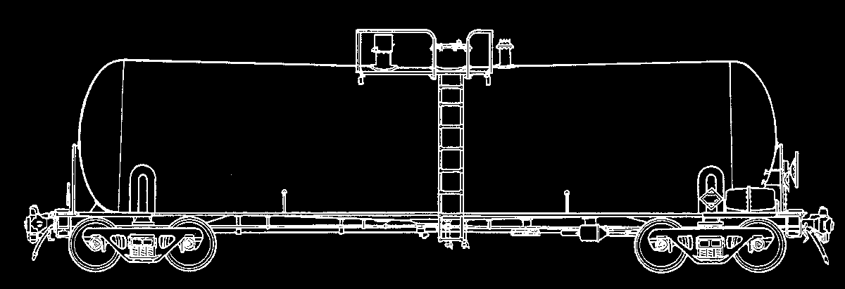
0
Corrosive Liquid Tank Car
Similar to non-pressure tank cars
Can be distinguished by staining around manway
Some painted with vertical stripe of corrosion-resistant paint
Vertical Stripe of Corrosion-Resistant Paint

Slide 64
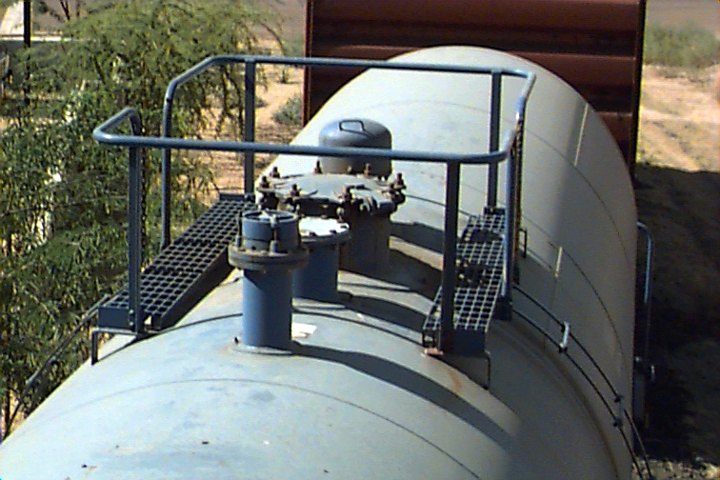
Non-Pressure Railroad Tank Cars
0
Non-Pressure Tank Cars (or general service cars) have visible valves and fittings at top of tank
Transport:
Flammable liquids
Flammable solids
Oxidizers
Organic peroxides
Poisons
Non-hazardous materials
Corrosive liquids
Valves and fittings at top of tank
Manway

Slide 65
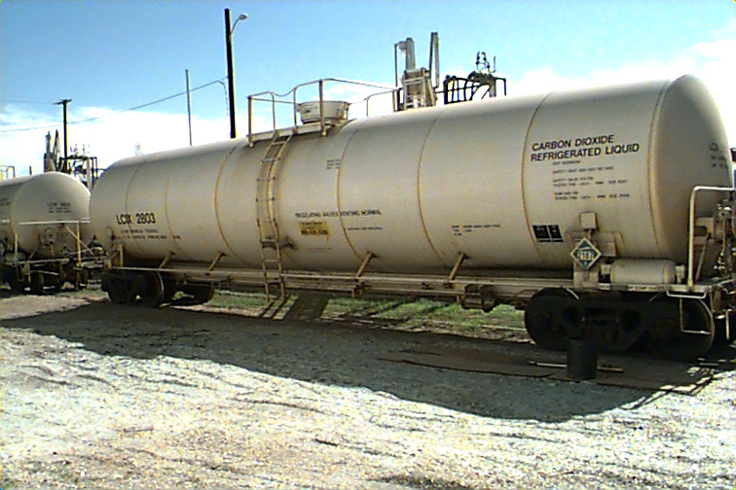
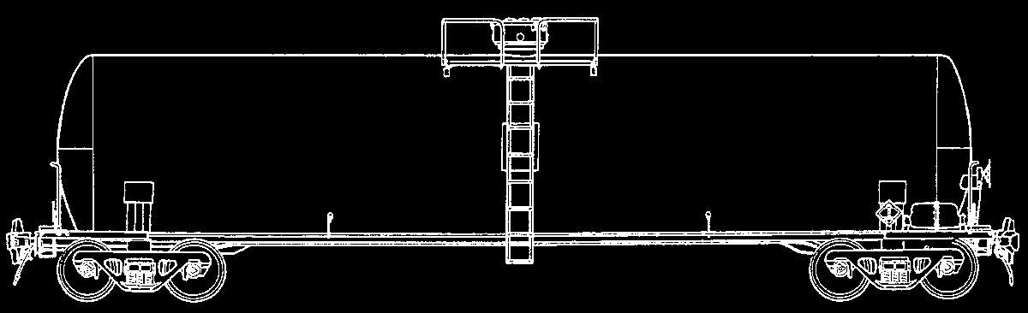
Pressure Tank Cars
0
Consists of protective housing at the top center Transports flammable, non-flammable, and poisonous compressed gases such as:
Chlorine
Propane
Anhydrous ammonia
Protective Housing at Top Center

Slide 66
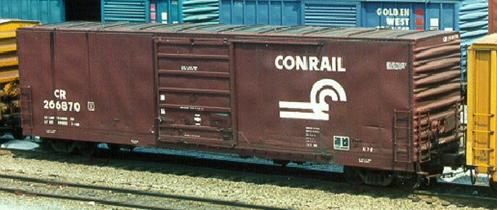
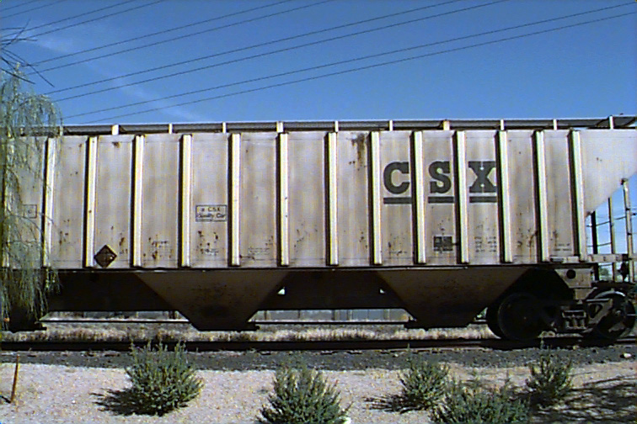
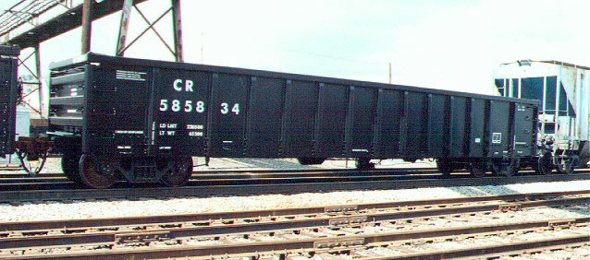
Other Railroad Cars
0
Other types of rail cars that transport hazardous materials include:
Trailer on flat cars (TOFC)
Container on flat cars (COFC)
Box cars
Gondola cars
Hopper cars
Tube trailer cars

Slide 67
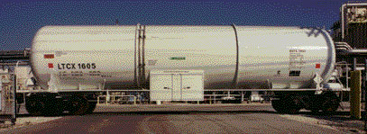
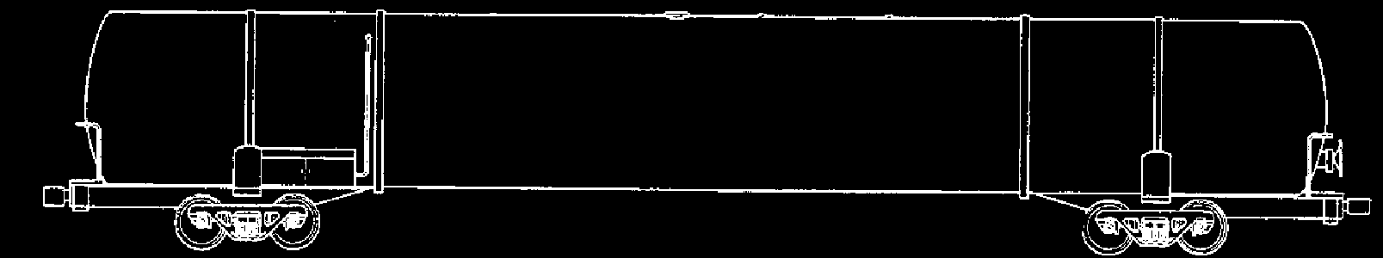
0
Cryogenic Liquid Tank Car
Carries low-pressure refrigerated liquids (minus 130˚F and below)
Designed as a tank-within-a-tank for insulation
Product may vent under normal conditions
Tank-Within-a-Tank

Slide 68
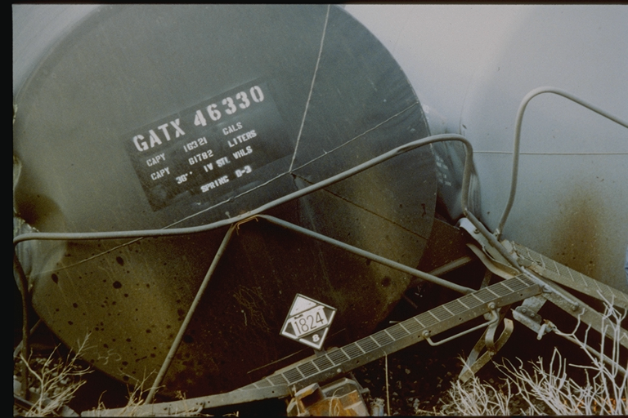
RAIL CAR IDENTIFICATION CHART

Slide 69
CONTAINER SHAPES & SIZES
Type 3: Bulk Portable Containers & Intermediate Bulk Containers
Types of bulk containers include:
Ton Containers
Intermodals
Intermediate Bulk Containers (IBCs) or Totes
The Department of Transportation (DOT) classifies three types of containers:
Type 1.
Bulk Containers
Type 2.
Non-Bulk Containers
Type 3.
Bulk Portable Containers and Intermediate Bulk Containers

Slide 70
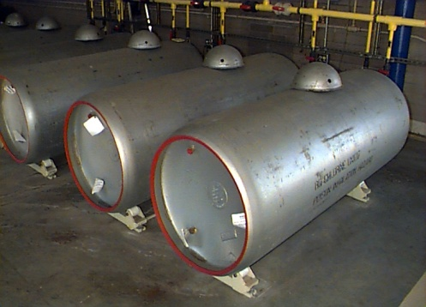
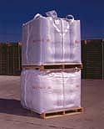
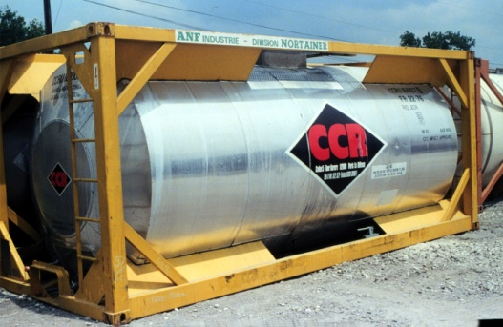
Bulk Portable Containers and Intermediate Bulk Containers
0
TON CONTAINERS transport:
Anhydrous ammonia, Butadiene, Chlorine, Phosgene, Sulfur dioxide, Refrigerant gases
INTERMEDIATE BULK CONTAINERS (IBCs) or TOTES: aluminum, stainless steel, or poly materials
Transport most hazardous materials classifications
Rigid or flexible portable packaging designed for mechanical handling
INTERMODAL TANK CONTAINERS (IMs): single metal tank mounted inside a sturdy metal supporting frame.
Transport LP gases, Flammable gases, Anhydrous ammonia

Slide 71
ID CODES for INTERMODAL CONTAINERS
33
1203

Slide 72



INTERMODAL CONTAINERS

Slide 73
ID CODES for INTERMODAL CONTAINERS
2 - Emission of gas due to pressure or chemical reaction.
3 - Flammability of liquid vapor/gases or self heating.
4 - Flammability of solids or self heating liquid.
5 - Oxidizing effect.
6 - Toxicity or risk of infection.
7 - Radioactivity
8 - Corrosivity
9 –Miscellaneous Dangerous Substance

Slide 74
ID CODES for INTERMODAL CONTAINERS
Por ejemplo…
X839 => X 8 3 9
X = material will react dangerously w/ water.
8 = corrosive
3 = flammable liquid, gas or self heating liquid
9 = risk of spontaneous violent reaction

Slide 75
Exercise
Go to guide 111 (Page 168).
What types of materials are referenced to this page ?

Slide 76
CONTAINER SHAPES & SIZES
Type 2: Non-Bulk Containers include:
1. Drums
2. Pails
3. Bags or sacks
4. Fiberboard boxes
5. Carboys
6. Cylinders
7. Dewars
8. Multi-cell packages
The Department of Transportation (DOT) classifies three types of containers:
Type 1.
Bulk Containers
Type 2.
Non-Bulk Containers
Type 3.
Bulk Portable Containers and Intermediate Bulk Containers

Slide 77
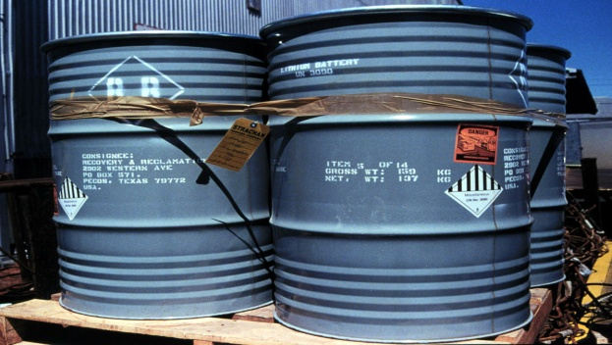
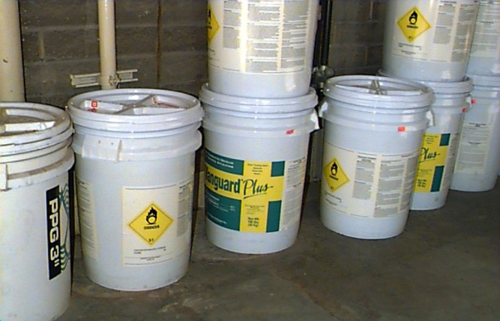
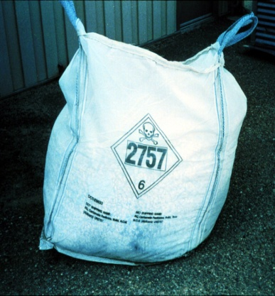
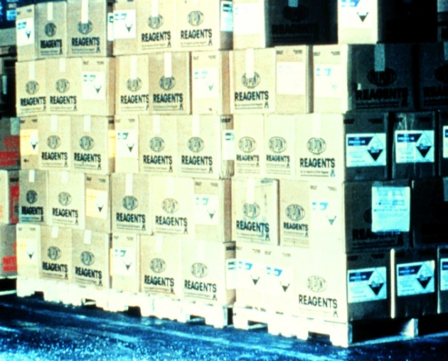
0
Non-Bulk Containers
1. DRUMS: steel, fiberboard, or poly materials
Transport several HAZMAT classifications.
2. PAILS: steel, fiberboard, or poly materials
Hold one to five gallons of flammable liquids, poisons or oxidizers.
3. BAGS or SACKS: paper or plastic
Holds dry corrosives, blasting agents, explosives, flammable solids, oxidizers, organic peroxides, poisons, or ORMs.
4. WOODEN BOXES transport every hazardous materials class, except compressed gases.
FIBERBOARD BOXES are used for everything, except compressed gases and poisons.

Slide 78




0
Non-Bulk Containers
5. CARBOYS: plastic, metal or glass.
Transport corrosives.
6. CYLINDERS contain compressed gases, flammable/ combustible liquids, poisons, radioactive materials, and corrosives.
7. DEWARS used for the storage of cryogenic materials, such as: Liquid nitrogen, Oxygen, Helium, and Argon.
8. MULTI-CELL PACKAGES
Usually polystyrene form-fitted containers with no more than six bottles holding four liters.

Slide 79
CONTAINER SHAPES & SIZES
TYPE 1: Bulk Containers - Fixed-site Bulk Containers have certain characteristics that identify them as non-pressurized, low pressure, or pressurized. Pressurized tanks have rounded ends and visible pressure relief valves. Non- and low pressurized tanks generally have flat ends; pressure relief devices will not be present.
The Department of Transportation (DOT) classifies 3 types of containers:
Type 1.
Bulk Containers
Type 2.
Non-Bulk Containers
Type 3.
Bulk Portable Containers and Intermediate Bulk Containers

Slide 80





0
Fixed Site Bulk Containers
Covered Floating Roof Tank
Cone-shaped roof covers inner floating roof with large vents at top
Cone Roof Tank
Circular with a cone-shaped roof
Vertical Flat Roof Tank
Circular with a flat roof
Open Floating Roof Tank
Roof floats on contents; may have ladder on sIde
Dome Roof Tanks
Vertical structure with dome-shaped roof with internal pressure up to 15 psi

Slide 81





0
Fixed Site Bulk Containers
Horizontal Tank
Restricted or banned due to possible tank/leg failure
Underground Storage Tank
Gauges and controls are above ground
Pressurized Horizontal Tank
Usually set on legs or blocks; painted white or reflective color; pressure relief devices on top
Spherical Tank
Ball-shaped; painted white or reflective color
Cryogenic Liquid Storage Tank
Vertical structure with dome-shaped roof; internal pressure up to 15 psi

Slide 82
CONTAINER SHAPES & SIZES
TYPES 1, 2, and 3: RADIOACTIVE MATERIAL CONTAINERS are made of any number of materials. Low-level radioactive materials are often packaged in glass bottles, then packaged in cardboard, fiberboard, wooden boxes or steel drums. High-level radioactive materials are packaged in steel containers lined with lead, paraffin, and/or depleted uranium.
The Department of Transportation (DOT) classifies 3 types of containers:
Type 1.
Bulk Containers
Type 2.
Non-Bulk Containers
Type 3.
Bulk Portable Containers and Intermediate Bulk Containers

Slide 83

0
Radioactive Materials Containers
INDUSTRIAL PACKAGING
Low levels of radioactivity; safer for normal transportation activities
EXCEPTED PACKAGING
Low levels of radioactivity; shipped in limited quantities
TYPE A PACKAGING
Tested for ability to contain contents; made of fiberboard, wood, or steel
TYPE B PACKAGING
Used to transport materials that would be a hazard if released

Slide 84


Marking Systems
Marking Systems provide information about types and hazards of products being stored or transported.
The most common marking systems are:
DOT system for
materials in transit
NFPA 704 system
for fixed sites
3
4
3
OX

Slide 85


0
DOT Placards & Labels
DOT placards & labels generally indicate a primary hazard.
DOT Placards are:
Diamond-shaped; 10 3/4” on each side
Affixed to both sides and ends of the vehicle
10 3/4” diamond- shaped placard
DOT Labels are:
Diamond shaped; 4” on each side
On two sides of the container near the shipping name of the material
Secondary hazards must be labeled
4” diamond-shaped labels
PROBLEMS with DOT Marking:
Secondary hazards may not be identified
Degree or severity of a hazard is not apparent for most classes
Enforcement is difficult

Slide 86



0
DOT Marking System
PLACARDS are required for Secondary Hazards that are:
Poisonous by inhalation
Dangerous when wet
Other specific chemicals
UNITED NATIONS (UN) ID NUMBERS:
Four-digit ID numbers can replace text on placards for bulk shipments of hazardous materials. However, it cannot replace the DANGEROUS placard or the class name for Radioactive or Explosive materials.
UN identification numbers can be posted on a separate orange panel next to a placard.
4” black numbers on orange panel next to a placard
2448
UN identification numbers can be incorporated into a DOT placard.
In the center of the placard
Or, in the center of placard-sized white diamond when no other placard is required
1075
3257

Slide 87







0
DOT Marking System
There are nine classes in the DOT marking system.
Some classes are broken down into divisions.
Class 1: Explosive
Class 2: Gases
Class 3: Flammable/ Combustible Liquid
Class 4: Spontaneously Combustible
Class 5: Oxidizer/ Organic Peroxide
Class 6: Poison
Class 7: Radioactive
Class 8: Corrosive Material
Class 9: Miscellaneous Dangerous Material

Slide 88
Table 1 Materials
Table 1 materials must always be placarded with their primary hazard placards, regardless of the amount being transported.
The categories are:
Explosive 1.1
Explosive 1.2
Explosive 1.3
Poisonous Gas (Class 2.3)
Dangerous When Wet (Class 4.3)
Organic Peroxides, Type B, Temperature Controlled (Class 5.2)
Poison Inhalation Hazard, Zone A or B (Class 6.1)
Radioactive (Class 7; those substances in Radioactive III packaging only)

Slide 89





0
DOT Marking System
CLASS 1: Explosives — 6 divisions
Orange = explosive
Bursting ball = explosive
EXAMPLES: TNT, Dynamite, Black powder

Slide 90



0
DOT Marking System
CLASS 2: Gases — 4 divisions
DIVISION 2.1:
Red = flammable/ combustible
Flame = flammable
DIVISION 2.2:
Green = non-flammable gas
Cylinder = non-flammable gas
OXYGEN: may be used in lieu of non-flammable placard
Flaming circle = oxidizer
Yellow = oxygen
DIVISION 2.3:
Skull & crossbones = poison
White = poisonous material
EXAMPLES: Argon, Chlorine, Helium, Nitrogen, Oxygen, Propane

Slide 91

0
DOT Marking System
CLASS 3: Flammable or Combustible Liquids — 4 divisions
FLAMMABLE
For all CLASS 3:
Red = flammable/ combustible
Flame = flammable
EXAMPLES: Gasoline, Diesel fuel, Acetone

Slide 92


0
DOT Marking System
CLASS 4: Flammable Solids, Spontaneously Combustible & Dangerous When Wet
DIVISION 4.1:
White with red stripes = flammable solid
Flame = flammable
DIVISION 4.2:
White over red = spontaneous combustion
Flame = flammable
DIVISION 4.3:
Blue = dangerous when wet
Flame = flammable
EXAMPLES: Nitrocellulose, Magnesium turning, Calcium carbide, Potassium, Sodium metal, Self-heating material

Slide 93


0
DOT Marking System
CLASS 5: Oxidizer/Organic Peroxide
OXIDIZER (5.1) EXAMPLES: Hydrogen peroxide, Potassium nitrate, Sodium persulfate
ORGANIC PEROXIDE (5.2) EXAMPLES: Dibenzoyl peroxide, Methyl ethyl ketone peroxide (MEKP), Peroxyacetic acid
DIVISIONS 5.1 & 5.2:
Yellow indicates oxidizer (including oxygen) or organic peroxide
Circle with flame indicates oxidizing material or organic peroxide

Slide 94

0
DOT Marking System
CLASS 6: Poison
6
DIVISION 6.1:
White = poisonous material
Skull & crossbones = poisonous material
POISON:
White = poisonous material
KEEP AWAY FROM FOOD:
White = poisonous material
St. Andrew’s Cross over wheat shaft = keep away from foodstuffs
EXAMPLES: Chloropicrin (tear gas), Arsenic

Slide 95
0
DOT Marking System
CLASS 7: Radioactive
*
CLASS 7:
Yellow over white = radioactive material
Trefoil (propeller) = radioactive material
EXAMPLES: Cobalt, Uranium hexafluoride, Yellow cake,
Nuclear pharmaceuticals (Gallium and Thallium)

Slide 96

0
DOT Marking System
CLASS 8: Corrosive Materials
CLASS 8:
White over black = corrosive
Test tube and hand/metal symbol = corrosive
EXAMPLES: Sulfuric acid, Nitric acid, Hydrochloric acid, Sodium Hydroxide

Slide 97


0
DOT Marking System
CLASS 9: Miscellaneous Dangerous Material
CLASS 9:
Black stripes over white indicates miscellaneous hazardous material
EXAMPLES: Dry ice, Molten sulfur, PCBs (electrical transformers)

Slide 98

0
DOT Marking System
DANGEROUS Placard
Red with white band = dangerous
EXAMPLES: Used if two or more Table 2 materials with a combined weight of more than 1,001 lbs. are being transported.

Slide 99
1
NFPA Marking System
The NFPA Marking System uses a diamond divided into four color-coded areas with numerals that indicate a degree of hazard.
NFPA Marking System Key (Scale 0 to 4)
Lowest Hazard 0 1 2 3 4 Greatest Hazard
YELLOW = Reactivity Hazard
3
RED = Flammability Hazard
4
3
WHITE =
Special Hazard
BLUE = Health Hazard
OX
Based upon this NFPA diamond, what can you predict for potential hazards?

Slide 100






6
Other Marking Systems
Trailer numbers, telephone numbers, license plate numbers are useful in identifying materials.
A company name may indicate the hazards that are present.
Can you think of other types of marking systems in your community that are used in identifying hazardous materials?
Companies may adopt their own marking systems for containers.
EPA requires pesticides labeling by health risk:
Danger = Highest
Warning = Medium
Caution = Lowest
The name of specific hazardous materials are sometimes stenciled on the side of tank cars.

Slide 101

The Future The HAZCOM Standard is now aligned with the Globally Harmonized System of Classification and Labeling of Chemicals (GHS).

Slide 102
Pictograms Vs. DOT Labeling
Should not be confused with one anotherDot Labels convey Hazard Info during transportation
GHS Pictograms convey Hazard Info while in use

Slide 103


Slide 104
Recognition & Identification Summary
Key Learning Goals :
1. Identify four basic clues for the presence of hazardous materials.
2. Use occupancy and location clues to identify hazardous materials.
3. Identify highway cargo tanks and
rail tank cars.
4. Identify HAZMAT marking systems.
5. Use 2012 ERG & NIOSH Pocket Guides, facility documents and shipping papers to identify hazardous materials.
6. Identify basic physical properties of hazardous materials.

Slide 105






1
What are the four basic clues used to recognize the presence of hazardous materials?
1. Occupancy and Location
2. Container Shapes and Sizes
4. Shipping Papers and Facility Documents
3. Marking Systems

Slide 106


Recognition and Identification Clues
1
Identify at least two types of occupancies that might indicate the presence of hazardous materials.
Industrial Locations
Residential

Slide 107

Recognition and Identification Clues
3
Identify at least two types of containers that might indicate the presence of hazardous materials.
Low Pressure Tanker
Non-Bulk Household Products
Type A Radioactive Packaging

Slide 108

Recognition and Identification Clues
1
Identify at least two types of shipping papers and facility documents used to recognize the presence of hazardous materials.
Material Safety Data Sheets
Bill of Lading or Freight Bill
Waybill and/or Consist
Dangerous Cargo Manifest
Air Bill

Slide 109


Recognition and Identification Clues
1
DOT system for materials in transit
The NFPA 704 system for fixed sites
Which marking system is used for materials in transit and which for fixed sites?

Slide 110
2
Shipping Containers
1. What are three types of products this non-pressure highway carrier might be carrying?
Gasoline
Fuel oil
Jet fuels
2. What types of products might this non-pressure railroad tank car be carrying?
Flammable liquids
Oxidizers
Organic peroxides
Poisons
Corrosive liquids
Non-hazardous materials

Slide 111



2
Shipping Containers
1. What types of hazardous materials may be shipped in TOFCs or COFCs?
There are no Federal Railroad Administration (FRA) restrictions specifying what hazard classes may be shipped in TOFCs or COFCs .
2. Although this gondola car transports bulk ores and other solid materials,
….what carcinogenic material does it often carry?
Gondola Car
Trailer on Flat Car (TOFC)
Container on Flat Car (COFC)
Radioactive materials

Slide 112

1
ERG & NIOSH Guidebooks
Which document contains in-depth information on physical properties,
toxicity, and personal protective equipment
Which document is designed for use in transportation incidents and provides information on common hazardous materials

Slide 113
3
ERG & NIOSH Guidebooks
1. STATES OF MATTER:
Substances can change from one state to another as changes occur in temperature or pressure, or both.
Why would a toxic substance be more hazardous in the gaseous state than in the liquid state?
Because it is easier to inhale as a gas and more difficult to control.
2. FLASH POINTS:
Which has a higher flash point - a flammable liquid or a combustible liquid?
3. VAPOR DENSITY:
Air has a vapor density of 1. When released into the air, what happens to a substance with a vapor density greater than 1?
A combustible liquid has the higher flash point - above 141˚F, below 200˚F. Flammable liquid’s flash point is less than 141˚F.
It will sink, staying close to the ground.
It will sink, staying close to the ground.
It will sink, staying close to the ground.
It will sink, staying close to the ground.
It will sink, staying close to the ground.

Slide 114
3
ERG & NIOSH Guidebooks
1. Describe how and why a release of chlorine gas from a one-ton cylinder at a community’s water treatment facility might affect the surrounding area.
Evacuate the area; wind direction is a factor; vapor density is heavier than air; check topography; a little liquid chlorine turns into a much greater volume of gas.
2. When oxidizers are added to other materials, they dramatically accelerate combustion. Oxidizers often continue to burn even after sources of air are removed. Why?
ox•i•dize (verb): combine with oxygen
3. Cryogenic gases are compressed and have very low temperatures.
During a fire, why would you not spray a cryogenic container with water?
Water may freeze the structure and crack the container.
Because oxidizers provide their own oxidizing capability and need no air to burn.

Slide 115

3
Lessons Learned
Use the four basic recognition and identification clues to detect the presence of hazardous materials.
Use available resources to identify specific hazards of materials
involved in an incident.
Understand the importance of the physical properties of hazardous materials to predict chemical reactions at the scene of an incident.
THE END

Slide 116
Summary
Identify the material.
Look up the material’s 3-digit guide number.
Turn to the numbered guide.
If there is there is nothing else, use the placard pages.
If a reference cannot be found, use guide 111.

Slide 117
Summary
Yellow-bordered pages : index list of dangerous goods in numerical order of ID number.
Blue-bordered pages : index of dangerous goods in alphabetical order of material name.
Orange-bordered pages : emergency response guides.
Green bordered pages : isolation & evacuation tables.

Slide 118
Summary
Approach cautiously from up-wind.
Secure the scene, deny entry.
Identify hazards.
Perform a “Risk Assessment”.
Obtain assistance.
Decide upon site entry.
Respond. IN AN APPROPRIATE MANNER.

Slide 119
Summary
DO NOT !
WALK INTO or TOUCH SPILLED MATERIALS.
AVOID INHALATION OF FUMES, SMOKE AND VAPORS.
ODORLESS GASES OR VAPORS MAY BE HARMFUL.

Slide 120
Health & Safety Summary
Key Learning Goals :
1. Explain exposure and contamination.
2. Identify the purpose of medical surveillance.
3. Explain decontamination procedures.
4. Explain limitations and proper care of Personal Protective Equipment (PPE).
5. Describe four major routes of entry of hazardous materials.
6. List ways to prevent/minimize exposure to hazardous materials.

Slide 121
1
What is the purpose of medical surveillance ...?
... to detect early changes in health status so permanent health effects can be prevented.
Your physician needs the following information:
A copy of 29 CFR 1910.120
Your job duties
Previous exposures
PPE used
Your health assessments are based on:
Diagnostic medical testing
Biological monitoring
Questionnaire data
Physical exams
CFR 1910.120 cites these conditions when fire fighters must be provided with a medical surveillance program:
When they operate as members of a HAZMAT Team.
When exposed to hazardous substances for 30 or more days per year at, or above, exposure limits set by OSHA.
When injured due to overexposure from an emergency incident involving hazardous substances.

Slide 122
1
What is medical surveillance?
Medical surveillance is a program of collecting and interpreting health data. It is required by law.
Environmental Protection Agency (EPA) regulations provide additional protection for workers that are not covered by OSHA.
The Occupational Health and Safety Administration (OSHA) Hazardous Waste Operations and Emergency Response (HAZWOPER) standard, 29 CFR 1910.120.
The National Fire Protection Association’s (NFPA) NFPA 1500: Standard on Fire Department Occupational Safety and Health Programs addresses the health and safety of fire fighters and emergency medical care providers.

Slide 123
1
What is the difference between exposure and contamination?
Match the correct answers.
1. EXPOSURE occurs when a toxic substance...
A. clings to or saturates parts of your body or clothing.
2. CONTAMINATION occurs when a toxic substance…
B. is taken into or is in direct contact with your body.

Slide 124

1
Would you be exposed or contaminated working around this overturned pesticide truck?
BOTH!

Slide 125

1
What is decontamination?
The process of removing or neutralizing contaminants that have accumulated on personnel and equipment.

Slide 126
4
Name the steps for decontamination.
CONTAMINATION
1. Leave the Hazard Area.
2. In the selected Decontamination Area:
Keep SCBA on and in use.
Brush off heavy particles of material.
Use handline without nozzle to rinse SFPC, top down.
After thoroughly rinsing, step into the clean area.
3. In the Clean Area
Remove SFPC.
Make sure you remove SCBA facepiece last.
4. At Quarters
Take a personal hygiene shower.
Don a clean uniform.
Clean and inspect your SFPC and SCBA.
DECONTAMINATION

Slide 127
6
Name the steps for emergency decontamination.
CONTAMINATION
1. Dry contaminants should be brushed off the skin.
2. Flush affected skin and mucous membranes (including eyes) with water—large amounts when corrosives are involved.
3. Remove outer clothing if not easily decontaminated.
4. Flush victims again with water.
5. When many areas of the body are affected, give priority to the most vulnerable areas, like the eyes.
6. If a contaminating substance is not water-soluble, wash the skin (never the eyes) with soapy water.
DECONTAMINATION

Slide 128

2
PPE (Personal Protective Equipment)
SCBA
The two primary components of PPE (Personal Protective Equipment) are: SFPC and SCBA. What are their limitations as protective equipment?
SFPC
SCBA provides respiratory protection.
However, its bulk and weight hinder maneuverability.
It has a limited air supply.
High temperatures can compromise its effectiveness.
SFPC protects you from heat and flame.
However, it is easily permeated by most hazardous chemicals.
Contaminants may not be removed by cleaning.

Slide 129
5
What are the four major routes of entry of hazardous materials?
Identify two factors that affect each route of exposure.
3. Ingestion
1. Skin absorption
Swallowing toxic materials
Eating before completion of decontamination
Skin temperature/ blood flow
Higher concentration = greater exposure
Areas w/ more hair = more exposure
Length of exposure
Type of chemical
2. Inhalation
4. Injection and puncturing
Rate of breathing
Depth of breathing
Jagged glass or metal
Syringes
High-pressure devices
* The eyes are also routes of toxic exposure.

Slide 130
8
For the following categories of toxic chemicals, identify the effects they may have on the body.
Asphyxiants
Corrosives
Irritants
Sensitizers
Carcinogens
Biological hazards
Radiological hazards
Neurotoxins
prevent oxygen use by the body
can cause irreversible tissue damage
cause uncomfortable to fatal effects
cause skin rashes or asthma-like reactions
cause cancer
can cause hepatitis, HIV, herpes, or TB
can cause cancer
cause damage to the central or peripheral nervous system

Slide 131
2
To prevent or minimize exposure to toxic materials, know the following:
Inhalation is a major route of exposure to chemicals:
Use SCBA as your primary means of respiratory protection.
Fit-test SCBA before use to maintain a positive pressure in the facepiece during inhalation and exhalation.
Secondary Contamination continues until everything exposed is decontaminated:
Patients must be decontaminated before emergency care is given.
Your equipment must be decontaminated before reuse.
If equipment cannot be decontaminated, it must be disposed of properly.

Slide 132

3
Pay daily attention to remaining as healthy as possible; reap the benefits in performance.
Key components of a proactive health strategy are:
Medical review
Fitness
Stress management
Nutrition
Physical fitness is critical to your ability to perform safely and effectively as an emergency responder.
A commitment to your health ensures:
Less risk of death, injury or disabling disease
Improved physical performance
Decreased stress, tension and anxiety
Enhanced rest and sleep
Increased ability to bounce back from strenuous events

Slide 133


0
Lesson learned from Unit 2?
Knowledge of exposures and prevention
plus
Participation in a medical surveillance program
equals
A healthier and longer life.
THE END

Slide 134
Personal Protective Equipment
The Following Items Offer You NO Protection What - So - Ever:
Weapon
Badge
Flak Vest

Slide 135
Planned Response Summary
Key Learning Goals :
1. Define the objectives to develop a pre- incident plan
2. List resources to consider when preplanning.
3. Identify types of information needed in order to assess risks.
4. List eight First Responder Actions.
5. Explain the importance of scene management at a HAZMAT incident.

Slide 136
3
What are the 3 steps in pre-incident planning?
1. HAZARD IDENTIFICATION.
• Identify all types and locations of hazards in the community or jurisdiction.
2. HAZARD ANALYSIS AND RISK ASSESSMENT. • Identify the potential for an incident that will cause damage to life, property, or the environment.
• Identify vulnerable areas and analyze the risk or probability of an incident.
3. ANALYSIS OF RESOURCES.
• Resources include everything needed to control an incident such as personnel, supplies, equipment, and funding.

Slide 137
3
Balancing risks and benefits at an incident
Low Risk for First responders
When actions are directed toward property conservation only, first responders should face only low risk. Risk nothing for property already lost.
Rescue Property Only
Moderate Risk for First Responders
Victims, Low Probability of Survival
When actions are directed toward the rescue of victims with low probability of survival, first responders should face only moderate risk.
Here, the appropriate decision is not obvious.
When actions are directed toward the rescue of victims with high probability of survival, first responders may be subjected to high risk. It is reasonable to face risks in order to save a life.
Victims, High Probability of Survival
Possible High Risk for First Responders

Slide 138
12
First Responder Actions
8. Continue to evaluate - Utilize the APIE process to determine whether objectives are being met:
First Responder Actions (FRAs) - An 8-step Process for Incident Management:
1. Establish command
2. Survey the scene
3. Collect / interpret information
4. Assess vulnerable population
5. Identify container damage
6. Isolate the hazard
7. Create an action plan
8. Continue to evaluate
Secure the scene.
Establish controlled access areas.
Start at an outside perimeter and work toward isolation of the contaminated area.
Observe conditions upon arrival.
Use recognition and identification clues to determine the presence of hazardous materials.
Is the material spreading?
What hazards are likely to result from the spill or release?
Strategic priorities: Life safety (operating forces and civilians), incident stabilization, property and environment conservation.
Evaluate container markings.
Estimate amount of hazardous materials present, form of the material, and point of release.
Consult at least three resources to compare recommended response actions.
Consider conditions at incident:
• Look for possible ignition source
• Evaluate accessibility
• Note weather conditions and wind
If contaminated individuals are rescued, then isolation, decontamination, and treatment must be arranged.
If an incident affects large groups of people, an Incident Commander must decide whether evacuation or in-place protection is most appropriate.
Rescue at HAZMAT incidents should not be performed unless the safety of rescuers can be assured.
The APIE Process
First Responder actions for isolating hazards are limited to defensive tactics only.
Use any of these 6 defensive actions:
1. Extinguishment - use a variety of materials (e.g., water or foam)
2. Vapor suppression
3. Diking, damming, diverting, and retaining
4. Absorption
5. Dilution
6. Remote valve shutoff
STEP 1. Analyze the Problem
Assess container from a location uphill and upwind. Look for:
• Rising sounds of pressure relief devices
• Paint discoloration on tanks
• Amount of product that may have escaped
Information may be available from employees or drivers at the scene of the incident.
Do not approach a container in order to collect this information.
An action plan requires quick decision-making based on a knowledge of:
• PPE usage
• Decontamination
• Rescue/Recovery
• Spill control techniques
• Remote valve shutoff
• Requesting additional resources
• Fire control
STEP 2. Plan the Response
1. Isolation Perimeter
2. Cold Zone
STEP 3. Implement the Plan
3. Warm Zone
STEP 4. Evaluate the Progress
4. Hot Zone
THE END

Slide 139

Always Survey Your Scene Be Aware of the Potential

Slide 140

The “Green Pages”
Don’t forget to look for the “SPECIAL” information here.

Slide 141

Remember The Rule of Thumb

Slide 142
Reebok vs. Rambo

Slide 143
Never A Crime to Stay Alive!

Slide 144

What’s in that black smoke and Barrels?
Maybe a good time to use the rule of Thumb ?

Slide 145

What’s NexT ?

Slide 146


Slide 147


Slide 148


Slide 149


Are you too close to the Action?

Slide 150


Decontamination is not Optional !

Slide 151

Keep The big picture in focus
Downwind concerns
Location
Time of day
Duration
Contamination
Weather
Escape paths
Self Protection

Slide 152


Meth Drug Labs An everyday risk

Slide 153
What to lookout for !
Toluene found in paint thinner
Methanol
found in gas tank anti-freeze "Heet"
Ethyl Ether found in starting fluid
Anhydrous ammonia found at farmer's co-ops
Hydrochloric acid found in hardware stores
Lithium found in camera batteries
Ephedrine found in cold medicine or dietary supplements
Sodium hydroxide found in "Drano" or Red Devil Lye
Sulfuric acid found in battery acid or drain cleaners
Iodine crystals found in iodine crystals or tincture of iodine
Red phosphorous found in striker plates

Slide 154


Don’t Expect “Good Housekeeping”

Slide 155
Center For Disease Control Report
From 1996 to 1999 there were 23,327 total incidents involving hazardous substances as reported by 16 states. HSEES also reports that 112 events (0.5%) were associated with methamphetamine (meth) labs with all of these events occurring in the five following states; Iowa, Minnesota, Missouri, Oregon, and Washington. Additionally, these 112 events at meth labs produced 155 total injuries with 79 occurring to first responders. In other words, 51% of all injuries at meth labs happened to first responders.

Slide 156
Meth Lab Injuries
The breakdown of 79 injuries to first responders is as follows;
55 (69.6%) - Police 9 (11.4%) - Emergency Medical Technicians/Paramedics 8 (10.1%) - Firefighters 7 (8.9%) - Hospital Employees

Slide 157
Lessons Learned
Washington In April, 1996 an oven exploded as two people were using acetone, hydrochloric acid, and sodium hydroxide to make methamphetamine "meth" in an apartment laboratory. One person received chemical burns and was taken to a hospital where three unknowing hospital employees were also exposed. They began vomiting and became incapacitated. Additionally, three ambulance personnel and two police officers received eye irritation and respiratory distress from their exposures. None of these people were wearing any personal protective equipment.

